Slide 1




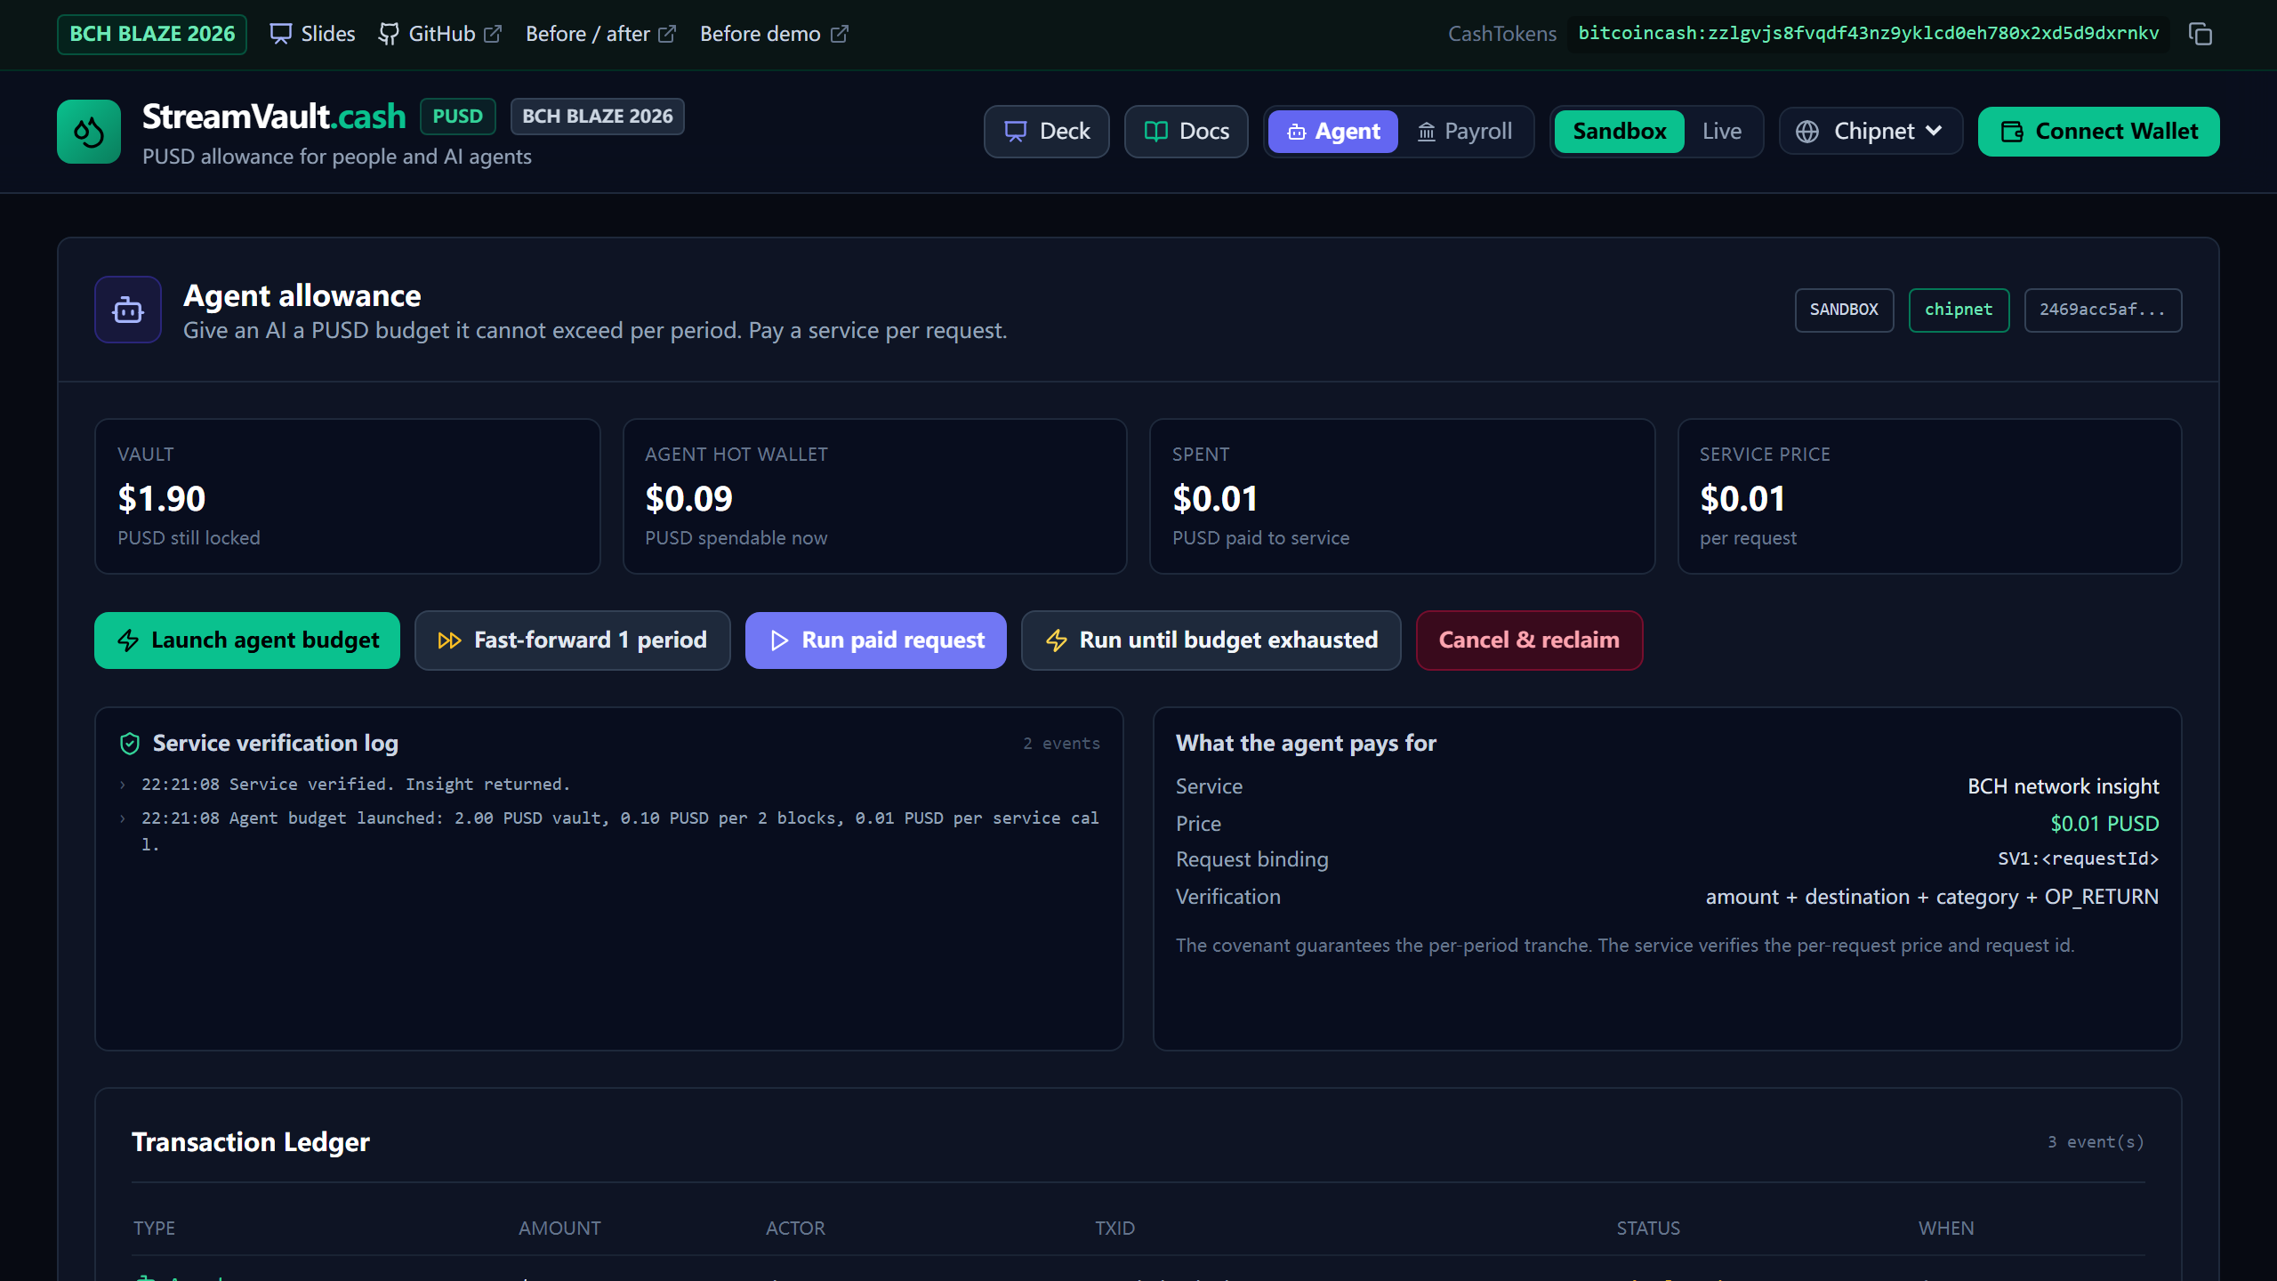

StreamVault.cash
Team Autonomous Cash: Jason
GitHub
Live demo
PUSD on BCH
Notes:
Live demo: https://streamvault-cash.vercel.app
Repository: https://github.com/juangh123/streamvault.cash
Baseline: https://github.com/juangh123/streamvault.cash/tree/v0-prehackathon-baseline

Slide 2
A PUSD budget the BCH VM can enforce
Per-period limits for people and AI agents
streamvault-cash.vercel.app
Notes:
StreamVault combines CashScript covenants, relative timelocks and CashTokens. Demo: https://streamvault-cash.vercel.app

Slide 3

The trust gap
An AI agent with a wallet can spend everything it can reach.
A cap in a prompt is not a financial control.
Custody adds a party that can freeze funds or lose the key.
The covenant is the control
PUSD stays on chain. The payee gets one tranche per period. The payer keeps a cancel key and can reclaim the remainder.
www.bchblaze.cash
Notes:
The cap is enforced by claim() in the CashScript covenant, not by application code. See docs/STREAM_MECHANICS.md.

Slide 4



One covenant,
three users
01 Sponsor locks PUSD and keeps cancel control
02 Worker claims one tranche per period
03 Agent claims a small budget and pays a service per request
Same primitive: claim(), cancel(), amountPerPeriod and periodBlocks.
Notes:
The same covenant supports payroll, subscriptions and agent allowances. See README.md and docs/PRD.md.

Slide 5
Limits enforced by the BCH VM
claim() requires one vault input and two outputs
this.age gates the next tranche
token category and amount conserve PUSD
only cancel() can empty the vault
Notes:
The v1.2 covenant passes 21 real BCH VM tests, including over-limit, early claim, wrong destination, third output, category mismatch and BCH-buffer drain tests.

Slide 6
Why BCH
Sub-cent settlement makes $0.01 service calls practical
CashTokens conserve PUSD on chain
Relative timelocks enforce the period
WizardConnect keeps keys in the user wallet
Business: hosted budget console, provider SDK and agent billing gateway. No protocol fee.
Notes:
PUSD category: 2469acc5afa4b10cb5b5c04afb89c3a3ffd61c5da9c01e26d00951cae2a02544. The app blocks Mainnet if a demo category is configured.

Slide 7

StreamVault.cash
Give an AI an allowance, not your bank account.
streamvault-cash.vercel.app
CashTokens: bitcoincash:zzlgvjs8fvqdf43nz9yklcd0eh780x2xd5d9dxrnkv
Notes:
Live demo: https://streamvault-cash.vercel.app
CashTokens receiving address: bitcoincash:zzlgvjs8fvqdf43nz9yklcd0eh780x2xd5d9dxrnkv

