Slide 1
Onboarding Coworker
Velocity for Enterprise Agents
Checkpoint deliverable · October 14, 2026
It chases the information; people decide and approve.
Notes:
We present the design and scope of the Onboarding Digital Coworker. The core idea: the Coworker chases information and prepares the case; people decide and approve. Business owner: Tonya Ramirez.

Slide 2
Checkpoint
PARTIAL DELIVERABLE OCT 14th
Profile: an onboarding assistant that cuts document onboarding from ~3 days to 1–1.5 days
Capabilities: 9 Must, 5 Should and 4 Could, each with an owner agent and a human checkpoint
MVP scope: intake, validation, package and approval, with simulated actions
Process: validation moves from the end to the start of onboarding
Solution: one Coworker for the user; an orchestrator and specialized agents inside
Integrations: local web app; JobDiva, IT, equipment and payroll simulated
Governance: seven human checkpoints, 12 acceptance criteria and an 8-day plan
Notes:
One line per checkpoint point. The full answers are in the checkpoint document in the repository.

Slide 3
PROBLEM & TARGETS
Starts arrive through JobDiva with key fields optional, so onboarding chases data after the fact. The Coworker moves validation to the start.
BUSINESS OUTCOME
Today
Start notes are optional and arrive blank
Onboarding chases missing data by email
Paperwork is picked from memory
Payroll reports are reconciled by hand
Targets
Document onboarding: ~3 days to 1–1.5 days
0 cases reach onboarding with gaps and no alert
Package ready 5 minutes after the last answer
0 actions without human approval
Principle
One Coworker for recruiters and the Onboarding Team
It chases, reminds and prepares
People decide and approve
Tonya Ramirez approves every package
Notes:
Today the start notes are optional and arrive blank, so onboarding chases data afterwards. Targets: document onboarding from about 3 days to 1 to 1.5 days in the pilot, zero cases with gaps and no alert, a package in 5 minutes and no action without approval.

Slide 4
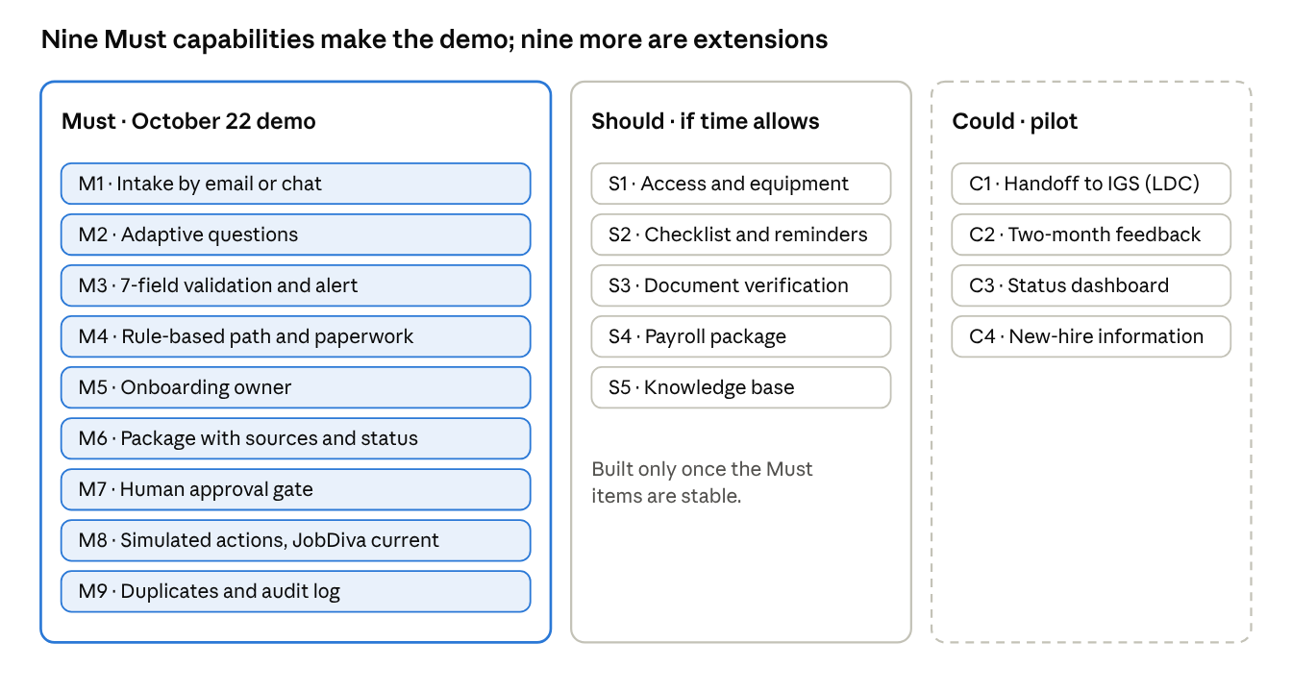
Priorities
Demo journeys
J1 Intake and validation (Must)
J2 Package, approval and actions (Must)
J3 Follow-up and payroll handoff (Should)
J4 Cultural handoff to IGS (Could)
Notes:
Nine Must capabilities make up the demo. Should items are built only if the Must items are stable; Could items stay for the pilot. Access and equipment is a Should.

Slide 5
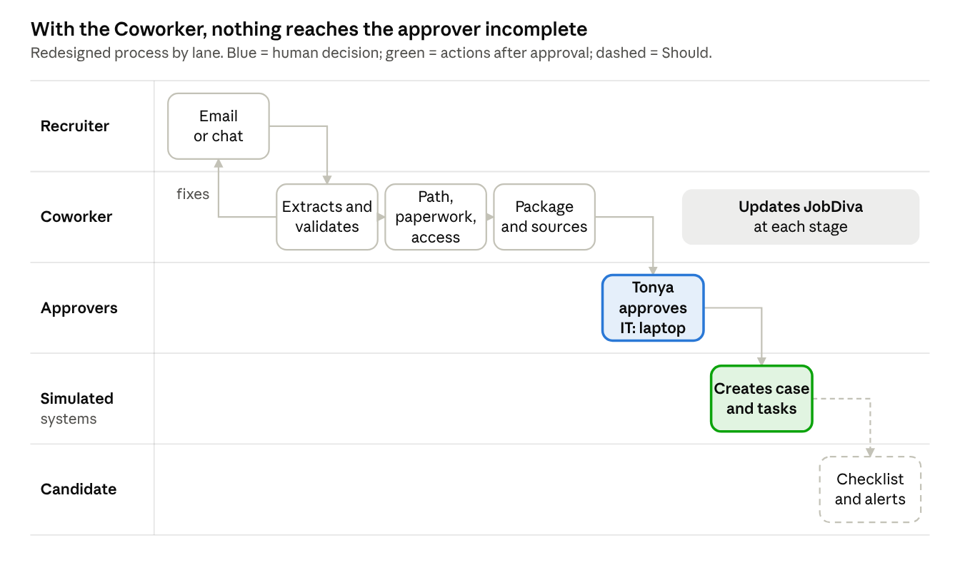
Redesigned process
What changes
The recruiter fixes only the flagged field, before onboarding steps in
One Coworker keeps JobDiva updated at each stage
Nothing reaches a system without Tonya’s approval, and IT’s for a laptop
Notes:
Today gaps are found once onboarding already has the case. With the Coworker, validation happens at the start and every action waits for human approval.

Slide 6
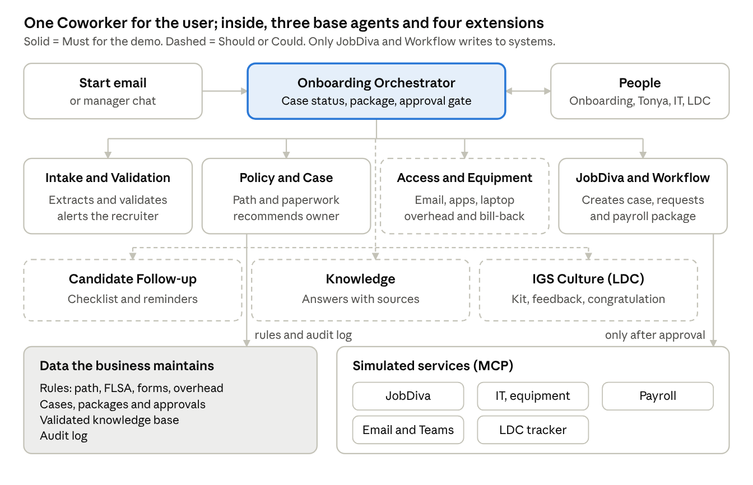
Architecture
Agents
Must: Orchestrator, Intake and Validation, Policy and Case Setup, JobDiva and Workflow
Extensions: Access and Equipment, Candidate Follow-up, Knowledge, IGS Culture
Only JobDiva and Workflow writes to systems, and only with approval
Notes:
To users it is one Coworker. Inside, an orchestrator splits the work across specialized agents that share one context. At least three agents collaborate in the demo.

Slide 7
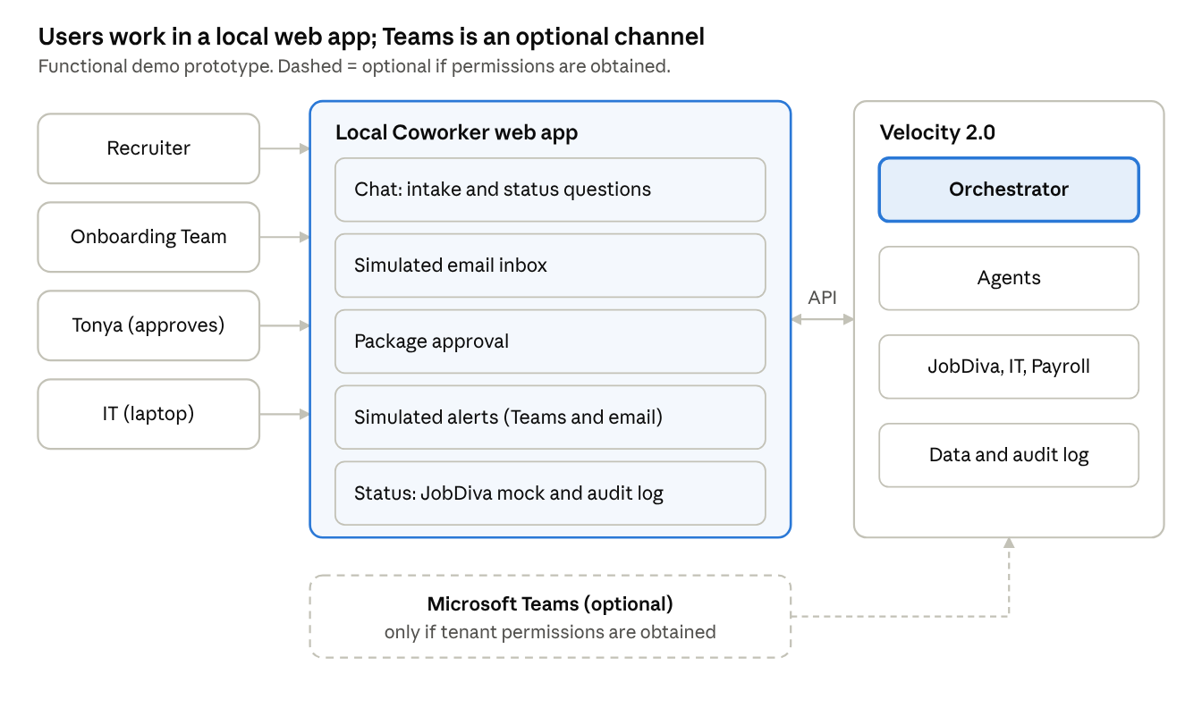
Prototype and JobDiva
JobDiva integration
Mock by default; sandbox read-only if API credentials arrive by October 16
Client ID, API user and password return a token
Secrets in a local .env; the repo ships .env.example
Teams is optional, only with tenant permissions
Notes:
Velocity 2.0 has no chat interface, so we build a light local web app with five views. The Coworker never writes to JobDiva; the sandbox is a read-only option.

Slide 8
Human Control
GOVERNANCE
Human checkpoint | Who
Corrects the flagged data | Recruiter
Confirms the case and resolves escalations | Onboarding Team
Approves the onboarding package | Tonya Ramirez
Approves the laptop | IT
Approves the payroll handoff | Onboarding Team
Approves the welcome kit and feedback | LDC
Validates new knowledge | Right person for the case
Notes:
People keep every decision that creates a record, grants access or touches employment law. The Coworker prepares, recommends, cites and logs.

Slide 9
Plan to October 22
Oct 14: Checkpoint (design and scope)
Oct 15–16: Velocity 2.0, repo, seed data, mocks
Oct 17–20: Journeys J1 and J2 (Must)
Oct 19–20: Extensions, only if Must is stable
Oct 21–22: Tests, README, presentation, video
Oct 22: Final submission
Notes:
Biggest risk: the 8-day timeline. If the foundations are not ready by October 16, the extensions are dropped and all time goes to J1 and J2.

