Slide 1
BomberJuan 2 player game
By Juan Gonzalez

Slide 2
Table of Contents
Requirements
Mechanics
Top-Down Design
Object Oriented Programming
Algorithm
Maintenance

Slide 3
Requirements
This is an arcade game
This is a two player game
It has 2D graphics
It is my own version of the Bomberman game also known as Dyna Blaster

Slide 4
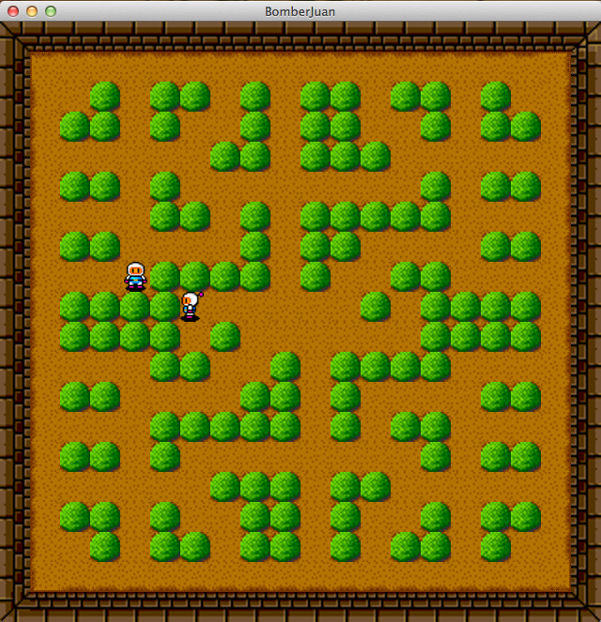
Mechanics
When player hits designated movement keys, the player moves accordingly or collides

Slide 5
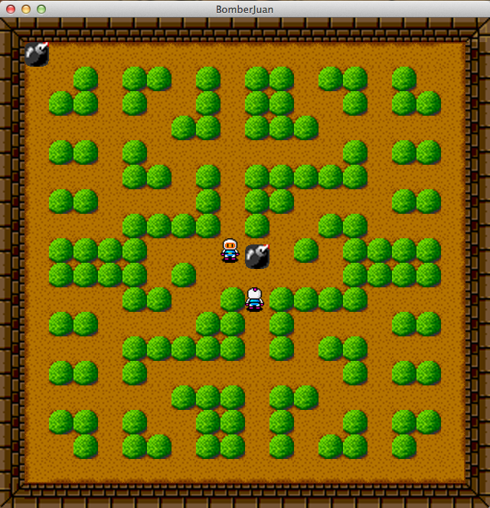
Mechanics …continued
When player hits designated bomb keys, a bomb is dropped on their location of the map

Slide 6
Mechanics …continued
When bomb explodes, players in the bomb’s radius are destroyed and game is reset

Slide 7
Top-Down Design
Start up the game
Window is made from Game2 file
Images are loaded and placed on screen
Screen with all the sprites(map and character sprites) are displayed

Slide 8
Object Oriented Programming
Bomb
Contains the variables for the bomb
Contains the images for the bomb and draws them
Character2
Contains the variables for the characters
Contains the sprites for the character and draws them
Updates the character

Slide 9
Object Oriented Programming …continued
Game2
Starts up the window and it’s properties
Contains the keyPressed and keyReleased events and updates when an action is performed
GamePanel2
Contains the movement and the code that checks for collision
Contains the code that resets the game
Contains the biggest update of the whole game
Contains the most important draw method
Screen2
Contains the map and the sprites for the screen
Contains the code that checks the level collision
Draws the map, and sets the level

Slide 10
Algorithm
Collision
When a key is pressed, direction is passed
Level collision is checked with direction variable
If collision is found, no movement happens
If collision is not found, movement happens corresponding movement variable

Slide 11
Maintenance
Upgrades that player is able to pick up
Game start screen
Game over screen
More levels

