Slide 1
Recommender Systems Ranking Metrics
Professor Robin Burke
Spring 2019

Slide 2
Ranking Measures
If the output is a list
Evaluating a list
are the things at the top better than the ones at the bottom?
in other words
for each item in the list
there should be no better items farther down
Possible to include non-uniformity
top items more important

Slide 3
Rank correlation
Two variants
Spearman rank coefficient
Turn the recommendation list L into <item, rank> pairs
Sort the user’s test set ratings to make a ranked list L_{u}
Create similar pairs
Compare the correlation of the ranks
Kandall’s rank coefficient
For all pairs of items in L ∩ L_{u}
Count the number of concordant pairs C+
Where i_{j} > i_{k} in both lists
Count the number of discordant pairs C-
Where i_{j} > i_{k} in one list and i_{j} < i_{k} in the other
Divide by the total # of pairs

Slide 4
Rank correlation
This has the same problem as ROC
Doesn’t discriminate between reversals at the front of the list
vs those at the end
Where we probably don’t care

Slide 5
NDCG
Normalized Discounted Cumulative Gain
A utility theoretic measure
Read the name it backwards
Gain
We are assuming that there is utility associated with a relevant item appearing in the recommendation list
Cumulative
We are assuming that multiple items may appear and that utility is cumulative of these appearances
You could imagine an alternate measure that says one good match is enough
Discounted
We assume that results have lower utility if they are farther down the list
Normalized
We want to be able to compare values across different data sets, so we normalize
As with precision
We will fix the list size NDCG@5, @10, etc.

Slide 6
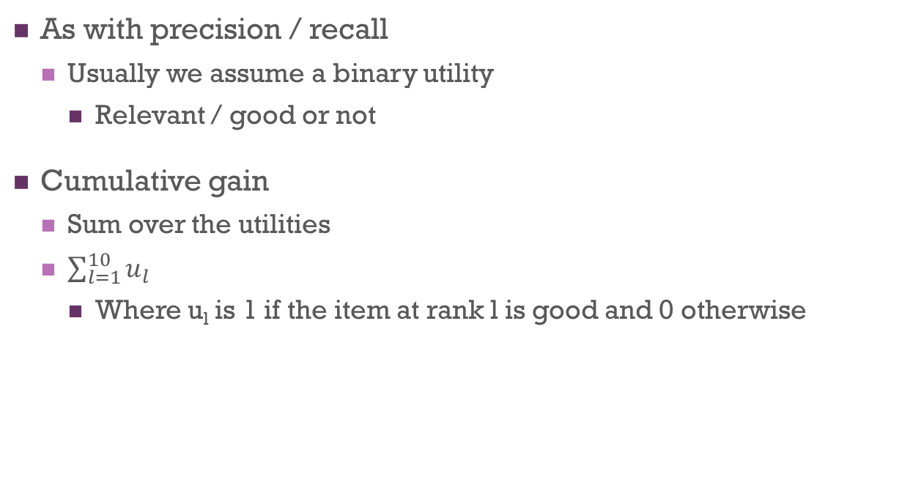
Gain
As with precision / recall
Usually we assume a binary utility
Relevant / good or not
Cumulative gain
Sum over the utilities
$\sum_{l=1}^{10}{u_{l}}$
Where u_{l} is 1 if the item at rank l is good and 0 otherwise

Slide 7
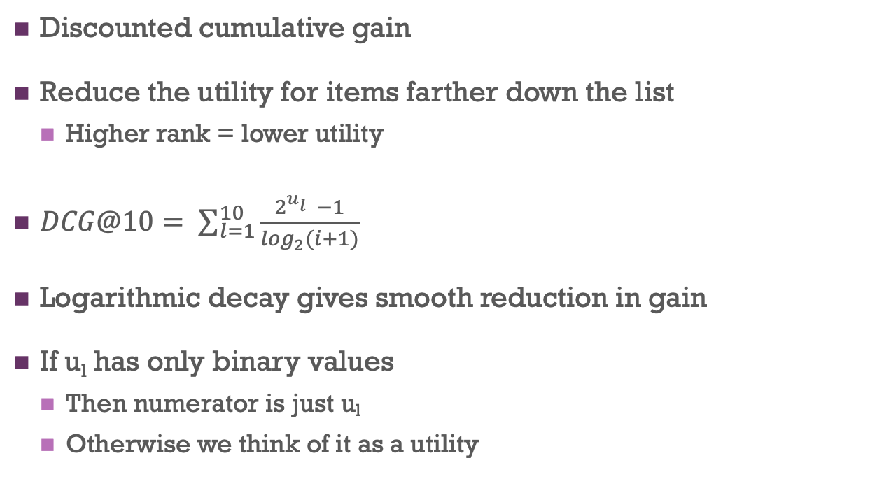
DCG
Discounted cumulative gain
Reduce the utility for items farther down the list
Higher rank = lower utility
$DCG@10= \sum_{l=1}^{10}{\frac{2^{u_{l}^{}}−1}{\log_{2}(i+1)}}$
Logarithmic decay gives smooth reduction in gain
If u_{l} has only binary values
Then numerator is just u_{l}
Otherwise we think of it as a utility

Slide 8
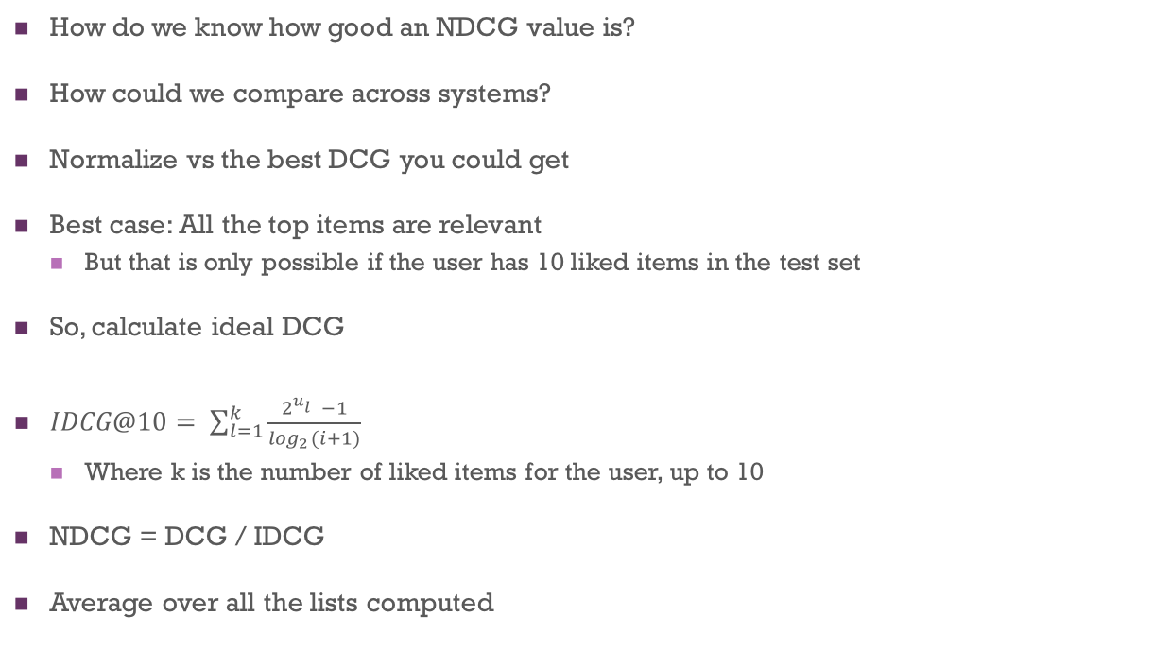
Normalize
How do we know how good an NDCG value is?
How could we compare across systems?
Normalize vs the best DCG you could get
Best case: All the top items are relevant
But that is only possible if the user has 10 liked items in the test set
So, calculate ideal DCG
$IDCG@10= \sum_{l=1}^{k}{\frac{2^{u_{l}^{}}−1}{\log_{2}(i+1)}}$
Where k is the number of liked items for the user, up to 10
NDCG = DCG / IDCG
Average over all the lists computed

Slide 9
NDCG
Very common measure
When rankings are being compared
Used by Google for search algorithm evaluation, for example
Gives a single number
Sensitive to the ordering of items
Often very difficult to improve NDCG by a large amount
But even small increases in NDCG (1-2%) are noticeable to users

Slide 10
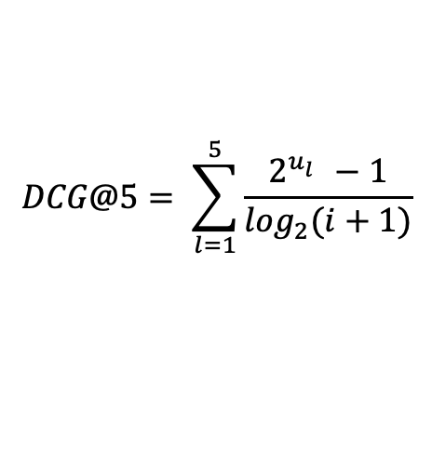
Example
[A,B,C,D,E]
User profile: C:4, B: 3.5, D: 3
Calculate NDCG@5
$$DCG@5= \sum_{l=1}^{5}{\frac{2^{u_{l}^{}}−1}{\log_{2}(i+1)}}$$

Slide 11
Mean Reciprocal Rank
MRR
More commonly used if there is only a single item
Can be used for ranked lists
Take the rank 𝓁 of the 1st relevant / liked item retrieved
1/ 𝓁 is the reciprocal rank
Average over all the retrievals
A different assumption than NDCG
Only interested in how far the user has to look to find one good thing
Could be surrounded by irrelevant stuff

Slide 12
Herlocker's results
Three groups are highly-correlated
Prediction-based
MAE, correlation
Precision-based
NDCG, MAP
Utility-based
ROC and AUC

Slide 13
Evaluation
Determine the goal of your system
Accurately predicting the user's ratings
Producing a good list of a certain size
Producing good lists at all sizes
Producing a good ranking
Then you know what metric to use
MAE or related
Average precision
ROC
NDCG

Slide 14
But wait!
What about surprise, novelty, diversity, etc.?
Also important for recommender systems
We will get to this next

