Slide 1
Recommender Systems Methodology
Professor Robin Burke
Spring 2019

Slide 2
Methodologies
Basic idea
take a large set of data with known ratings
select some data as test data S ⊂ P
use the rest of the data to generate predictions over the test data
training data T ⊂ P
Essential practice
Don’t evaluate your system with data it already “knows”
S ∩ T = { }
Otherwise, you will not know if you are overfitting
Will usually overestimate achievable performance
Notes:
2

Slide 3
Test / Training Split
Most techniques require a user profile
To generate recommendations
If the user has no profile in the training set
Then no recommendations can be produced
Typical split is by profile
80% training means
For each user, put 80% of the profile in the training set
20% in the test set
LKPy
partition_user method

Slide 4
Cross-validation
Could be “lucky” in training / test split
Cross-validation is a methodology that reduces the probability of outlier results
Basic idea
Shuffle the data randomly
Divide into k partitions
For i = 1 to k
Set S = partition i
Set T = P – S // Everything else
Result = evaluate(S,T)
Average all the results
K of 5 or 10 are common

Slide 5
Leave-one-out
Extreme of cross validation
Use all the data except 1 rating
Predict that
Record the evaluation measure
Pick the next rating
Repeat
Rarely used because it requires |R| training episodes
Deadly for matrix factorization
Not so bad for neighborhood methods

Slide 6
Profile requirements
Note that cross-validation imposes requirements on the data
If a user has only 3 ratings
How can I partition her profile into 10 parts?
This is a cold-start user, where most recommendation techniques don’t work anyway
Typical filter
Remove all users with fewer than k ratings

Slide 7
LKPy
Partition methods
partition_rows
partition_users
Similar functions
Returns an iterator
Iterator produces (train, test) pairs
Data frames in and out
Example
partition_users(data, 5, xf.SampleFrac(0.2))
See “Getting Started” in the documention for LKPy
https://lkpy.lenskit.org/en/latest/GettingStarted.html

Slide 8
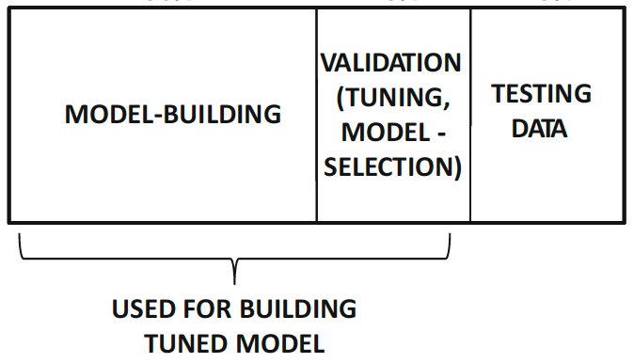
Validation data
Parameter tuning
Should be considered part of learning
Best practice
Separate validation set
Use the test set only once

Slide 9
Temporal evaluation
Not talked about in the book
What if your algorithm depends on time?
Older ratings decay
Or if you want to capture the temporal qualities of algorithms
New users arrive
New items arrive
Want to avoid “leakage” of knowledge of the future into the learned model

Slide 10
Single time ratio
Choose the test data to follow the other data in time
User by user basis
T = First k% of each profile
S = Most recent remaining data
Netflix prize
Note that this isn’t “ecologically valid”
User A’s profile might have joined after User B’s last rating
But A’s training profile would be used to predict for User B
Not Implemented in LKPy
but you could add it by specifying it as a sampling method
last argument to the partition function

Slide 11
Temporal sequence
Most appropriate if the algorithm has a temporal component
Divide the data into k epochs
Train on epoch 1 / Test on epoch 2
Train on epochs 1+2 / Test on epoch 3
Etc.
Initial evaluation
Cold start
Then steady state
Temporal rating density is a problem
Users may provide all their ratings in one epoch
Not implemented in LKPy
But you can achieve this by providing your own splits of the data into training and test

Slide 12
You divide each user’s profile into five equal-sized partitions by time. You do five evaluation steps with (train, test) partitions as follows: (p1, p2), (p1+p2, p3), (p1+p2+p3, p4), (p1+p2+p3+p4, p5). This type of evaluation would be good for:
A: Evaluating the performance of a time-based recommendation algorithm
B: Evaluating any algorithm, if the five trials were averaged together
C: Evaluating how an algorithm adapts to users with more or less experience using the system.
D: All of the above
E: A and C only

Slide 13
Sensitivity
Different class of evaluation
Test the algorithm against itself
In different conditions
Typical use: test robustness to sparsity
Idea
Delete different amounts of training data
See how the test data performance changes
Can do this randomly or in a more targeted way
Per user
Per item

