Slide 1
Recommender Systems Metrics
Professor Robin Burke
Spring 2019

Slide 2
Metrics (for offline evaluation)
Accuracy measures
MAE, RMSE, etc.
Classification measures
precision, recall, ROC curves
Ranking measures
Rank correlation, half-life, NPDM, NDCG, MRR
Others
Coverage
Confidence
Novelty
Serendipity
Diversity
Robustness
Scalability
Notes:
2

Slide 3
Methodologies
Basic idea
take a large set of data with known ratings
select some data as test data S ⊂ P
use the rest of the data to generate predictions over the test data
training data T ⊂ P
Essential practice
Don’t evaluate your system with data it already “knows”
S ∩ T = { }
More on this later
Notes:
3

Slide 4
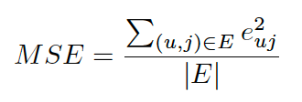
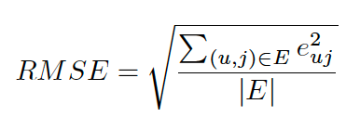

Accuracy Measures
Mean Absolute Error (MAE)
$MAE= \frac{\sum_{(u,j)∈E}{\left|e_{uj}\right|}}{\left|E\right|}$
Mean squared error
Root Mean Squared Error (RMSE)
Notes:
4

Slide 5
Which to use?
RSME has a well-defined interpretation
variance of the data + bias of the predictor
if you can calculate the variance of the data
you know how far you are from perfect
gives a higher weight to big errors
MAE
highly correlated with RSME
perfectly good if you are comparing systems
May be better than RSME if the importance of outliers is limited
Notes:
5

Slide 6
Issues
Accuracy measures
Very useful for annotation tasks
how good is the system at predicting the right rating?
This is rarely the recommendation task
More common = Find a few good items to recommend
Ratings are a means to ranking but RMSE doesn’t capture ranking directly
Notes:
6

Slide 7
Error placement
RSME evaluates all prediction errors
Doesn’t care if the errors are for liked or disliked items
(Note that the same point applies to our MF objective functions)

Slide 8
Example: Two algorithms A and B A does a great job at predicting high ratings but all low rated items get the same low score = 1 B does a great job at predicting low ratings but all high rated items get the same high score = 5. Your results show that RMSE(A) > RMSE(B). You want to recommend a list of 10 top items for each user. Which do you pick?
A: Pick A because items with high ratings are more likely to appear at the top of the list.
B: Pick B because it has lower RMSE
C: Not enough information to tell which algorithm to pick

Slide 9
Item popularity
Many recommendation tasks have skewed distribution
A small head of very popular items
These will commonly appear in the test data
RSME counts all errors the same
But predicting high ratings for the blockbuster items is “easy”
Plus users will likely know about these items anyway
Don’t need recommendations
Might prefer an algorithm that made a few errors on these items
But was more accurate for the long tail
Unlikely to get good RMSE scores
Possible to weight scores to lessen this problem

