Slide 1
Recommender Systems Classification-based Metrics
Professor Robin Burke
Spring 2019

Slide 2
Classification Measures
Classification measures
better suited to "find relevant items" tasks
Idea
there is a class of relevant items
test how well the recommender system can identify items that belong in this class
Notes:
2

Slide 3
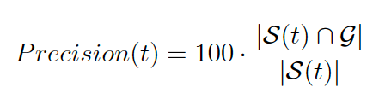

Precision / Recall
Traditional measures from Information Retrieval
Idea
Sets based on relevance: and
relevant G and not relevant ~G
Sets based on classification
classified as relevant S(t) and not relevant ~S(t)
t is how many items are retrieved
Precision
Fraction of good items among the retrieved set
Recall
Fraction of retrieved good items out of all good ones
Notes:
3

Slide 4
Confusion Matrix
Another way to think about precision and recall
Precision = True Positive / True Positive + False Positive
how many of the classified items are right
Recall = True Positive / True Positive + False Negative
how many of relevant items were classified that way
 | Relevant | ~Relevant
Recommended | True Positive | False Positive (type I error)
~Recommended | False Negative (type II error) | True Negative
Notes:
4

Slide 5
Recall
Recall is not very useful
we usually do not know G completely
we know some relevant and non-relevant items for each user
but there will be many items with no information
IR experiments use judges
determine a global "objective" relevance judgment
recommender systems are supposed to be personalized
Notes:
5

Slide 6
Precision
More useful
we know how many items were recommended
some of them will be items that the user has rated positively
some of them will be items that the user rated negatively
some will be unknown items
Can measure
the fraction of high rated items in the recommendation set
"observed precision"
but vulnerable to variations in user profile size
precision directly by eliminating unrated items
success depends on the density of the profiles
Notes:
6

Slide 7
User 1 has the following profile: [A: 1,B:2,C:3,D:4,E:5]. The system recommends [E,A,D,F,J]. The precision of this list is:
A: 3/5
B: 2/5
C: 1
D: It depends on the “good item” threshold

Slide 8
“Hidden” precision
Missing ratings makes it hard
It depends on whether the user would find recommendations of the unknown items relevant
The precision of the algorithm may be underreported
The relevance of unseen items is unknown
Particularly a problem for algorithms that are trying improve non-accuracy measures
Diversity, for example
It may seem that you are losing precision, even if you really aren’t

Slide 9
Precision and Recall
Linked measures
must be measured together
since high precision can always be had by creating a stricter classifier
since high recall can always be had by retrieving everything
recall measures the coverage "cost" of being more precise
Hard to compare systems with two numbers
Notes:
9

Slide 10
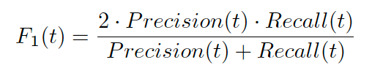
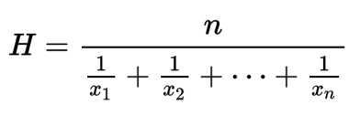
F1 measure
The harmonic mean of recall and precision
Harmonic mean is preferred for aggregating fractions that have different denominators

Slide 11
Precision@k
(usually top N but we use N for neighborhood)
Recommender systems
often generate lists
user patience with such lists is limited
we can pick a fixed size k
look at precision of such lists
sometimes called average precision
or hit ratio
more common in data mining literature
Notes:
11

Slide 12
Mean Average Precision
Sounds redundant
Again there is a limit k
We use all lists up to size k
MAP@10
AvePrecision@1+ AvePrecision@2+ … +AvePrecision@10 / 10
Notes:
12

Slide 13
Calculating Precision
Need two things
a list of recommendations
a set of relevant items
How to know what items are relevant?
Must be items with known ratings
Part of test data
Find items that the user likes
Usually done with a threshold, θ
Midpoint of the rating scale
The user's personal mean
Test if these items show up in recommendation list
Notes:
13

Slide 14
Issues
Much slower than previous technique
must predict for all possible items
and then perform ranking
More realistic for "find relevant items" tasks

Slide 15
ROC Curve
Receiver Operating Characteristic
from signal detection theory
Idea
Fallout = False Positive / True Positive + False Positive
Measure: Precision vs Fallout
at different thresholds
Characteristics
perfect performance
100% precision reached at 0% fallout
then horizontal line as threshold encompasses non-relevant items
random performance
diagonal line from origin to upper right
relevant and irrelevant items evenly distributed at each point

Slide 16
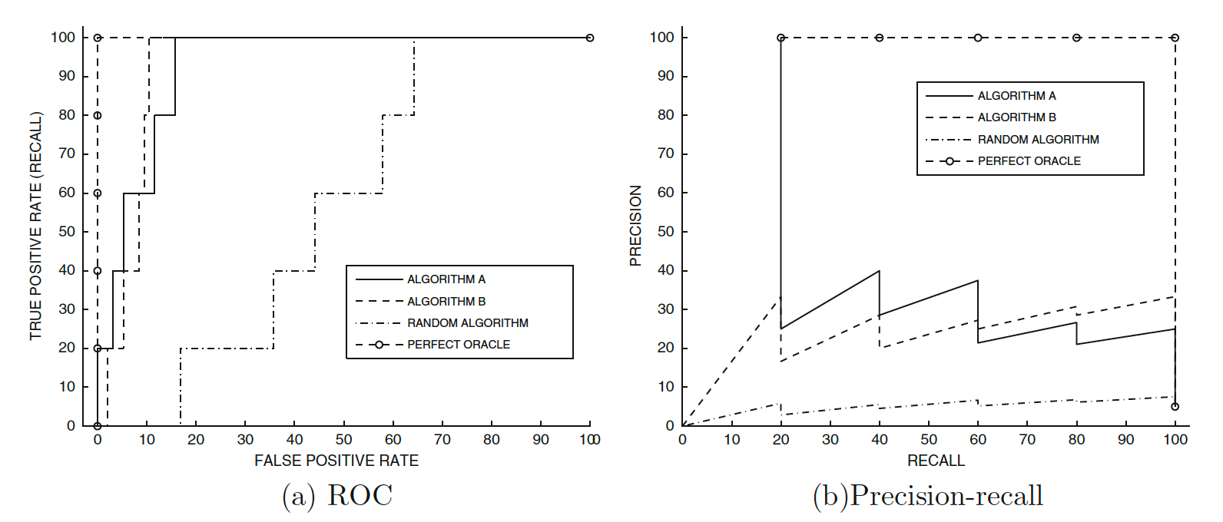
Example ROC Curve
A dominates at the front of the list

Slide 17
Swets A Measure / AUC
Area under the ROC curve
single measure more useful than whole curve
measures probability the system can accurate assign "relevant" and "irrelevant" labels
Uniformity assumption
assumes that mistakes are equally costly at any place in retrieval set
Sometimes you have AUC@k
Sometimes you have AUC over all items
Potentially less useful because distant list shouldn’t incur a big cost

Slide 18
Issues
Comparison to chance performance important
is 20% recall good or bad?
bad if 50% of items are relevant
great if 0.001% are relevant
ROC has a built-in comparison to chance classifier
other measures experimenter (and reader) must evaluate

Slide 19
Classification measures
Depend on a classification-based concept
An item is in the “good” set or it isn’t
They don’t measure the ordering of the list
Except indirectly by considering lists of different lengths

