Slide 1
Recommender Systems Non-Negative Matrix Factorization
Professor Robin Burke
Spring 2019

Slide 2
Non-Negative Factorization
Means that we constrain the factors to only contain non-negative entries

Slide 3
Application
Unary data
Shopping cart
Click-through
“Positive/Unlabeled” classification
Effectively assume that 0 = not liked
Reasonable
If users tend to interact with liked items
If the set of liked items is very small relative to the catalog

Slide 4
Different kind of optimization
U >= 0
Different kind of constraint
Cannot easily build this into the objective function
“Ill-posed” problem
Meaning that there is not a guaranteed single optimum point
Non-linear optimization
A variety of solution methods

Slide 5
Lagrange multipliers
Suppose we want to maximize f(x,y) with the constraint g(x,y)=c
Replace this problem with
L(x,y,λ) = f(x,y) – λ(g(x,y) – c)
Note that when g(x,y) = c
λ(g(x,y) – c) is zero
If x*,y* is a maximum for f(x,y)
Then L(x*,y*, λ*) is a stationary point for some λ*
Stationary point = all partial derivatives are 0
Necessary, but not sufficient (multiple stationary points)

Slide 6
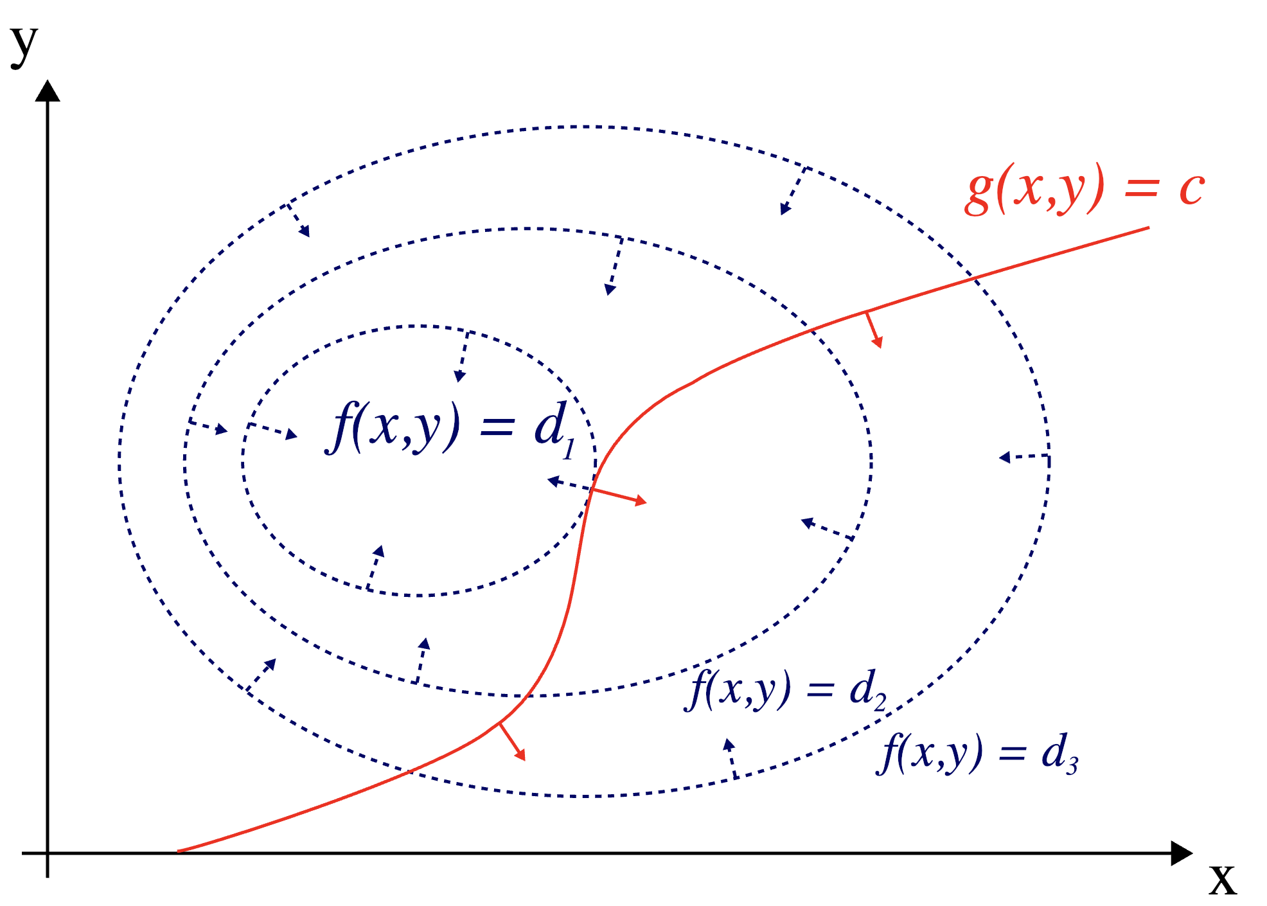
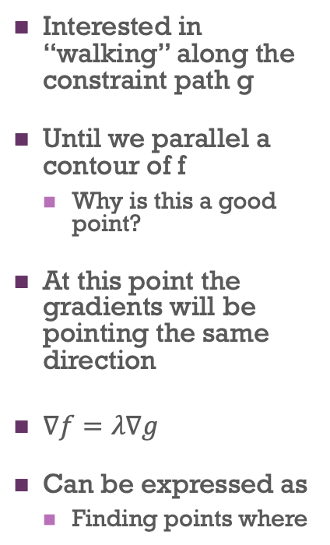


Intuition
Interested in “walking” along the constraint path g
Until we parallel a contour of f
Why is this a good point?
At this point the gradients will be pointing the same direction
$∇f=λ∇g$
Can be expressed as
Finding points where
$$L\left(x,y,λ\right)=f\left(x,y\right)−λ(g\left(x,y\right)−c)$$
$$∇L\left(x,y,λ\right)=0$$

Slide 7
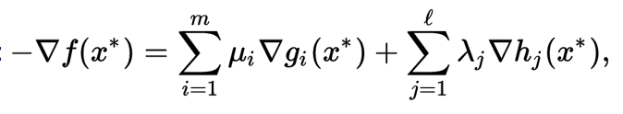
Generalizable
We can generalize to multiple equality constraints
One λ for each constraint
We can generalize to inequalities
Kuhn-Tucker conditions
Generalizes Lagrange multipliers to inequalities
Where g_{i} are inequality functions
And u_{i} are the Kuhn-Tucker multipliers
h_{j} are equality conditions = Lagrange conditions

Slide 8
Non-negative matrix factorization
Derive the gradients on each side
g is just a sum of the x’s so RHS is just a sum of the u_{i}’s
At the inflection point
We want the gradient to be zero, so the u_{i}’s must be zero
Yields equality:
(RV)_{ij}u_{ij} – (UV^{T}V)_{ij}u_{ij}=0
(R^{T}U)_{ij}v_{ij} - (VU^{T}U)_{ij}v_{ij}=0

Slide 9
Update rule
Note multiplicative
Can never be negative
ϵ in denominator protects against instability close to zero
Can be proved that this converges to optimal solution
Fairly efficient also
Regularization should be incorporated
Very prone to overfitting

Slide 10
Benefit
Explainability
Negative factors are hard to understand
Positive factors show association

Slide 11
What does Professor Burke really expect us to remember from all this math?
A. We should be able to rederive and prove all of the formulas from first principles
B. We should be able to create new algorithms based on these methods
C. We should understand why the updates rules here are different than for other kinds of factorization
D. We should forget this stuff because it is too confusing

Slide 12
Issues with implicit data
Usually sparsity is very high
Advertising click-through rate may be less than 0.2%
0 = disliked
False for precisely the items to be recommended
But many of these are disliked (or at least avoided)
Can sample the zeros to get additional data
Adds noise
Can treat all missing values as zero
But weight the errors on these terms less
Factor of 40x
Produces a complete matrix
Bad for efficiency

