Slide 1
Recommender Systems Content-based Recommendation
Professor Robin Burke
Spring 2019

Slide 2
I’m here!
Notice
No office hours on Tuesday 3/19
Andrew Lison: “Towards a Theory of 100% Utilization”
2:00 – 3:30 pm ENVD 214

Slide 3
SCuiz
Remember deadline is right after Spring Break!
Get your questions in

Slide 4
Homework 3
For evaluation:
RecListAnalysis returns results by algorithm, fold, user
Average over users -> algorithm, fold
Average of folds -> algorithm metric
What other questions?

Slide 5
Content-Based Recommendation
A grab bag
Everything that isn’t other user’s opinions
Which is really a lot of different knowledge sources

Slide 6
Content-Based Recommendation
Collaborative recommendation
requires only ratings
Content-based recommendation
all techniques that use properties of the items themselves
usually refers to techniques that only use item features
Knowledge-based recommendation
in which we apply knowledge
about items and how they satisfy user needs

Slide 7
Content-Based Profiling
Suppose we have no other users
but we know about the features of the items rated by the user
We can imagine building a profile based on user preferences
here are the kinds of things the user likes
here are the ones he doesn't like

Slide 8
Recommendation Knowledge Sources Taxonomy
Recommendation Knowledge
Collaborative
Opinion
Profiles
Demographic
Profiles
User
Opinions
Query
Demographics
Constraints
Requirements
Preferences
Content
Item Features
Context
Domain Knowledge
Means-ends
Contextual
Knowledge
Feature Ontology
Domain Constraints

Slide 9
Content-based Profiling
To find relevant items
Recommend
? | item | a₁ | a₂ | a₃ | a₄ | ... | a_{k}
? | item | a₁ | a₂ | a₃ | a₄ | ... | a_{k}
? | item | a₁ | a₂ | a₃ | a₄ | ... | a_{k}
? | item | a₁ | a₂ | a₃ | a₄ | ... | a_{k}
? | item | a₁ | a₂ | a₃ | a₄ | ... | a_{k}
Obtain rated items
Build classifier
✓ | item | a₁ | a₂ | a₃ | a₄ | ... | a_{k}
Classifier
✓ | item | a₁ | a₂ | a₃ | a₄ | ... | a_{k}
✗ | item | a₁ | a₂ | a₃ | a₄ | ... | a_{k}
✓ | item | a₁ | a₂ | a₃ | a₄ | ... | a_{k}
Predict
✗ | item | a₁ | a₂ | a₃ | a₄ | ... | a_{k}
Y
N
✗ | item | a₁ | a₂ | a₃ | a₄ | ... | a_{k}
✓ | item | a₁ | a₂ | a₃ | a₄ | ... | a_{k}
✗ | item | a₁ | a₂ | a₃ | a₄ | ... | a_{k}
✓ | item | a₁ | a₂ | a₃ | a₄ | ... | a_{k}
✗ | item | a₁ | a₂ | a₃ | a₄ | ... | a_{k}
✗ | item | a₁ | a₂ | a₃ | a₄ | ... | a_{k}
✗ | item | a₁ | a₂ | a₃ | a₄ | ... | a_{k}

Slide 10
Origins
Began with earliest forms of user models
Grundy (Rich, 1979)
Elaborated in information filtering
Selecting news articles (Dumais, 1990)
More recently spam filtering

Slide 11
Basic Idea
Record user ratings for item
Generate a model of user preferences over features
Give as recommendations other items with similar content

Slide 12






Movie Recommendation
Predictions for unseen (target) items are computed based on their similarity (in terms of content) to items in the user profile.
E.g., user profile P_{u} contains
recommend highly: and recommend “mildly”:

Slide 13

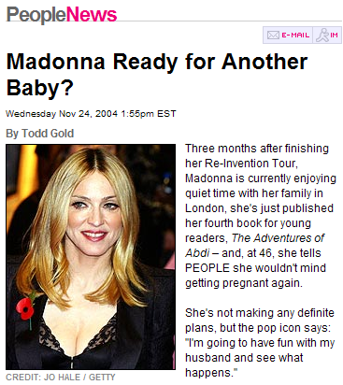
Personalized Search
How can the search engine determine the “user’s context”?
?
Query: “Madonna and Child”
?
Need to “learn” the user profile:
User is an art historian?
User is a pop music fan?

Slide 14
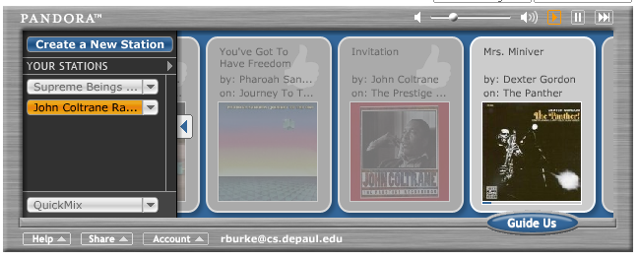
Play List Generation
Music recommendations
Configuration problem
May need to take into account other items already in list
Example: Pandora

Slide 15
Item Attributes
What do we know about an item?
The book concentrates on unstructured data
Words extracted from text
There are also many cases where the data is structured
Product catalogs
Music content
http://labrosa.ee.columbia.edu/millionsong/pages/field-list

Slide 16
User profiles
Still need associations between users and items
Ratings
Clicks
Purchases
Etc.
May be multiple types
But we don’t need other users
No item cold-start problem
Privacy advantages

Slide 17
Feature selection
Like other machine learning contexts
Need to identify features that are going to be predictive
With documents
A long history in information retrieval about how to do this
You want the “short head” of the feature distribution
So that there isn’t too much noise
But if you eliminate too many features
Then there may be items that you can’t recommend
“Catalog coverage”

Slide 18
Feature selection criteria
All of these are global
Measure how the feature affects ratings over all the data
Individual users may differ
Gini index
Entropy
X square
= keep
Normalized deviation

Slide 19
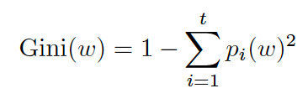
Gini impurity
(Not the same as the Gini index – a measure of distributional inequality)
Measures the distribution of an item feature. Works for discrete ratings
p_{i}(w) = the observed probability of the feature
How often a randomly chosen element from the set would be incorrectly labeled if it was randomly labeled according to the distribution of labels in the subset
Evenly distributed = high Gini
Focused on a single class / rating = low
Keep these features

Slide 20
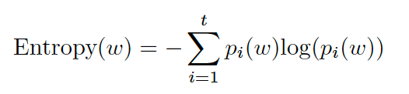
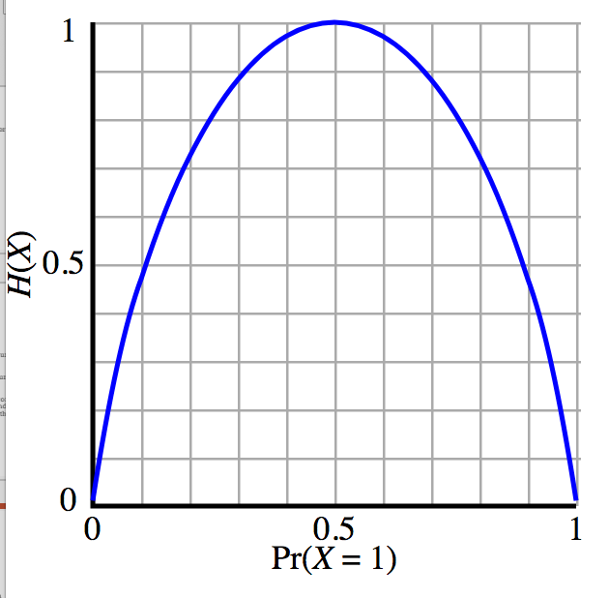
Entropy
Similar to Gini impurity
Measures “randomness” of a distribution
The lower entropy, the more predictable the distribution
Highest entropy = random coin flip
Less random feature = keep

Slide 21
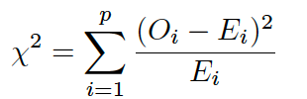
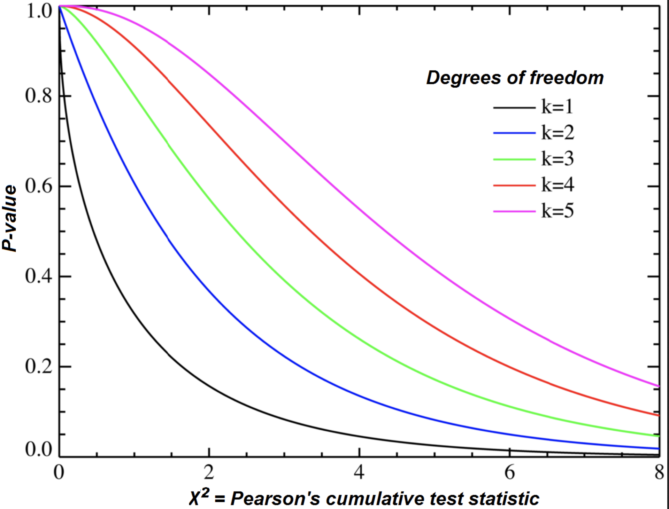
Chi square
Measures independence
Familiar from hypothesis testing
Is the rating judgement independent of this feature?
High value means mean dependence
Note – measure assumes no zero count observations
possible to correct

Slide 22
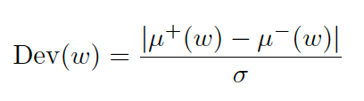
Normalized deviation
What is the average rating of items with and without this feature?
If they are about the same, then the feature is not too significant
Large value = keep

Slide 23
In which of these domains would you expect purely content-based recommendation to be better than purely collaborative recommendation?
A. Online dating
B. Music recommendation in an app like Spotify
C. News recommendation
D. Product recommendation on an auction site like eBay
E. A and C

Slide 24
Algorithms
kNN
Naive Bayes
Regression
PLSA

