Slide 1
Recommender Systems Naïve Bayes
Professor Robin Burke
Spring 2019

Slide 2
Naive Bayes
p(A) = probability of event A
p(A,B) = probability of event A and event B
joint probability
p(A|B) = probability of event A given event B
we know B happened
conditional probability
Example
A is a student getting an "A" grade
p(A) = 20%
B is the event of a student turning no homework
p(A|B) is much less than 20%
p(A,B) would be the probability of both things
how many students are in this category?
Recommender system question
c(X)=1_{i} is the event that the user rates the item 1 (liked)
x₁, x₂, … x_{d} are the features

Slide 3
Bayes Rule
p(A|B) = p(B|A) p(A) / p(B)
We can always restate a conditional probability in terms of
the reverse conditional p(B|A)
and two prior probabilities
p(A)
p(B)
Often the reverse condition is easier to know
we can count how often a feature appears in items the user liked
frequentist assumption

Slide 4
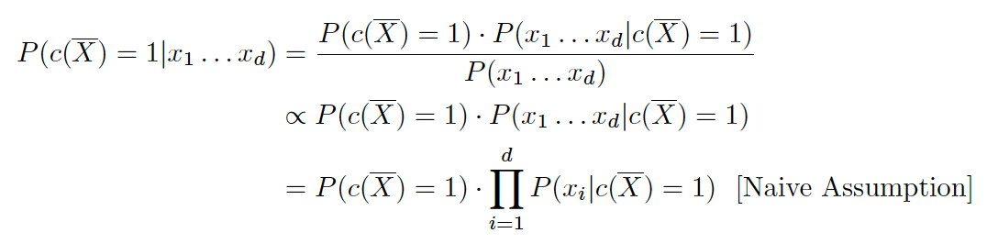
Naive Bayes
Probability of liking an item given its features
p(c(X)=1|x₁, x₂, ... , x_{d})
Note: Bernoulli model
By the theorem

Slide 5
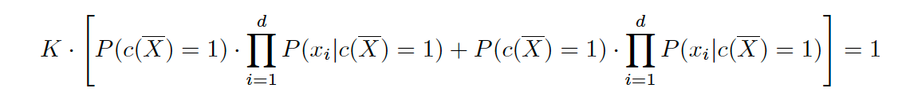
Proportionality
We might need the denominator to compare items
Joint probability must sum to one over all possibilities
So multiply prior calculation by 1/K
Error in book
-
-

Slide 6
Naive Assumption
Independence
the features x₁, x₂, ... , x_{k} are independent
independent means
p(A,B) = p(A)p(B)
Example
two coin flips P(heads) = 0.5
P(heads,heads) = 0.25
Anti-example
appearance of the word "Recommendation" and "Collaborative" in papers by Robin Burke
P("Recommendation") = 0.6
P("Collaborative") = 0.3
P("Recommendation","Collaborative")=0.3 not 0.18

Slide 7
Naïve Assumption
In general
this assumption is false for items and their features
but pretending it is true works well
Consequence
Probabilities are not very reliable
Tends to a bimodal distribution (low / high)
Ordering a bit weak
Better to use as a binary decision than a probability or rating

Slide 8
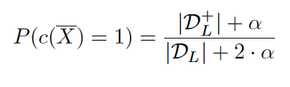
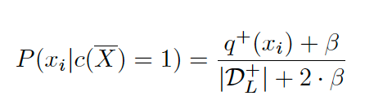
Basic elements
Probabilities of the classes
P(Liked)
α = smoothing parameter
Laplace smoothing makes the function behave smoothly around zero
More of a problem for features
Probabilities of features within a given class
P(x_{i}|Liked)
Similar computaiton

Slide 9
Frequency Table
Iterate through all examples
if example is "liked"
for each feature a
add one to the cell for that feature under L
similar for ~L
 | L | ~L
a₁
a₂
...
a_{k}

Slide 10
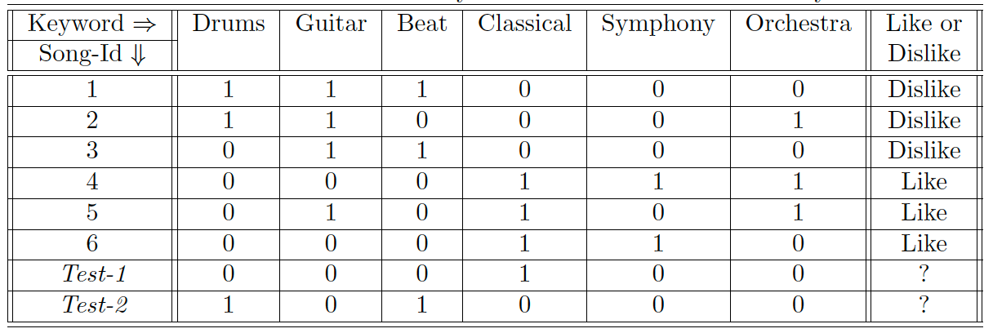
Example
Liked | Disliked
0 | 2 | Drums
1 | 3 | Guitar
0 | 2 | Beat
3 | 0 | Classical
2 | 0 | Symphony
2 | 1 | Orchestra
8 | 8 | Total

Slide 11
Probabilities
 | alpha | Drum | Beat | Classical | Product*.5
Test1 Like | 0.01 |  |  | 0.3753 | 0.1877
Test1 Dislike | 0.01 |  |  | 0.001247 | 0.0006234
Test2 Like | 0.01 | 0.001247 | 0.0012467 |  | 7.774E-07
Test2 Dislike | 0.01 | 0.2506 | 0.2506 |  | 0.03141
Probabilities
P(Liked) = 4/8 = 0.5
P(Liked|Classical) = 3/8 (plus smoothing)
P(Disliked|Classical) = 0 (but smoothing makes non-zero)
Etc.
Class probabilities for items
P(Liked|Test1) = 0.1877
P(Disliked|Test1) = 0.0006
Note that book includes absence of a feature as a feature
So there are actually Drum / ~Drum and each of these is counted
This is not typical of NB classifiers, plus hard to explain to users

Slide 12
If the items that a user likes all contain feature A, then we should conclude any new item containing A will also be liked by the user?
A. True
B. False
C: Maybe

Slide 13
Classification MAP
Maximum a posteriori
Calculate the probabilities for each possible classification
pick the one with the highest probability
Examples
Test1
P(L|Test1) = .1877
p(~L|Test1)=0.0
Predict liked
Test2
p(L|Test2)=0.0
p(~L|Test2)=0.031
Predict disliked
Probabilities seem too low

Slide 14
Classification LL
Log likelihood
For two possibilities
Calculate probabilities
Compute ln(p(L_{i}|a₁, ... , a_{k})/p(~L_{i}|a₁, ... , a_{k})
If > 0, then classify as liked
Examples
Test1
ratio = 0.1877 / 6.4x10-4 = 301
ln = 5.71 > 0
Predict liked
Test2
ratio = 7.8x10-7/0.03 = 2.5x10-5
ln = -10.6 < 0
Predict disliked
This is better for ranking

Slide 15
Naive Bayes
Works surprisingly well
Commonly used in spam filtering
Simple implementation
just counting and multiplying
requires O(F) space
where F is the feature set used
BUT… when the feature space is very large
As in some recommendation problems
Use hashing to shrink the memory profile without (much) loss of information
easy to update the profile
classification is very fast
Try this first

Slide 16
Homework 4
We will implement Naïve Bayes in LKPy

