Slide 1
Recommender Systems Regression
Professor Robin Burke
Spring 2019

Slide 2
Regression
We have talked about this a lot
in the context of rating prediction
Can also be used for content-based recommendation

Slide 3
Differences
We have an item / feature matrix
Could be dense
all features present for all items
Could be sparse
Typical for unstructured data like documents
But still will much less sparse than a rating matrix
Often it will have some dense features and some sparse ones
As in book
Matrix of item features: D

Slide 4


Regression model
We want to learn weights for each feature
So that we can predict the ratings
With the minimum error
Weight matrix W
Equation
Can use regularization to reduce overfitting
Minimization problem
Ridge regression

Slide 5
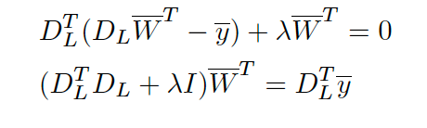

Closed form solution
Solution
Note that we are assume sufficient density in D
Otherwise we couldn’t compute the inverse
Result are weights that predict the user’s rating over any set of features

Slide 6
Predict ”liked”
Like Naïve Bayes
More typical to predict liked / disliked
Rather than ratings directly
Can use the probability of liked for ranking

Slide 7
Logistic regression
Logistic regression predicts binary values
Uses the logit function
- ∞ < x < ∞
0 < y < 1
A “soft” version of the step function
Can also be interpreted as a function of the probability

Slide 8
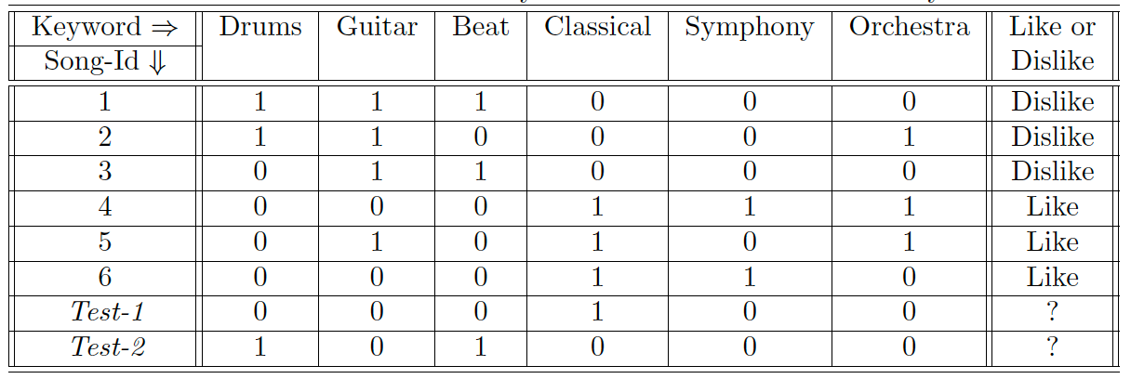
Logistic regression
The regression equation can output any value
But the interpretation stays probabilistic
Example
Learn coefficients w for drums, guitar, etc.
So that DW predicts the like / dislike vector for all users

Slide 9
Logistic regression
Very commonly used for large-scale industrial content-based recommendation
Handles correlated features better than Naïve Bayes
Less need for feature selection / feature engineering
Can be computed / approximated very efficiently
See Vowpal Wabbit (http://hunch.net/~vw/)

Slide 10
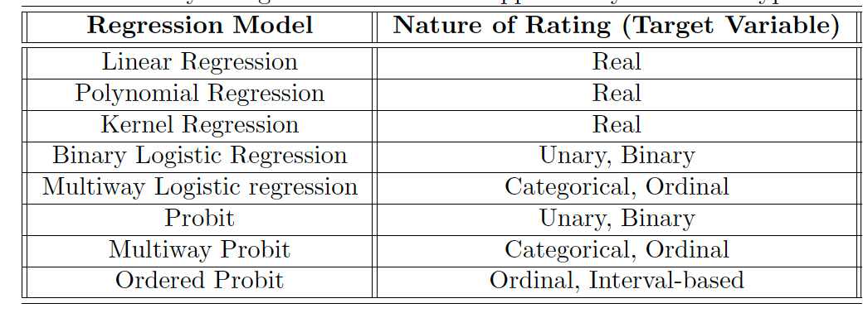
Regression family
Many options
Based on the interpretation of the ratings

Slide 11
If logistic regression is so great, why don’t we just stop here?
A. That’s right. Class is over
B. Logistic coefficients are even harder to explain than regular regression coefficients
C. If we stopped there, researchers wouldn’t get to write any more papers

