Slide 1
Recommender Systems Overview
Professor Robin Burke
Spring 2017

Slide 2
Outline
What is this all about?
Types of recommender systems
What we are covering
What we are not covering

Slide 3
A bit of history
The field is generally dated to two important milestones
The “naming” moment
Paul Resnick and Hal Varian “Recommender Systems” Communications of the ACM. March 1997.
The “business case” moment
The Netflix Prize competition
2006-2009
$1 million awards to BellKor’s Pragmatic Chaos
Andreas Töscher, Michael Jahrer. Robert Bell, Chris Volinsky, Yehuda Koren, Martin Piotte, Martin Chabbert
Familiar from the Microsoft Academic list

Slide 4
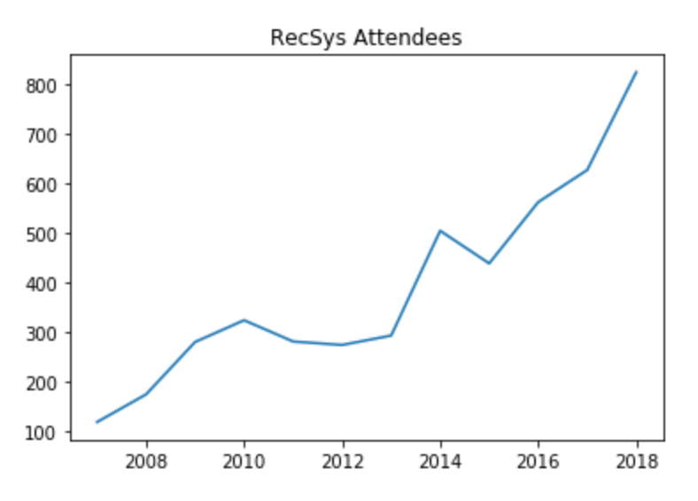
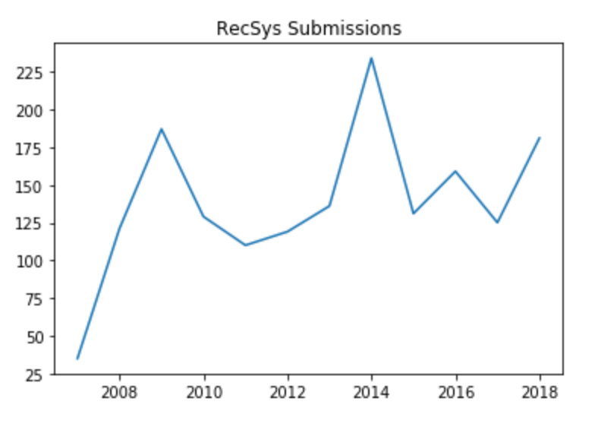
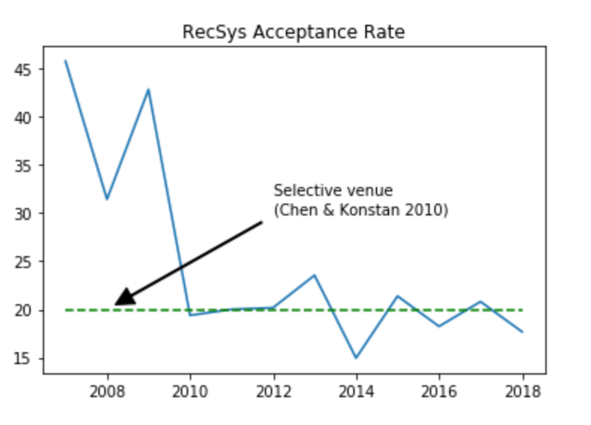
Recommender Systems conference

Slide 5
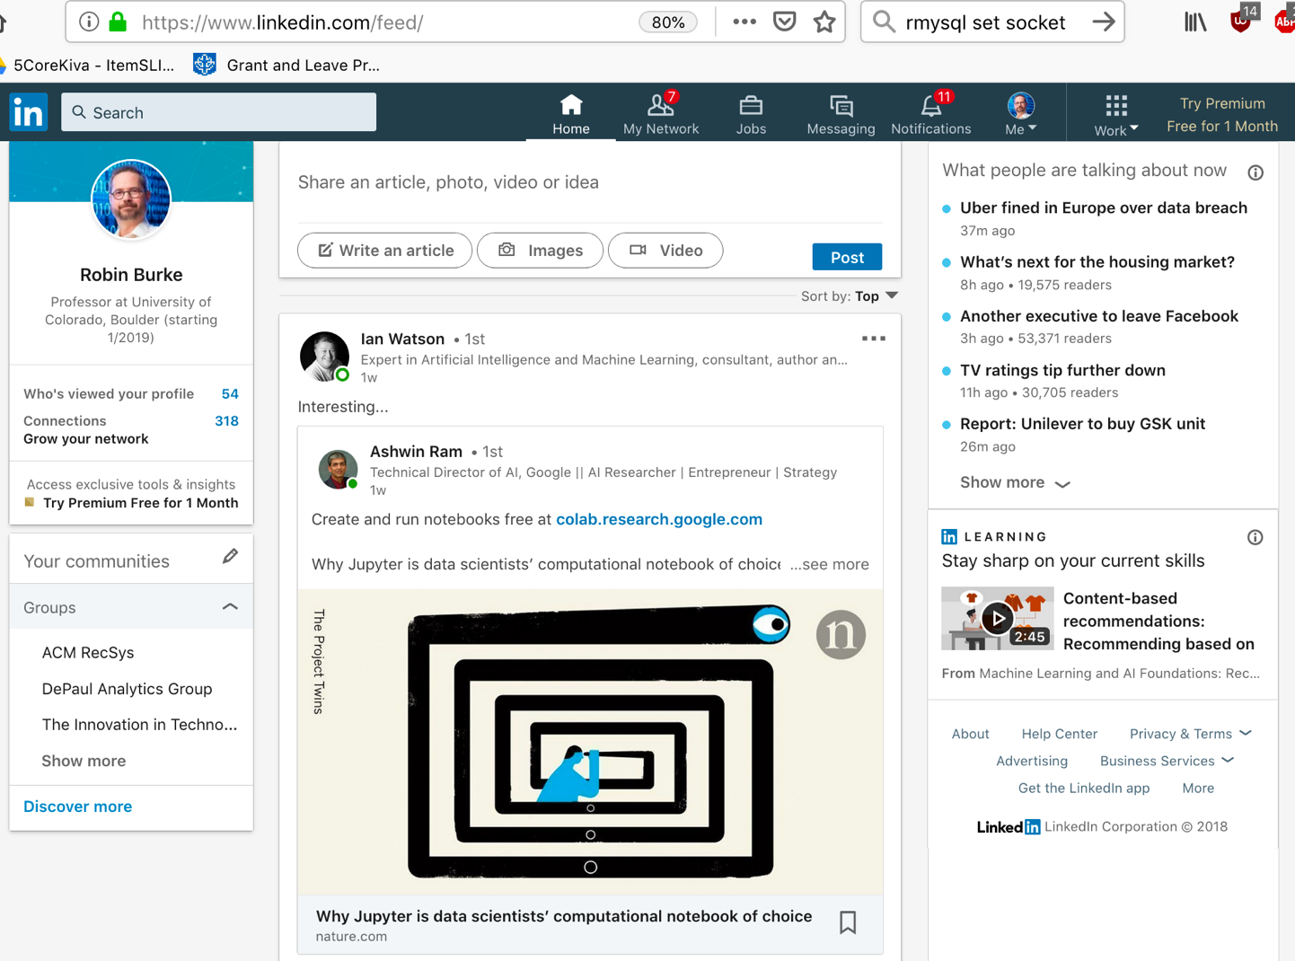
2019: Recommender Systems everywhere
Recommending connections
Recommending topics
Recommending groups
Recommending media content
Recommending posts

Slide 6
Recommender Systems
Wikipedia:
Recommender systems ... are a subclass of information filtering system that seek to predict the "rating" or "preference" that a user would give to an item.
My definition
Any system that guides the user in a personalized way to interesting or useful objects in a large space of possible options or that produces such objects as output.
Resnick and Varian’s definition (1997)
people provide recommendations as inputs, which the system then aggregates and directs to appropriate recipients.
Aggarwal
Doesn’t really supply a definition

Slide 7
Aspects of the definition
basis for recommendation
personalization
process of recommendation
interactivity
results of recommendation
interest / useful objects

Slide 8
Personalization
Any system that guides the user in a personalized way to interesting or useful objects in a large space of possible options or that produces such objects as output.
Definitions agree that recommendations are personalized
Some might say that suggesting a best-seller to everyone is a form of recommendation
Meaning
the process is guided by some user-specific information
could be a long-term model
could be a query
Potentially different outcome for every user

Slide 9
Interactivity
Any system that guides the user in a personalized way to interesting or useful objects in a large space of possible options or that produces such objects as output.
Many possible interaction styles
query / retrieve
recommendation list
predicted rating
dialog

Slide 10
Results
Any system that guides the user in a personalized way to interesting or useful objects in a large space of possible options or that produces such objects as output.
Recommendation = Search?
Search
a query matching process
given a query
return all items that match it
Recommendation
a need satisfaction process
given a need
return items that are likely to satisfy it

Slide 11
Our approach
Personalization
Focus on machine learning (while not ignoring other methods)
Most widely deployed solutions
”Find good items” task
Returning a small set of suggested items
There are other tasks, but this is the dominant one
Emphasize domain-specificity
What you’re recommending, to whom and in what content is important

Slide 12
Domain specificity
User bases vary
dedicated subscribers vs anonymous untraceable visitors
Item catalogs vary
objects of durable value vs ephemera
low cost vs high cost
Domains vary
recommending news articles is different from
recommending restaurants is different from
recommending music tracks is different from
recommending romantic partners is different from
recommending investments, etc.

Slide 13
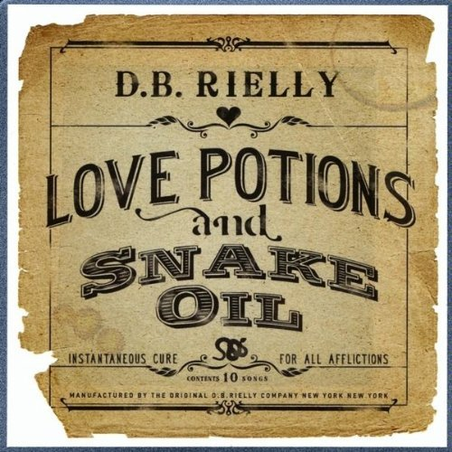
No silver bullet
Anybody who tells you they have THE solution for recommender systems
doesn’t know what they are talking about
or is trying to sell you something
or both
You need to understand
the scope of recommendation solutions
how domain characteristics fit those solutions

Slide 14
Topics we won’t cover
Explore / exploit tradeoffs
“Multi-arm bandit”
Recommender system robustness
Explanation generation
Privacy-preserving and peer-to-peer recommendation
Group recommendation
Diversity in recommendation
A little bit related to fairness
Almost enough to have a part 2 of this class

