Slide 1
Profiles
Professor Robin Burke
Spring 2017

Slide 2
Exercise
Work with the others at your table
Imagine that you own LinkedIn
What data can you collect about users of your website and apps that might be useful in making recommendations for job opportunities?
10 minutes to come up with a list

Slide 3
User profiles
This is the information that you know about a user
The basis for personalization
What makes the user different from everybody else?
Crucially, what makes the user similar to others?

Slide 4
Implicit vs Explicit indicators
Explicit indicator / rating
The user tells you how much they prefer something
Can be binary: thumbs up / thumbs down
Can be ordinal: 1 – 5 stars
Implicit indicator / rating
User preference is inferred from observation
How long on a web page?
Click vs non-click
Purchase

Slide 5
Exercise
Refer back to your list
What is explicit and what is implicit?

Slide 6
Tradeoffs
Explicit ratings
Not always reliable
People sometimes rate aspirationally
”Magic barrier”
Require user effort
Implicit ratings
Not always reliable
Users can click accidentally
Can be easily gathered

Slide 7
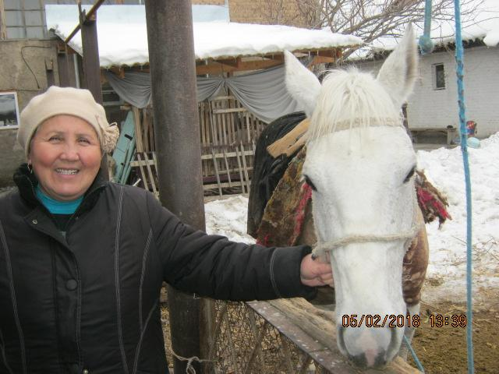

Example: Kiva.org
Kiva.org
Crowd-sourced microlending
Users make small loans to borrowers in developing countries
Think Kickstarter
Profiles
Explicit contributions towards particular loans

Slide 8
Kiva.org
 | Loan A | Loan B | Loan C | Loan D | Loan E | Loan F
Uiser 1 | $25 | $25 | $25 | $25 | $100 | $50
User 2 | $100 | $100 | $100 | $100 | $100 | $50
Total Amount | $200 | $300 | $500 | $250 | $5,000 | $250
How should we interpret these as ratings / preferences?
Does your opinion change if you know the total loan amount?

Slide 9
What to do now
Get the book in whatever form you prefer
Read Ch. 2.1-2.4 for Tuesday (and Ch. 1 if you didn’t already)
Get a clicker if you don’t have one
Bookstore or secondary market
Install latest Anaconda 3 distribution
Follow up Slack email invite
Sign up for SCuiz

