Slide 1
Recommender Systems Ratings
Professor Robin Burke
Spring 2019

Slide 2
Outline
Admin
Profiles
Characteristics of rating matrices
User-based neighborhood models
Item-based neighborhood models
Clustering

Slide 3
Clicker setup
If it is a new clicker, you have register it as belonging to you
Mycuinfo > CUClicker Registration button
Enter name, identikey and clicker remote ID (at the bottom of the back)
In class, set to frequency
The frequency in this class is CC
Press and hold power button until you see the flashing green light
Then press “C” twice
All the lights should flash

Slide 4
Course tools survey
Use your clicker!
A: I have logged into SCuiz and opened the course quiz
B: I have responded to the Slack invite and created my account there
C: Both A and B
D: I didn’t get a Slack invite
E: I don’t know what you are talking about

Slide 5
User profile
The information about the user that we use to make recommendations
Two types
Explicit: The user tells you their preferences
Implicit: You infer the user’s preferences from their action
Not always straightforward to create profiles from implicit data

Slide 6
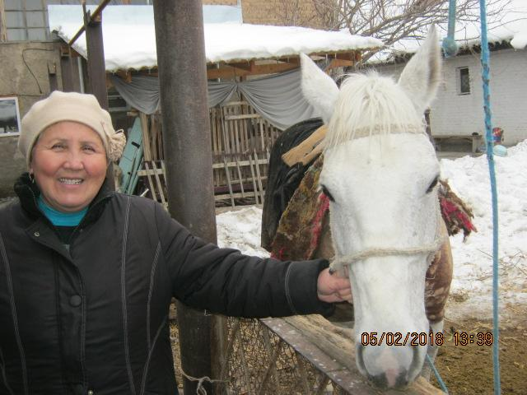

Example: Kiva.org
Kiva.org
Crowd-sourced microlending
Users make small loans to borrowers in developing countries
Think Kickstarter
Profiles
Explicit contributions towards particular loans
Not quite the same thing as preferences

Slide 7
Kiva.org
 | Loan A | Loan B | Loan C | Loan D | Loan E | Loan F
Uiser 1 | $25 | $25 | $25 | $25 | $100 | $50
User 2 | $100 | $100 | $100 | $100 | $100 | $50
Total Amount | $200 | $300 | $500 | $250 | $5,000 | $250
We want to convert this raw data into user profiles
Individual answer
A: (1) 1,1,1,1,1,1 / (2) 1,1,1,1,1,1
B: (1) 0,0,0,0,1,1 / (2) 1,1,1,1,1,0
C: (1) 1,1,1,1,5,2 / (2) 5,5,5,5,5,2
D: (1) 1,1,1,1,5,2 / (2) 5,5,5,5,5,1

Slide 8
Work with others at your table
Try to agree on the answer
Raw data
(1) 25,25,25,25,100,50 / (2) 100,100,100,100,100,50
A: (1) 1,1,1,1,1,1 / (2) 1,1,1,1,1,1
B: (1) 0,0,0,0,1,1 / (2) 1,1,1,1,1,0
C: (1) 1,1,1,1,5,2 / (2) 5,5,5,5,5,2
D: (1) 1,1,1,1,5,2 / (2) 5,5,5,5,5,1

Slide 9
More information
 | Loan A | Loan B | Loan C | Loan D | Loan E | Loan F
Uiser 1 | $25 | $25 | $25 | $25 | $100 | $50
User 2 | $100 | $100 | $100 | $100 | $100 | $50
Total Amount | $200 | $300 | $500 | $250 | $5,000 | $250
Does your opinion change if you know the total loan amount?

Slide 10
Key point
Any conversion from raw data to preferences encodes assumptions about what users’ actions mean
Need to be very clear about this
The right answer…

Slide 11
Some notation
User: a unique individual (for the system’s purposes), possibly the target of personalization
u or v
U (all users)
Item: a unique item (for the system’s purposes), possibly to be recommended to a user
i or j
I (all items)
Rating / preference: a numerical association between some u and some i
r_{uj}
R (all ratings)

Slide 12
Rating matrix
Analogy with standard classification breaks down
Sparsity
Long tail property
Training vs test data
No fixed dependent variable

Slide 13
Ordinal vs unary ratings
Ordinal (rating scale)
Example: 1-5 stars
often treated as cardinal
Unary (interaction)
Example: items purchased
Other items are unknown

Slide 14
Ordinal vs cardinal
A: Ordinal values are ordered; cardinal values are not ordered
B: Both ordinal and cardinal values are ordered, but the difference between cardinal values is meaningful
C: Ordinal values can be anything; cardinal values must be integers.

Slide 15
Sparsity
Most users will not have rated most items
Some domains this is very severe
web pages, music tracks
Forced to generalize from a small amount of data

Slide 16
“Cold start” problem
Cold start user
New user = no ratings on which to base prediction
Cold start item
New item = no one has rated it yet
(although...)

Slide 17


Long tail
Typically, ratings are unequally distributed
Some items are highly popular
Some items attract only a niche audience
Bad idea to recommend only “short head” items
users typically know about them already

Slide 18
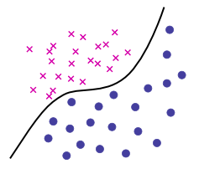
Training vs test data
Classical machine learning
there are known instances (training)
trying to classify unknown instances (test)
single distinction to be captured
Recommendation
all users have some known and some unknown data

Slide 19
Matrix completion problem
Rather than classification
Think of recommendation as a “matrix completion” problem
If we can “fill in” missing values
we’ll know what items a user would have liked
User 1 seems to like gangsters, but not ancient Romans
ř_{uj} for some j

Slide 20
Predicting ratings
We want a ranked list
But we can use predicted ratings to compute that

