Slide 1
Recommender Systems Homework 1
Professor Robin Burke
Spring 2019

Slide 2
Homework 1
Examine a profile data set
Produce some visualizations
Write two recommender systems
1. Non-personalized popular items (PopFreq)
2. Non-personalized top-rated items (PopRating)

Slide 3
Notes
Starting notebook .ipynb
Blank code sections
Some answers supplied so you can check your results
Written questions are important
Don’t leave these blank
These tell me if you understand what the computations are showing
Turn in both the completed .ipynb file AND an .html file
Use “Download as…” option in Jupyter notebook to create this
Use the “Add another file” option in Canvas to submit both
Due date: 2/5 (two weeks)

Slide 4
INFO 5871
Additional requirements
Must do the extraction operations without hard-coding
You can’t find stick specific values into your Python code
Just the output of functions that you call
Should work even if the data set changes
Additional implementations
A version of PopFreq in which items are filtered out if their average rating is below 3.5
A version of PopRating in which items are filtered out if there are fewer than 20 users rating them
4871 students can do these, too

Slide 5
Demo

Slide 6
Hints
Pandas API
read_csv
DataFrame.groupby
DataFrame.query
DataFrame.join
Pandas documentation
"Indexing and Selecting Data”
"Group By: split-apply-combine”
Data frames
Your life will be easier if everything is a data frame

Slide 7
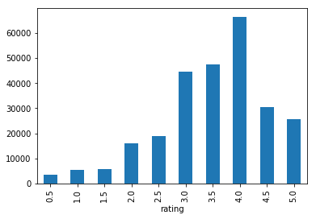
More hints
Least frequently-rated movie
“The War”
Most frequently-rated movie
“The Matrix”
Rating distribution
Some hints in the assignment, too

Slide 8
Question: Which best describes your reaction to Homework 1?
A: This homework looks pretty easy.
B: Good thing we have two weeks to do this.
C: This homework looks really hard.
D: I don’t even know how to get started on this.

