Slide 1
Recommender Systems User KNN
Professor Robin Burke
Spring 2019

Slide 2

Neighborhood models
Basic assumption
Tastes are shared
Peers are predictive
If every user had unique / random tastes
this would not work

Slide 3
User-based
Identify neighborhood of u
peer users P_{u}
Use peers to generate prediction ř_{uj}
Similar to knn classifier
find the most similar instances
Instead of trying to generalize

Slide 4
Question
What user would be the best (single) peer for Fred in predicting a score for Item 6?
User | Item 1 | Item 2 | Item 3 | Item 4 | Item 5 | Item 6
Fred | 5 | 4 |  | 3 | 4 | ?
A | 5 | 4 |  | 3 | 4
B | 1 | 4 | 3 | 3 |  | 4
C | 5 | 1 | 1 | 5 | 1 | 2
D | 4 | 3 |  | 2 | 3 | 2
E | 5 |  | 5 |  |  | 5

Slide 5
Peer selection
Depends on j, the item in question
a neighbor who hasn’t rated j can’t make a prediction
P_{u}(j)
Depends on the similarity measure
What makes two profiles similar?

Slide 6
Peer neighborhoods
Measure the similarity between a user and all other users
who have rated j
sim(u,v)
Select k closest neighbors
Possible similarity metrics
Pearson correlation (original literature)
Jaccard coefficient (binary data)
Cosine (often just as good as Pearson)
Select k neighbors
P_{u}(j)

Slide 7
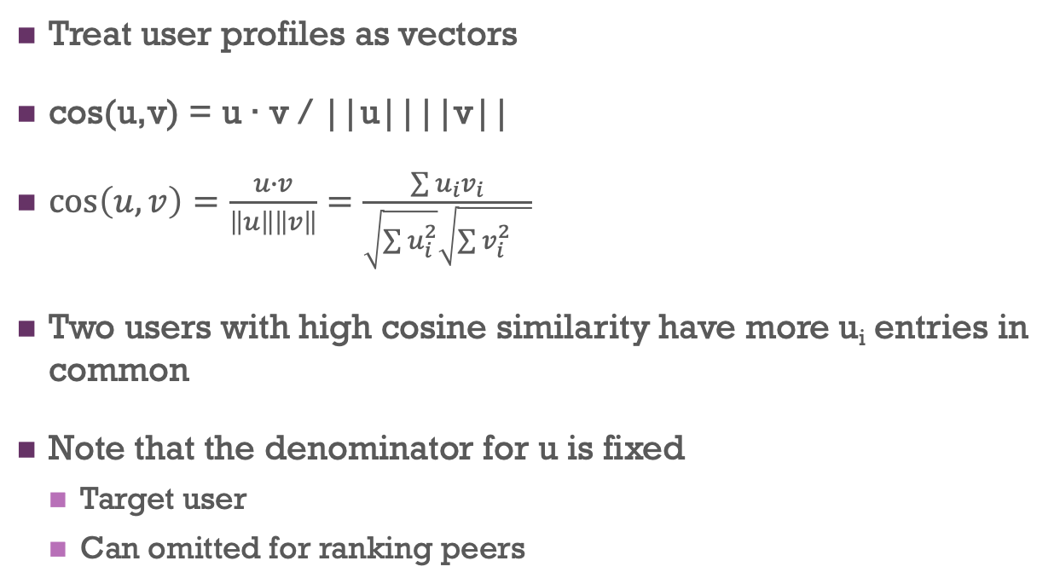
Similarity metrics: Cosine
Treat user profiles as vectors
cos(u,v) = u ∙ v / ||u||||v||
$\cos\left(u,v\right)=\frac{u∙v}{\left\|u\right\|\left\|v\right\|}=\frac{\sum{u_{i}v_{i}}}{\sqrt{\sum{u_{i}^{2}}}\sqrt{{\sum{v_{i}^{2}}}_{}^{}}}$
Two users with high cosine similarity have more u_{i} entries in common
Note that the denominator for u is fixed
Target user
Can omitted for ranking peers

Slide 8

Similarity metrics: Jaccard
For binary data
Treat vectors as sets
Size of intersection divided by size of union
$Jaccard\left(u,v\right)=\frac{|A∩B|}{|A∪B|}$

Slide 9
Similarity: Pearson correlation
Cosine measure adjusted by the mean
Takes into account different baseline rating behaviors
Generous vs stingy raters

Slide 10
Correlation

Slide 11
Example

Slide 12
How many neighbors?
Large k
Means that each prediction is closer to a global mean
Less personalization
Small k
Sensitive to neighbor noise
Interestingly
If you had an oracle to tell you the exact right k for each user
You can be very accurate
No way to know that in advance

Slide 13
Similarity threshold
May want to combine k value with minimum similarity threshold
Otherwise, when users have few close neighbors
distant users get pulled in to get to k
Zero is a common threshold
Don’t profiles with negative similarity!
Might be hard to find k neighbors that are close
“black sheep” users
k=4
k=5

Slide 14
Prediction
Once you have a neighborhood
use the peers to generate a prediction
Resnick’s algorithm
take all the (mean-adjusted) ratings of all peers v on item j
form a weighted sum
weighting by their similarity to user u
add back in u’s mean rating
Not strictly necessary for ranking

Slide 15
Thursday
More on neighborhood methods
Including item-based kNN

