Slide 1
Recommender Systems Item kNN
Professor Robin Burke
Spring 2019

Slide 2
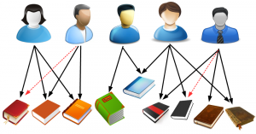
Neighborhood models
Basic assumption
Tastes are shared
Peers are predictive
If every user had unique / random tastes
this would not work

Slide 3
User-based
Identify neighborhood of u
peer users P_{u}
Use peers to generate prediction ř_{uj}
Similar to knn classifier
find the most similar instances
Instead of trying to generalize

Slide 4
Neighborhood methods
Key idea
We extrapolate the values of missing ratings, ř_{uj}
From peer users
Select peers based on similarity
Typically computed with correlation
Predict using a weighted average
Where the similarity is the weight
Personalization
Comes from each user having a unique neighborhood
Determined by their particular pattern of ratings

Slide 5
How many neighbors?
Large k
Means that each prediction is closer to a global mean
Less personalization
Small k
Sensitive to neighbor noise
Interestingly
If you had an oracle to tell you the exact right k for each user
You can be very accurate
No way to know that in advance

Slide 6
Similarity threshold
May want to combine k value with minimum similarity threshold
Otherwise, when users have few close neighbors
distant users get pulled in to get to k
Zero is a common threshold
Don’t profiles with negative similarity!
Might be hard to find k neighbors that are close
“black sheep” users
k=4
k=5

Slide 7
Prediction
Once you have a neighborhood
use the peers to generate a prediction
Resnick’s algorithm
take all the (mean-adjusted) ratings of all peers v on item j
form a weighted sum
weighting by their similarity to user u
add back in u’s mean rating
Not strictly necessary for ranking

Slide 8
Sparsity
What happens as the ratings matrix becomes more sparse?
A: There is less overlap between user profiles and it is harder to find neighbors
B: Items have fewer ratings and so predictions have to be made on the basis of less data
C: The ratings matrix requires more and more memory to store
D: A and B only
E: A, B and C

Slide 9
Efficiency
kNN seems slow but…
sim(u,v) can be computed offline
O(|U|²) space
Can use clustering or sampling if there are many users
users can be indexed by what items they’ve rated
possible to identify peers pretty quickly
still must predict for all items in order to compute a ranked list

Slide 10
Peer significance
Correlation can be computed with two values
an overlap of two ratings
Probably we shouldn’t have too much confidence in such similarity scores
when they are based on few data points
Want to rely more on peers who have more ratings in common

Slide 11
Significance weighting
Discounted Similarity
if the users have less than β ratings in common, then discount the similarity by overlap / β
can be used for neighborhoods and for prediction

Slide 12
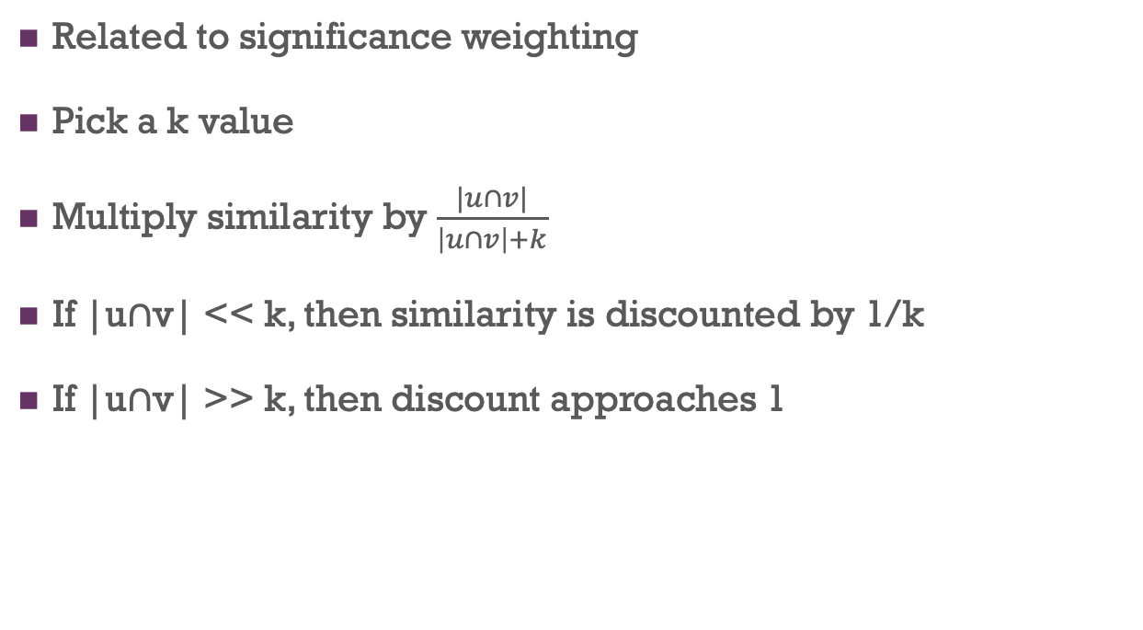
Shrinkage
Related to significance weighting
Pick a k value
Multiply similarity by $\frac{|u∩v|}{\left|u∩v\right|+k}$
If |u∩v| << k, then similarity is discounted by 1/k
If |u∩v| >> k, then discount approaches 1

Slide 13
Item significance
Long-tail properties
Mean that some items will be very frequently rated
Users’ opinions on these items not very informative
Can even bias recommendation output
Can use methods to discount items with high “user frequency”

Slide 14
TFIDF
Idea originated in information retrieval
Term frequency * inverse document frequency
Discount terms in a document
if they appear in many documents in a collection
Often logarithmic transformation applied to df part
Thus a term appearing in every document:
Frequency = 1
Inverse frequency = 1
Log(frequency) = 0

Slide 15
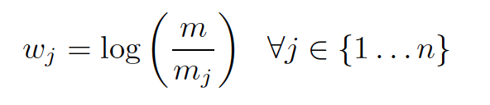
Item weighting
Recommender systems term
m = number of users
m_{j} = number of users rating j
Can use for prediction and for neighborhood formation

Slide 16
Item-based
There’s nothing special about user neighborhoods
you can also have item neighborhoods
Compute item similarities based on user ratings
Find items similar to the target item
Compute predictions based on user’s ratings of the peer items

Slide 17
Transpose
Mathematically, we are just transposing the ratings matrix
And applying the same operation
But the symmetry isn’t perfect
Usually many more users than items
So the item-based matrix is wider and shorter
Sparsity shows up in a different way

Slide 18
More formally
Identify neighborhood of i
peer items N_{i}
Use peer items to generate prediction ř_{uj}
Note that the right peers
depend on j
a item that hasn’t been rated by the target user can’t be used to a good prediction
P_{u}(j)

Slide 19
Normalization
Note that Pearson normalized by subtracting the row (user) mean
although note that the correct mathematical definition uses the mean of the overlapping items only
Item-based definition would imply subtracting item mean
you can do this
Standard algorithm is to normalize by the user mean anyway
“adjusted cosine”

Slide 20
Question
What item would be the best (single) peer item for Fred in predicting a score for the Target item?
Item | Fred | User 1 | User 2 | User 3 | User 4 | User 5
Item A | 5 | 5 | 1 | 5 | 4 | 5
Item B | 4 | 4 | 4 | 1 | 3
Item C |  |  | 3 | 1 |  | 5
Item D | 3 | 3 | 3 | 5 | 2
Item E | 4 | 4 |  | 1 | 3
Target | ? |  | 4 | 2 | 2 | 5

Slide 21
Comparing: item-based
Item-based benefits
Item-based recommendation can be more accurate
possibly because you are extrapolating only from the user’s own ratings
Item-based has less memory overhead
requires storing |I| x |I| item similarities
often many fewer items than users
Item-based neighborhoods tend to be smaller
sparse rating behavior
Item-based recommendations can be easier to explain
You liked Deadpool, Deadpool is like Aquaman, therefore you’ll like Aquaman

Slide 22
Comparing: user-based
User-based recommendations can be more diverse
Users may be more stable in recommendation domains
Items may churn more quickly, and have shorter profiles

Slide 23
Possible to combine
Book discusses ways of creating unified UB / IB models
Matrix factorization is another way to achieve this

Slide 24
Clustering
Efficiency can be an issue for knn methods
Even though similarities can be cached
O(m²n)
Where m is the number of users
n is the number of items used to compute similarity
m could be millions

Slide 25
Clustering, cont’d
Create clusters of users
Consider only members of the same cluster as neighbors
Reduces the number of similarity comparisons needed
Can do the clustering with many fewer than m² operations
K-means: O(nmki)
Where k is the number of clusters and i is the number of iterations
k * i << n

Slide 26
Clustering, cont’d
If we perform offline clustering
We use a clustering algorithm to find groups of similar users
K-means is O(knm) instead of O(n²m) where k << n
Now we can find peers by just looking at the user’s cluster
O(cnm’) where c is the cluster size
Some algorithms use several closest clusters
The object is to reduce greatly the number of peers to consider
Only look for peers in this cluster

Slide 27
Example
Medium-sized site
10 million users
10,000 items
sim(u,v) requires O(10¹⁴10⁴) = O(10¹⁸) time = est. 10⁸ seconds
Clustering
1,000 clusters
i = 10 is typical
O(10⁷10⁴10³10)=O(10¹⁴)
Sim(u,v) now only compares 10⁴ possible neighbors
O(10⁶10⁴) = O(10¹⁰)
O(10¹⁴)+O(10¹⁰) = O(10¹⁴)
10000x speed up
Difference between 160 minutes and 116 days

Slide 28
Sawar, et al. 2002
CF results vary because neighborhood size set = cluster size

Slide 29
Other benefits of clustering
Helps parallelism
The data for each cluster can be on a separate processor
Better updateability
The impact of updates can be confined to a single cluster
As long as they aren’t too large
Periodic re-clustering

Slide 30
Tradeoff
Not getting the “best” set of users
Accuracy goes down
The smaller the clusters, the more the neighborhoods are restricted
The larger the clusters, the more the algorithm behaves like regular kNN
Limiting case: 1 cluster with everyone in it

Slide 31





Diversity
We want a recommender to provide a useful list
Suppose I like this:
Should I get this list?
not diverse

Slide 32
Some problems
Risk
If the user doesn’t like one of these items
She won’t like any
Utility
If the user already knows about one item
She probably knows about the others
Worst case
Copies of known items: news stories, etc.
Choice confidence
If the items are too similar
The user might not believe that the search was “fair”
Non-diverse choices
Likely to concentrate on short-head

Slide 33
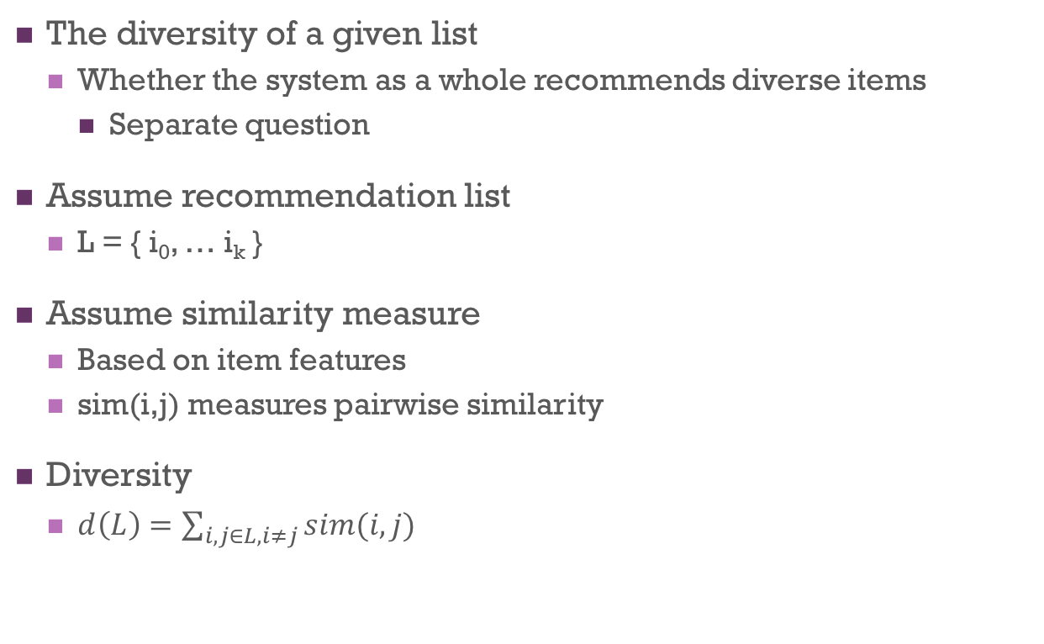
Local diversity
The diversity of a given list
Whether the system as a whole recommends diverse items
Separate question
Assume recommendation list
L = { i₀, … i_{k} }
Assume similarity measure
Based on item features
sim(i,j) measures pairwise similarity
Diversity
$d\left(L\right)=\sum_{i,j∈L,i≠j}{sim(i,j)}$

Slide 34
Question
If diversity is the only property you want in recommendations, you would want
A: A content-based recommendation that knows about item features
B: A collaborative recommender with diverse individuals in it
C: A recommender that chooses items randomly

Slide 35
Not to be maximized
Easy to get a maximally-diverse recommendation
Pick random items
Non-accuracy metrics
Have to be maximized while not losing (too much) accuracy
Multi-objective problem
More about this later in the quarter

Slide 36
Tuesday
No class
I will be at the Conference on Fairness, Accountability and Transparency
Work on the homework

Slide 37
Thursday
Guest lecturer: Himan Abdollahpouri, PhD student
Topic: Regression-based models

