Slide 1

Development and Implementation of a Person-Following System on a Mobile Robot – Part 2 Extension
Gesture interaction, SLAM mapping and autonomous navigation on a TurtleBot 2
Juan Muñoz Rovira
Academic tutor: Enric Cervera Mateu
Master's Degree in Intelligent Systems · Universitat Jaume I · 2026
Notes:
[≈ 0:40]
Good morning. My name is Juan Muñoz Rovira, and I am going to present my Master's thesis, supervised by Enric Cervera: the second part of a person-following system on a mobile robot.
In short, I took a TurtleBot 2 that could only follow a person and turned it into a small mobile assistant: it understands gestures, builds and uses a map of the lab, navigates on its own, and combines both behaviours in a single system.

Slide 2




Where this work starts
Part 1 (Martínez Miralles, 2025) left a robot that could follow a person’s legs — and little else.
PART 1 PIPELINE
2D LiDAR scan
No map
No global localization
No planned navigation was possible.
Once the person was lost, there was no reference to reorient.
DBSCAN clustering
Leg-pair pattern
Limited interaction
Camera not integrated
No clear way to start or stop following.
Vision played no part in the control loop.
Follow the person
This thesis → add gestures, a map and autonomous navigation — and make them work together.
Notes:
[≈ 1:00]
This work starts from a previous Master's thesis by Joaquín Martínez Miralles. His robot detected the person with a 2D LiDAR: it grouped the scan points with DBSCAN, looked for the pattern of two legs, and followed them.
It worked, but it had four clear limitations. It had no map, so no planned navigation was possible. It had no global localization, so once it lost the person it had nothing to reorient itself with. The user had no clear way to start or stop it. And the camera was mounted, but it played no part in the control loop.
Each of these limitations became one of my objectives.

Slide 3
Objectives and status
Goal: turn the follower into a mobile assistant that navigates on its own and understands the user.
1
Gesture interaction
2
SLAM mapping
3
Autonomous navigation
Start, stop and “home” gestures with MediaPipe Pose
Map of the lab with SLAM Toolbox, reused for localization
AMCL + Nav2 on the saved map: 6 of 7 goals
Completed
Completed
Completed
4
LiDAR–camera fusion
5
User guidance
6
QR room recognition
Camera bearing as a fallback when no leg pair is found
First step: return home on a gesture, 9 of 11 completed
Exploratory objective; links to multi-destination guidance
Completed
First step
Not addressed
Notes:
[≈ 0:45]
The general objective was to turn the follower into a mobile assistant. It breaks down into five specific objectives plus an exploratory one.
Gesture interaction, SLAM mapping, autonomous navigation with Nav2 and LiDAR–camera fusion are completed and validated on the real robot.
User guidance has a validated first step — the "home" gesture, which I will show later. Guidance to several destinations, and the exploratory objective of recognizing rooms with QR codes, remain as future work.

Slide 4
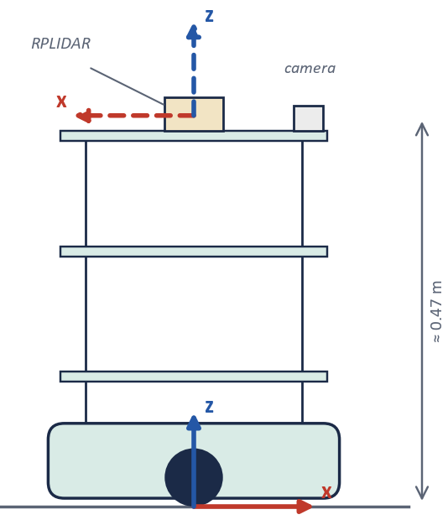



Platform
Low-cost hardware, with everything running on one onboard computer.
Kobuki base (TurtleBot 2)
Differential drive · wheel encoders + gyroscope → odometry
RPLIDAR A2M8
360° 2D LiDAR · ≈ 12 m range · ≈ 10 Hz · scans at leg height
RGB camera (SPCA2650)
Replaced the Logitech C270 to frame gestures at ≈ 1 m · MediaPipe Pose
Intel NUC · Ubuntu 24.04 · ROS 2 Jazzy
Drivers, perception, tracking and SLAM/Nav2 together: ≈ 30% load per core
SOFTWARE
ROS 2 Jazzy
SLAM Toolbox
Nav2 + AMCL
MediaPipe Pose
OpenCV · Python
Side view (Fig. 3.4): the LiDAR scan plane sits at ≈ 0.47 m — leg height.
Notes:
[≈ 1:00]
The platform is deliberately low-cost. The Kobuki base is a differential drive that provides odometry from its wheel encoders and gyroscope.
The RPLIDAR A2M8 scans 360 degrees at about 10 hertz. It is mounted about 47 centimetres above the floor, so its scan plane cuts people at leg height — that is what the detector exploits, and also, as we will see, its main limitation.
I replaced the original webcam with an SPCA2650 to frame the gestures at the real tracking distance, about one metre.
And everything — drivers, MediaPipe, tracking, SLAM or Nav2 — runs on a single Intel NUC with ROS 2 Jazzy. With everything running, the load is around 30 percent per core.

Slide 5
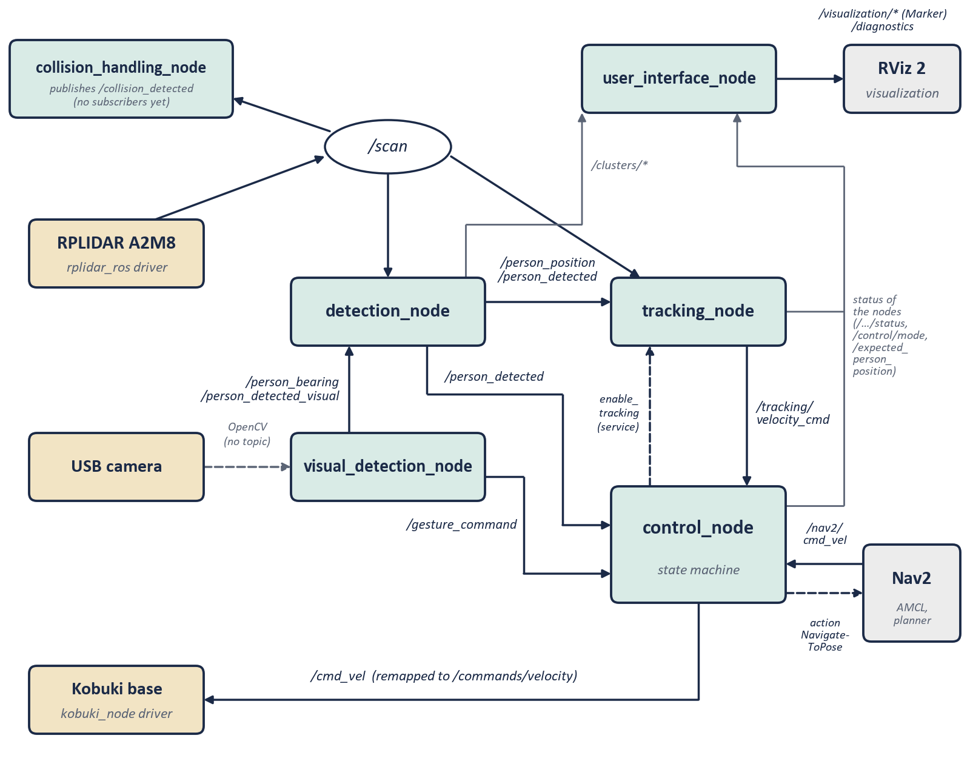



Architecture
Independent ROS 2 nodes linked by topics — and a single node that decides what reaches the wheels.
Perception
detection_node — legs from the LiDAR (DBSCAN + geometric filter)
visual_detection_node — MediaPipe gestures + person bearing
Estimation & control
tracking_node — 6-state Kalman filter, Mahalanobis gate, PD heading, reactive avoidance
Arbitration
control_node — state machine: forwards tracking, Nav2 or teleop velocity, never two at once
Notes:
[≈ 1:15]
The software is a set of independent ROS 2 nodes that communicate only through topics, services and actions.
Follow the path of the data: the LiDAR publishes its scans; detection_node turns them into a position of the person; tracking_node filters that position and computes a velocity. The camera node contributes the gestures and an approximate direction of the person.
The key piece is control_node. It is a state machine, and it is the only node whose output reaches the wheels. At every moment it decides which source drives the base — the tracker, Nav2 or the keyboard — so the robot never receives two contradictory commands.
This arbitration is what later allows tracking and navigation to coexist.

Slide 6
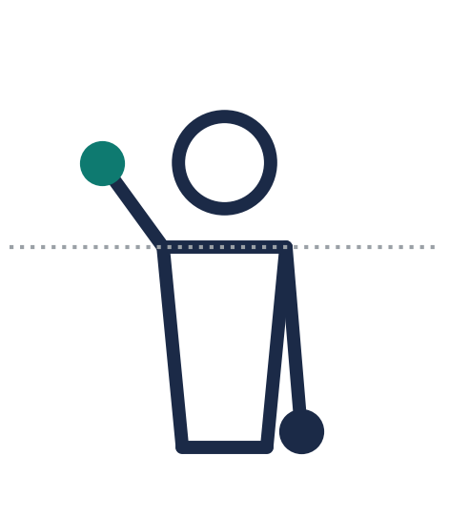
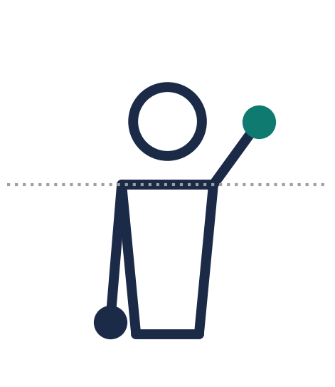
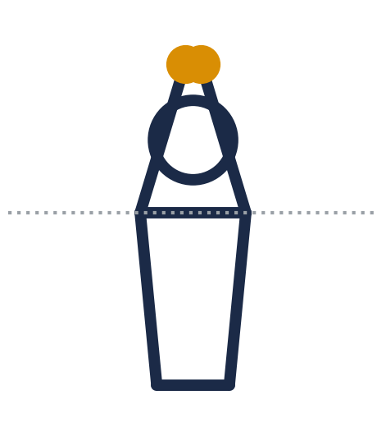

Gesture interaction
Three mutually exclusive gestures, recognized from the MediaPipe Pose skeleton.
Right hand up
Left hand up
“Roof” above the head
START following
STOP · cancel
RETURN HOME
Camera view: the person’s right hand appears on the left.
VIDEO 1 The three gestures recognized live (right hand → left hand → roof).
Confirmed over several consecutive frames, with a cooldown between commands
No false positives in ≈ 4 min of free gesturing
The roof is symmetric: also recognized from behind (2 of 2)
Notes:
[≈ 1:15]
The user talks to the robot with three gestures, recognized from the MediaPipe Pose skeleton. Right hand up starts following. Left hand up stops it — or cancels a return home. And both hands joined above the head, like a roof, sends the robot home.
Each gesture must hold for several consecutive frames, and there is a cooldown between commands, to avoid false positives.
I chose the roof because it is symmetric, so it also works when the person has their back to the robot — which is the normal situation while following. In the final session there were no false positives in about four minutes of free gesturing.
[VIDEO 1] Here you can see the three gestures recognized live.

Slide 7
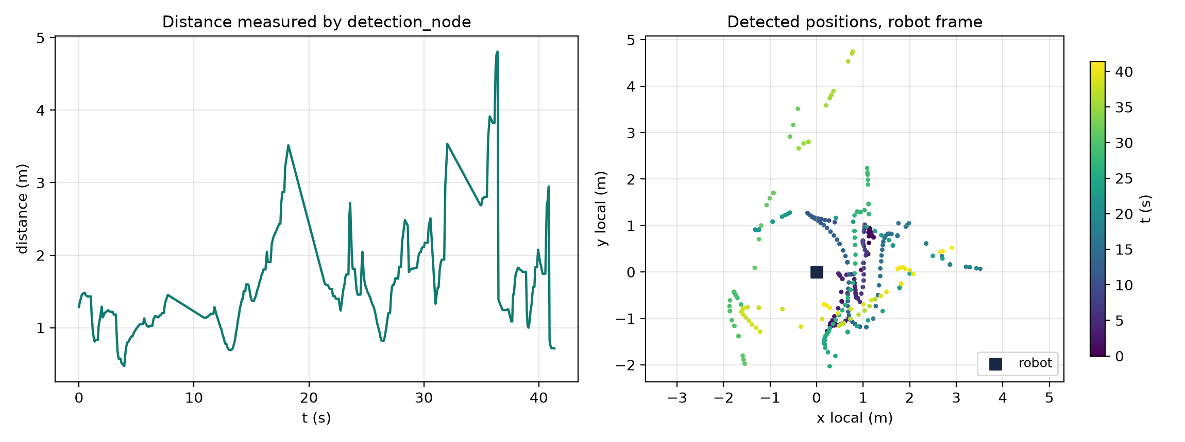
Detection and LiDAR–camera fusion
Legs from the LiDAR first; the camera only steps in when no valid leg pair is found.
Scan
300–400 points
Median filter
+ interpolation
DBSCAN
eps 0.12 m · min 4
Leg filter
size · radius · shape
Leg pair →
/person_position
No valid pair? Use the cluster best aligned with the camera bearing
100%
detection with fusion, robot not moving (25/06)
≈ 6°
camera bearing vs. chosen LiDAR cluster
Before the fallback, tracking stopped after 30 s without legs.
Real take, straight line (22/07/2026): measured distance and detected positions.
Notes:
[≈ 1:15]
Detection works in two stages. First, the LiDAR: each scan has 300 to 400 points. They are filtered, interpolated and grouped with DBSCAN, and the clusters are filtered by size, radius and shape to find a pair of legs. I reimplemented DBSCAN on a KD-tree, because scikit-learn's compiled extension was not compatible with the NUC's Python version.
Second, the fusion. When there is no valid leg pair — for example, when the person turns sideways — the camera's bearing is used to choose the LiDAR cluster best aligned with the person. Before this fallback, tracking stopped after 30 seconds without legs.
In the test with the robot not moving, detection was continuous — 100 percent — with a deviation of about 6 degrees between the camera bearing and the chosen cluster. The figure shows a real take: the distance measured over time, and the detected positions.

Slide 8
Tracking and safety
A Kalman filter absorbs intermittent detections; a reactive layer keeps the robot off obstacles.
Position jumps > 0.8 m: 3.5% → 0.7%
Obstacles: 2 light contacts → 0 with furniture after fixing the slow-down factor and adding a detour manoeuvre
VIDEO 2 Following through a turn, and avoiding an obstacle.
Under the hood: 6-state Kalman (constant acceleration) · Mahalanobis gate · PD heading · ±50° frontal sector
Notes:
[≈ 1:30]
Detections are noisy and intermittent, so tracking_node keeps a six-state Kalman filter with a constant-acceleration model. A Mahalanobis gate rejects implausible jumps, and a PD controller turns the robot towards the person.
The first test in motion revealed the problem: the person was detected only 32 percent of the time. Three chained fixes — a continuity filter, the Mahalanobis gate and a limit on the angular velocity — raised it to 83 percent, and cut the position jumps from 3.5 to 0.7 percent.
For safety, the tracker watches a ±50-degree frontal sector: it slows down, stops, and, if it stays blocked, performs a short detour manoeuvre. In the first obstacle takes the robot brushed the furniture twice, because the slow-down factor never reached zero. After the fix, there were no more contacts with furniture.
[VIDEO 2]

Slide 9
Mapping and autonomous navigation
Standard ROS 2 tools, configured for this robot: SLAM Toolbox builds the map, AMCL + Nav2 use it.
6 / 7
≈ 8 m
navigation goals reached (86%)
longest routes (two of them)
An obstacle not on the map was detected and avoided by the local costmap
Only failure: goal changed mid-route — recovered automatically in ≈ 2 s
AMCL seemed frozen at first: DDS discovery latency, fixed with longer test commands
NAVIGATION CHAIN
VIDEO 3 Nav2 navigating to a goal on the lab map (RViz and/or robot view).
SLAM Toolbox
map
AMCL
localization
Nav2 planner
+ DWB controller
control_node
(HOMING only)
Notes:
[≈ 1:15]
For the spatial part I used the standard ROS 2 tools instead of reinventing them. SLAM Toolbox built the map of the lab; AMCL localizes the robot on that map; and Nav2 plans and follows the route.
The first test had a surprise: AMCL seemed to freeze. The cause was that my short test commands finished before DDS completed node discovery; with longer commands, it converged without problems.
Then, out of seven goals, six were reached — 86 percent — including two routes of about 8 metres and one with an obstacle that was not on the map, which the local costmap detected and avoided. The only failure happened when I changed the goal mid-route, and Nav2 recovered automatically.
[VIDEO 3]

Slide 10
The “home” gesture: tracking + navigation
One gesture hands the robot over from the person-follower to Nav2 — and back.
right hand
IDLE
TRACKING
left hand
arrival · Nav2 failure · left hand
roof
HOMING
HOMING: control_node sends NavigateToPose(home) and forwards only Nav2’s velocity
Exit: arrival, Nav2 failure or left hand → IDLE
Detail that mattered: the disabled tracker still publishes zero velocity at 10 Hz — forwarding it would have cancelled Nav2
VIDEO 4 Full sequence (≈ 40 s): right hand → following with a turn → roof → autonomous return home.
Notes:
[≈ 1:30]
This is the part that brings everything together: the "home" gesture.
While the robot is following me, I make the roof gesture. control_node stops forwarding the tracker's velocity, sends Nav2 a goal to the home pose, and forwards only Nav2's velocity. When the robot arrives — or if Nav2 fails — it goes back to idle; and with the left hand I can cancel at any moment.
One detail mattered a lot: the disabled tracker keeps publishing zero velocity ten times per second. Forwarding that would have cancelled Nav2. That is why the arbitration is done by state, and not by "the last message wins".
[VIDEO 4] This is the full sequence, about 40 seconds: right hand, following through a turn, the roof, and the autonomous return home.

Slide 11
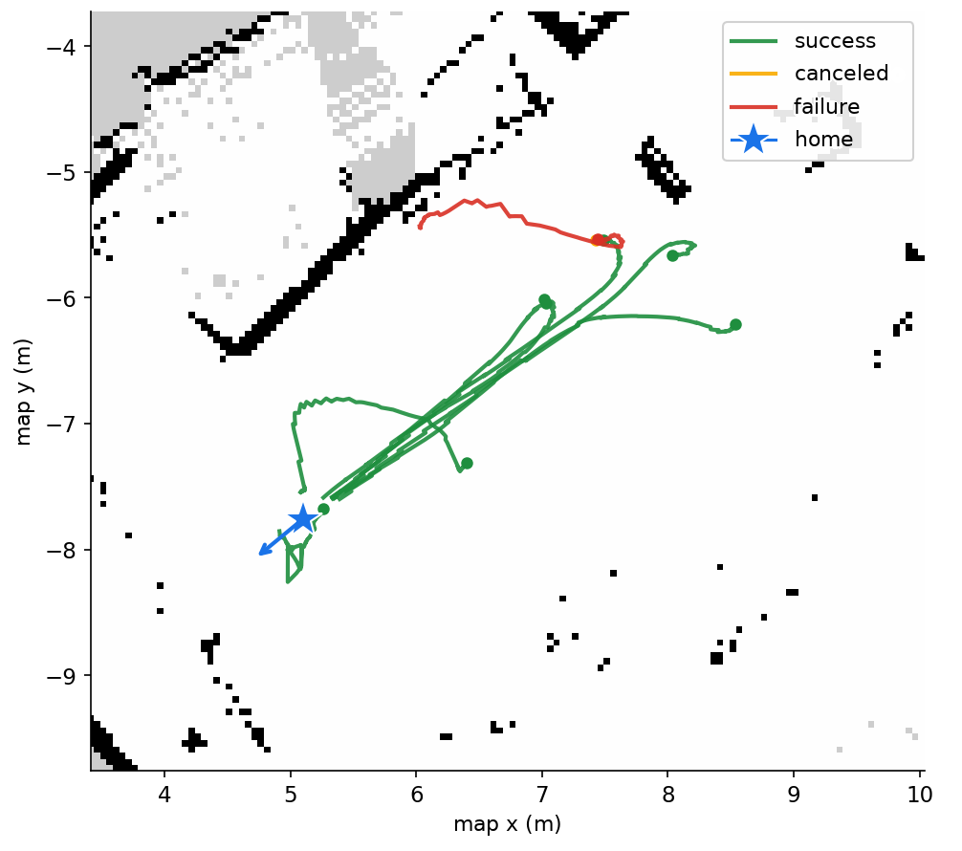

“Home” gesture: results
Final lab session (23/09/2026): 9 of 11 returns home completed.
9 / 11
15.5 s
returns home completed (82%)
mean time, gesture → home (11–21 s)
0.27 m · 8°
20 ms
mean arrival error (Nav2 tolerance 0.25 m / 14°)
cancel with the left hand (≈ 7 cm of travel)
0
2 / 2
gesture false positives in ≈ 4 min
“roof” recognized from behind
Both failures: localization (AMCL, σ ≈ 0.5 m) put the robot inside an obstacle’s safety zone → no valid plan → safe return to IDLE.
Recorded returns on the lab map (Fig. 5.5). The star marks “home”.
Notes:
[≈ 1:15]
In the final lab session, in September, I asked for twelve returns home: one I cancelled on purpose, and eleven real attempts.
Nine were completed — 82 percent — in 15 and a half seconds on average, with a mean arrival error of 27 centimetres and 8 degrees, very close to Nav2's own goal tolerance. Cancelling with the left hand was confirmed by Nav2 in 20 milliseconds.
The map shows the recorded trajectories; the star is the home pose.
The two failures were not caused by the gesture or by the state machine: localization, with an uncertainty of about half a metre, placed the robot inside the safety zone of an obstacle. From there the planner could not find a route, and the robot safely returned to idle.

Slide 12




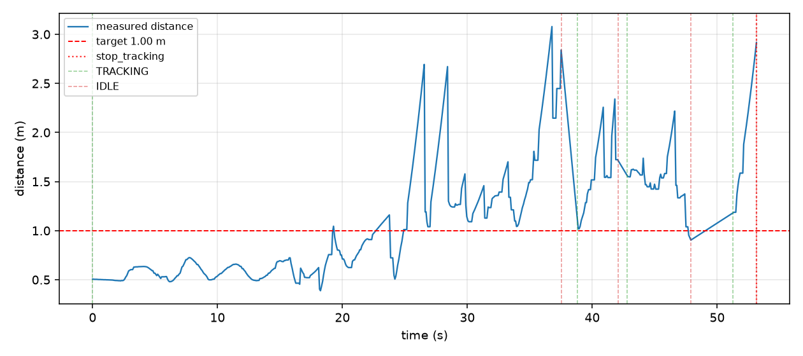

Measure, don’t guess
Every correction was checked on the real robot, with numbers rather than impressions.
Take on
the robot
rosbag
on the NUC
CSV + metrics
MAE · RMS · % detection
4 figures
distance · angle · velocity · path
Fix and
repeat
Bugs that only showed up in the lab
Inverted sign in the PD heading controller
Inverted obstacle-avoidance sector
Slow-down factor that never reached zero
DDS discovery latency (AMCL looked frozen)
Example output: distance over time, take with all three continuity fixes (08/07).
Notes:
[≈ 0:45]
A word on method, because it shaped the whole project. Every take was recorded as a rosbag on the robot, converted to CSV and analyzed offline, producing the metrics and four standard figures. That is how each fix was checked with numbers, not impressions.
And it was necessary: almost all the relevant bugs — an inverted sign in the PD controller, an inverted avoidance sector, the slow-down factor that never reached zero, the DDS discovery latency — only showed up on the real robot. They would hardly have appeared in simulation.

Slide 13


Limitations and future work
A working first result in one lab — with clear next steps.
Limitations
Future work
The 2D LiDAR sees one plane (≈ 0.47 m): it missed a chair’s thin legs
Small samples: Nav2 and the “home” gesture, one session each
Localization next to obstacles caused both homing failures
Reactive avoidance does not tell the person from an obstacle
A single test environment (UJI robotics lab)
Guidance to several destinations: one gesture or QR code each (objectives 5 and 6)
Exit manoeuvre before re-planning when localized next to an obstacle
Orbbec Astra RGB-D camera or a second LiDAR for obstacles off the scan plane
Connect collision_handling_node to control_node
Tests with more people, environments and lighting
Notes:
[≈ 1:00]
The results also have clear limits. The 2D LiDAR sees a single plane, so it missed the thin legs of a chair. Several results come from small samples: Nav2 and the home gesture were validated in one session each, and all tests were done in one lab.
The natural next steps are: guidance to several destinations, with one gesture or QR code each, which would complete objectives 5 and 6; an exit manoeuvre before re-planning when the robot is localized next to an obstacle; an RGB-D camera or a second LiDAR for obstacles outside the scan plane; and tests with more people and environments.

Slide 14

Conclusions
The contribution is the integration: detection, tracking, navigation and gestures on one low-resource robot.
01
02
03
Objectives
Arbitration
Built for limited compute
4 of 5 specific objectives completed and validated on the real robot; the 5th, guidance, has a working first step.
control_node lets tracking and Nav2 coexist without interfering — and the user switches between them with a gesture.
Own DBSCAN on a KD-tree, asymmetric fusion without precise calibration, linear Kalman + Mahalanobis gate: ≈ 30% per core.
Main lesson: test on the real robot, and measure every change.
Notes:
[≈ 0:45]
To conclude. Four of the five specific objectives are completed and validated on the real robot, and the fifth has a working first step.
The contribution is not a new algorithm but the integration: detection, tracking, navigation and gestures on a single robot with limited resources, where control_node lets tracking and Nav2 coexist and the user switches between them with a gesture.
And the main lesson: test on the real robot, and measure every change.

Slide 15
Thank you
Questions?
Juan Muñoz Rovira · Tutor: Enric Cervera Mateu
Code: github.com/juanitomuro1999/TFM_JUAN
Notes:
[≈ 0:10]
Thank you for your attention. I am happy to answer your questions.
(Backup slides follow: state machine, Nav2 architecture, per-scenario table, obstacle takes, TF tree, planning and cost, use of AI tools.)

Slide 16
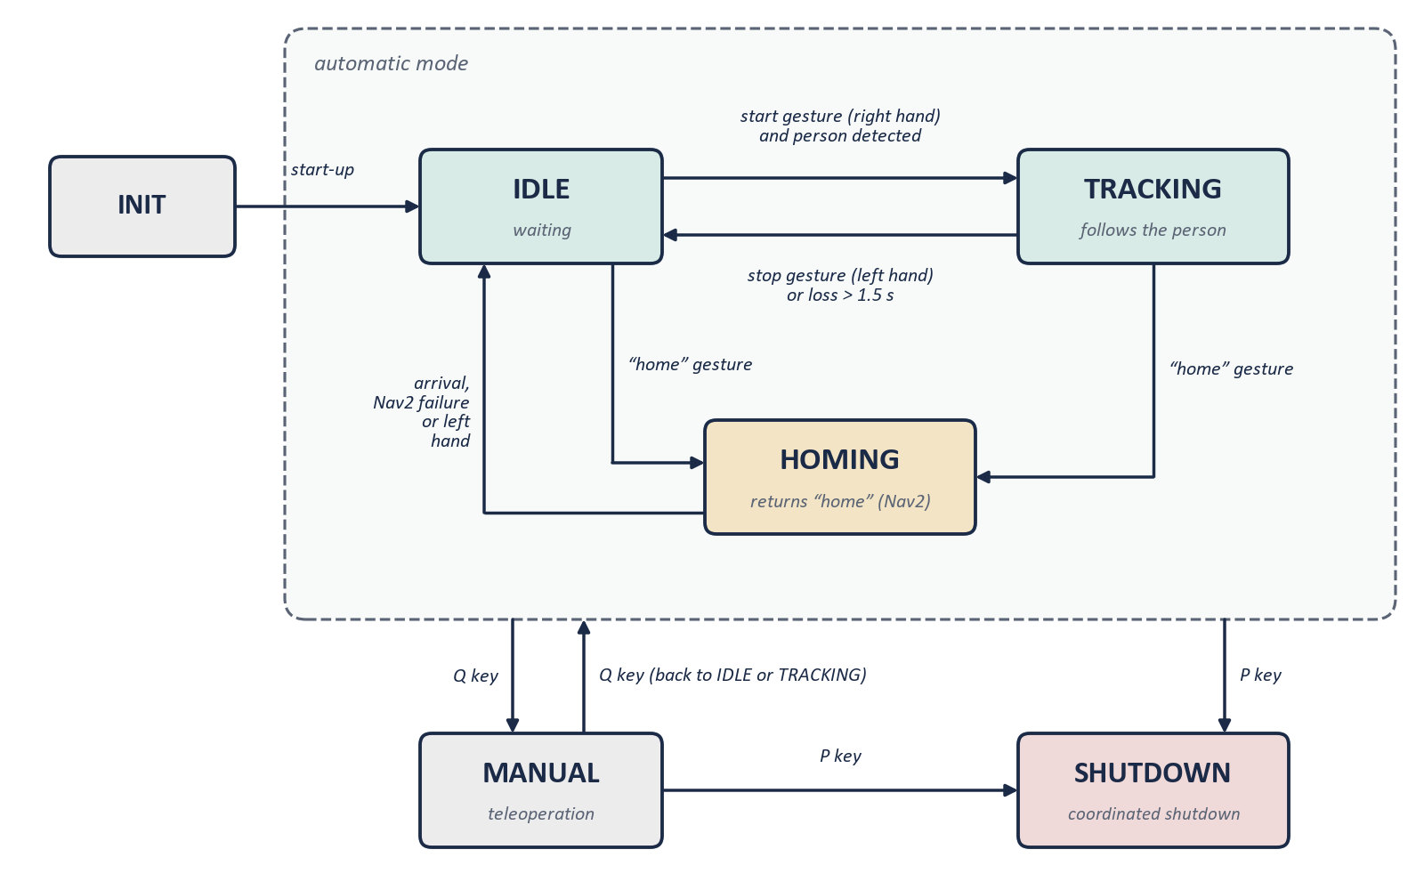
control_node state machine
Full finite-state machine (Fig. 3.3); the Q and P keys act from any state.
Notes:
Backup — use if asked about the state machine. After INIT the system waits in IDLE. Right hand (with the person detected) → TRACKING; left hand or loss for more than 1.5 s → IDLE. The roof gesture from IDLE or TRACKING → HOMING; arrival, a Nav2 failure or the left hand → IDLE. MANUAL (keyboard teleoperation) and SHUTDOWN (coordinated shutdown) are reached with the Q and P keys from any state.

Slide 17
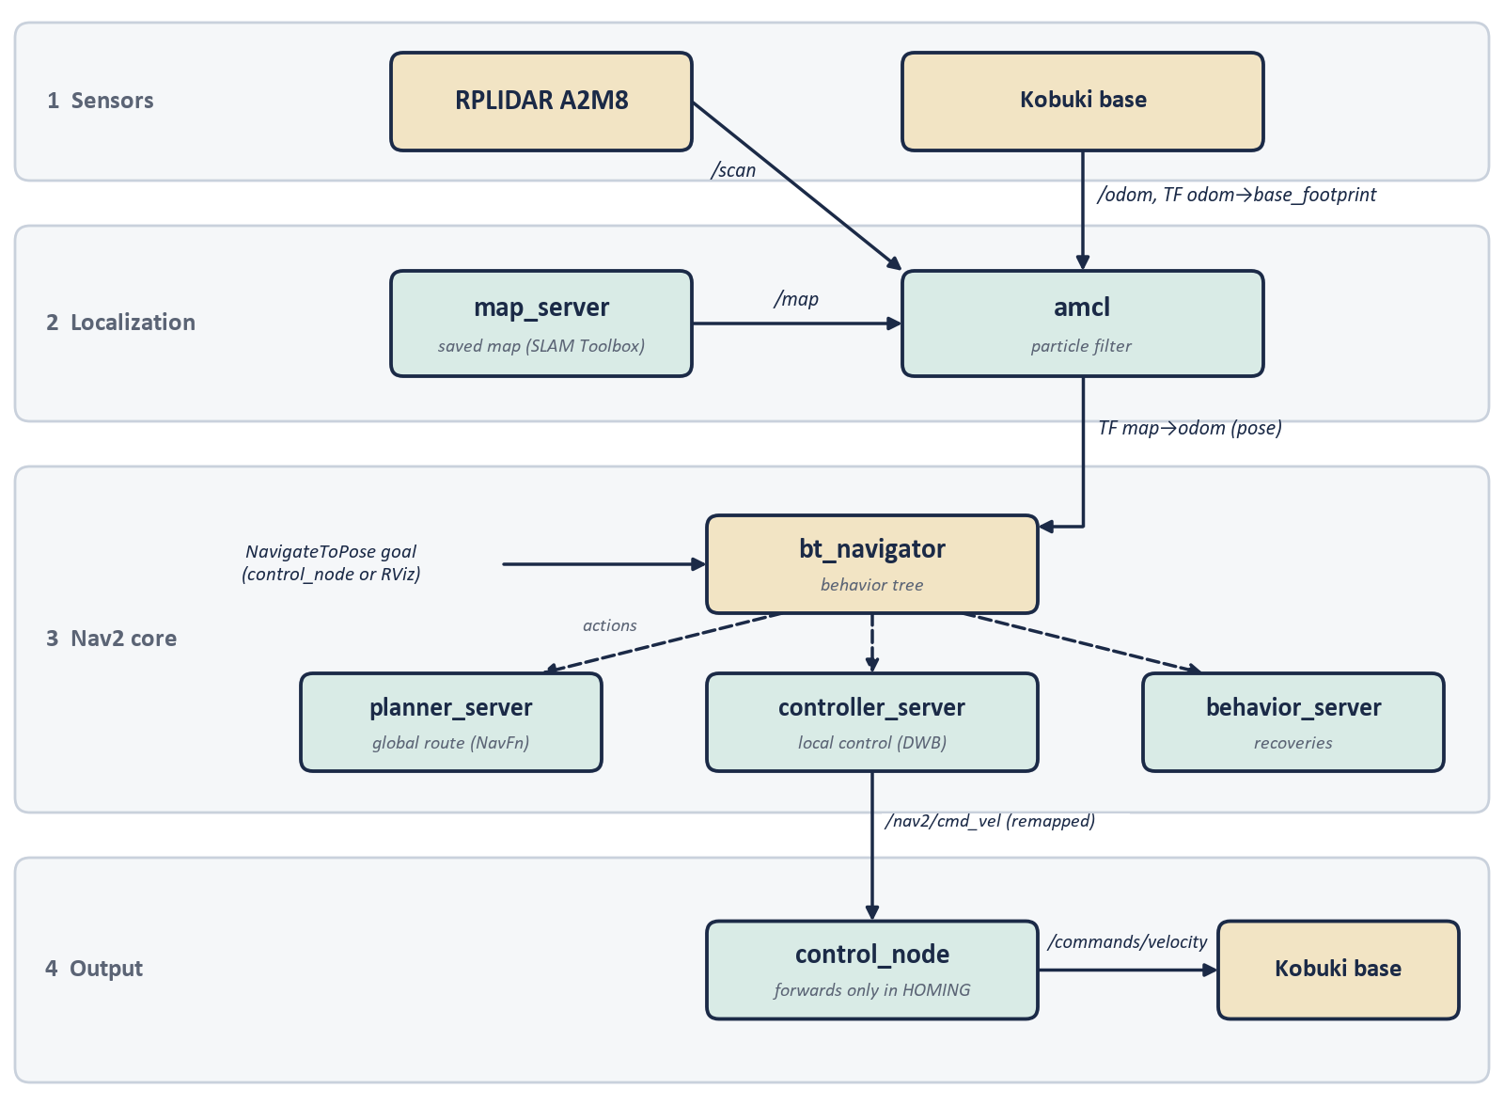
Nav2 architecture
Four layers; Nav2’s velocity is remapped and only reaches the base through control_node in HOMING.
Notes:
Backup — use if asked how Nav2 is integrated. Sensors → localization (map_server + AMCL, which publishes map→odom) → Nav2 core (bt_navigator with a behavior tree; planner_server with NavFn for the global route; controller_server with DWB for local control; behavior_server for recoveries) → output remapped to /nav2/cmd_vel, which control_node forwards to the base only in HOMING.

Slide 18
Per-scenario repetitions (22/07)
Stabilized system, five scenarios without collision risk (Table 5.3).
Scenario | Duration | MAE dist. | Mean ang. | % detec. | Losses | Jumps > 0.8 m | Stable sat.
Straight (contaminated) | 41.4 s | 0.626 m | 62.0° | 76.2% | 7 | 6.8% | 13.8%
Straight (clean) | 25.9 s | 0.420 m | 26.5° | 100% | 0 | 2.3% | 1.8%
Curve #1 | 33.5 s | 0.794 m | 14.5° | 100% | 0 | 2.8% | 6.8%
Curve #2 (short) | 12.2 s | 0.759 m | 23.7° | 97.1% | 1 | 2.0% | 20.8%
Curve #3 | 14.3 s | 0.976 m | 6.2° | 100% | 0 | 0.9% | 0.0%
Stop | 36.5 s | 0.326 m | 5.9° | 100% | 0 | 0.0% | 0.0%
Short #1 (min. 0.15 m) | 32.5 s | 0.443 m | 32.8° | 100% | 0 | 2.0% | 25.1%
Short #2 (min. 0.42 m) | 8.4 s | 0.628 m | 4.9° | 98.8% | 1 | 0.9% | 0.0%
Short #3 (min. 0.02 m) | 18.7 s | 0.508 m | 46.8° | 100% | 0 | 1.2% | 28.6%
Occlusion | 30.6 s | 0.678 m | 16.2° | 100% | 0 | 2.5% | 1.5%
Notes:
Backup — use if asked about tracking quality per scenario. The first straight-line take was contaminated by a residual tracking state; once tracking was de-authorized before each take, it did not recur. Short durations in curve #2 and short #2: the gesture took a while to be recognized. In short #3 the person came within 0.02 m, so saturation was expected. The occlusion caused no real loss thanks to the Kalman prediction and the single-leg fallback.

Slide 19
Obstacle scenario (22–23/07)
From light contacts to contact-free avoidance with furniture (Table 5.4).
Take | Configuration | Result
v3, v4 (furniture) | Safety threshold raised; slow-down factor unfixed | Light contact: the factor never reached zero, no full stop
v5 (furniture) | Factor fixed: real ramp to zero between warning and stop thresholds | No contact
v6 (furniture + chair) | Same | No contact (the chair did not trigger avoidance)
v7 (furniture + chair) | + detour manoeuvre (tight turn + short advance) | No contact; manoeuvre triggered 4 times
v8 (furniture + chair) | Same | Furniture avoided; contact with the chair (not seen by the LiDAR)
v9 (furniture, 23/07) | No code changes | No contact — confirmed in a different session
Notes:
Backup — use if asked about obstacle avoidance. The fault was in the formula: the reduction factor never dropped below 0.4, so the robot detected the obstacle but never fully stopped. The fix computes the factor from the real minimum distance in the frontal sector (1 at 0.40 m, 0 at 0.25 m), plus the detour manoeuvre. The chair contact in v8 is a sensor limitation: the LiDAR scans at ≈ 0.47 m and does not see thin chair legs.

Slide 20
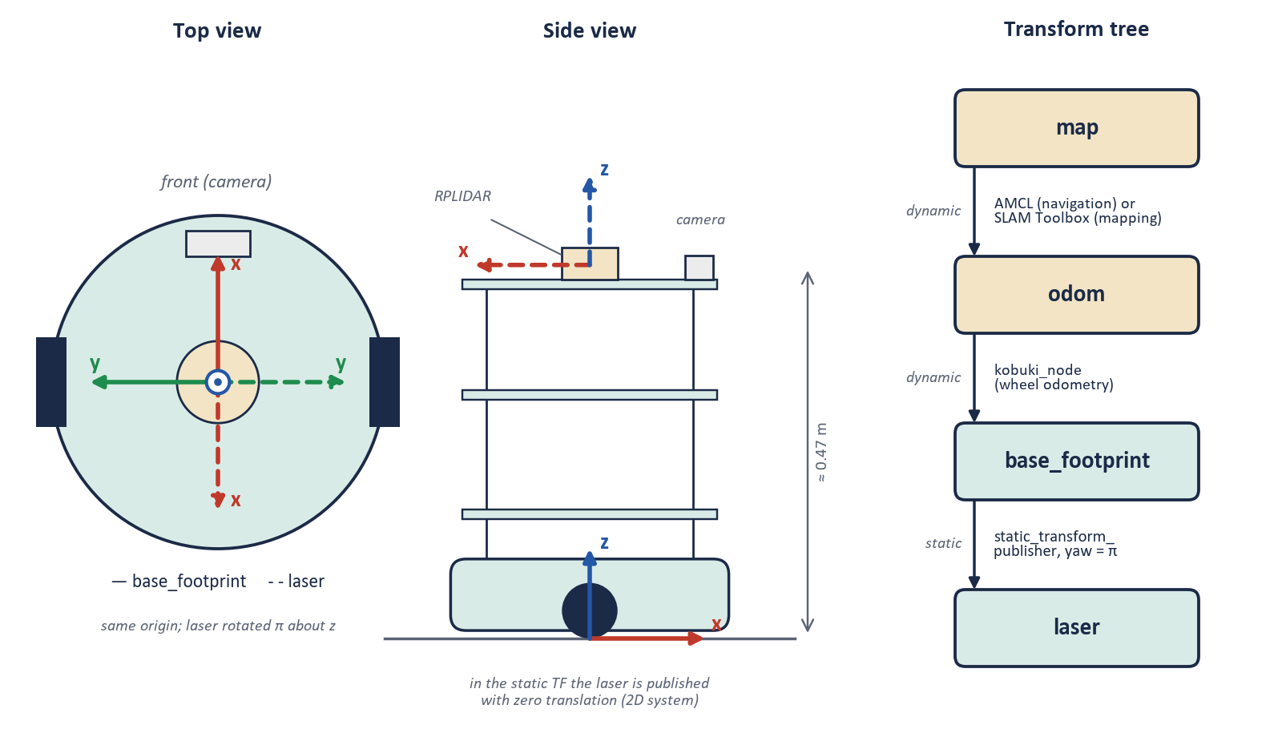
Reference frames (TF)
map → odom → base_footprint → laser; the LiDAR is mounted rotated 180° about z.
Notes:
Backup — use if asked about frames. map is the fixed frame; odom is continuous but drifts; base_footprint is attached to the robot (REP-103: x forward, y left, z up); laser is the LiDAR frame. base_footprint→laser is static with a 180° rotation about z, because the LiDAR is mounted rotated. odom→base_footprint comes from the Kobuki driver; map→odom from AMCL (navigation) or SLAM Toolbox (mapping).

Slide 21
Planning and cost estimate
Five phases, ≈ 350 h (14 ECTS); hardware already available in the lab.
Phase | Description | Period | Hours
1 | Definition, review of the prior system, initial drafting | May 2026 | 50
2 | Gestures, SLAM integration, sensor fusion | June 2026 | 80
3 | Autonomous navigation with Nav2 | July 2026 | 50
4 | Validation in the lab and “home” gesture | June–Sept. 2026 | 80
5 | Closing, report and defense | Aug.–Oct. 2026 | 90
Item (5 months of depreciation) | Cost
TurtleBot 2 (Kobuki + frame) | ≈ €83
RPLIDAR A2M8 | ≈ €32
Intel NUC | ≈ €33
RGB camera | ≈ €3
Software (open source) | €0
Personnel (350 h × €15/h) | €5,250
Approximate total | ≈ €5,400
Notes:
Backup — use if asked about planning or cost. Lab access was limited: sessions from May to July, none in August, a final session in September. Hardware was already in the lab: its cost is attributed by depreciation over five years, five months of use (8.3%). Personnel: 14 ECTS × 25 h ≈ 350 h at €15/h (junior engineer reference).

Slide 22
Use of AI tools (Appendix A)
Technical support; design, experiments and interpretation by the author.
Task | By the author | AI support
System architecture design | 90% | None
DBSCAN for leg detection | 90% | Debugging
Kalman filter (tracking_node) | 90% | None
control_node state machine | 90% | None
Package configuration errors | 60% | Diagnosis
Physical robot bring-up | 90% | Log diagnosis
Writing of the report | 70% | Rephrasing and style revision
Preparation of the figures | 40% | Design and drawing from code and recorded data
Experiments and validation | 100% | None
Notes:
Backup — use if asked about AI. AI tools were used as technical support: diagnosing ROS 2 errors and logs, code review, rephrasing and style revision of the report, and drawing the figures from the code and the recorded data. Architecture, design decisions, experiments and interpretation of the results are the author's.

