Slide 1
The Yield Curve as an Accurate Predictor of Economic Crises
By: Juan A. Javier
Class: Data Bootcamp
Professor: Mike Waugh

Slide 2
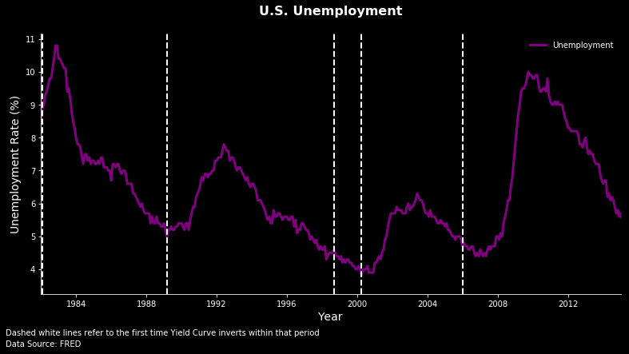

Slide 3
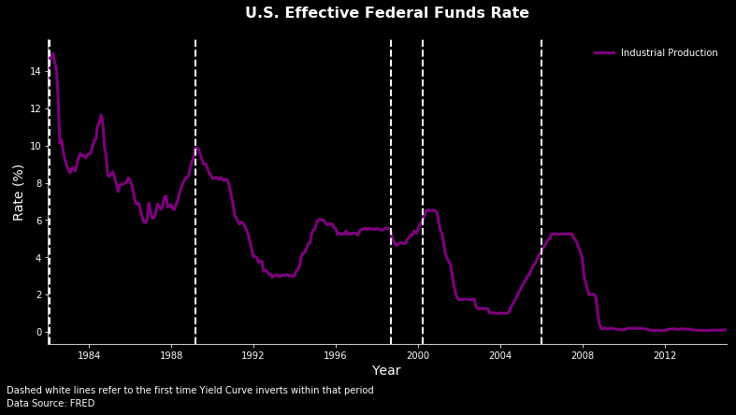

Slide 4
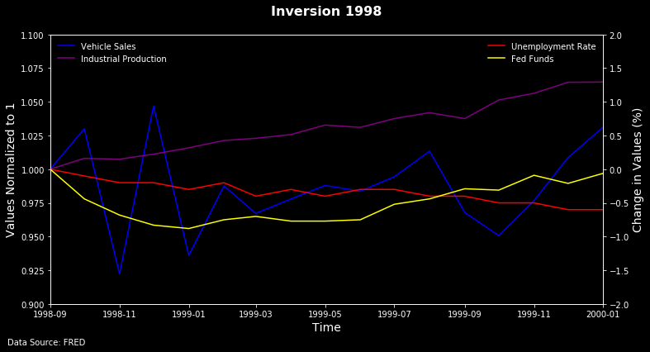

Slide 5
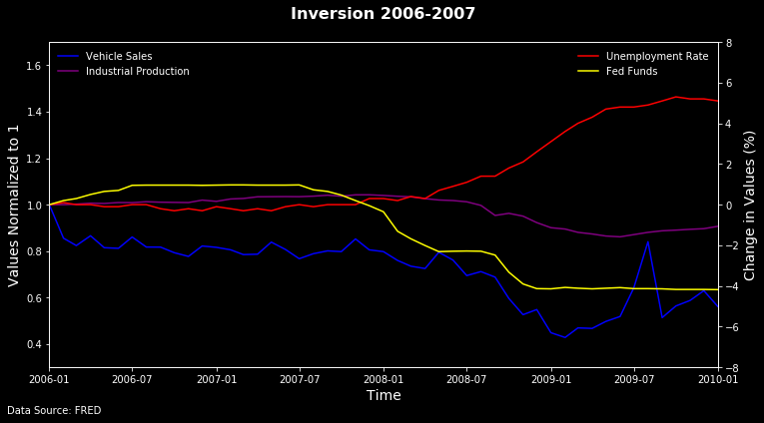

Slide 6
