Slide 1
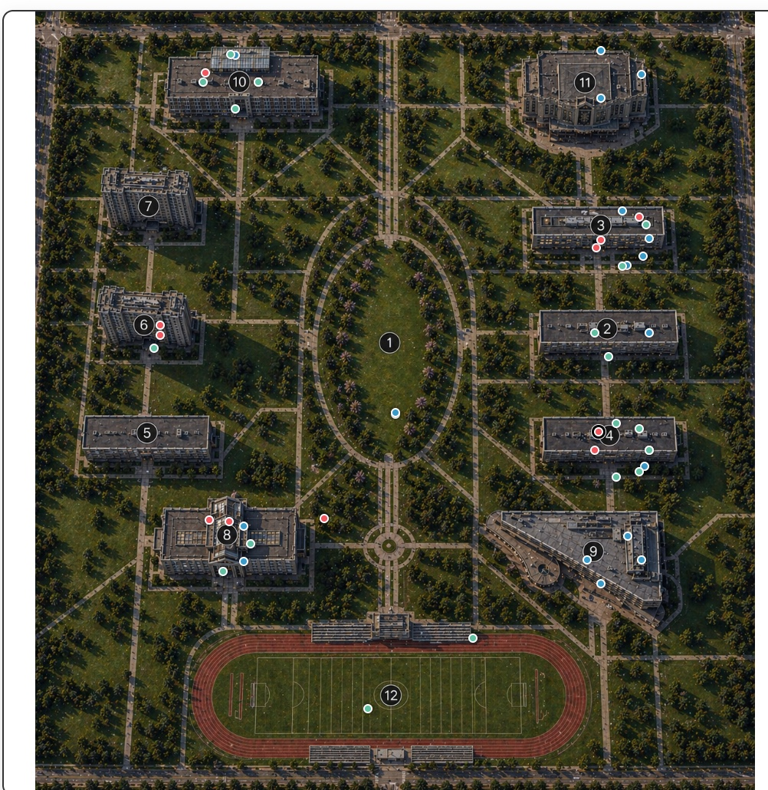
Final Project
Juan Barrera Professor Mark Voortman Advanced Topics in AI

Slide 2
Domain: AI-Driven Campus Simulation
A 50-agent university campus environment with explainable AI reasoning
Agents
The simulation creates 50 student agents with different profiles. Each agent has an ID, name, student type, housing location, personality, current location, expected location, and next destination.
Environment
Campus map with paths and buildings
Time slots from sleep to free time
Track practice and class obligations
Interaction
Ask agents natural-language questions
Issue polite commands
Inspect AI evidence and decisions
Goal: simulate, explain, and control autonomous student agents in a dynamic campus environment.
1/10

Slide 3
Specific Problems Being Solved
From location prediction to autonomous conversation and consequences
Where should each agent be during each time slot?
Where is the agent actually located, and is it rebelling?
Why did the agent choose this location instead of the expected one?
Who is nearby in the same location?
Should the agent obey a command or miss an obligation?
How can the system expose evidence from NLP, EM, utility, and Q-learning?
Key Output
Natural-language answer
Current and expected location
Rebel status
Attention weights
EM hidden mode
Q-learning recommendation
Decision consequences
2/10

Slide 4
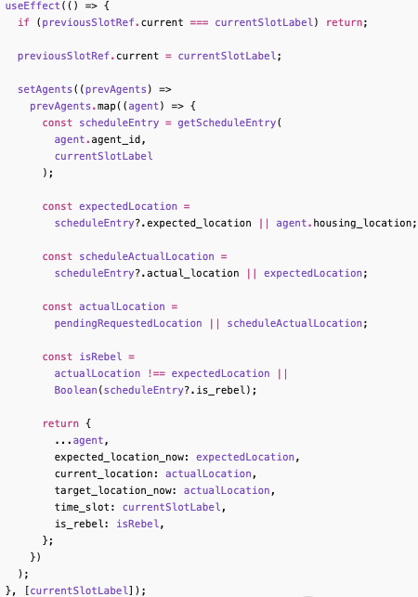
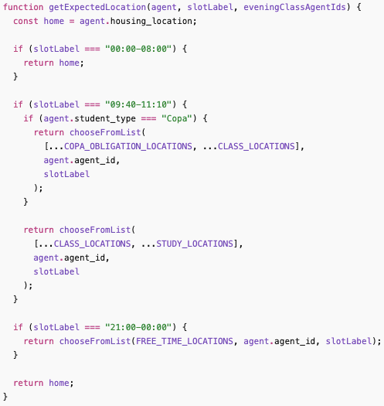
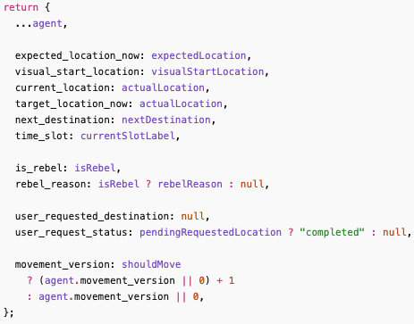
Temporal and Probabilistic Simulation
Chapter 15 - Probabilistic Reasoning over Time
Implemented
The project models the campus day as a sequence of time slots. Each time slot updates the state of every agent, including where the agent is expected to be, where the agent actually is, and where the agent should go next.
The code separates expected_location_now from current_location. This is important because an agent can be scheduled for one place but actually choose another.
Inputs
The temporal simulation uses the current simulation time as the main input. The time determines which slot is active, such as class time, practice time, evening, sleep, or free time.
Personality and autonomy introduce uncertainty because not every agent follows the expected schedule. A social, tired, responsible, or risk-taking agent may behave differently.
Outputs
For each time slot, the system outputs the agent’s current location, expected location, next destination, and rebel status.
These outputs are shown in the map, the selected agent panel, and the Rebel Agents list.
This makes the simulation temporal because the agent state changes over time, and probabilistic because the actual behavior can differ from the expected schedule.
3/10

Slide 5
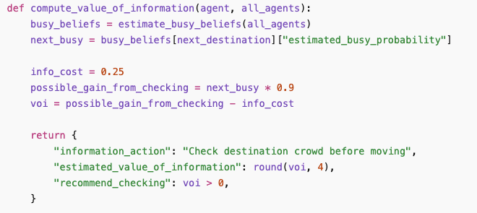
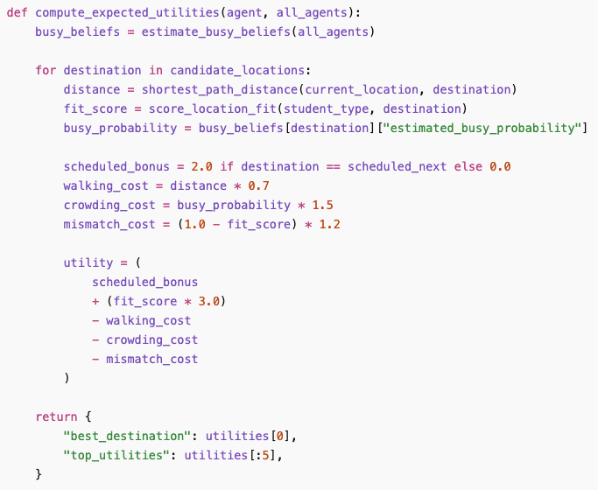
Utility, VOI, and Rational Decisions
Chapter 16 - Making Simple Decisions
Value of Information
Estimates whether checking a location is useful
Supports sensing/crowd-checking behavior
Appears in Campus AI Reasoning Evidence
The code also applies Value of Information by estimating whether it is useful for an agent to check more information before moving. In the project, this is connected to crowd-checking and sensing behavior.
Expected Utility
Compares destinations
Uses schedule fit, distance, crowding
Adds personality/location preferences
Explains why one destination is better
The code uses expected utility to compare possible destinations for an agent. Instead of choosing a location randomly, the Campus AI Reasoner scores destinations based on schedule fit, distance, crowding, and whether the location matches the agent’s type or personality.
4/10

Slide 6
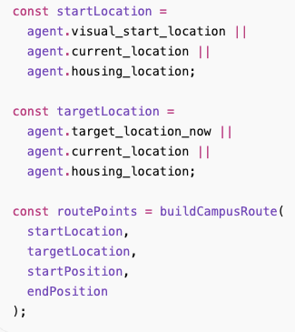
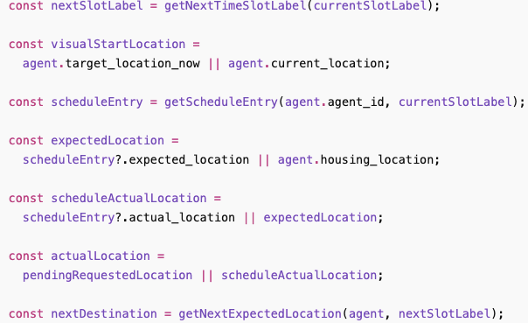
Sequential Decisions and Campus Movement
Chapter 17 - Making Complex Decisions
Agents move through a sequence of time slots.
The app tracks next destination and visual movement path.
Movement uses campus paths instead of straight-line teleporting.
Decision state includes current, expected, and target location.
Sequential State
State: time + location + obligation
Action: move, stay, follow, rebel
Transition: new location in next time slot
Outcome: alignment or rebel status
5/10

Slide 7
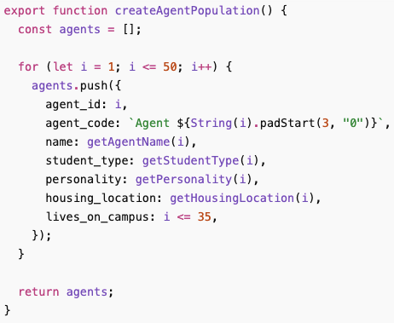
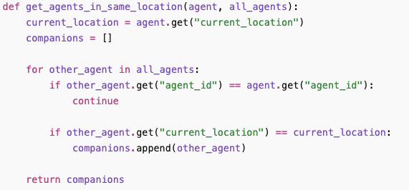
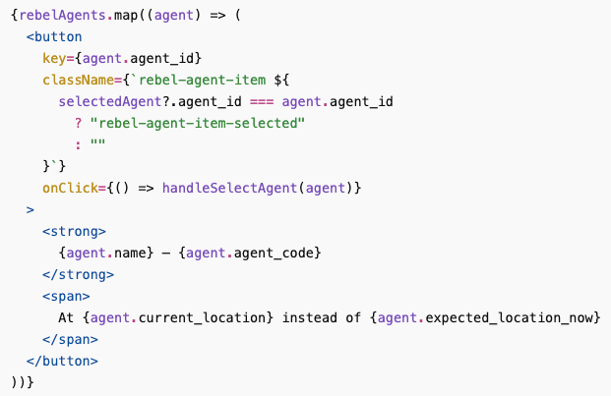
Multi-Agent Reasoning and Rebel Agents
Chapter 17.5 - Decisions with Multiple Agents
50 Agents
The agents are divided into athletes, COPA students, and regular students. Some live in dorms and others live off campus. This gives the simulation a realistic campus population instead of only one or two example agents.
At every time slot, the code updates each agent’s expected location based on its schedule and compares it with the actual location where the agent chose to be.
Social Awareness
The system checks which agents are currently in the same location. When the user asks “Who are you with?”, the backend searches the full list of agents and returns the names, agent IDs, and student types of nearby agents.
This means the selected agent is not answering alone. It is aware of the multi-agent environment around it.
Rebel Agents
A rebel agent is an agent whose actual location is different from its expected location. The code tracks this using expected_location_now, current_location, is_rebel, and rebel_reason.
Around 10%–15% of agents can deviate from their schedule depending on personality and time slot.
The Rebel Agents panel lists these agents under the map. When one is clicked, the same agent is selected on the map and in the agent information panel.
6/10

Slide 8
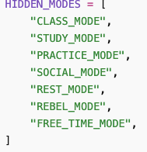
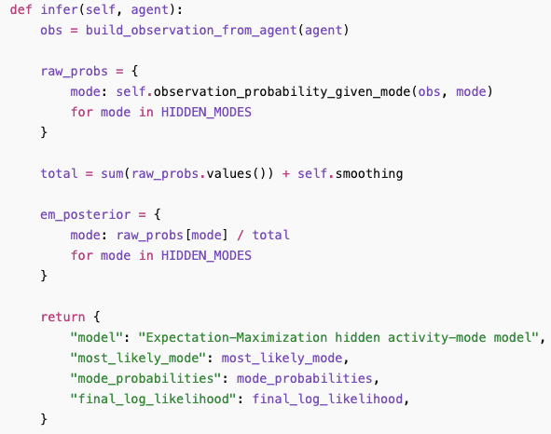
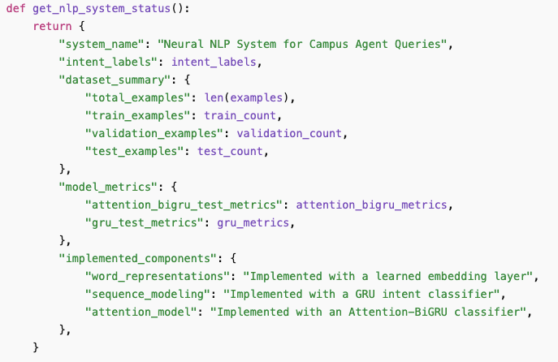
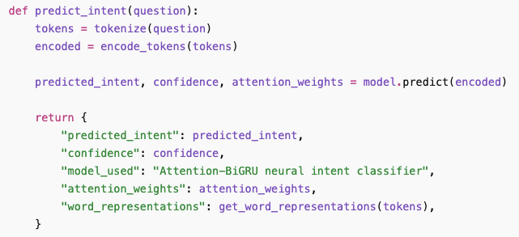
Supervised and Probabilistic Learning
Chapter 18 and Chapter 20
Supervised Learning
The project uses supervised learning in the neural NLP backend. The model is trained with labeled question examples, where each sentence is paired with an intent label such as identity_query, social_presence_query, miss_class_request, user_instruction, or destination_reason.
When the user asks a question, the backend classifies the text into one of these learned intent categories. The selected intent determines which reasoning path the agent uses to answer.
The system also reports confidence, attention weights, word representations, and model metrics.
Probabilistic Learning
The project uses probabilistic learning to estimate hidden activity modes and location behavior. The agent’s true internal state is not directly visible, so the system infers it from observed evidence such as time slot, current location, expected location, personality, student type, and rebel status.
The EM model estimates hidden modes such as CLASS_MODE, STUDY_MODE, PRACTICE_MODE, SOCIAL_MODE, REST_MODE, REBEL_MODE, and FREE_TIME_MODE.
Chapter 18
7/10

Slide 9
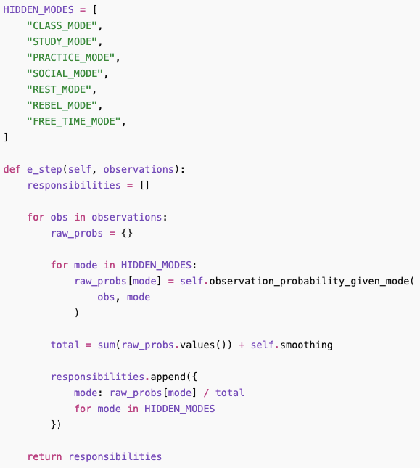
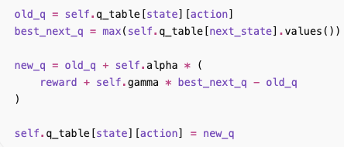
Module 6: EM and Q-Learning
Actual algorithm implementations for Chapters 20 and 21
Q-Learning Reinforcement Learning
This project implements Q-learning to recommend actions for an agent. The state includes the agent’s type, personality, time bucket, obligation status, rebel/aligned status, academic risk level, and missed-class level.
The reward function gives positive reward for following obligations and matching personality preferences. It gives penalties for missing obligations, rebelling during class or practice, and increasing academic risk. After training, the model returns learned Q-values and a recommended action.
EM Hidden Activity-Mode Model
This project implements an EM model to infer the agent’s hidden activity mode. The model is estimated from evidence such as current location, expected location, time slot, student type, personality, and rebel status.
The E-step estimates the probability that the agent belongs to each hidden mode: CLASS_MODE, STUDY_MODE, PRACTICE_MODE, SOCIAL_MODE, REST_MODE, REBEL_MODE, or FREE_TIME_MODE.
The M-step updates the categorical probabilities for those modes. The system returns the most likely mode, the probability distribution over all modes, the number of EM iterations, and the final log-likelihood.
8/10

Slide 10
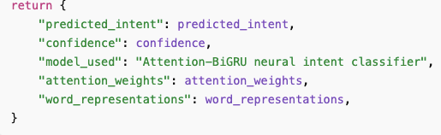
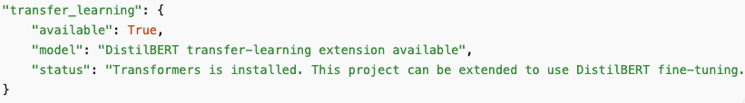
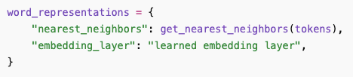
Module 7: Neural NLP, Attention, and Transfer Learning
Chapter 22 - NLP and Chapter 23 - Communication
Word Representations
The neural NLP backend converts user questions into tokens and learned vector representations. Instead of treating words only as plain text, the model uses an embedding layer so words with related meanings can be represented numerically.
The system also returns nearest-neighbor word evidence. This lets the user see which learned words are close to important tokens in the question.
This supports the agent conversation system because questions like “Where are you going?” or “Can we miss class?” must be transformed into representations before the model can classify the intent.
Sequence Modeling
The code uses a GRU-based neural intent classifier to process the question as a sequence of words. This matters because the meaning of a question depends on word order, not only individual words.
The Attention-BiGRU model reads the input in both directions and assigns attention weights to the most important tokens. For example, in “Can we miss class?”, words like “miss” and “class” should receive more attention.
Transfer Learning
The system includes a DistilBERT transfer-learning extension. This means the project is designed so a pretrained transformer model can be used for stronger language understanding.
In the current system, the status panel reports whether the transformer extension is available. This is important because transfer learning allows the project to move beyond a model trained only on the project’s small intent dataset.
the project includes transfer-learning capability, while the main active model used in the app is the neural intent classifier with embeddings, GRU, and attention.
9/10

Slide 11
Conclusion and Discussion
Are the problems solved?
Yes: the system simulates 50 agents across time and campus locations.
Yes: agents distinguish expected vs. actual location and explain deviations.
Yes: users can ask questions, issue commands, and continue conversations.
Yes: the app exposes actual AI evidence from NLP, EM, utility, VOI, and Q-learning.
Main limitation: the campus data is simulated; future work should use real schedule/sensor data.
The project works fully in the local environment. The live version was deployed with Netlify and Render, but the AI backend features time out because the backend uses heavy AI modules on a free Render instance. The local version is the complete reliable implementation. FrontEnd:
https://github.com/juanjbarreraj/AdvancedTopicsInAIFinalProjectFrontEnd BackEnd:
https://github.com/juanjbarreraj/AdvancedTopicsInAIFinalProjectBackEnd
Final Claim
The project is not only conceptually aligned. But it also implements AI implementations and concepts from the book. By integrating them into one interactive AI system.
Solved
10/10

