Slide 1
Taxi Cancellation
Prediction
Business Analytics Problem
Can R-based data mining models help identify taxi bookings likely to be cancelled?
Final Project | Applied Data Mining
Juan Barrera
Professor Patrick Maher
Key result: Boosting was strongest because it detected more cancellations than KNN or Decision Tree.

Slide 2
Project Purpose
From a taxi operations problem to a predictive analytics model
Taxi cancellations can create wasted driver time, inefficient dispatching, and lost revenue.
The goal is to predict whether a booking will be cancelled using historical booking data.
The real business value is identifying risky bookings, not only maximizing overall accuracy.
Operational implication
Use predictions to support confirmation calls, dispatch planning, and risk-based booking review.

Slide 3
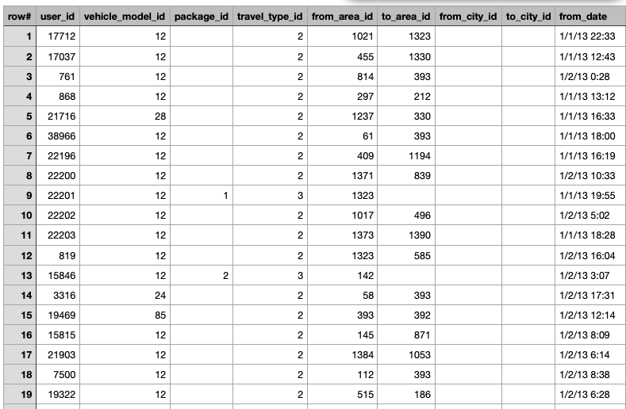
Data Overview
10,000 taxi booking records and a binary cancellation target
10,000
19
14
60 / 40
booking records
original variables
modeling variables
train / validation split
Target: Car_Cancellation (0 = not cancelled, 1 = cancelled).
Predictors included vehicle model, package, travel type, area IDs, booking channel, date/time features, and trip length.
Trip length was engineered from latitude and longitude coordinates.

Slide 4
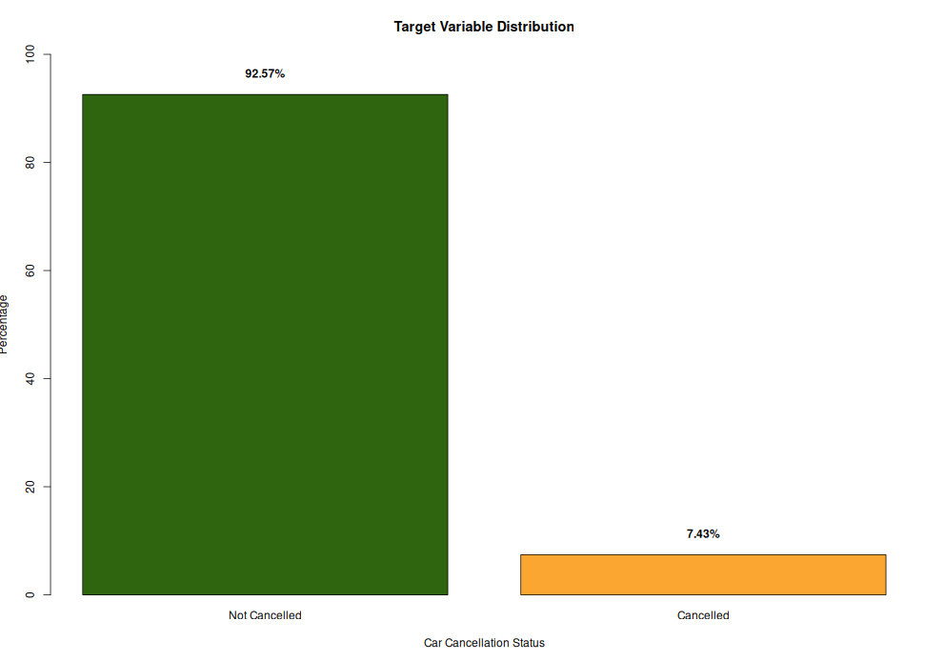
Main Data Challenge: Class Imbalance
Most bookings were not cancelled, so accuracy alone is misleading
92.57%
7.43%
not cancelled
cancelled
This imbalance means a model can look accurate by simply predicting “not cancelled” most of the time.
Accuracy must be interpreted with sensitivity, precision, F1 score, and gains charts.
The minority class is the business-critical class because cancellations drive operational waste.

Slide 5
Analytic Methods Used in R
Three main techniques plus one baseline attempt
Technique
Why it was used
K-Nearest Neighbors
Simple classification baseline using nearby records.
Decision Tree
Interpretable model that shows decision rules and splits.
Boosting
Ensemble model that combines weak learners to improve prediction.
Logistic Regression
Traditional baseline; failed due to factor-level issue.
Selected R packages: caret, gains, rpart, rpart.plot, and adabag.

Slide 6
Model Comparison Results
Boosting performed best overall because it improved cancellation detection
Model
Accuracy
Sensitivity
Specificity
Precision
F1
KNN
0.9212
0.0063
0.9995
0.5000
0.0125
Decision Tree
0.9212
0.0000
1.0000
NA
NA
Boosting
0.9232
0.1206
0.9919
0.5588
0.1984
Logistic Regression
NA
NA
NA
NA
NA
KNN and Decision Tree had high accuracy but almost no cancellation detection.
Boosting had the best accuracy, sensitivity, precision, and F1 score among working models.
Logistic Regression failed because the validation data had a vehicle_model_id level not seen in training.

Slide 7

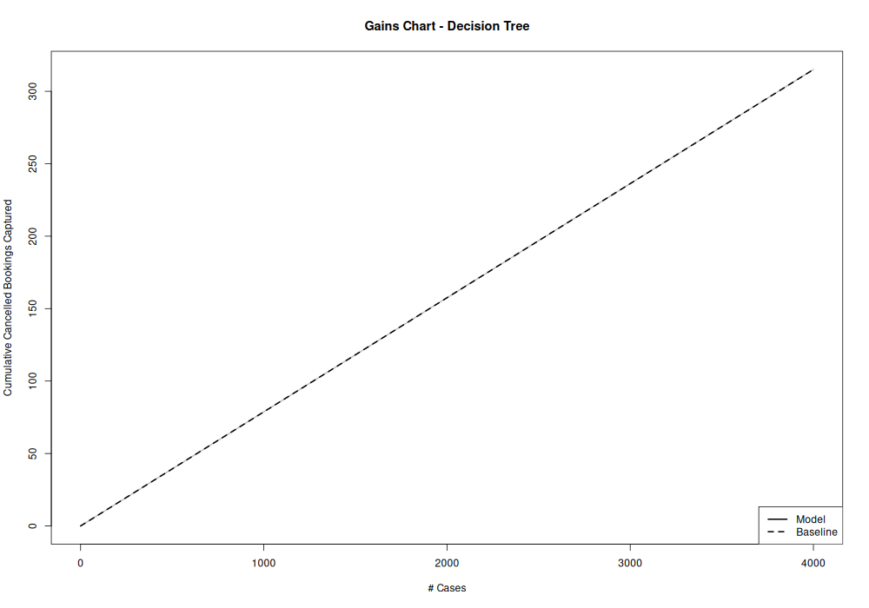
Decision Tree Finding
The tree did not create useful splits after pruning.
It predicted the majority class: 0 = not cancelled.
Accuracy was 92.12%, but sensitivity was 0.0000.
This proves accuracy alone is misleading for this dataset.
The pruned tree collapsed into a majority-class prediction

Slide 8
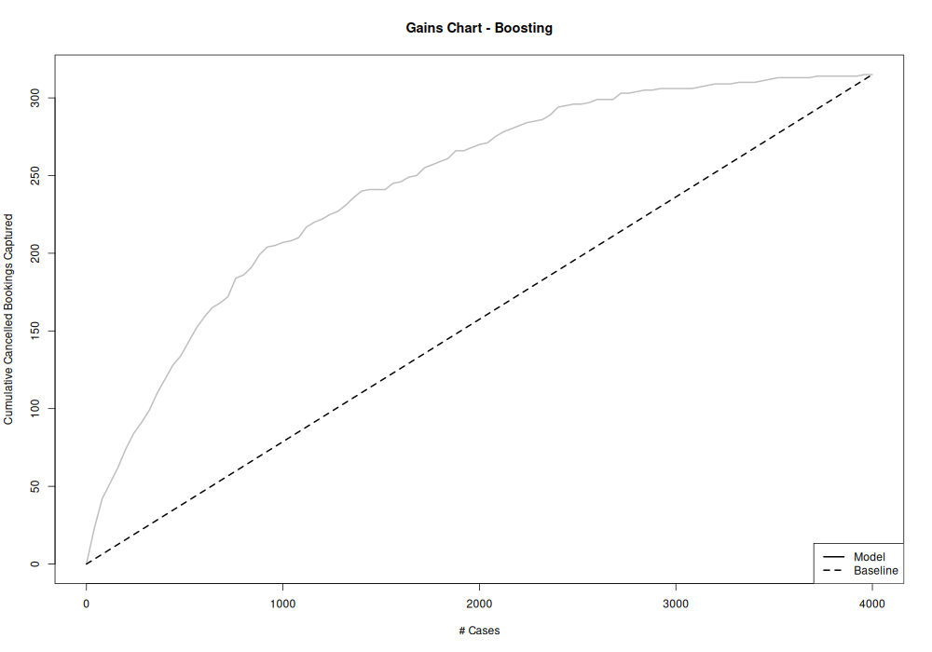
Best Model: Boosting
Boosting ranked cancellation-risk cases better than the baseline
92.32%
12.06%
0.1984
accuracy
sensitivity
F1 score
Correctly identified 38 of 315 actual cancellations in validation data.
Performed above the baseline in the gains chart.
Important predictors included trip_length, vehicle_model_id, from_area_id, booking_created_DOW, to_area_id, from_date_Hour, and online_booking.

Slide 9
Business Implications
How the findings could support taxi operations
Use Boosting to rank bookings by cancellation risk.
Prioritize confirmation calls or additional verification for high-risk bookings.
Use risk scores to improve driver allocation and reduce wasted dispatches.
Evaluate models with sensitivity and gains charts, not just accuracy.
Future work should test resampling, cost-sensitive models, and adjusted probability thresholds.
Recommendation
Use Boosting as the preferred starting model, but continue improving cancellation detection before operational deployment.

Slide 10
Conclusion
The strongest insight is about evaluation, not just prediction
Main conclusion
Key lesson
Boosting was the strongest model because it had the best accuracy, sensitivity, precision, F1 score, and gains chart performance among the working methods.
Because cancellations were only 7.43% of the data, accuracy alone hid weak model performance. Sensitivity and gains charts revealed the real story.
Final takeaway: predictive analytics can support taxi cancellation planning, but the model must be evaluated around the business goal of detecting actual cancellations.

