Slide 1
RetailMax
Business Analytics Report
REVENUE $13.9M
Profitability analysis across 25 regional stores
PROFIT $3.9M
Key question: sales increased, but profitability is under pressure. Where can RetailMax protect margin and improve store execution?
MARGIN 28.4%
Prepared by Juan José Barrera
Masters Information Systems Professor Jeffrey Seaman

Slide 2
Executive Summary
RetailMax performance overview
TOTAL REVENUE $13.9M
TOTAL PROFIT $3.9M
PROFIT MARGIN 28.4%
AVG SATISFACTION 3.85
Revenue rose sharply Revenue grew 108.7% from January to December, with the strongest regional performance in the West and South.
Margin pressure is visible Margin declined from 32.5% in January to 22.9% in December, even as holiday sales increased.
Execution gaps remain Detroit RM-12 has the lowest satisfaction at 3.25, while Seattle RM-16 leads at 4.64.
Monthly Revenue Trend
Monthly Margin Trend
RetailMax Analytics | 2

Slide 3
Data Exploration: Revenue Leaders
Which stores and regions generated the highest revenue?
Revenue by Region
Top Revenue Stores
West generated the most revenue at $3.2M.
Seattle RM-16 is the highest-revenue store at $731K.
Revenue momentum is seasonal: November and December are the strongest months.
Interpretation RetailMax should not only chase revenue volume. High revenue is valuable, but the core issue is preserving margin during demand spikes and copying practices from high-performing stores.
RetailMax Analytics | 3

Slide 4
Profitability Analysis
Which categories perform best and worst?
Profit by Product Category
Margin by Product Category
Finding Grocery creates volume but very little profit. Marketing should prioritize higher-margin baskets instead of blanket discounting.
BEST MARGIN Beauty 49.9%
HIGHEST PROFIT Electronics $1.1M
WORST MARGIN Grocery 7.8%
RetailMax Analytics | 4

Slide 5
Customer and Operational Performance
Satisfaction and sales-per-employee insights
Lowest Satisfaction Stores
Sales per Employee by Region
Customer insight Detroit RM-12 and Buffalo RM-04 are the clearest service improvement targets based on satisfaction scores.
Operational insight Average sales per employee is $2K. Regions above this benchmark can guide process improvements.
Action lens Pair store coaching with merchandising and staffing analysis so recommendations improve both customer experience and profitability.
RetailMax Analytics | 5

Slide 6
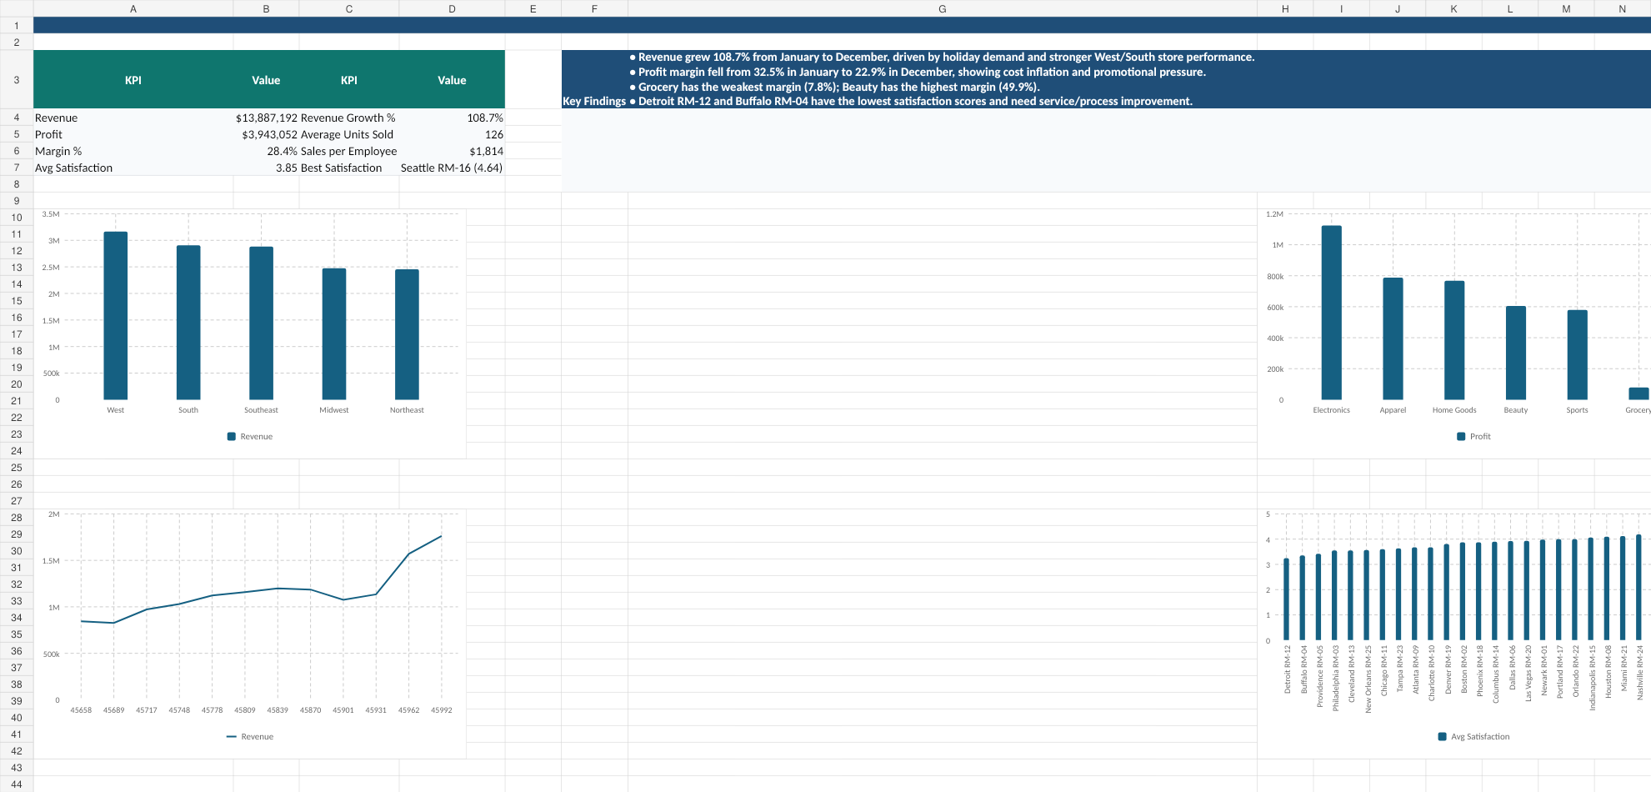
Dashboard Created in Excel Workbook
Required visualizations and KPI summary
The workbook includes raw data, cleaning formulas, pivot-table-style summaries, KPI calculations, charts, dashboard, and recommendations.
RetailMax Analytics | 6

Slide 7
Recommendations and Conclusion
Data-supported actions to improve profitability
Focus marketing on high-margin categories Beauty margin is 49.9%; Grocery margin is only 7.8%. Prioritize higher-margin bundles and reduce broad discounting.
1
Investigate low-satisfaction stores Detroit RM-12 scored 3.25, the lowest in the network. Audit staffing, checkout wait times, inventory issues, and service training.
2
Protect margins during seasonal spikes December had the highest revenue ($1.8M) but margin dropped to 22.9%. Use targeted promotions and vendor negotiation before peak months.
3
Conclusion: Analytics helps RetailMax identify where growth is profitable, where costs are eroding margin, and which stores need operational support.
RetailMax Analytics | 7

