Slide 1
Using Decision Support Systems to Make a Business Decision
Scenario: New Store Location Selection
Prepared by Juan Barrera
Professor Jeffrey Seaman
Decision output
3-year NPV
Risk view
SouthSide
$213K
3 scenarios
highest NPV + score
expected case
best / expected / worst
Decision Support Systems Assignment | New Store Location Selection
1

Slide 2
Part 1: Decision Problem Analysis
Management must choose the location with the best return and acceptable risk.
Business problem
Why it matters
Select one new store site from three alternatives while balancing demand potential, fixed costs, competition, and profitability.
A location decision locks in rent, staffing, opening cost, and brand exposure for multiple years. The wrong choice can create permanent fixed-cost pressure.
Stakeholders
Variables included in the DSS model
Group
Decision need
Executives
Growth and strategic fit
Rent
Population
Finance
Positive ROI and NPV
Traffic
Competition
Operations
Efficient staffing and launch readiness
Opening cost
Avg ticket
Marketing
Visible market and acquisition potential
Gross margin
Conversion
Customers
Convenient access and service quality
Staffing
Marketing
Decision Support Systems Assignment | New Store Location Selection
2

Slide 3
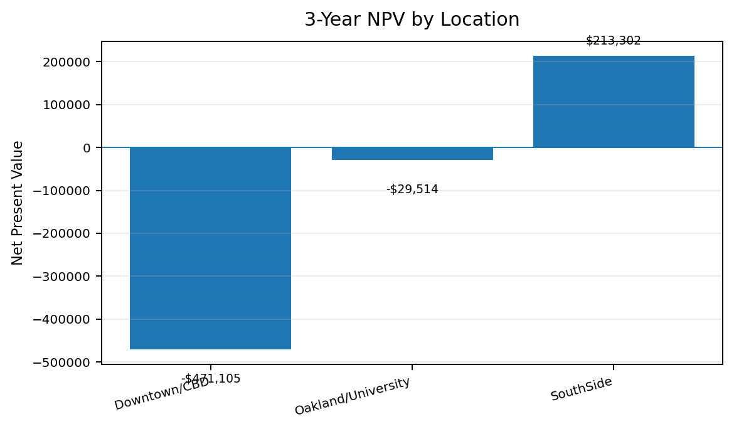
Part 2: Data Analysis Model
The workbook turns market assumptions into expected profit, NPV, and a weighted score.
Location
Rent
Traffic
Comp.
Revenue
Monthly Profit
3-Year NPV
Score
Downtown/CBD
$18,000
23,000
12
$120,837
-$8,414
-$471,105
37.2
Oakland/University
$13,500
18,000
8
$116,184
$5,210
-$29,514
49.6
SouthSide
$11,500
21,000
10
$120,923
$12,844
$213,302
79.0
Decision logic
Estimate demand from population, traffic, conversion, and competition penalty.
Calculate revenue, gross profit, operating cost, profit, and 3-year NPV.
Rank alternatives using a weighted score across financial and market variables.
Best NPV
Best score
SouthSide
79.0
$213K over 3 years
composite ranking
Decision Support Systems Assignment | New Store Location Selection
3

Slide 4
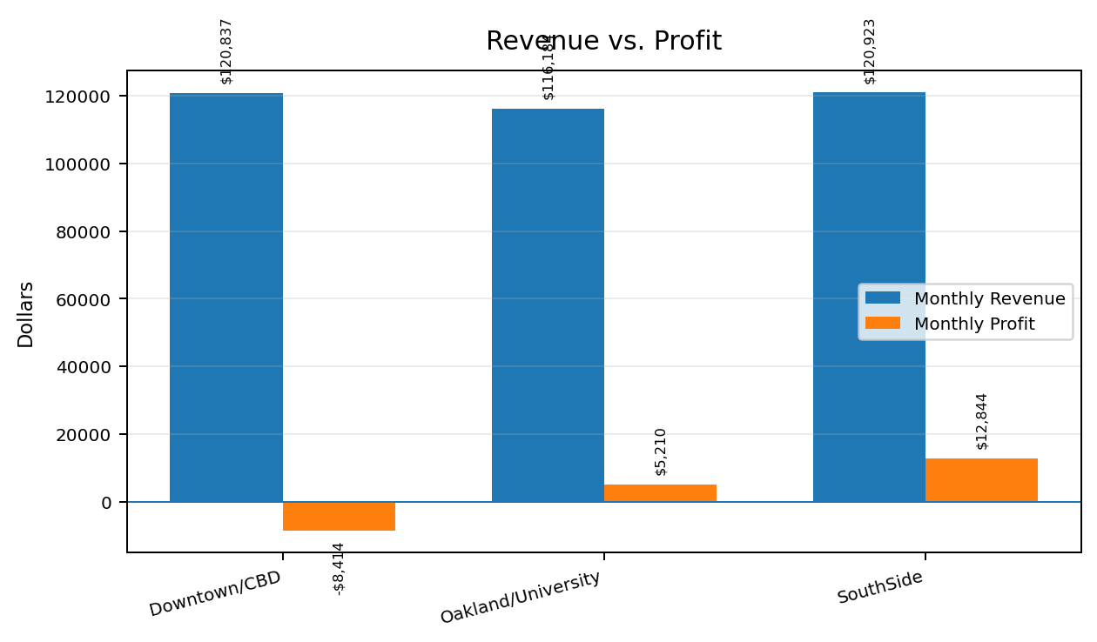
Financial Finding: SouthSide Creates Value
Revenue is similar across the top choices, but cost structure separates the winner.
What the chart means
SouthSide and Downtown/CBD have similar expected revenue, but SouthSide turns that revenue into profit because rent and operating costs are lower.
SouthSide revenue
$120,923
expected monthly sales
SouthSide profit
$12,844
expected monthly profit
Result: choose profit quality, not only top-line revenue.
Decision Support Systems Assignment | New Store Location Selection
4

Slide 5
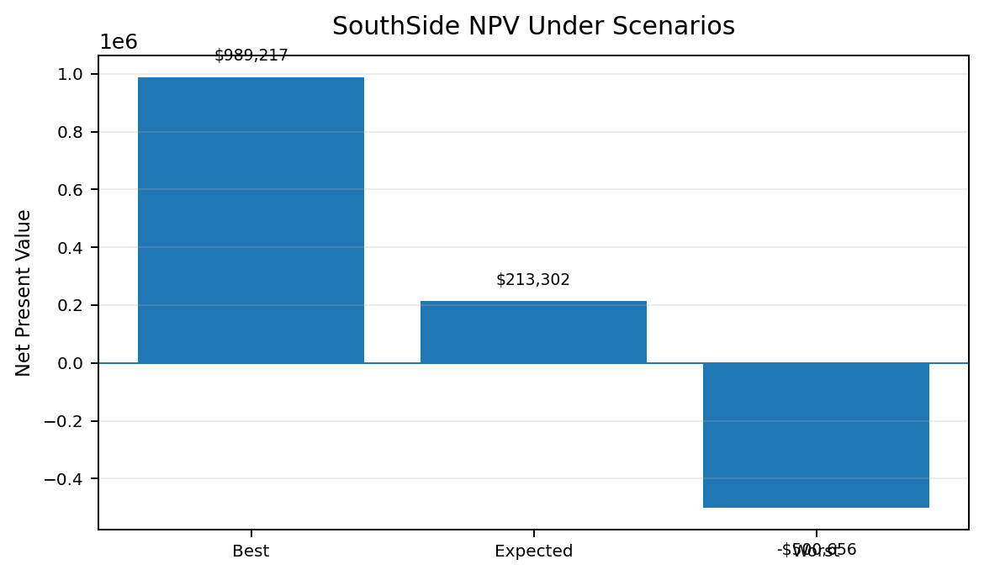
Part 3: Scenario Evaluation
Best, expected, and worst cases stress-test the SouthSide recommendation.
Scenario
Key assumptions
Monthly Profit
3-Year NPV
Best Case
Traffic +15%; conversion +12%; margin +2 pts; one fewer competitor
$38,845
$989,217
Expected Case
Base forecast assumptions
$12,844
$213,302
Worst Case
Traffic -15%; conversion -12%; rent +7%; margin -3 pts; two more competitors
-$11,080
-$500,656
Risk interpretation
The expected case is financially attractive, but the worst case is a material risk. Management should negotiate flexible lease terms, validate demand, and monitor conversion before final commitment.
Expected case
Worst case
$213K NPV
-$501K NPV
go-forward base case
risk to mitigate
Decision Support Systems Assignment | New Store Location Selection
5

Slide 6
Goal Seek and Solver Outputs
The DSS identifies the break-even revenue target and efficient staffing level.
Goal Seek result
Expected revenue
Revenue cushion
$108,808
$120,923
$12,115
monthly revenue needed for NPV = 0
monthly forecast for SouthSide
expected revenue above break-even
Solver-style staffing logic
Input / result
Value
Purpose
Proceed only if revenue stays above break-even and the staffing plan can cover the projected customer load.
Projected customers
5,258/month
Expected demand to serve
Capacity per employee
250/month
Staffing productivity assumption
Minimum employees
22
Smallest feasible staffing level
Optimized monthly profit
$12,844
Profit after efficient staffing
Decision checkpoint: revenue forecast has an 11.1% cushion above the break-even target.
Decision Support Systems Assignment | New Store Location Selection
6

Slide 7
Part 4: Recommendation
Open SouthSide, with risk controls before final lease commitment.
Recommended decision
Potential limitations
Open the SouthSide location.
Limitation
Mitigation
Demand estimates
Validate foot traffic and conversion with field checks
Data justification
Lease risk
Negotiate rent escalators and exit terms
SouthSide is the only option with a clearly positive three-year NPV, the highest expected monthly profit, the lowest rent, and the strongest weighted score.
Competition
Update competitor count before signing
Operating assumptions
Replace model inputs with actual company benchmarks
Next actions
Final rule
1) Verify site data. 2) Negotiate lease. 3) Finalize staffing plan. 4) Launch with KPI monitoring.
Proceed
if validation supports expected-case inputs
Decision Support Systems Assignment | New Store Location Selection
7

