Slide 1


GROUP 2
WEATHER
FORECASTING
MATTHEW BUILES
BRENDAN RYAN
TANNER JACKSON JUAN GARCIA

Slide 2

OUR GOALS
ROADMAP:
1
2
3
Predict wind speed accurately
Identify what constitutes high damage
Predict low-risk pricing while maximizing profits

Slide 3
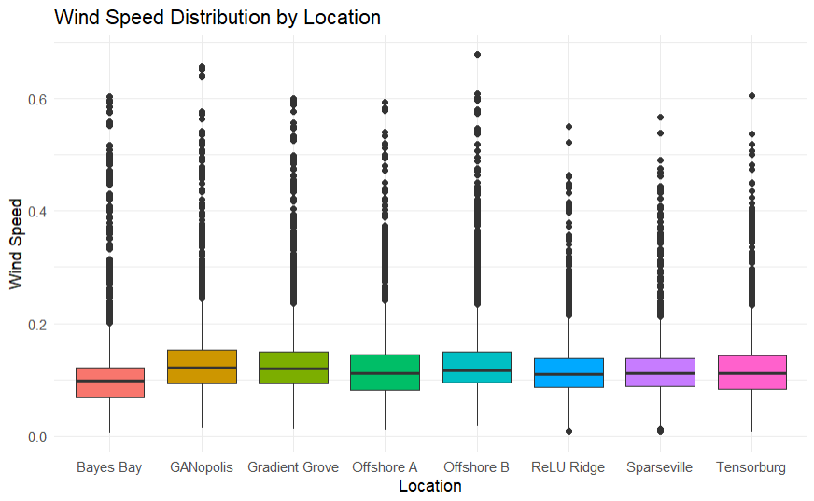
FIRST WERE TAKING A LOOK AT OUTLIERS IN THE WINDSPEED DISTRIBUTION TO DECIDE HOW TO PREPROCESS DATA

Slide 4

XGBOOST
XGBoost was a simple method to acheive accurate wind speed results with an R^2 of over .99. The only problem with this is that the model is better suited for estimating using time-adjacent data rather then predicting future values.

Slide 5
WHAT ARE BETTER SEQUENCE
BASED ALTERNATIVES?

Slide 6
LSTM
LSTM is an advanced version of a recurrent neural network with more advanced tuning features that allowed us to better predict windspeed for the next 5 days based on the previous 5 days.

Slide 7
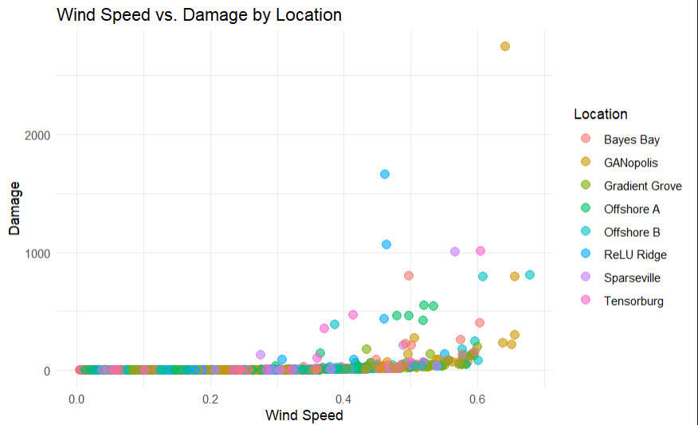
NOW, WE ARE PLOTTING WINDSPEED VS DAMAGE TO FIND A CORRELATION THAT WE CAN USE FOR OUR PRICING.

Slide 8
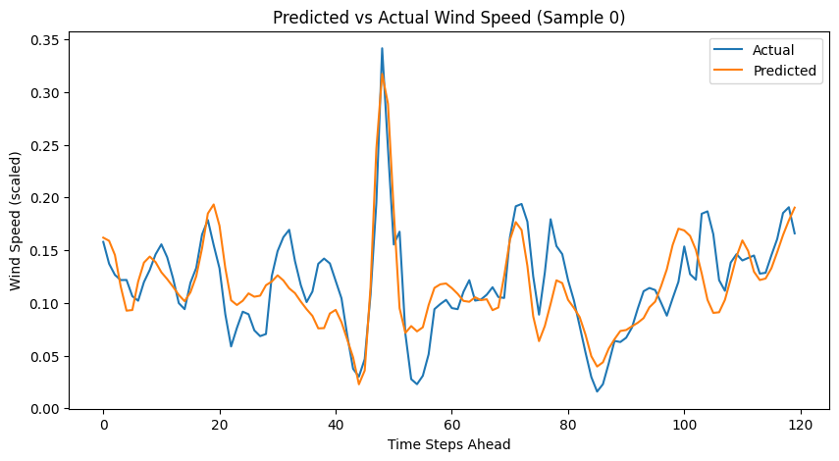
TESTING ACCURACY COMPARISON GRAPH

Slide 9
OUR PRICING MODEL

Slide 10
SUNNY
We consider sunny hour to be any hour where the wind speed is below .4.

Slide 11
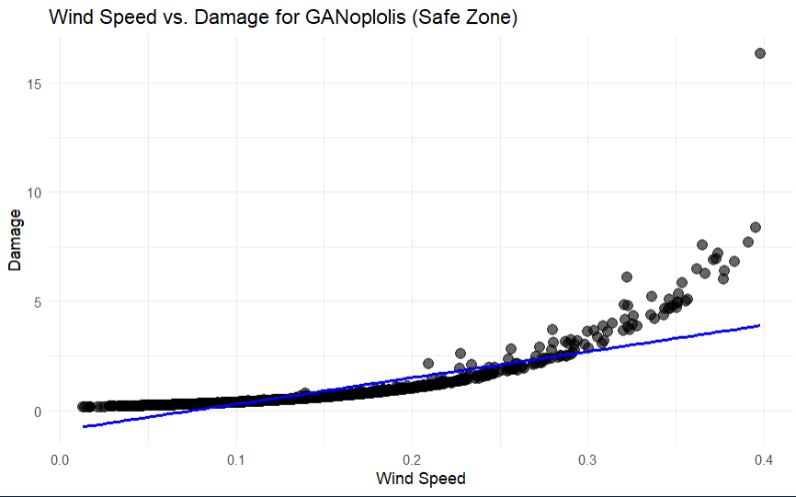

Slide 12

WINDY
A windy hour is any hour where the wind speed is below .4.

Slide 13
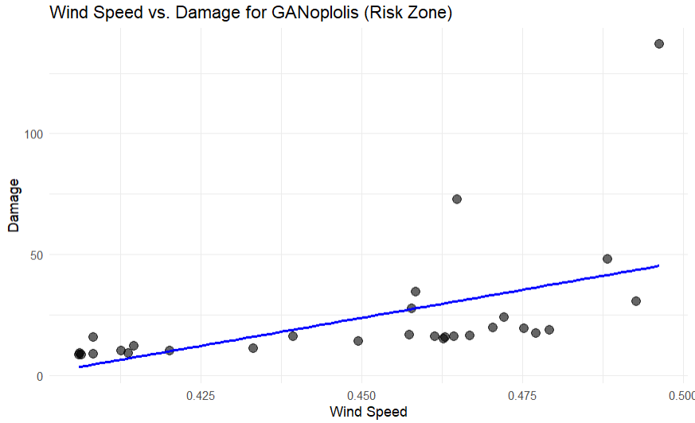

Slide 14

STORMY
A stormy hour is any hour where the wind speed is above .5.

Slide 15
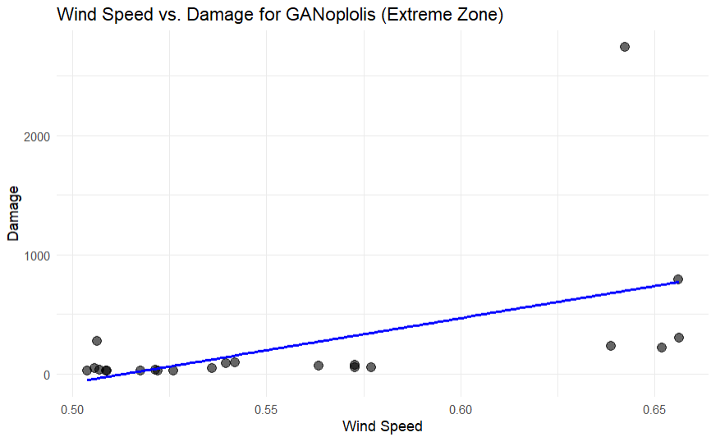

Slide 16
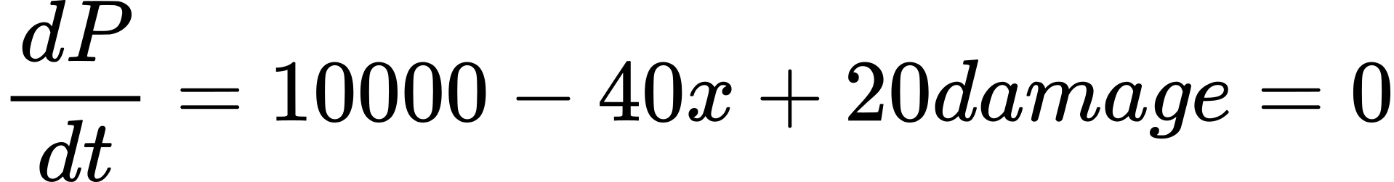
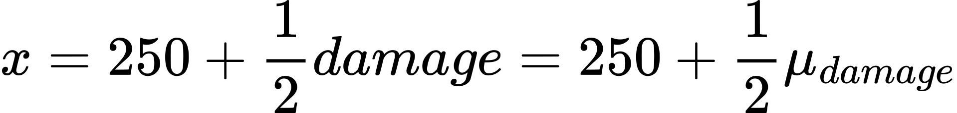

Slide 17
FUTURE
IMPROVEMENTS
Geospatial Location - Using the modeling of wind speeds at certain coordinates (cities) in order to better model weather in GANopolis.
Exponential regression functions - Using an exponential regression function that better matches the damage rather than using “blocks”.
Predicting damage with ML Model - Rather than using regression all together, we train an ML model to predict damage based on values other than wind speed.

Slide 18

INSACORP’S INTERESTS
How well do Machine Learning (ML) models perform at surrogate modeling of climate models?
What is the role of insurance pricing models - should they be integrated in the same model as the surrogate model or a separate model in the pipeline?
What price will be robust to catastrophic events
Over what time horizons do ML model representations of surrogate models break down?

Slide 19
THANK YOU
FOR LISTENING!

