Slide 1
Chapter 1
Part 1 (pgs. 1-8)
Adapted from Nicole Rodriguez

Slide 2
Objectives
General Introduction to the course Cognates
Gender and Gender Agreements Plurals and Number Agreement

Slide 3
General Introduction
Spanish for Reading Knowledge
After reading the syllabus, you should know that the goal of this course is to help you acquire reading skills in Spanish
This may seem daunting at first, but with tools, strategies, and practice, it will be easy.
For example:
Read the following short paragraph in Latin and see if you can understand it.

Slide 4
Recitā, respondē, surge, cōnsīde, dīc, venī.
Quid facis? Recitō. Quid faciō? Recitās. Quid facit?
Recitat.

Slide 5
Easy? Hard?

Slide 6
Cognates
(I’m sure you used these to get through the last activity)
Cognates are words with similar spellings and meaning that exist in both languages
They give you an immediate working vocabulary
Examples:
English | Spanish
April | abril
adventure | aventura
biography | biografía
montana | montaña

Slide 7
Cognates
Cont.
There are also partial cognates and false cognates
Spanish | English
lengua | language | but also | tongue
idioma | idiom | but also | language
mayor | major | but also | older
único | unique | but also | only
Spanish | English
actual | at this moment | NOT | “actual”
realizar | to achieve | NOT | “to become aware of”
lectura | reading | NOT | “lecture”
librería | bookstore | NOT | “library”

Slide 8

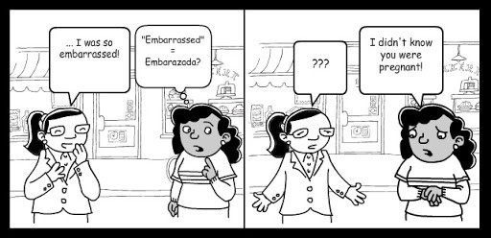
For cognates: remember that you should learn to take advantage of true cognates and to be alert to the presence of false or partial cognates.

Slide 9
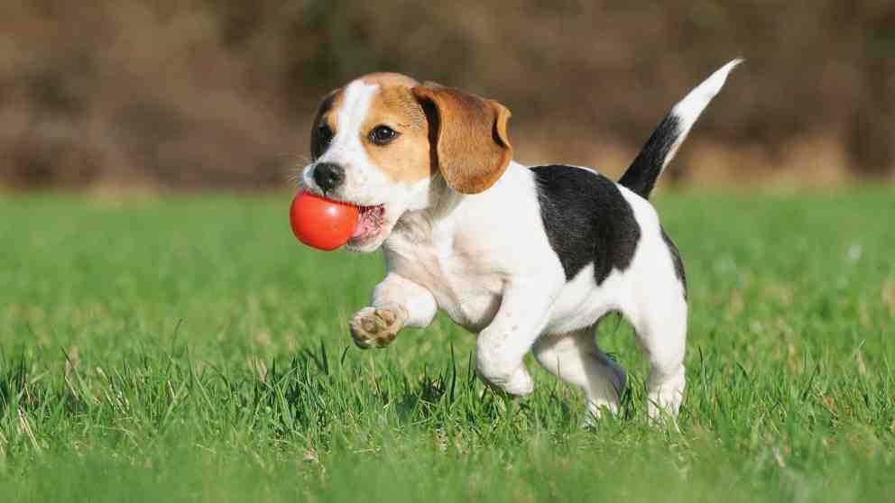
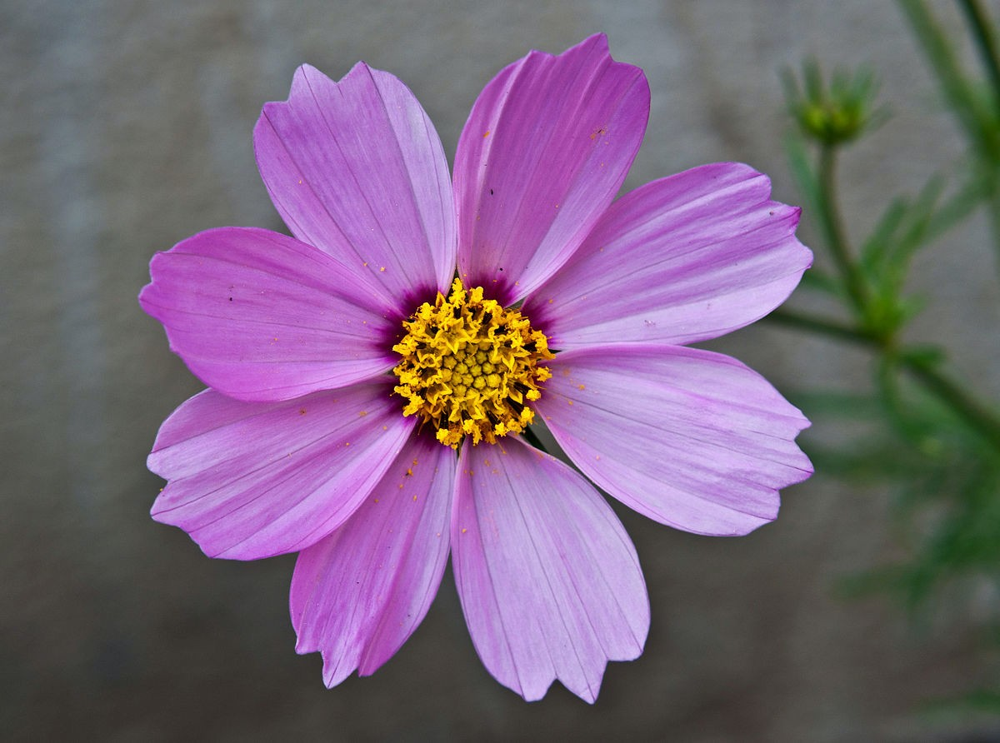
Gender and Gender Agreement
Nouns
Spanish nouns are either masculine or feminine
they are preceded by definite (el, la, los, las (the)) or indefinite pronouns (un, una, unos, unas (a, some)).
El and un are for singular masculine nouns: el/un perro
La and una are for singular feminine nouns: la/una flor

Slide 10
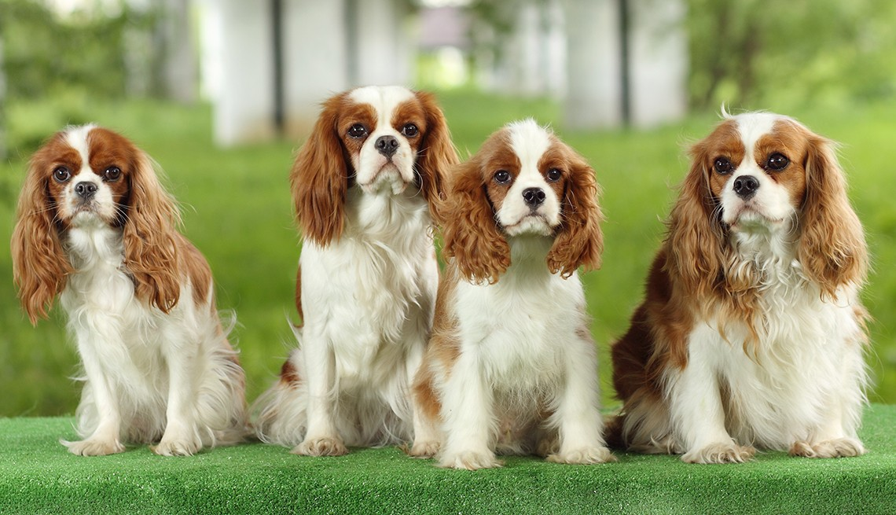
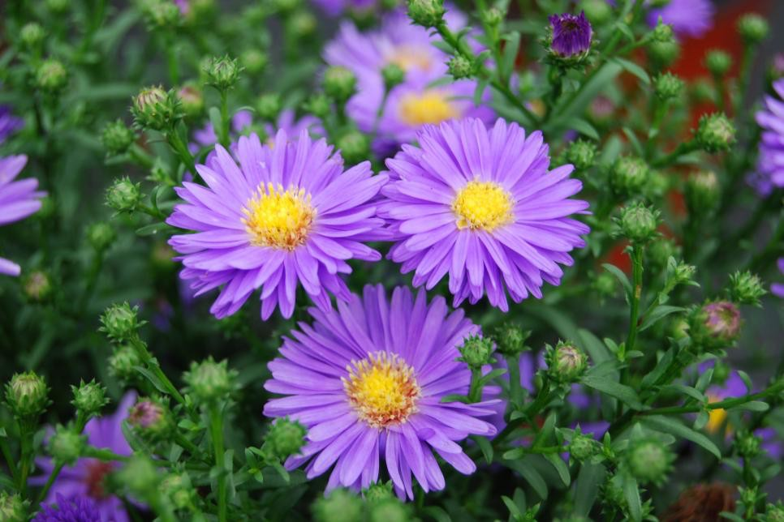
Plurals and Number Agreement
Nouns
Spanish nouns also need agreement in number
Look at the following examples:
Los and unos are for plural masculine nouns: los/unos perros
Las and unas are for plural feminine nouns: las/unas flores
When the noun gets pluralized (normally with an
-s or -es ending) the definite
(los/las) or indefinite pronoun (unos/unas) needs to agree with the noun.

Slide 11
Nouns
There are a number of Spanish and English nouns that end in -al, -ion, -or,
-sis have identical or nearly identical spellings and meanings
Examples: experimental, región, vapor, crisis

Slide 12
Nouns
Continued
There are also other groups of words that have characteristic patterns that make them easily identifiable
-ancia | Usually corresponds to | -ance, -ancy
-ante | Usually corresponds to | -ant
-ción | Usually corresponds to | -tion
-encia | Usually corresponds to | -ence, -ency
-ente | Usually corresponds to | -ent
-io, -ía, -ia | Usually corresponds to | -y
-ura | Usually corresponds to | -ure
-mente | Usually corresponds to | -ment

Slide 13
Nouns
Continued
Here are some examples:
Ending | Spanish | English
-ancia | una distancia | a distance
-ante | el instante | the instant
-ción | una nación | a nation
-encia | la evidencia | the evidence
Ending | Spanish | English
-ente | los continentes | the continents
-io, ía, ia | el contrario | the contrary
-ura | la literatura | the literature
-mento | el compartimento | the compartment

Slide 14

After reviewing this ppt:
Practice Test
Go to this course’s canvas site
Click on “Quizzes”
Take the Practice Test labeled: “Practice Test 1”

