Slide 1
Chapter 1
Part 2
Spanish for Reading Knowledge: Summer 2020 - Nicole Rodriguez

Slide 2
Objectives
Gender and Gender Agreements
Plurals and Number Agreement
The Articles
Adjectives
Adverbs
Personal Pronouns
The Verb “ser”
Prepositions
Conjunctions

Slide 3
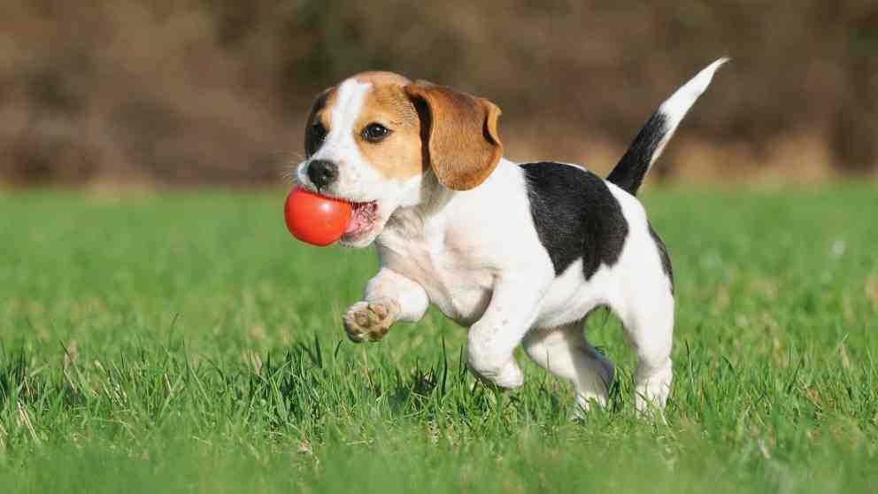

Gender and Gender Agreement
Nouns
Spanish nouns are either masculine or feminine
they are preceded by definite (el, la, los, las (the)) or indefinite pronouns (un, una, unos, unas (a, some)).
El and un are for singular masculine nouns: el/un perro
La and una are for singular feminine nouns: la/una flor

Slide 4
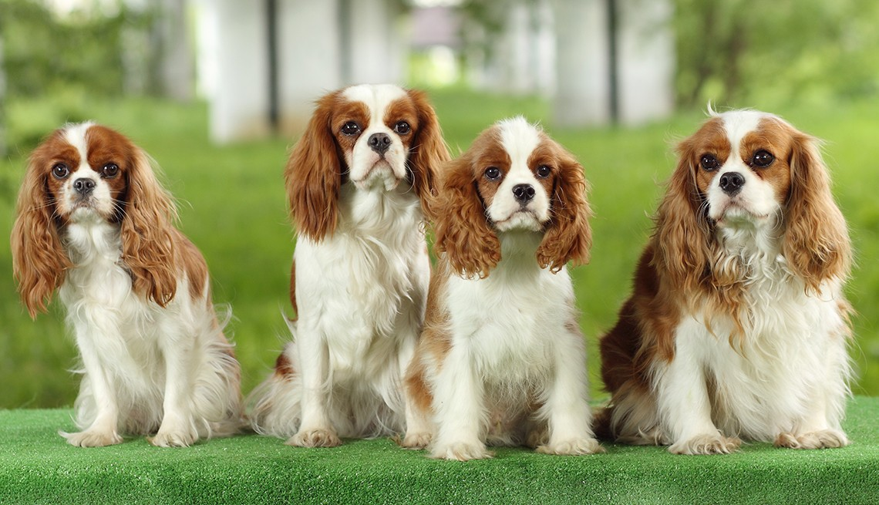

Plurals and Number Agreement
Nouns
Spanish nouns also need agreement in number
Look at the following examples:
Los and unos are for plural masculine nouns: los/unos perros
Las and unas are for plural feminine nouns: las/unas flores
When the noun gets pluralized (normally with an
-s or -es ending) the definite
(los/las) or indefinite pronoun (unos/unas) needs to agree with the noun.

Slide 5
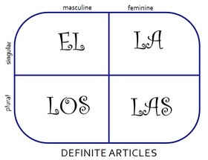

The Articles

Slide 6
Adjectives
Look to the following adjective endings that suggest reliable cognates in English:
Spanish |  | English
-al | usually remains the same | -al
-ano | usually corresponds to | -an
-ante | usually corresponds to | -ant
-ar | usually remains the same | -ar
Spanish |  | English
-ario | usually corresponds to | -ent
-ente | usually corresponds to | -ent
-ico | usually corresponds to | -ic, -ical
-ivo | usually corresponds to | -ive

Slide 7
Adjectives
Examples
Spanish Ending | Spanish | English
-al | oficial | official
-ano | humano | human
-ante | predominante | predominant
-ar | peninsular | peninsular
Spanish Ending | Spanish | English
-ario | extraordinario | extraordinary
-ente | diferente | diﬀerent
-ico | político | political
-ivo | exclusivo | exclusive

Slide 8
Adjectives
Word Order and Agreement
Adjectives in Spanish take the gender (masculine or feminine) and number (singular or plural) of the noun which they describe
-o = masculine singular
-a = feminine singular
-s = adjectives ending in a vowel
-es = adjectives ending in a consonant

Slide 9
Adjectives
Word Order and Agreement Examples
el último número | the last number
la última página | the last page
el artículo importante | the important article
los artículos importantes | the important articles
una ideal fundamental | a fundamental idea
unas ideas fundamentales | fundamental ideas

Slide 10
Adjectives
Word Order and Agreement
In Spanish the adjective may precede the noun, but it usually follows it.
Examples:
the exclusive heritage a political crisis
el patrimonio exclusivo
una crisis política

Slide 11
Adverbs
The ending -mente attached to an adjective indicates an adverb and usually corresponds to the English word ending -ly
Examples:
really oﬃcially
realmente
oﬁcialmente

Slide 12
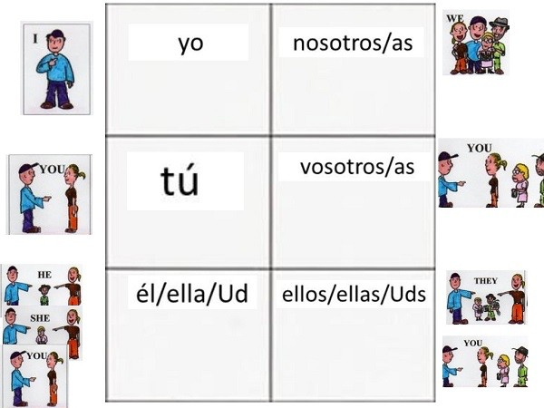
Personal Pronouns

Slide 13
The Verb “ser”
Ser = “to be”
There are two verbs in Spanish that translate to “to be” - ser and estar
yo | soy | nosotros | somos
tú | eres | vosotros | sois
él/ella/usted | es | ellos/ellas/ ustedes | son

Slide 14
Prepositions
Spanish | English | Spanish | English
a | to | por | by, through
con | with | sobre | on, over
de | of, from | para | for
en | in, on, at

Slide 15
Prepositions
Continued
When de is combined with the article el it changes to del
Al is the combination of a + el
Al, a la, a los, a las usually translate as to the, at the, or in the depending on the context

Slide 16
A few common adverbs and conjunctions
Spanish | English | Spanish | English
a partir de | beginning with, since
 |  | y (e before i) | and
por el contrario | on the contrary
 |  | más | more
después de | after
 |  | también | also
fuera de | outside of, in addition to
 |  | hoy | today, nowadays
pero | but

