Slide 1
Chapter 2
Part 1
Spanish for Reading Knowledge - Summer 2021 – Juan Garrido

Slide 2
Objectives
The Verb: “estar”
Verb forms
Present Tense
Present Tense of -ar Verbs
Comparisons of Equality
Superlatives

Slide 3
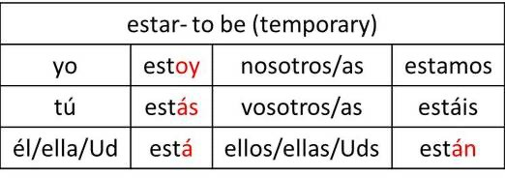
The Verb: “estar”
Estar, like ser, also means “to be”

Slide 4
Examples with the verb “estar”:
Nosotros estamos en el parque.
Mis amigos están en el supermercado.
José está en su casa.
Tú estás muy feliz.
Yo estoy muy cansado hoy.

Slide 5
Practice with the verb “estar”:
https://121spanish.com/el-verbo-estar

Slide 6
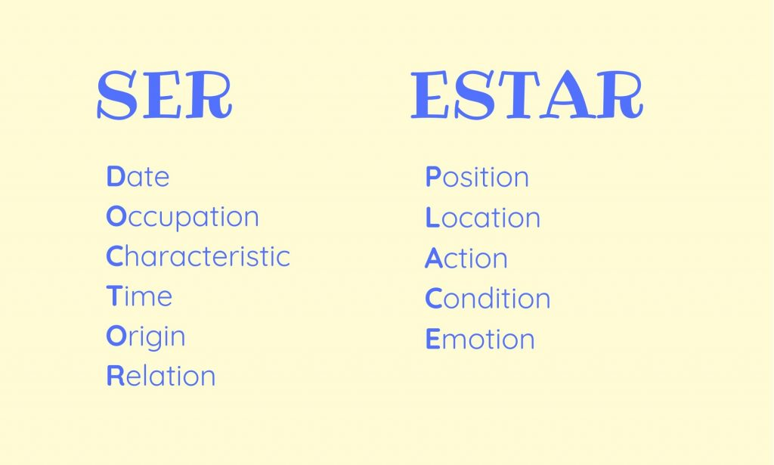
“ser” vs “estar” :

Slide 7
“ser” vs “estar” :
Uses of Ser
The hour, day, and date.
Place of origin.
Occupation.
Nationality.
Religious or political affiliation.
The material something is made of.
Possession.
Relationship of one person to another.
Where an event is taking place.
Essential qualities (what makes this thing, this thing?).
Uses of Estar
Geographic or physical location.
State or condition (like emotions).
Many idiomatic expressions.
Actions in progressive tenses (-ing).

Slide 8
Examples:
SER María is a happy person. María es una persona muy alegre.
Being happy is a part of María’s personality, so it’s a constant, is part of WHAT María is, so we use ser.
ESTAR María is very happy. María está muy feliz.
One’s mood always changes throughout the day, and we experience different emotions in one day, so, we use Estar because we are talking about a condition.

Slide 9
Practice with “ser” and “estar”:
https://studyspanish.com/grammar/test/serest1

Slide 10
Present Tense
The base form of verbs end in one of three endings: -ar, -er, -ir
The present tense is used to talk about…
general truths
facts
routines
habits
schedules

Slide 11
Present Tense of -ar Verbs
You take oﬀ the -ar of the verb stem and add the following endings:
Subject Pronoun | Ending
Yo | -o
Tú | -as
Él, ella, Ud. | -a
Nosotros | -amos
Vosotros | -áis
ellos, ellas, Uds. | -an

Slide 12
Present Tense of -ar Verbs
Regular -ar verbs can be conjugated as follows in the present tense:
Presentar | To Present
Yo presento | I present
Tú presentas | You present
Él, ella, Ud. presenta | he, she presents / you present
Nosotros presentamos | We present
Vosotros presentáis | You present
ellos, ellas, Uds. presentan | They present

Slide 13
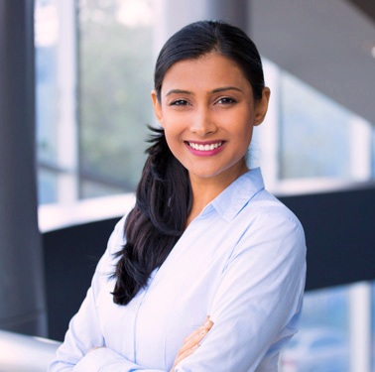
Practice: translate the following paragraph
¡Hola! Me llamo María. Soy de Lima, Perú. Soy una estudiante universitaria. Estudio contabilidad en la Universidad Nacional Federico Villarreal. Estoy en el último año de mi carrera.
También, trabajo en el área de contabilidad de una corporación de hoteles muy importante en Perú.
Cuando tengo tiempo libre, veo películas, voy a caminar al parque y leo novelas de ficción.

Slide 14
Answer the following questions:
What is her name? Her name is María
Where is she from? She’s from Lima, Perú
What is her occupation? She is a university student
What does she study? She studies accounting
Does she have a job? What is it? She works in the accounting department for a hotel corp
What does she do in her free time? She watches movies, walks in the park, and reads fiction novels.

Slide 15
More than = más… que Less than = menos … que Mi casa es más grande que tu casa.

Slide 16
Comparisons of Equality
To make comparisons in Spanish, we use
With nouns: tanto, -a, -os, -as… como
With adjectives: tan… como
Examples:
En Perú hay tantos idiomas como en México | In Peru there are as many languages as in Mexico.
En España hay tantas montañas como llanuras. | In Spain there are as many mountains as plains.
En Canadá el invierno es tan frío como en el norte de Estados Unidos. | In Canada the winter is as cold as in the north of the United States

Slide 17
Comparisons of Equality
To make comparisons in Spanish with verbs, we use:
tanto como
Example:
Estudiamos tanto como ustedes.
We study as much as you all do.

Slide 18
Superlatives
See if you can find the pattern that indicates superlative qualities
La península Ibérica es la más occidental de las tres penínsulas meridionales de Europa. | The Iberian Peninsula is the most western of the three southern peninsulas in Europe.
Rusia, Francia y España son los países más extensos de Europa. | Russia, France, and Spain are the largest countries in Europe.
La cadena montañosa más elevada de España está en el sur. | The highest chain of mountains in Spain is in the south.

Slide 19
Superlatives
To indicate superlative qualities: use más and only and change the superlative to agree with the noun
La península más…; las penínsulas más…; el país más…; los países más…
Más could also be replaced with menos (least)
example: Andalucía es la parte de España menos semejante al resto de Europa.
Note: after a superlative, de is translated by in.
example: Galicia es la región más verde y lluviosa de España.

Slide 20
Superlatives
Continued
One way to show the absolute superlative of adjectives is by dropping the ﬁnal vowel of the adjective (if any) and adding -ísima, ísimo, ísimos
Examples
España es un país hermosísimo. | Spain is a very beautiful country.
La Sierra Nevada es una cadena montañosa altísima. | The Sierra Nevada is a very high mountain chain.

Slide 21
Practice: translate the following sentences
En las mañanas, mi hermana corre tanto como yo.
Ecuador no tiene tantos bosques como Brasil.
Tokio es la ciudad más poblada del mundo y la ciudad del Vaticano es la menos poblada.
Roberto es tan alto como Luis, pero no es tan alto como María.
María estudia tanto como Luis, pero María tiene la nota más alta de la clase.

