Slide 1
Chapter 3
Part 1
Spanish for Reading Knowledge - Summer 2021 – Juan Garrido

Slide 2
Objectives
Present Tense of -er, -ir Verbs Verb “Tener”
Possessive Adjectives Comparisons of Inequality

Slide 3
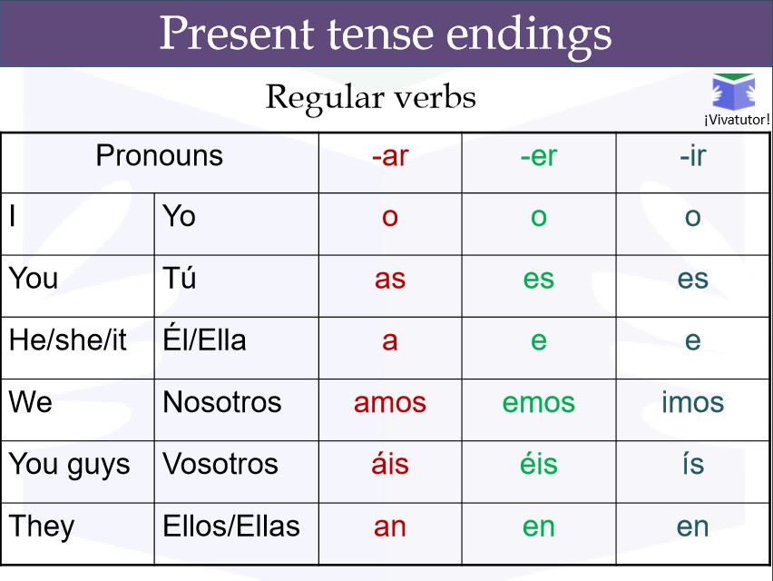
Present Tense of -er, -ir Verbs
Notice that -e is a common vowel of both groups (except nosotros and vosotros form)
Remember: present tense has 3 usual meanings:
Comer = to eat
Como = I eat, am eating, do eat
Vivir = to live
Vivo = I live, am living, do live

Slide 4
Present Tense of -er, -ir Verbs: Examples:
Comer
Yo como
Tú comes
Él/Ella/Usted come
Nosotros comemos
Vosotros coméis
Ustedes comen
Ellos comen
Subir
Yo subo
Tú subes
Él/Ella/Usted sube
Nosotros subimos
Vosotros subéis
Ustedes suben
Ellos suben

Slide 5
Practice
https://studyspanish.com/grammar/test/regverb1

Slide 6
The Verb tener
meaning: to have
In English, the verb to have indicates possession and is also used as an auxiliary verb, but in Spanish tener is used only to indicate possession while haber is used as the auxiliary.
Examples:
El mundo hispánico ha sufrido una crisis política. | The Hispanic world has suffered a political crisis.
La lengua española tiene muchos modismos. | The Spanish language has many idioms.

Slide 7

The Verb tener
Continued
Tener is an irregular verb in the present tense in Spanish:

Slide 8
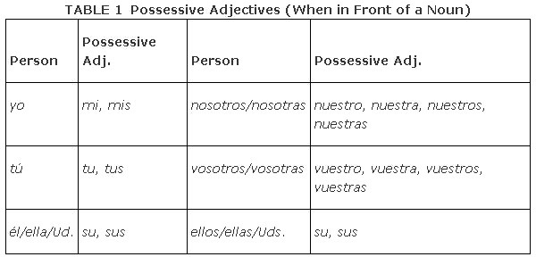
Possessive Adjectives
Possessive adjectives go before a noun
In English this is: my, your, his, hers, yours, its, theirs, our, your
As seen in the chart —>
all possessive adjectives in Spanish agree in number with the noun they describe.
First and second person plural
Examples: Mis perros
Nuestras casas
possessive adjectives agree both in gender and number with the noun they describe.
tu libro
su teléfono

Slide 9
Remember…
Comparisons of equality
En Perú hay tantas lenguas como en México.
María tiene tantos libros como Luis.
La sierra es tan bonita como la selva.
Yo duermo tanto como tú.

Slide 10
Remember…
Superlatives
Este libro es el más interesante de este autor.
Yo tengo la familia más amorosa del mundo.
Susana es la más cómica de la clase.
La pastelería “Ensueño” vende los postres más deliciosos.

Slide 11
Comparisons of Inequality
Look at the following sentences to see if you can tell how comparisons of inequality are shown in Spanish
Los germanos aportan menos elementos a la cultura española que otros pueblos. | The Germanic peoples bring fewer new elements to Spanish culture than other peoples do.
La reconquista de España dura más de siete siglos. | The reconquest of Spain lasts more than seven centuries.
El imperio de los incas es más poderoso que los demás imperios del sur. | The empire of the Incas is more powerful than the other empires of the south

Slide 12
Comparisons of Inequality
How to make them:
Unequal comparisons are formed in Spanish by placing más (more) or menos (less) before the noun, adjective, or adverb
Que and de are normally translated by than (De precedes a number or numerical expression).

Slide 13
Kahoot
Comparisons Kahoot

Slide 14
Entrevista a María

