Slide 1
Chapter 8
Spanish for Reading Knowledge - Summer 2021 – Juan Garrido

Slide 2
Objective
Preterite Tense - Regular Verbs and Irregular Verbs (u-stem) Preterite Tense - of ser, ir, and dar
Negative Words

Slide 3
Preterite Tense - Regular Verbs
The preterite expresses actions that started and stopped at a given moment in the past
Can also be used to describe a series of actions as they happened one after the other
Vine, vi, vencí. | I came, I saw, I conquered.
San Martín fue el libertador de Argentina. | San Martin was the liberator of Argentina.

Slide 4
Preterite Tense - Regular Verbs
-ar verbs
-er and -ir verbs take the following endings:
yo decidí | nosotros decidimos
tú decidiste | vosotros decidisteis
él/ella/Ud. decidió | ellos/ellas/Uds. decidieron

Slide 5
Preterite Tense - Irregular Verbs
u-stem
Irregular verbs are to be memorized, but most of them fall into clear patterns
All irregular verbs have a third person singular ending in an unstressed -o
All of them have u stems: tuv-; estuv-; uv-; sup-; pud-; pus-; cup-;
The whole conjugation will repeat the stem of the third person singular
The endings for the whole conjugation of these verbs will be:
-e, -iste, -o, -imos, -isteis, -ieron

Slide 6
Preterite Tense - Irregular Verbs
u-stem examples
andar (to walk)
yo anduve | nosotros aduvimos
tú anduviste | vosotros anduvisteis
él/ella/Ud. anduvo | ellos/ellas/Uds. anduvieron
caber (to fit)
yo cupe | nosotros cupimos
tú cupiste | vosotros cupisteis
él/ella/Ud. cupo | ellos/ellas/Uds. cupieron
estar (to be)
yo estuve | nosotros estuvimos
tú estuviste | vosotros estuvisteis
él/ella/Ud. estuvo | ellos/ellas/Uds. estuvieron
poder (to be able, can, manage to)
yo pude | nosotros pudimos
tú pudiste | vosotros pudisteis
él/ella/Ud. pudo | ellos/ellas/Uds. pudieron

Slide 7
Preterite Tense - Irregular Verbs
u-stem examples
poner (to put)
yo puse | nosotros pusimos
tú pusiste | vosotros pusisteis
él/ella/Ud. puso | ellos/ellas/Uds. pusieron
saber (to know to find out)
yo supe | nosotros supimos
tú supiste | vosotros supisteis
él/ella/Ud. supo | ellos/ellas/Uds. supieron
tener (to have)
yo tuve | nosotros tuvimos
tú tuviste | vosotros tuvisteis
él/ella/Ud. tuvo | ellos/ellas/Uds. tuvieron

Slide 8
Preterite Tense of ser, ir, and dar
Ser and Ir have the same form:
ser
yo fui | nosotros fuimos
tú fuiste | vosotros fuisteis
él/ella/Ud. fue | ellos/ellas/Uds. fueron
ir
yo fui | nosotros fuimos
tú fuiste | vosotros fuisteis
él/ella/Ud. fue | ellos/ellas/Uds. fueron
dar
yo di | nosotros dimos
tú diste | vosotros disteis
él/ella/Ud. dio | ellos/ellas/Uds. dieron

Slide 9
Preterite Tense
Practice:
https://studyspanish.com/grammar/test/pret1
Regular verbs
https://create.kahoot.it/details/f3901d6a-5682-4d70-ae9b-d43bf7d7b59d
Irregular verbs
https://create.kahoot.it/details/9782ce35-86d4-4ec5-92e4-ae21313cc834

Slide 10
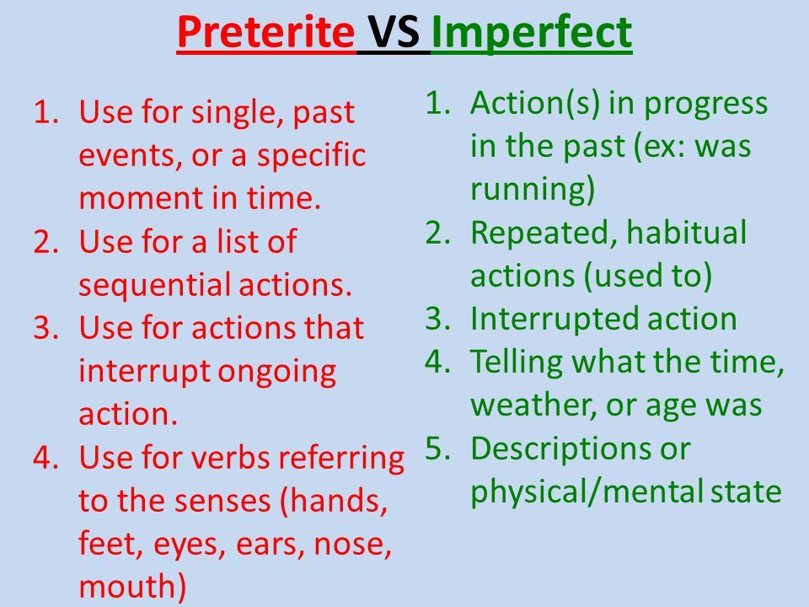

Slide 11
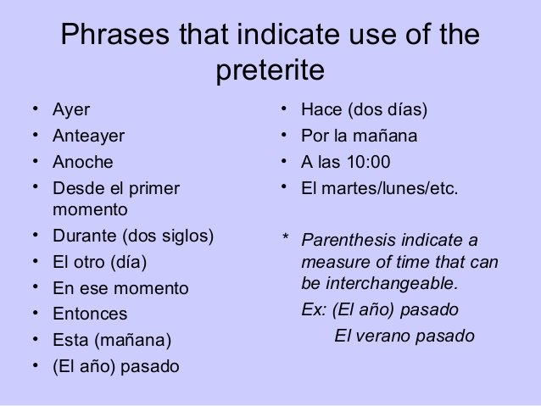

Slide 12
Preterite vs Imperfect
Practice:
https://studyspanish.com/grammar/test/pretimp1
https://create.kahoot.it/details/2725f73a-5a3e-4804-9a1b-baf9a48cb5bb

Slide 13
Activity
Go to the following link:
https://aprenderespanol.org/lecturas/cuentos-breves-fabulas.html
In this link, you will find a list of short stories in Spanish. In groups/pairs, select one of the readings. Read and understand the story together as a group/pair. You will be asked to retell the story you chose in English. You can select one member of the group/pair to retell the story. Finally, identify some examples of the preterite and imperfect.

Slide 14
Negative Words
The negative words in Spanish are:
nunca | never
jamás | never
nadie | nobody
ninguno, -a, -os, -as or ningún | no one
ni…ni | neither…nor
tampoco | neither

Slide 15
Negative Words
There are two possible constructions using negative words:
Double negative
No estaba nadie aquí.
Negative word before the verb
Nadie estaba aquí.
Nobody was here.
Nobody was here.

