Slide 1
Chapter 9
Part 1
Spanish for Reading Knowledge - Summer 2021 – Juan Garrido

Slide 2
Objective
More Irregular Verbs in the Preterite Tense Stem-Changing Verbs
Imperfect vs. Preterite (Review)

Slide 3
More Irregular Verbs in the Preterite
Stem-Changing Verbs
Hacer (to do)
yo hice | nosotros hicimos
tú hiciste | vosotros hicisteis
él/ella/Ud. hizo | ellos/ellas/Uds. hicieron
Querer (to want, to wish, to love)
yo quise | nosotros quisimos
tú quisiste | vosotros quisisteis
él/ella/Ud. quiso | ellos/ellas/Uds. quisieron
Venir (to come)
yo vine | nosotros vinimos
tú viniste | vosotros vinisteis
él/ella/Ud. vino | ellos/ellas/Uds. vinieron
Decir (to say)
yo dije | nosotros dijimos
tú dijiste | vosotros dijisteis
él/ella/Ud. dijo | ellos/ellas/Uds. dijeron

Slide 4
More Irregular Verbs in the Preterite
Stem-Changing Verbs
Producir (to produce)
yo produje | nosotros produjimos
tú produjiste | vosotros produjisteis
él/ella/Ud. produjo | ellos/ellas/Uds. produjeron
Conducir (to drive)
yo conduje | nosotros condujimos
tú condujiste | vosotros condujisteis
él/ella/Ud. condujo | ellos/ellas/Uds. condujeron

Slide 5
More Irregular Verbs in the Preterite
All verbs ending in -ducir (traducir, introducir, etc) are conjugated like producir
and conducir.
These verbs usually correspond to English verbs ending in -duce or -duct
Producir (to produce)
yo produje | nosotros produjimos
tú produjiste | vosotros produjisteis
él/ella/Ud. produjo | ellos/ellas/Uds. produjeron
Conducir (to drive)
yo conduje | nosotros condujimos
tú condujiste | vosotros condujisteis
él/ella/Ud. condujo | ellos/ellas/Uds. condujeron

Slide 6
More Irregular Verbs in the Preterite
Stem-changing =ir verbs that change -e —> -ie, and -e —> -i in the present tense, change -e —> -i in the third person singular and plural only of the preterite tense as follows:
Infinitive -ir | Present (e —> i and e —> ie) | Preterite (e —> i, third person)
pedir (to ask for) | él pide (he asks for) | él pidió, ellos pidieron (he, they asked for)
reñir (to fight) | él riñe (he fights) | él riñó, ellos riñeron (he, they fought)
divertirse (to enjoy, to amuse onself) | él se divierte (he enjoys) | él se divirtió, ellos se divirtieron (he, they enjoyed)

Slide 7
More Irregular Verbs in the Preterite
Stem-changing -ir verbs o —> ue, such as dormir and morir, change o —> u in the third person singular and plural of the preterite tense as follows:
Dormir | él duerme (he sleeps) | él durmió, ellos durmieron

Slide 8
Imperfect vs. Preterite
Review
The imperfect usually corresponds to the following:
1. Was, were + ing ( action in progress)
Yo comía cuando él vino. | I was eating when he arrived
2. Used to + infinitive (habitual actions)
Ella venía los lunes. | She used to come on Mondays
3. A simple past (-ed) describing a physical, mental, or emotional state that took place
Nosotros sufríamos mucho | We suffered a lot.
4. Would + infinitive (indicating a usual, repeated action).
Ellos iban a la escuela. | They would go to school.

Slide 9
Imperfect vs. Preterite
Review
The preterite must be translated using the simple past
The action is viewed as a single, completed even that started and stopped in the past.
Tú me diste un regalo.
You gave me a present.

Slide 10
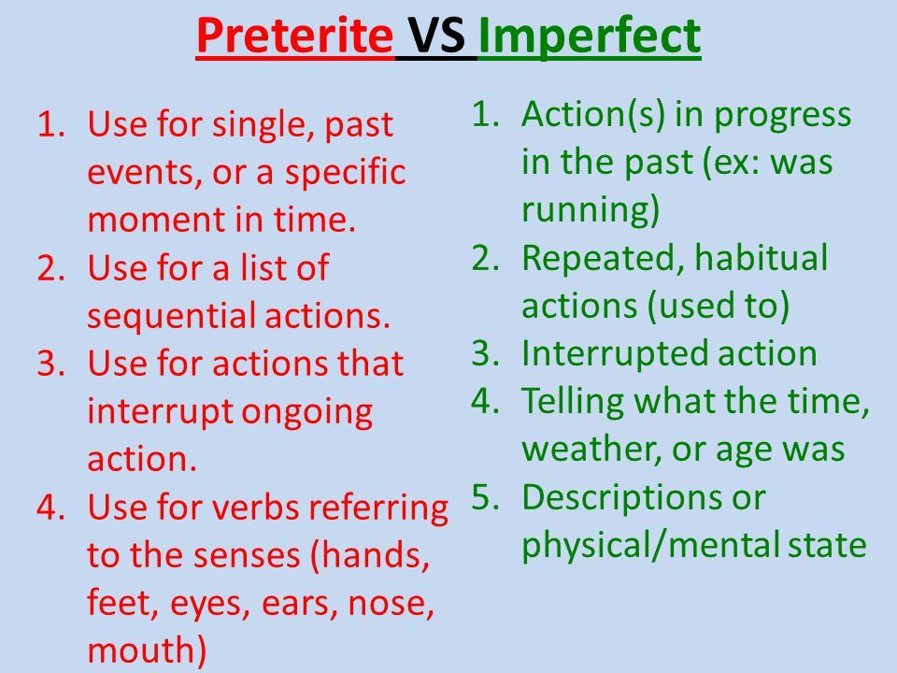

Slide 11
