Slide 1
Chapter 9
Part 2
Spanish for Reading Knowledge - Summer 2021 – Juan Garrido

Slide 2
Objective
Interrogative Pronouns The Pluperfect Tense

Slide 3
Interrogative Pronouns
¿Qué? | What
¿Quién? ¿quiénes? | Who
¿Dónde? | Where
¿Cuándo? | When
¿Por qué? | Why
¿Cuál? | Which (also what)
¿Cuántos? ¿Cuántas? | How many
¿Cuánto? ¿Cuánta? | How much
¿Cómo? | How

Slide 4
Interrogative Pronouns
Interrogative pronouns may be accompanied by a preposition
In this case the preposition precedes the pronouns in Spanish
¿A dónde vas? (¿Adónde vas? | Where are you going (to)?
¿Con quién estabas? | Who were you with? (With whom were you?)

Slide 5
The Pluperfect Tense
The Spanish pluperfect tense describes a past action that happened before another past action. In other words, it is used to say what someone or something had done.
Ella llamó a Luis
Ella visitó a Luis
Jueves
Domingo
Hoy
Ella había llamado a Luis antes de visitarlo.

Slide 6
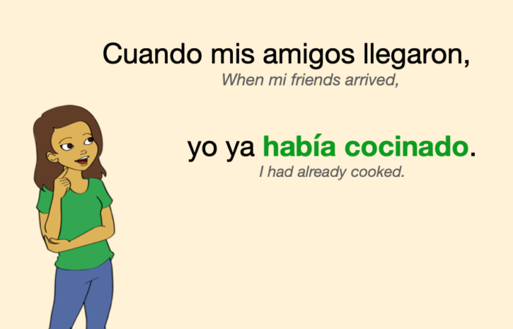
The Pluperfect Tense

Slide 7
The Pluperfect Tense
The pluperfect tense is formed with the imperfect of the verb haber and the past participle (-ado, -ido).
Examples:
Imperfect of haber:
yo había | nosotros habíamos
tú habías | vosotros habíais
él/ella/Ud. había | ellos/ellas/Uds. habían
Se cuenta que en Potosí habían construido hasta sesenta templos. | It is said that they had built up to 60 churches in Potosí.
Decayó la ciudad que había sido próspera. | The city that had been prosperous declined.

Slide 8
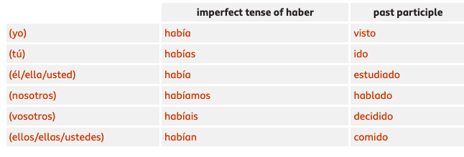
The Pluperfect Tense
The pluperfect tense is formed with the imperfect of the verb haber and the past participle (-ado, -ido).
-ar verbs → -ado
-er verbs → -ido
-ir verbs → -ido

Slide 9
The Pluperfect Tense
Some verbs have irregular past participles. For example:
decir (to say) → dicho
escribir (to write) → escrito
hacer (to make/do) → hecho
ver (to see) → visto

Slide 10
The Pluperfect Tense
More examples:
Ya habíamos comido cuando llegó (We had already eaten when he arrived)
Nunca lo había visto antes de aquella noche (I had never seen it before that night)
Había vendido su caballo (She had sold her horse)

Slide 11
The Pluperfect Tense
Practice:
https://www.spanishdict.com/quizzes/100/past-perfect-forms-and-uses
https://studyspanish.com/grammar/test/pastperfect

Slide 12
Noticia Telemundo Surfside

