Slide 1
Predictive Processing of Grammatical Gender by Native and Non-native Speakers of Spanish
Juan José Garrido
April, 2019

Slide 2
Outline
Introduction to Predictive Processing
The Linguistic Phenomenon
Previous Studies
The Present Study
Research Questions and Hypotheses
Methods
Expected Results
Conclusions

Slide 3
Notes:
This means the goalie has to make an assumption of where the ball will be kicked before the player makes contact with the ball. To do this, the goalie must observe every movement the shooter makes. If they wait until the ball is kicked it will be impossible to stop the ball, both physically and mathematically,” says ESPN’s Sports Science.

Slide 4
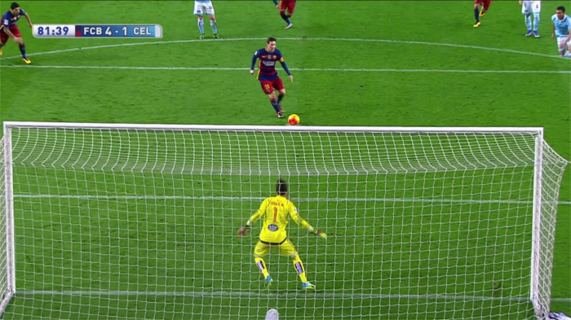

Slide 5
Introduction
Predictive Processing:
The pre-activation of subsequent information using incoming linguistic cues (Kamide, 2008).
”The language comprehender is not only integrating each word into the preceding structure as it comes in but also forming predictions as to which syntactic structure, word category, or lexical item comes next” (Kaan, 2014)
In visual world eye-tracking paradigms, Predictive Processing can be observed if participants move their eyes to an object before it is explicitly referred to in the auditory input.
Native speakers can predict upcoming information at various levels including the grammatical gender of a word, the phonological form of a word, the syntactic category, the arguments of a verb, among others.
Predictions can be based on real-world knowledge, syntactic information, verb properties, prosody, etc.
Notes:
The idea of predictive processing is not new. It has been around since 1991, to my knowledge. However, it was not until recently that investigators started studying Predictive Processing directly, thanks to the development of new online experimental paradigms such as visual-world eye-tracking and electrophysiology. A very simple way to understand predictive processing is to note that during processing the language comprehender… (read quote). Making predictions actually facilitates and increases the speed of processing. In visual-world (read quote) There is ample evidence that native speakers can (read quote) and these predictions can be based on (read quote).

Slide 6
Altmann and Kamide (1999):
Eye movements were recorded.
Scene: a boy, a toy car, a toy train, and a cake.
Sentence: The boy will eat the cake.
Participants moved their eyes to the edible object after hearing ‘eat’, before the target word was presented.
Knowledge of the verb “eat” used to predict what will come next in the input.
Studies on second language (L2) learners suggest that non-native speakers do not anticipate to the same extent as native speakers. (e.g., Dussias, Valdés Kroff, Guzzardo Tamargo & Gerfen, 2013; Grüter, Lew-Williams & Fernald, 2012; Hopp, 2013; Lew-Williams & Fernald, 2010)

Slide 7
The Linguistic Phenomenon
Grammatical Gender in Spanish:
Dual gender classification: masculine and feminine.
Gender assignment may correspond to a biological distinction of sex (e.g., niño/niña) or to formal assignment rules (e.g., carro, casa) (Corbett, 1991).
It is manifested through the required modification of associated words (Corbett, 1991)
The gender of a noun affects the form of dependent words that are syntactically associated with the noun (i.e. gender agreement)(La casa bonita).
Notes:
Many authors propose an alternative view that supports that masculine is the default classification of Spanish nouns; therefore, there is only one gender, the feminine since it marks the exceptions to the default.

Slide 8
Grammatical Gender in Spanish:
Gender in most Spanish nouns may be overtly marked with morphological inflections (i.e., transparent gender) (‘o’ for masculine, ‘a’ for feminine)
However, some nouns have opaque gender: reloj, calle.
Some nouns are gender-ambivalent: el/la estudiante.
Some nouns are irregular: mapa, problema, mano.
Gender agreement happens between nouns and determiners, adjectives, and pronouns (e.g., el carro nuevo, la mesa nueva).
Some adjectives are overtly marked (e.g., nuevo/a); others are not and can be used for either gender (e.g., grande).
Even highly advanced L2 learners of Spanish show difficulties with gender assignment and agreement.
Notes:
Since the English language does not have grammatical gender, English speakers that learn Spanish need to obtain this gender feature which is not present in their L1. Available literature in SLA provides different explanations to account for the acquisition of grammatical gender in a L2

Slide 9
Models of L2 Grammatical Gender:
Can adult L2 learners acquire L2 semantic and grammatical mental representations?
-Adult L2 learners CANNOT acquire grammatical features not present in their L1
Critical Period Hypothesis (Bley-Vroman, 1989) and the Representational Deficit Hypothesis (Hawkins & Chan, 1997; Hawkins & Casillas, 2008; Hawkins, 2009)
-L2 learners CAN acquire new grammatical representations. L2 morphosyntactic difficulties are not due to a syntactic representational deficit but to difficulties in mapping of L2 uninterpretable features.
Full Transfer Full Access Hypothesis (Schwartz & Sprouse, 1996) and the Feature Reassembly Hypothesis (Lardiere, 2005, 2009)
Notes:
Generativist Approaches
These approaches assume a syntactic deficit in the underlying grammatical competence of adult L2 learners because in spite of the availability of L1 features to adults, L2 features not present in the L1 cannot be acquired after a critical period.
Argue that adult L2 learners initially transfer L1 morphosyntactic settings to their L2 and that successful L2 acquisition depends on the reconfiguration of L1 parameters to L2 values.

Slide 10
Models of L2 Grammatical Gender: Processing
Lexical Gender Learning hypothesis (Grüter, Lew-Williams, & Fernald, 2012)
Inflectional variability happens as a result of weaker links between nouns and gender nodes in the L2 mental lexicon .
The mode of acquisition affects the strength of mental representations.
Failures in retrieving the appropriate gender during real-time processing results in inability to use gender predictively.
Parser-as-Language Acquisition Device Hypothesis (P-LADH) (Dekydtspotter & Renaud, 2009, 2014)
Inflectional variability is a result of the parsing constraints on the L2 feature reassembly process (Lardiere, 2005, 2009).
As proficiency and automatization increase, this variability can be reduced (Hopp, 2010).
Continuity Hypothesis (Hopp, 2009, 2010; McDonald, 2006)
Differences between native and non-native speakers can be mainly attrib- uted to resource deficits
Non-native speakers may be slower in accessing lexical items in the L2, or in applying parsing routines that are automatic in native speakers.
Notes:
In the present study, this predicts that L2 learners will be able to access and use gender informatively for prediction only if the nouns are strongly connected to their corresponding gender nodes and if L2 learners can access these representations effectively under real-time processing pressure
The feature reassembly process is driven by a universal human language parser. Inflectional variability happens because of the changes that occur during L2 development as the parser adapts feature matrices of lexical items. As proficiency and automatization increase, this variability can be reduced (e.g., Hopp, 2010).
in the present study L2 learners can compute gender agreement during processing and that higher proficiency and automatization of gender agreement will reduce variability allowing L2 learners to use grammatical gender as a reliable cue for predictions.
According to this account, non-native speakers can dis- play the same anticipatory behavior as native speakers but may show differences if a) the task gets harder, and/or b) their access to lexical information is slower; and/ or c) their parsing routines are less automatic.
The parser is the mechanism in charge of matching the use of prediction to the statistics and the reliability of the input in order to adapt its predictive beliefs to reduce processing difficulty

Slide 11
Previous Studies
Lew-Williams and Fernald (2010):
Intermediate level English-speaking adult L2 learners of Spanish
Participants listened to sentences or instructions that contained a gender- marked determiner (Encuentra el/la..., ‘Find theMASC/ theFEM....’) and looked at pictures of objects that differed in gender.
Eye movements were recorded
Native speakers moved their eyes to the target object when they heard the gender marked article, before they heard the noun.
Adult L2 learners did not use the determiner as a predictive cue.
Experiment 2 introduced nonwords with a definite article. L2 learners exhibited prediction.
Experiment 3 introduced nonwords with a indefinite article and tested them with definite articles. L2 learners did not show prediction.
Possible limitations:
-Participants self-rated their proficiency level
-No test of gender assignment or agreement
Authors suggest that inability to predict may be related to differences in L1 and L2 acquisition.
Notes:
Experiment 2 introduced nonwords with a definite article. L2 learners exhibited prediction.
Experiment 3 introduced nonwords with a indefinite article and tested them with definite articles. L2 learners did not show prediction.

Slide 12
Grüter, Lew-Williams, & Fernald (2012):
Highly proficient English-speaking L2 learners of Spanish and native Spanish speakers.
Offline gender assignment and agreement tests for production and comprehension.
Participants had difficulties with gender assignment in production more than agreement.
Eye-tracking task similar to Lew-Williams and Fernald (2010). Novel and familiar nouns.
Mira es el/la… / Look, it’s the…! -> ¿Dónde está el/la…? / Where is the…?
Native speakers exhibited predictive processing.
L2 learners exhibited prediction for novel nouns.
L2 learners showed weaker and/or less consistent prediction for familiar nouns. NOT significant.
Participants had difficulties with gender assignment for familiar nouns.
Authors suggest that inability to predict may be related to differences in L1 and L2 acquisition and/or problems with gender assignment.
Notes:
They tested for gender agreement in comprehension and gender assignment and agreement in production.

Slide 13
Hopp (2012):
English-speaking adult L2 learners and native speakers of German
German has opaque gender
Tested gender assignment and agreement in production and comprehension.
Only the L2 learners who had target-like performance in gender assignment in the production task were able to use gender as a predictive cue
Hopp (2016)
Participants received training on gender assignment
The pre-test showed that participants did not use grammatical gender predictively
Posttest: only the participants who had advanced on target gender assignment were able to use gender predictively
Author suggests that mastery of the target gender system in production is needed for prediction and that lexical variability might disrupt predictive processing of grammatical gender.
Notes:
Following this, variability in using gender as a predictive cue is more likely related to lower levels of activation of and access to gender nodes rather than deficits of mental representation in the L2 grammar.

Slide 14
Fowler and Jackson (2017):
The number of gender cues available also seems to have an effect on L2 speakers’ ability to predict upcoming information.
Dussias et al (2013):
Whether L2 learners speak a gendered L1 or not seems to affect how they process L2 gender agreement.
Dahan et al (2000):
Predictive processing could happen through dependencies of probability, form-based effects, grammar-based effects.

Slide 15
The Present Study
The present study investigates predictive processing of grammatical gender in native and non-native speakers of Spanish.
Goals:
-To test whether target gender assignment is necessary for target-like L2 predictive processing.
-To test whether the number and type of gender cues available affects predictive processing.
-To test whether predictive processing of gender agreement is achieved through form-based effects, grammar-based effects, or phonological correspondence.
Notes:
Most studies addressing this issue in adult L2 learners of Spanish explored determiner-noun pairs. The present study includes determiner-noun, determiner-noun-adjective, and noun-adjective pairs.

Slide 16
Research questions:
Do native speakers and adult L2 learners rely differently on the determiner and the noun to process noun-adjective gender agreement?
Do native speakers and adult L2 learners process gender agreement based on syntactic agreement rules or on phonological correspondence?
Do native speakers and adult L2 learners process gender based on the word form or on a lexical representation?
Hypotheses:
L2 learners rely differently on the determiner and the noun to process noun-adjective gender agreement.
L2 learners process gender agreement both ways depending on their proficiency level and gender assignment/agreement in production.
L2 learners process gender based both ways depending on their proficiency level and gender assignment/agreement in production.

Slide 17
Methods
Participants:
60 adult English-speaking learners of Spanish (intermediate and advanced levels)
30 native speakers.
Materials:
Background questionnaire.
DELE proficiency test
A forced-choice task (gender assignment and agreement in production and comprehension)
A visual world eye-tracking task

Slide 18
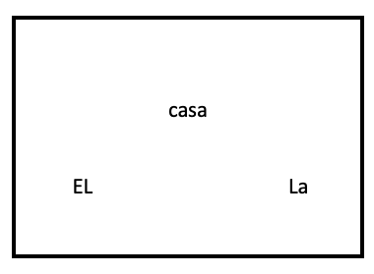
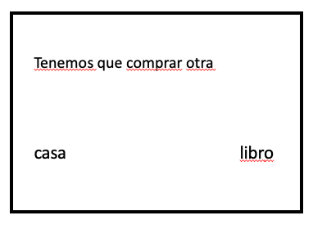
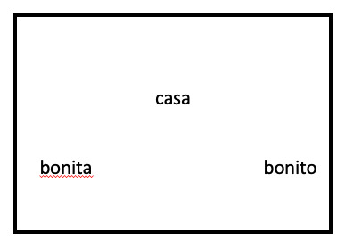
accuracy
Forced-choice task
El
Tenemos que comprar otra
production
libro
comprehension
bonita

Slide 19

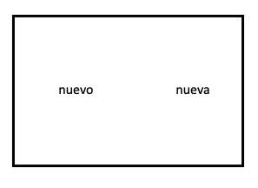
Eye movements recorded
Gaze duration
Visual world eye-tracking task
Dice que el libro nuevo cuesta mucho dinero.
Dice que su libro nuevo cuesta mucho dinero.
Dice que el camión nuevo cuesta mucho dinero.
Dice que su camión nuevo cuesta mucho dinero.
Dice que el mapa nuevo cuesta mucho dinero.
Dice que su mapa nuevo cuesta mucho dinero.

Slide 20
Stimuli
All sentences have the same structure (Dice que, Piensa que…)
Target nouns:
Inanimate
Transparent, opaque, and irregular
2-4 syllables long
half masculine and half feminine I
Similar lexical frequency and phonotactic frequency.
Each noun appears only once.
Target adjectives:
half masculine, half feminine
transparent gender
2-4 syllables long
each adjective appears only once

Slide 21
Expected Results
L2 learners rely differently on the determiner and the noun to process noun-adjective gender agreement.
Participants will be more likely to exhibit predictive processing when the determiner is present.
The number of cues will affect predictive processing. (Fowler & Jackson, 2017)
L2 learners process gender agreement in different ways depending on their proficiency level and gender assignment/agreement in production.
Participants who show mastery of grammatical gender in the forced-choice tasks will be more likely to process gender agreement predictively based on syntactic agreement rules and the lexical representation.
If participants who do not show mastery of grammatical gender in the forced-choice tasks process gender agreement predictively, it will be more likely to be based on phonological correspondence and the formal aspects of words.
(Dahan et al., 2000; Grüter et al, 2012; Hopp, 2013, 2016)

Slide 22
Conclusions
-Target gender assignment may be necessary for L2 learners to use grammatical gender predictively.
-L2 learners may process gender agreement differently depending on different factors such as proficiency level and gender assignment in production.
-L2 learners who show mastery of gender may be able to process gender agreement based on the mental lexical representation and the syntactic agreement rules.
-The number of gender cues presented in the stimuli may affect the use of gender for predictive processing.

