Slide 1
Ensembles of Classifiers
Evgueni Smirnov

Slide 2
Outline
Methods for Independently Constructing Ensembles
  Majority Vote
  Bagging and Random Forest
  Randomness Injection
  Feature-Selection Ensembles
  Error-Correcting Output Coding
Methods for Coordinated Construction of Ensembles
  Boosting
  Stacking
Reliable Classification: Meta-Classifier Approach
Co-Training and Self-Training

Slide 3
Ensembles of Classifiers
Basic idea is to learn a set of classifiers (experts) and to allow them to vote.
Advantage: improvement in predictive accuracy.
Disadvantage: it is difficult to understand an ensemble of classifiers.

Slide 4
Why do ensembles work?
Dietterich(2002) showed that ensembles overcome three problems:
The Statistical Problem arises when the hypothesis space is too large for the amount of available data. Hence, there are many hypotheses with the same accuracy on the data and the learning algorithm chooses only one of them! There is a risk that the accuracy of the chosen hypothesis is low on unseen data!
The Computational Problem arises when the learning algorithm cannot guarantees finding the best hypothesis.
The Representational Problem arises when the hypothesis space does not contain any good approximation of the target class(es).
The statistical problem and computational problem result in the variance component of the error of the classifiers!
The representational problem results in the bias component of the error of the classifiers!

Slide 5
Methods for Independently Constructing Ensembles
One way to force a learning algorithm to construct multiple hypotheses is to run the algorithm several times and provide it with somewhat different data in each run. This idea is used in the following methods:
Majority Voting
Bagging
Randomness Injection
Feature-Selection Ensembles
Error-Correcting Output Coding.

Slide 6
Majority Vote
Original
D
Training data
Step 1:
Build Multiple
C
C
C
C
Classifiers
1
2
t -1
t
Step 2:
Combine
C
*
Classifiers

Slide 7
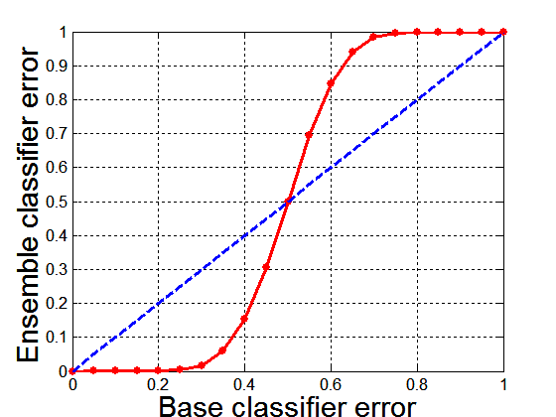
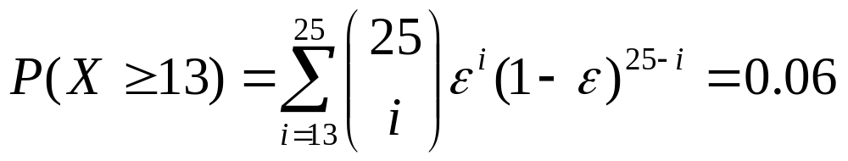
Why Majority Voting works?
Suppose there are 25 base classifiers
  Each classifier has
  error rate, ε = 0.35
  Assume errors made
  by classifiers are uncorrelated
  Probability that the ensemble classifier makes a wrong prediction:

Slide 8
Bagging
Employs simplest way of combining predictions that belong to the same type.
Combining can be realized with voting or averaging
Each model receives equal weight
“Idealized” version of bagging:
  Sample several training sets of size n (instead of just having one training set of size n)
  Build a classifier for each training set
  Combine the classifier’s predictions
This improves performance in almost all cases if learning scheme is unstable (i.e. decision trees)

Slide 9
Bagging classifiers
Classifier generation
Let n be the size of the training set.
For each of t iterations:
Sample n instances with replacement from the training set.
Apply the learning algorithm to the sample.
Store the resulting classifier.
classification
For each of the t classifiers:
Predict class of instance using classifier.
Return class that was predicted most often.

Slide 10
Why does bagging work?
Bagging reduces variance by voting/ averaging, thus reducing the overall expected error
  In the case of classification there are pathological situations where the overall error might increase
  Usually, the more classifiers the better

Slide 11
Random Forest
Classifier generation
Let n be the size of the training set.
For each of t iterations:
(1) Sample n instances with replacement from the training set.
(2) Learn a decision tree s.t. the variable for any new node is the best variable among m randomly selected variables.
(3) Store the resulting decision tree.
Classification
For each of the t decision trees:
Predict class of instance.
Return class that was predicted most often.

Slide 12
Bagging and Random Forest
Bagging usually improves decision trees.
Random forest usually outperforms bagging due to the fact that errors of the decision trees in the forest are less correlated.

Slide 13
Randomization Injection
Inject some randomization into a standard learning algorithm (usually easy):
  Neural network: random initial weights
  Decision tree: when splitting, choose one of the top N attributes at random (uniformly)
Dietterich (2000) showed that 200 randomized trees are statistically significantly better than C4.5 for over 33 datasets!

Slide 14
Feature-Selection Ensembles
Key idea: Provide a different subset of the input features in each call of the learning algorithm.
Example: Venus&Cherkauer (1996) trained an ensemble with 32 neural networks. The 32 networks were based on 8 different subsets of 119 available features and 4 different algorithms. The ensemble was significantly better than any of the neural networks!

Slide 15
Error-Correcting Output Codes
Exhaustive Codes:
We receive 2^{(K-1)}-1 number of binary classifiers. The final classification rule is the nearest neighbor. Assume that for an instance x we have a code word
[+1,+1, +1, +1,+1, +1, -1].
Binary Classification Problems
 | BP1 | BP2 | BP3 | BP4 | BP5 | BP6 | BP7
y1 | +1 | +1 | +1 | +1 | +1 | +1 | +1
y2 | +1 | +1 | +1 | -1 | -1 | -1 | -1
y3 | +1 | -1 | -1 | +1 | +1 | -1 | -1
y4 | -1 | +1 | -1 | +1 | -1 | +1 | -1
Classes

Slide 16
Error-Correcting Output Codes (ECOC)
An ECOC matrix M has to satisfy two properties:
  Row separation: any class code word in M should be well-separated from all other class code words M
  Column separation: any class-partition code word in M should be well-separated from all other class-partition code words and their complements.
Binary Classification Problems
 | BP1 | BP2 | BP3 | BP4 | BP5 | BP6 | BP7
y1 | +1 | +1 | +1 | +1 | +1 | +1 | +1
y2 | +1 | +1 | +1 | -1 | -1 | -1 | -1
y3 | +1 | -1 | -1 | +1 | +1 | -1 | -1
y4 | -1 | +1 | -1 | +1 | -1 | +1 | -1
Classes
Example. For Exhaustive ECOC:
the Hamming distance between class code words is 2^(|Y|-2);
the minimal Hamming distance between class partition code words is 1.

Slide 17
Error-Correcting Output Codes
The number K of classes is greater than 2 and we have a binary classifier L only.
One-Against- All Strategy:
We receive K number of binary classifiers. The final classification rule is majority vote.
Binary Classification Problems
 | BP1 | BP2 | BP3 | BP4
y1 | +1 | -1 | -1 | -1
y2 | -1 | +1 | -1 | -1
y3 | -1 | -1 | +1 | -1
y4 | -1 | -1 | -1 | +1
Classes

Slide 18
Error-Correcting Output Codes
One-Against- One Strategy :
We receive K(K-1)/2 number of binary classifiers. The final classification rule is majority vote.
Binary Classification Problems
 | BP1 | BP2 | BP3 | BP4 | BP5 | BP4
y1 | +1 | +1 | +1 | 0 | 0 | 0
y2 | -1 | 0 | 0 | +1 | +1 | 0
y3 | 0 | -1 | 0 | -1 | 0 | +1
y4 | 0 | 0 | -1 | 0 | -1 | -1
Classes

Slide 19
Error-Correcting Output Codes
Minimal Codes:
We receive log₂(K) number of binary classifiers. The code word determines exactly the class.
Problem: an error of one binary classifier causes error of the whole ensemble.
Binary Classification Problems
 | BP1 | BP2
y1 | +1 | -1
y2 | +1 | +1
y3 | -1 | -1
y4 | -1 | +1
Classes

Slide 20
Methods for Coordinated Construction of Ensembles
The key idea is to learn complementary classifiers so that instance classification is realized by taking an weighted sum of the classifiers. This idea is used in two methods:
Boosting
Stacking.

Slide 21
Boosting
Also uses voting/averaging but models are weighted according to their performance
Iterative procedure: new models are influenced by performance of previously built ones
  New model is encouraged to become expert for instances classified incorrectly by earlier models
  Intuitive justification: models should be experts that complement each other
There are several variants of this algorithm

Slide 22
AdaBoost.M1
classifier generation
Assign equal weight to each training instance.
For each of t iterations:
Learn a classifier from weighted dataset.
Compute error e of classifier on weighted dataset.
If e equal to zero, or e greater or equal to 0.5:
Terminate classifier generation.
For each instance in dataset:
If instance classified correctly by classifier:
Multiply weight of instance by e / (1 - e).
Normalize weight of all instances.
classification
Assign weight of zero to all classes.
For each of the t classifiers:
Add -log(e / (1 - e)) to weight of class predicted by the classifier.
Return class with highest weight.

Slide 23
Remarks on Boosting
Boosting can be applied without weights using re-sampling with probability determined by weights;
Boosting decreases exponentially the training error in the number of iterations;
Boosting works well if base classifiers are not too complex and their error doesn’t become too large too quickly!
Boosting reduces the bias component of the error of simple classifiers!

Slide 24
Stacking
Uses meta learner instead of voting to combine predictions of base learners
  Predictions of base learners (level-0 models) are used as input for meta learner (level-1 model)
Base learners usually different learning schemes
Hard to analyze theoretically: “black magic”

Slide 25
Stacking
BC₁
0
BC₂
1
instance₁
BC_{n}
1
BC₁
BC₂
…
BC_{n}
Class
meta instances
instance₁
0
1
1
1

Slide 26
Stacking
BC₁
1
BC₂
0
instance₂
BC_{n}
0
BC₁
BC₂
…
BC_{n}
Class
meta instances
instance₁
0
1
1
1
instance₂
1
0
0
0

Slide 27
Stacking
Meta Classifier
BC₁
BC₂
…
BC_{n}
Class
meta instances
instance₁
0
1
1
1
instance₂
1
0
0
0

Slide 28
Stacking
BC₁
0
1
BC₂
1
instance
Meta Classifier
BC_{n}
1
BC₁
BC₂
…
BC_{n}
meta instance
instance
0
1
1

Slide 29
More on stacking
Predictions on training data can’t be used to generate data for level-1 model! The reason is that the level-0 classifier that better fit training data will be chosen by the level-1 model! Thus,
k-fold cross-validation-like scheme is employed! An example for k = 3!
train
train
test
train
test
train
test
train
train
Meta Data
test
test
test

Slide 30
More on stacking
If base learners can output probabilities it’s better to use those as input to meta learner
Which algorithm to use to generate meta learner?
  In principle, any learning scheme can be applied
  David Wolpert: “relatively global, smooth” model
    Base learners do most of the work
    Reduces risk of overfitting

Slide 31
Some Practical Advices
If the classifier is unstable (high variance), then apply bagging!
If the classifier is stable and simple (high bias) then apply boosting!
If the classifier is stable and complex then apply randomization injection!
If you have many classes and a binary classifier then try error-correcting codes! If it does not work then use a complex binary classifier!

Slide 32
Reliable Classification
Classifiers applied in critical applications with high misclassification costs need to determine whether classifications they assign to individual instances are indeed correct.
We consider one of the simplest approaches that is related to ensembles of classifiers:
  Meta-Classifier Approach

Slide 33
The Task of Reliable Classification
Given:
Instance space X.
Classifier space H.
Class set Y.
Training sets D ⊆ X x Y.
Find:
Classifier h ∈ H, h: X → Y that correctly classifies future, unseen instances. If h cannot classify an instance correctly, symbol “?” is returned.

Slide 34
Meta Classifier Approach
instance
BC
BC
Class
Meta Class
instance₁
0
1
0
…………………………………………..
instance_{n}
1
1
1

Slide 35
Meta Classifier Approach
instance
BC
MC
Meta Class
meta instances
instance₁
0
…………………..
instance_{n}
1

Slide 36
Meta Classifier Approach
Combined Classifier
instance
BC
MC
The classification of the base classifier BC is outputted if the meta classifier decides that the instance is classified correctly.
Theorem. The precision of the meta classifier equals the accuracy of the combined classifier on the classified instances.

Slide 37
Co-Training (WWW application)
Consider the problem of learning to classify pages of hypertext from the www, given labeled training data consist of individual web pages along with their correct classifications.
The task of classifying a web page can be done by considering just the words on the web page, and the words on hyperlinks that point to the web page.

Slide 38
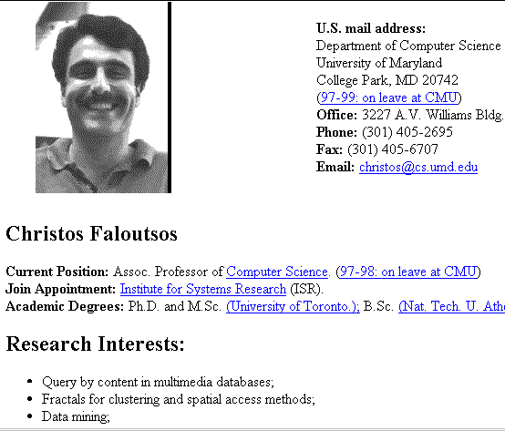
Co-Training
Professor Faloutsos
my advisor

Slide 39
The Co-Training algorithm
Given:
  Set L of labeled training examples
  Set U of unlabeled examples
Loop:
  Learn hyperlink-based classifier H from L
  Learn full-text classifier F from L
  Allow H to label p positive and n negative examples from U
  Allow F to label p positive and n negative example from U
  Add these self-labeled examples to L

Slide 40
The Self-Training algorithm
Given:
  Set L of labeled training examples
  Set U of unlabeled examples
Loop:
  Learn a classifier H from L
  Allow H to label p positive and n negative examples from U
  Add these self-labeled examples to L

Slide 41
Learning to Classify Web using Co-Training
Mitchell(1999) reported an experiment to co-train text classifiers that recognize course home pages.
In experiment, he used 16 labeled examples, 800 unlabeled pages.
Mitchell(1999) found that the Co-training algorithm does improve classification accuracy when learning to classify web pages.

Slide 42
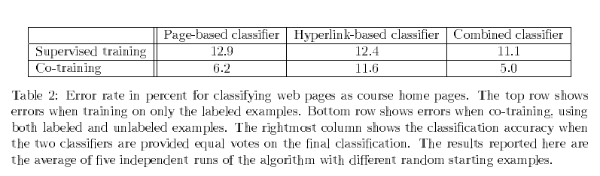
Learning to Classify Web using Co-Training

Slide 43
When does Co-Training work?
When examples are described by redundantly sufficient features; and
When the hypothesis spaces corresponding to the sets of redundantly sufficient features contain different hypotheses or the learning algorithms are different.

