Slide 1

Treasure Trove
Crypto Lottery Concept

Slide 2
Description
A crypto lottery system premised on a tradeable coin that is ephemeral in nature
Weekly lottery pots funded through trading, with liquidity distributed to the winners at the end of coin life
Winners are selected at random by means of “lottery tickets”, The allocation of these tickets will be weighted by the following:
Average holding time of coins
Average number of coins held
Pool will be funded through traders purchasing Treasure Coins
$Treasure is bought, and BNB added to the liquidity pool
At the end of the coin life, trading function will cease (no more buys and no more sells)
The liquidity pool will be drained of BNB and this will be distributed as rewards to the winners
Coin life will be a random time between 4 days and 7 days
Trading will cease at a random point in time within that time interval
This reduces the possibility of rogue traders draining the LP just before trading ceases
Winners will be determined once trading has stopped, with rewards distributed at a fixed weekly time. Winners can be announced live on voice chat or video (via YouTube channel)

Slide 3
Coin Mechanics
Coin contract released weekly
Pre Launch:
Initial presale to kick-start the project with minimum raise of 100BNB
90% added to LP, 10% used to partially cover initial expenses of developers, marketers, shillers and designers
DEX Launch:
Maximum buy amount in first [5 minutes] to prevent mempool bot sniping pushing price up (extremely small amount to make multi-wallet sniping extremely uneconomical)
[70%] tax on sales in first [5 minutes] to prevent dumping (no tax on buying)
General Coin Mechanics (designed to encourage holding)
[40%] tax on every transaction after the initial 5 minutes:
[30%] to the liquidity pool (high distribution to the LP provides more stability on price)
[10%] redistributed to the holders

Slide 4
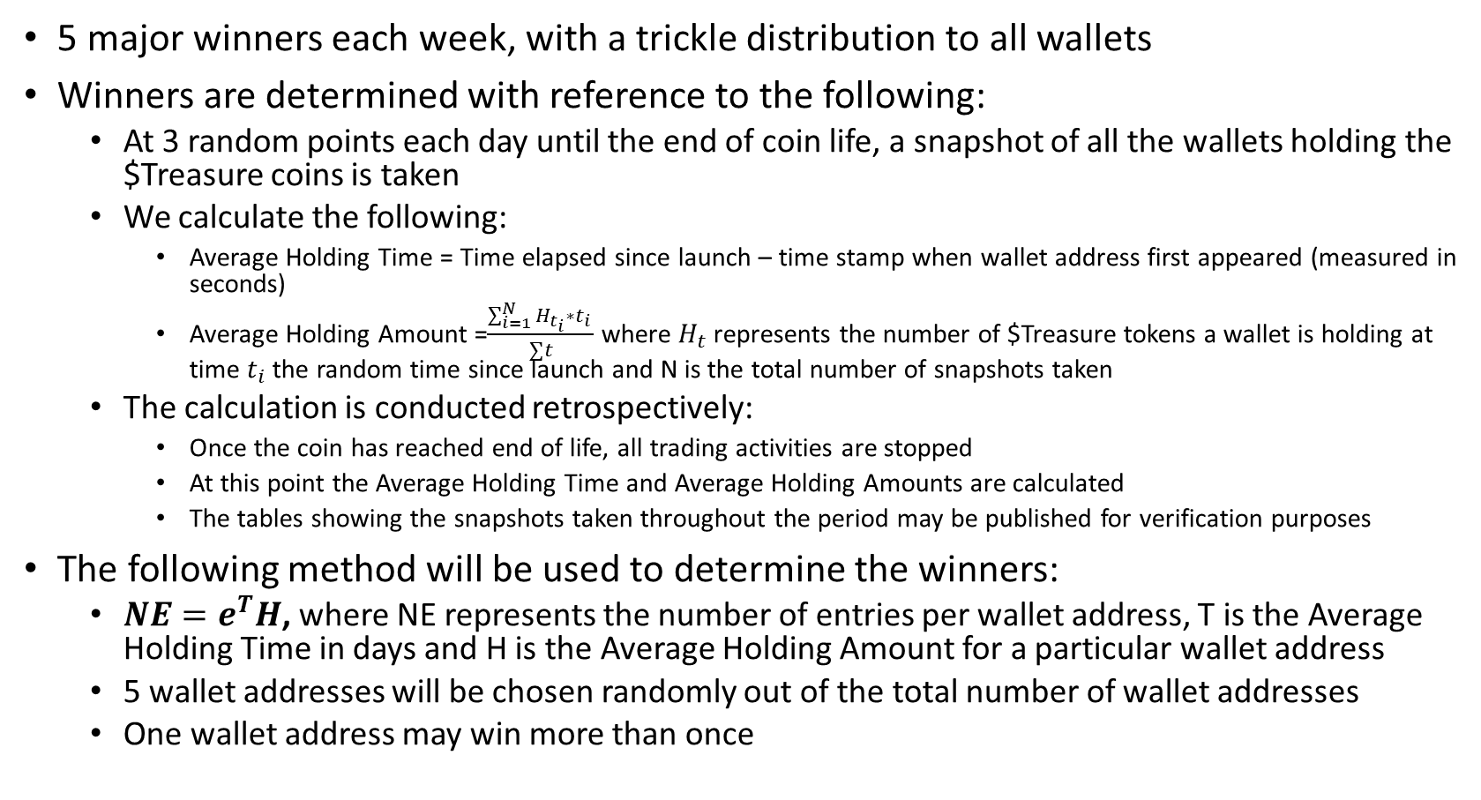
Winner Selection
5 major winners each week, with a trickle distribution to all wallets
Winners are determined with reference to the following:
At 3 random points each day until the end of coin life, a snapshot of all the wallets holding the $Treasure coins is taken
We calculate the following:
Average Holding Time = Time elapsed since launch – time stamp when wallet address first appeared (measured in seconds)
Average Holding Amount =$\frac{\sum_{i=1}^{N}{H_{t_{i}}∗t_{i} }}{∑t}$ where $H_{t}$ represents the number of $Treasure tokens a wallet is holding at time $t_{i}$ the random time since launch and N is the total number of snapshots taken
The calculation is conducted retrospectively:
Once the coin has reached end of life, all trading activities are stopped
At this point the Average Holding Time and Average Holding Amounts are calculated
The tables showing the snapshots taken throughout the period may be published for verification purposes
The following method will be used to determine the winners:
${NE=e}^{T}H$, where NE represents the number of entries per wallet address, T is the Average Holding Time in days and H is the Average Holding Amount for a particular wallet address
5 wallet addresses will be chosen randomly out of the total number of wallet addresses
One wallet address may win more than once

Slide 5
Share of Winnings Pool
When the end of coin life is reached, the liquidity in the liquidity pool will be allocated as follows:
10% to the development and maintenance team
10% rollover into next lottery draw (if there is at least 90BNB, then no pre-sale will be necessary)
80% distributed to the winners as follows:
5 winners each get equal amounts of winnings from 70% of the winners distribution pool (70% * 80%)
30% of the 80% is distributed to all participating wallets, weighted by the number of entries per wallet address (NE)

