Slide 1
Overview of UMAP
Juan Malagon

Slide 2
UMAP is a nutshell
Topological Data Analysis and Simplicial Complexes
Adapting to Real World Data
Finding a Low Dimensional Representation
The UMAP Algorithm

Slide 3
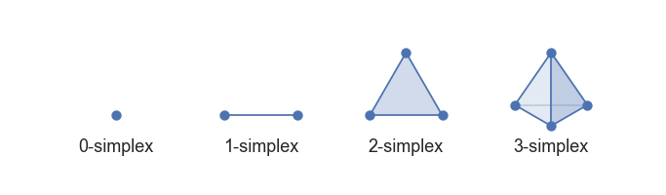
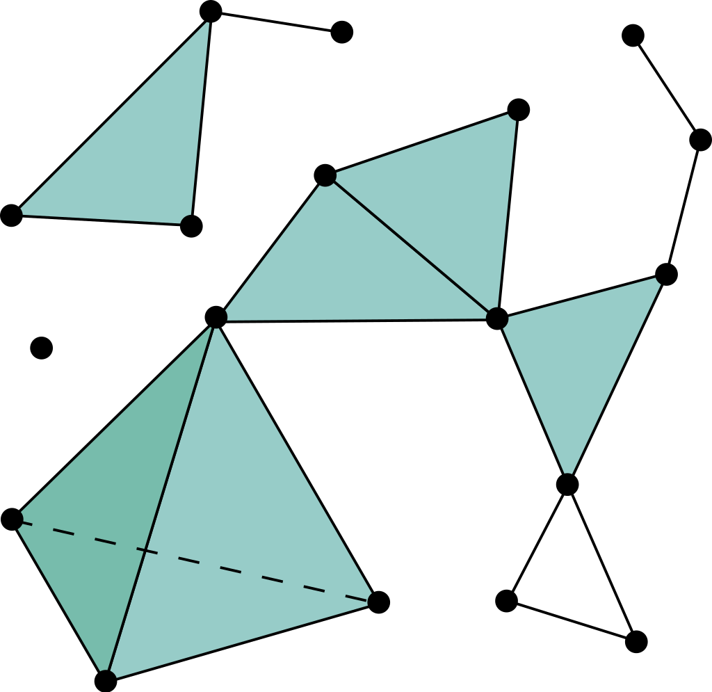
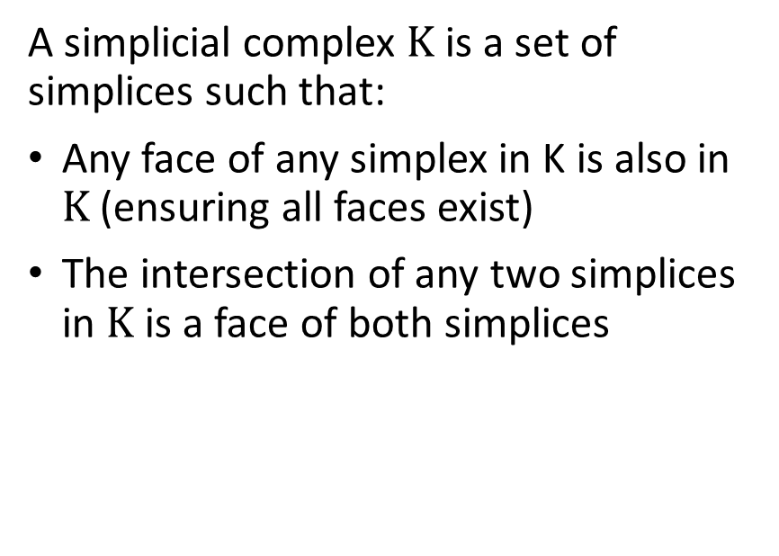
Some algebraic topology concepts
A k-dimensional simplex
Simplicial complex
Take the convex hull of k+1 independent points
A simplicial complex $Κ$ is a set of simplices such that:
Any face of any simplex in K is also in $Κ$(ensuring all faces exist)
The intersection of any two simplices in $Κ$ is a face of both simplices

Slide 4
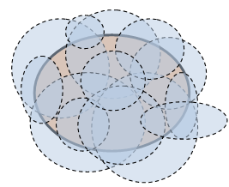
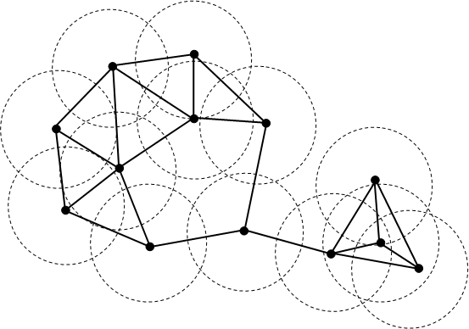

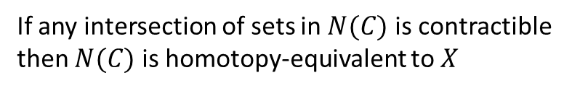

Nerve theorem
If any intersection of sets in $N(C)$ is contractible
then $N(C)$ is homotopy-equivalent to $X$
Čech
cohomology
Open cover $C$ of a topological space $X$
Nerve of a covering $N(C)$

Slide 5
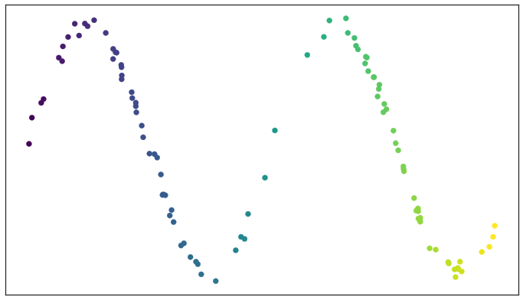

Test data set of a noisy sine wave
Start with some data points in a topological space
If it’s a metric space, we can create 0-simplex for each data point with a fixed radius $ε$

Slide 6
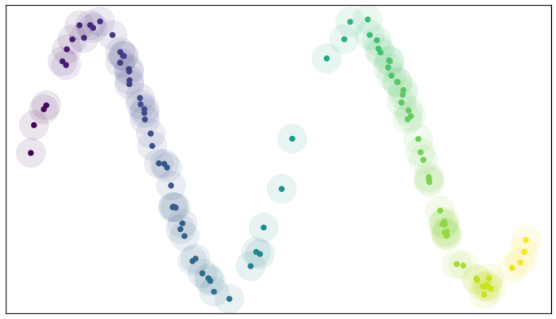
A basic open cover of the test data
Hence, we have an open covering centered in each data point

Slide 7
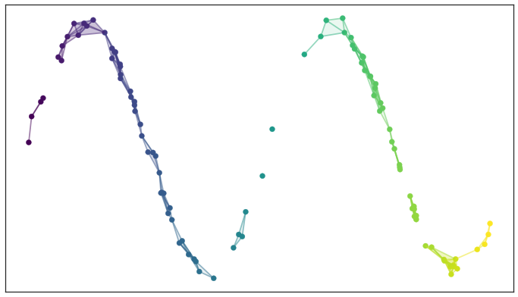
A simplicial complex built from the test data
From the covering, we may create the Čech complex (0-, 1-, and 2-simplices displayed in the graph)
For computational reasons, it is better to build the Vietoris–Rips complex (it differs from the Čech complex using only 0- and 1-simplices in the simplicial abstract complex)
Finding a low dimensional representation of the data that has a similar topological representation is a graph layout problem (if we use 0- and 1-simplices)
Dimensionality reduction options:
Laplacian eigenmaps
Diffusion maps
MDS
Sammon mapping

Slide 8
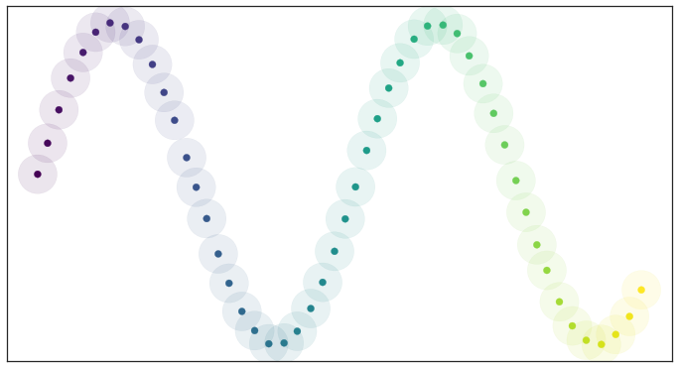
Open balls over uniformly distributed data
Fixed radius caveat: it would work only with uniformly distributed data points
Small radius caveat: the resulting simplicial complex splits into many connected components
Large radius caveat: the simplicial complex turns into just a few very high dimensional simplices (and their faces etc.) and fails to capture the manifold structure

Slide 9
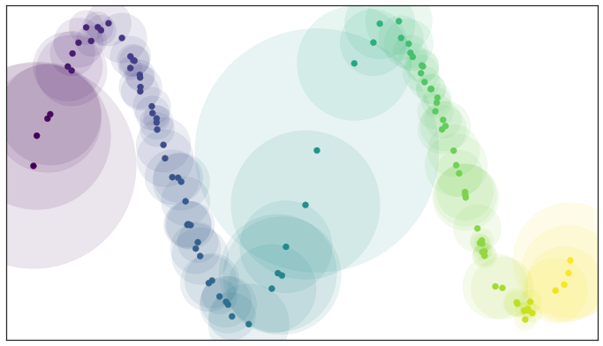
Open balls of radius one with a locally varying metric
The proofs that Laplacian eigenmaps work well require the assumption that the data is uniformly distributed on the manifold
Each point is given its own unique distance function, and we can simply select balls of radius one with respect to that local distance function: a unit ball about a point stretches to the k-th nearest neighbor of the point

Slide 10
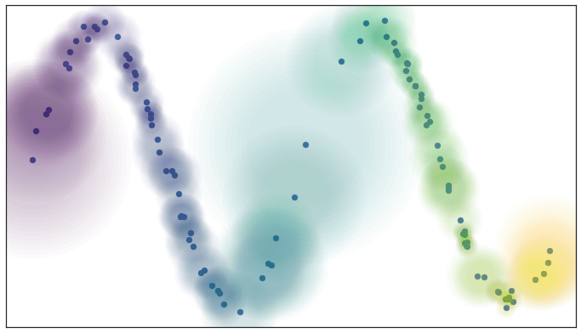
Fuzzy open balls of radius one with a locally varying metric
We have a local metric space associated to each point
We weight the edges of the graph we might generate by how far apart (in terms of the local metric) the points on the edges are
Fuzzy topology: being in an open set in a cover is no longer a binary yes or no, but instead a fuzzy value between zero and one

Slide 11
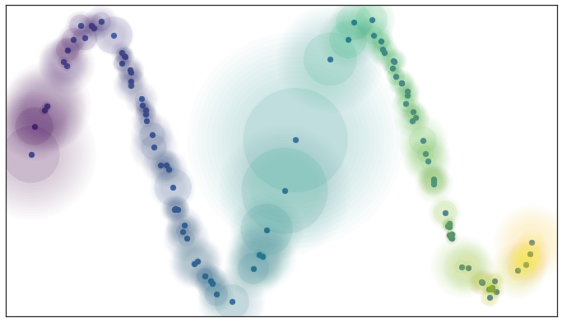
Local connectivity and fuzzy open sets
Additional assumption: local connectivity
For the practical problem we are working with, where we only have a finite approximation of the manifold, this means that no point should be completely isolated
i.e., the open set extends as far as the closest neighbor of each point
Curse of dimensionality: the distance to the first nearest neighbor can be quite large, but the distance to the tenth nearest neighbor can often be only slightly larger
The local connectivity ensures that we focus on the difference in distances rather than the absolute distance

Slide 12
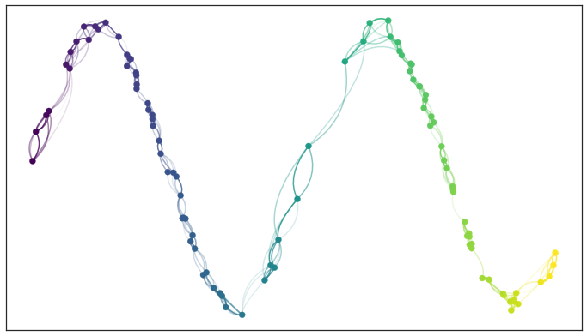
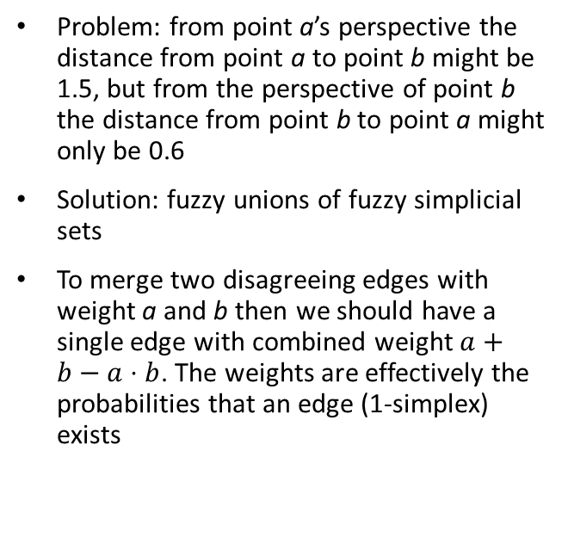
Edges with incompatible weights
Problem: from point a’s perspective the distance from point a to point b might be 1.5, but from the perspective of point b the distance from point b to point a might only be 0.6
Solution: fuzzy unions of fuzzy simplicial sets
To merge two disagreeing edges with weight a and b then we should have a single edge with combined weight $a+b−a⋅b$. The weights are effectively the probabilities that an edge (1-simplex) exists

Slide 13
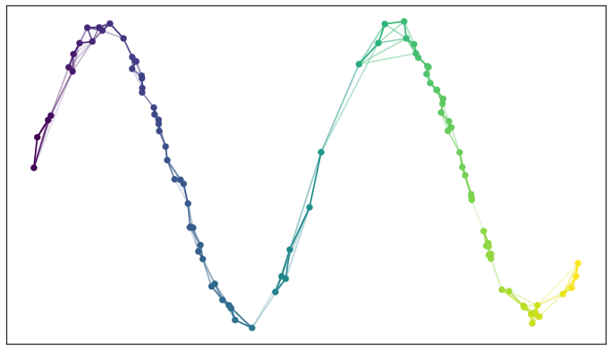
Graph with combined edge weights
If we apply this process to union together all the fuzzy simplicial sets we end up with a single fuzzy simplicial complex, which we can again think of as a weighted graph
In the end we have simply constructed a weighted graph which captures the topology of the manifold underlying the data

Slide 14
Finding a Low Dimensional Representation
Determine the fuzzy topological structure of a low dimensional representation
Optimization problem: finding the low dimensional representation with the closest fuzzy topological structure
Since both topological structures we are comparing share the same 0-simplices, we can imagine that we are comparing the two vectors of probabilities indexed by the 1-simplices
These are Bernoulli variables (ultimately the simplex either exists or it doesn’t, and the probability is the parameter of a Bernoulli distribution), the right choice here is the cross entropy

Slide 15


Formulation
$E$: the set of all possible 1-simplices
$w_{h}(e)$ is the weight of the 1-simplex $e$ in the high dimensional case
$w_{l}(e)$ is the weight of $e$ in the low dimensional case
Reduce the cross-entropy

Slide 16
The UMAP Algorithm
Step 1: constructing a fuzzy topological representation as described before.
Step 2: optimizing the low dimensional representation to have as close a fuzzy topological representation as possible as measured by cross entropy (use stochastic gradient descent).

Slide 17
References
https://umap-learn.readthedocs.io/

