Slide 1

Master in Business Analytics and Data Science
MLOps: Machine Learning Operations
Session 7
Monitoring, Explainability & Responsible AI
Juan Manuel Ramírez García · jramirezg@faculty.ie.edu
Live online session · Saturday 24 October 2026 · 90 minutes
Data ingestion & versioning
Data validation
Data pre-processing
Model training
Model tuning
Model analysis
Model validation
Model deployment
Model feedback
MLOps · MBDS-PT2026F · Session 7 · Juan Ramírez
1
Notes:
On screen 5 minutes before. As people join: "what would you need to measure every month to know whether the retrain trigger was crossed?" in chat.
Opening line (1 min): "The model is live. Today is about what happens next: the world moves, the model stays still, and somebody has to notice. And when the model decides something about a person, somebody has to be able to explain why."
Rhythm as always; break at 46; one breakout; closing trio. Mention that Video 1 opens today with the metrics in depth and a quiz that counts. Leave this slide by minute 2.

Slide 2



Master in Business Analytics and Data Science
Where we are: what Forum 3 said, and what today adds
From Forum 3 (paste 2–3 quotes on Friday)
Minute | Block
0–8 | Recap, outcomes, "what would you measure?", three levels of monitoring
8–16 | The world moves: drift and decay; ground truth
16–35 | Detecting and deciding: causes, tests, the plan, the loop (+ 8-min demo, + poll)
35–46 | Explainability as an operational requirement (SHAP and LIME); bias
46–51 | Break
51–58 | Responsible AI in the loop
58–76 | Activity: a monitoring plan for a churn model
76–86 | Debrief
86–90 | Three things, your forum, Video 1, your reading
What you said
"…" — [student]
"…" — [student]
Misconception of the week: accuracy as the metric for a rare event
By the end of this session you can…
Tell three kinds of "worse" apart
Data drift, concept drift, performance decay, and respond to each.
Write a monitoring plan; demand an explanation
Metrics, thresholds, actions; and why explanations are operational, not academic.
MLOps · MBDS-PT2026F · Session 7 · Juan Ramírez
2
Notes:
Paste two or three Forum 3 quotes on Friday night. Misconception of the week from Forum 3: accuracy as the A/B metric for a model that blocks 0.4% of transactions. Say it will come back today and in Video 1.
Then outcomes and agenda. Timing: minute 2–4.

Slide 3
Master in Business Analytics and Data Science
"Accuracy below 0.85 on the monthly labelled sample": what would you have to measure?
One line in the model card…
…needs five things nobody wrote down
Retrain trigger: accuracy below 0.85 on the monthly labelled sample
1
The labels
Who really churned: they arrive 30 days later.
2
The predictions from 30 days ago
Stored, with the customer id and the model version.
What students usually answer: "measure the accuracy", "compare predictions with reality".
3
A match, customer by customer
Prediction and outcome live in different systems, with different timestamps.
4
A sample big enough
And representative: not only the customers the campaign called.
5
Someone allowed to act
Who reads the number, when, and what they may do.
MLOps · MBDS-PT2026F · Session 7 · Juan Ramírez
3
Notes:
Harvest the preparation task (90 seconds). Typical answers: "the accuracy", "how many customers churned", "compare predictions to reality". Draw out the hidden requirements: you need the labels (who really churned), which arrive a month later; you need to keep the predictions you made a month ago; you need to match the two, customer by customer; you need a sample big enough; and you need someone who looks at the number and is allowed to act. Five things for one line in a model card.
Timing: minute 4–6.

Slide 4




Master in Business Analytics and Data Science
Monitoring at three levels: the machine, the model, the business
Resources · IT
Model · data science
Business · KPIs
Is the system alive? CPU, memory, disk, network as expected? Requests processed at the expected rate?
Is the model still an accurate representation of the incoming data? Is it performing as well as at design time?
Is the model delivering value? Is it helping to achieve the goals it was built for?
NorthRetail watched only this: "green, 40 ms".
IberBank's hotfix weekend needed this.
Most companies never build this level.
Today and Video 1 are about the second level. The first is IT's job; the third is yours as a business owner: define the KPI before the model exists (Session 1).
Source: Treveil et al., Introducing MLOps (O'Reilly, 2020)
MLOps · MBDS-PT2026F · Session 7 · Juan Ramírez
4
Notes:
From Treveil. Resource level (IT): is the system alive, CPU, memory, disk, are requests processed at the expected rate. Performance level (data science): is the model still an accurate representation of the incoming data; is it performing as well as at design time. Business level (KPIs): is the model delivering value; is it helping the goals. NorthRetail watched the first level only ("green, 40 ms"). IberBank's hotfix weekend needed the second. Most companies never build the third.
Timing: minute 6–8.

Slide 5
Master in Business Analytics and Data Science
The world moves: drift and decay
Three ways a model gets worse, and why the truth arrives late
Data ingestion & versioning
Data validation
Data pre-processing
Model training
Model tuning
Model analysis
Model validation
Model deployment
Model feedback
The lifecycle we follow through the course · highlighted: where this section sits
MLOps · MBDS-PT2026F · Session 7 · Juan Ramírez
5
Notes:
Section divider. Minute 8. The image for this block: the model is a photograph of the world taken in June; the world keeps moving; the photograph does not.

Slide 6
Master in Business Analytics and Data Science
Three different things hide behind "the model got worse"
Data drift
A new pricing plan: monthly charges moved up for many customers. The model sees numbers it rarely saw in training.
Seen by: Detectable without labels, by comparing distributions.
Response: Check the data; re-scale or retrain on recent data.
The inputs changed.
Concept drift
A competitor launched fibre in the North: long-tenure customers who never churned now do. Same inputs, different behaviour.
Seen by: Invisible in the inputs; needs the labels.
Response: Retrain with new labels; sometimes new features (region mattered zero in June).
The relationship changed.
Performance decay
Accuracy from 82% to 80% overall; to 65% in one segment. Or the business KPI: saved customers per campaign fell.
Seen by: Measured against labels, late; or against the business KPI.
Response: The symptom: find which of the two causes, then act.
The result got worse.
Forum 4, Q2 is this slide: an example of each, and why the operational response differs.
MLOps · MBDS-PT2026F · Session 7 · Juan Ramírez
6
Notes:
The new slide of the session, with the churn model. Data drift: the inputs changed. A new pricing plan moved monthly charges up for many customers; the model sees numbers it rarely saw in training. You can detect it without any labels, by comparing distributions. Concept drift: the relationship between inputs and outcome changed. A competitor launched fibre in the North; long-tenure customers who never churned now do; the inputs look the same, the behaviour does not. You cannot see it in the inputs; you need the labels. Performance decay: the measured result got worse, whatever the cause: accuracy, or the business KPI. It is the symptom; the other two are causes.
Responses differ: data drift may need only a data fix or a re-scale, or retraining on recent data; concept drift needs retraining with new labels, sometimes new features (region mattered zero in June); decay tells you to look for which of the two. Forum 4 Q2 asks exactly this.
Timing: minute 8–11.

Slide 7

Master in Business Analytics and Data Science
Two ways to know: wait for the truth, or watch the inputs
Ground truth: wait for the answer
Input drift: watch what comes in
The correct answer to the model's question: did they churn? was it fraud?
Arrives in seconds (a click), in weeks (a chargeback), or never (a rejected loan)
When it arrives: compute the metric, compare with training, retrain if the gap exceeds a threshold
A model predicts well only if today's data resembles the training data
Compare recent requests with the training set: if they differ, performance is probably compromised
All the data already exists: no waiting, no labels needed
How often to retrain? Depends on the domain (trading: daily; mortgage risk: yearly), the cost (a week of pipeline for 1%?) and the labels available. Not if, but when.
Source: Treveil et al., Introducing MLOps (O'Reilly, 2020)
MLOps · MBDS-PT2026F · Session 7 · Juan Ramírez
7
Notes:
Ground truth is the correct answer to the question the model was asked: did the customer churn, was the transaction fraud. Sometimes it arrives in seconds (did the user click the ad), often it arrives late (chargebacks in 60 days, churn at month end) or never (a rejected loan: we never learn whether it would have been repaid). Ground-truth evaluation: when labels arrive, compute the metric and compare with the training metric; if the gap exceeds a threshold, retrain. Input drift: compare recent requests with the training data; if they look different, performance is probably compromised; the beauty is that all the data already exists, no waiting.
How often to retrain: no universal answer; it depends on the domain (cybersecurity and trading move daily; mortgage risk yearly), the cost (a week of pipeline for 1% is not worth it) and the data (some problems have few new labels). Not if, but when.
Timing: minute 11–13.

Slide 8
Master in Business Analytics and Data Science
Why the truth is hard to use: late, decoupled, partial
1
Late
Months for some models. If the model degrades faster than the lag, the loss happens before you can know. Long lags need input-drift monitoring and early proxies.
2
Decoupled
The prediction lives in one system, the outcome in another, with different timestamps. Matching them customer by customer is engineering work, and someone must have kept the predictions.
3
Partial
Labelling everything is too expensive, so you label a sample. Choosing the sample introduces bias: you learn the truth only about the customers the campaign called.
Design the monitoring before deployment: which predictions to store, where the outcomes come from, how they are matched, who samples what. Nobody does this after the fact.
MLOps · MBDS-PT2026F · Session 7 · Juan Ramírez
8
Notes:
Three challenges. Late: for some models teams wait months for labels; if the model degrades faster than the lag, you lose money before you can know; drift is not forecastable, so models with long lags need mitigation (input drift monitoring, shorter proxies). Decoupled: to compute performance you must match each prediction with its outcome; in many companies the two are generated and stored in different systems at different times, and nobody kept the prediction. Partial: labelling every case is too expensive, so you label a sample, and choosing the sample introduces bias (you only learn the truth about the customers the campaign called). Also: for low-cost, short-lived models, automated ground-truth collection may not be worth it, which is risky.
Timing: minute 13–16.

Slide 9
Master in Business Analytics and Data Science
Detecting it, and deciding what to do
Causes, tests in plain words, the monitoring plan, and the loop that closes
Data ingestion & versioning
Data validation
Data pre-processing
Model training
Model tuning
Model analysis
Model validation
Model deployment
Model feedback
The lifecycle we follow through the course · highlighted: where this section sits
MLOps · MBDS-PT2026F · Session 7 · Juan Ramírez
9
Notes:
Section divider. Minute 16. This block contains the demo and the poll, and produces the template for the activity and Forum 4 Q1.

Slide 10


Master in Business Analytics and Data Science
Where drift comes from: a biased sample, or a world that moved
Sample selection bias: wrong at birth
Non-stationary environment: the world moved
The training sample never represented the population
Often the collection pipeline itself: a discount model trained on the customers who got the best discounts
Hard to fix: the problematic features are often unknown or unavailable
Training data from a population the target no longer resembles
Time-dependent tasks with seasonality: a model learned in one month does not generalise to another
The normal case; expected, plan for it
Both look the same in a drift report. The difference is in the fix: the first needs new data collection; the second needs retraining on a schedule.
MLOps · MBDS-PT2026F · Session 7 · Juan Ramírez
10
Notes:
Two causes from Treveil. Sample selection bias: the training sample was never representative of the population; often the data collection pipeline itself (you built a discount model on the customers who received the best discounts: the best clients). Hard to fix because the problematic features are often unknown or unavailable. Non-stationary environment: the training data came from a population that the target population no longer resembles; typical of time-dependent tasks with seasonality (a model learned in one month does not generalise to another). The first is a mistake at birth; the second is the world moving. Both look the same in a drift report.
Timing: minute 16–18.

Slide 11


Master in Business Analytics and Data Science
Detecting drift, in plain words: does today's data look like the training data?
One feature at a time
A model that tells the two apart
Numeric: compare the two curves; get a distance and a p-value (Kolmogorov–Smirnov, Wasserstein)
Categorical: compare the frequencies (chi-squared, Jensen–Shannon)
Fast; but on big data it flags tiny, harmless changes: read the score, not only the yes/no
Train a classifier: "is this row from training or from production?"
If it succeeds, the data has drifted; its accuracy is the drift score
Its feature importance tells you which features moved
Formulas in the appendix, not in the exam. The demo in a few minutes shows the first family on the churn model.
MLOps · MBDS-PT2026F · Session 7 · Juan Ramírez
11
Notes:
Two families, no formulas. Univariate tests, one feature at a time: for a numeric feature, compare the two distributions and get a distance and a p-value (Kolmogorov–Smirnov, Wasserstein); for a categorical feature, compare the frequencies (chi-squared, Jensen–Shannon). Advantage: fast detection. Drawback: on large datasets they flag tiny, harmless changes, so the drift score matters more than the yes/no. Domain classifier: train a model to tell training rows from production rows; if it can (high accuracy), the data has drifted, and its feature importance says which features are responsible. The appendix has the formulas; the demo shows the first family.
Timing: minute 18–20.

Slide 12
Master in Business Analytics and Data Science
The monitoring plan: one row per metric, and every row ends in an action
Metric | What it detects | Threshold (number + window) | Action
Share of drifted input features (weekly) | Data drift | More than 30% of features drifted, two weeks running | Alert the ML engineer; check the upstream extract; consider retraining on recent data
Distribution of predicted churn risk (weekly) | Data or concept drift, early | Mean predicted risk moves more than 5 points vs training | Investigate before labels arrive; compare by segment
Accuracy on the monthly labelled sample, by segment | Performance decay (and hidden concept drift) | Below 0.75 overall, or below 0.70 in any segment with more than 200 customers | Retrain with the new labels; product owner approves the new version
Scoring latency, 95th percentile; failed requests | System health | Above 500 ms, or more than 0.5% failures, for 10 minutes | Page IT on call; roll back if it followed a deployment
A metric without a threshold is a chart. A threshold without an action is an alarm nobody answers. Session 5's rollback trigger was one row of this table.
MLOps · MBDS-PT2026F · Session 7 · Juan Ramírez
12
Notes:
The template for the activity and Forum 4 Q1. Four columns: metric; what it detects (data drift, concept drift, performance decay, or system health); threshold (a number and a window); action (alert whom, retrain, roll back, investigate). Walk the four example rows. The rule: a metric without a threshold is a chart; a threshold without an action is an alarm nobody answers. Thresholds come from the cost of being wrong in both directions (Session 5's rollback trigger was one row of this table).
Timing: minute 20–22.

Slide 13



Master in Business Analytics and Data Science
The loop that closes: monitor → alert → retrain → validate → redeploy, with a human at the gate
Monitor
Alert
Retrain
Validate
Approve
Redeploy
…and the loop starts again
Metrics from the plan
A threshold crossed
On recent data, with new labels (S5: CT)
Model tests: not worse, fair by segment
A person signs the gate (S3)
Shadow, canary, A/B (S5)
Logging system
Model evaluation store
Comparison in production
Collects what happened in production: requests, predictions, later the outcomes.
Versions and compares model versions on the same data over time (S3: the registry).
Champion/challenger in shadow, or an A/B test (S5).
MLOps · MBDS-PT2026F · Session 7 · Juan Ramírez
13
Notes:
The recurring diagram of this session. Monitoring produces metrics; a threshold crossing raises an alert; the alert triggers retraining on recent data (Session 5's continuous training); the new candidate goes through validation (the model tests: not worse than production, fairness by segment); a human approves (the gate from Session 3); the rollout follows a strategy (Session 5); and the loop starts again. The three components of the feedback loop from Treveil: a logging system that collects production data; a model evaluation store that versions and compares versions; a comparison in production (shadow or A/B).
The human gate is the argument for the poll in two slides. Timing: minute 22–24.

Slide 14

Master in Business Analytics and Data Science
What a drift report looks like
A drift report
June training data against October requests, feature by feature: which moved, how much, and a verdict.
What the report cannot see
Accuracy by segment when the October labels arrive: a fall the drift report never showed.
Live demo · 8 minutes
Evidently drift report, a segment chart, a SHAP waterfall. Pre-rendered; browser only. Tools: Evidently, SHAP; the cloud platforms and IBM watsonx.governance do the same in dashboards.
One explanation
Why one customer scores 70% churn risk: which features pushed the score up, which pulled it down.
MLOps · MBDS-PT2026F · Session 7 · Juan Ramírez
14
Notes:
Then the demo (8 minutes): three pre-rendered artefacts, browser only. The Evidently drift report comparing June training data with October requests; the performance-by-segment chart that shows what the drift report cannot see; and a SHAP waterfall for one customer. Script in MLOps_S07_Demo_Script.md.
Timing: minute 24–32 including the demo.

Slide 15
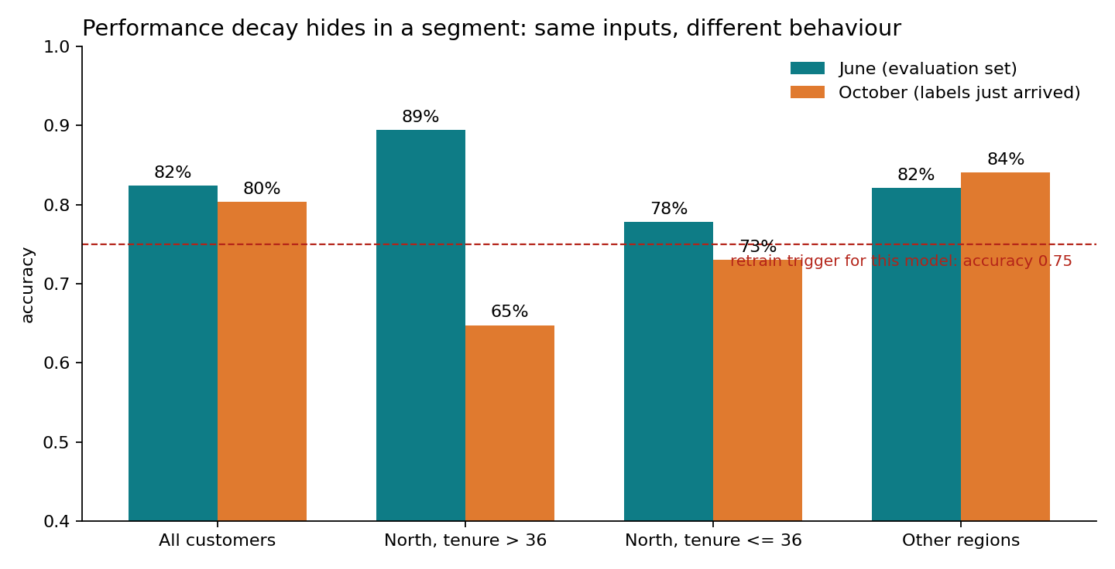
Master in Business Analytics and Data Science
What you just saw
3 of 7 drifted, verdict "no drift"
The default rule needs half the features to move. Thresholds are decisions, not facts.
Two points overall, seventeen in a segment
Tenure and region did not move; the behaviour did. Only labels, by segment, show it.
The explanation gave region zero weight: in June region did not matter. Now it does. Concept drift, made visible by an explanation.
MLOps · MBDS-PT2026F · Session 7 · Juan Ramírez
15
Notes:
Fix the demo in memory with the chart on the slide. Three things. The report flagged three of seven features (charges, promotions, and the model's own predictions) but declared "dataset drift not detected" because its default rule needs half the features to move: thresholds are decisions, not facts. The chart: overall accuracy fell two points, from 82% to 80%; in one segment, North customers with more than three years' tenure, it fell to 65%; the drift report could not see it because tenure and region did not move: the behaviour moved. The explanation: the model gave zero weight to region because in June region did not matter; now it does. Concept drift, made visible by an explanation.
Timing: minute 32–33.

Slide 16


Master in Business Analytics and Data Science
The cost of a false alarm, and the cost of a missed one
Too sensitive
Too lax
Alerts every week; each one costs two days of a data scientist and a review
After the third false alarm nobody reads them: alert fatigue
The monitor is switched off "temporarily"
NorthRetail: four months, €2.1M
A threshold that never fires is a threshold nobody tested
The dashboard is green; the business is not
Chat poll (2 min): "If the drift monitor fires, the model should retrain and redeploy automatically, no human needed." AGREE or DISAGREE, one line why.
MLOps · MBDS-PT2026F · Session 7 · Juan Ramírez
16
Notes:
Every threshold trades two errors. Too sensitive: alerts every week, a retrain that costs two days of a data scientist and a review, and after the third false alarm the team stops reading the alerts (alert fatigue). Too lax: NorthRetail, four months. Set thresholds from the cost of each error, and review them: an alert that never fires and an alert that fires weekly are both wrong. Then the chat poll (2 minutes): "If the drift monitor fires, the model should retrain and redeploy automatically, no human needed." AGREE/DISAGREE plus one line. Do not resolve; it is Theme A of Forum 4. The honest answer: automatic retraining is fine; automatic redeployment without validation and a gate is how you deploy a model trained on a broken extract (the rejected run in Session 3).
Timing: minute 33–35.

Slide 17
Master in Business Analytics and Data Science
Explainability: an operational requirement, not an academic one
Who asks for an explanation, what one looks like, and where it can mislead
Data ingestion & versioning
Data validation
Data pre-processing
Model training
Model tuning
Model analysis
Model validation
Model deployment
Model feedback
The lifecycle we follow through the course · highlighted: where this section sits
MLOps · MBDS-PT2026F · Session 7 · Juan Ramírez
17
Notes:
Section divider. Minute 35. The framing: explanations are asked for by four people, and three of them are not data scientists.

Slide 18




Master in Business Analytics and Data Science
Four people ask "why did the model do that?", and only one of them is a data scientist
The customer
The regulator
"Why was I rejected?" A right, under GDPR, to meaningful information about the logic.
"Show me this decision is not discriminatory." Credit, hiring, insurance; the EU AI Act (Session 12).
The business owner
The data scientist
"Why did the campaign target these customers and not those?" Trust before budget.
"Why did the North segment collapse?" Debugging drift; the demo.
Three of the four are not technical. An explanation nobody but its author understands is not an explanation. Purposes: trust, predict behaviour, improve.
Adapted from Ribeiro et al. (LIME, 2016) and Treveil et al. (2020)
MLOps · MBDS-PT2026F · Session 7 · Juan Ramírez
18
Notes:
Motivation from last year (many models are functionally black boxes; trust) recast as who asks. The customer: "why was I rejected?" The regulator: "show me that this decision is not discriminatory" (GDPR, the EU AI Act, Session 12). The business owner: "why did the campaign target these customers?" The data scientist debugging drift: "why did the North segment collapse?" (the demo). Three of the four are not technical; the explanation must be understandable by them. Explanations serve three purposes: trust (can I rely on this prediction?), prediction of behaviour (how will it act on new data?), improvement (can the model be made better?).
Timing: minute 35–37.

Slide 19
Master in Business Analytics and Data Science
Four reasons interpretability is needed
1 · Identify and mitigate bias
2 · Account for the context
Bias hides in any dataset and often shows only when you look at how predictions relate to inputs.
The data is a rough picture of the problem. Knowing what the model does not include changes what you do with its output.
3 · Generalise and perform better
4 · Ethical and legal reasons
Understanding the model usually produces a model that holds up on new data. Not every detail; the shape of the reasoning.
Finance and healthcare must audit decisions. GDPR. Where one wrong prediction has a large impact, the system must be verifiable.
MLOps · MBDS-PT2026F · Session 7 · Juan Ramírez
19
Notes:
Last year's four reasons, one slide. Identify and mitigate bias: bias can be present in any dataset; it often becomes visible only when the relation between predictions and inputs is analysed. Account for the context: the dataset is a rough representation; an interpretable model helps you see what it does not include and act accordingly. Generalise and perform better: understanding the model usually leads to a model that generalises better; interpretability is not about every detail. Ethical and legal: finance and healthcare must audit decisions; GDPR; applications where a single wrong prediction has a large impact must be verifiable.
Timing: minute 37–39.

Slide 20
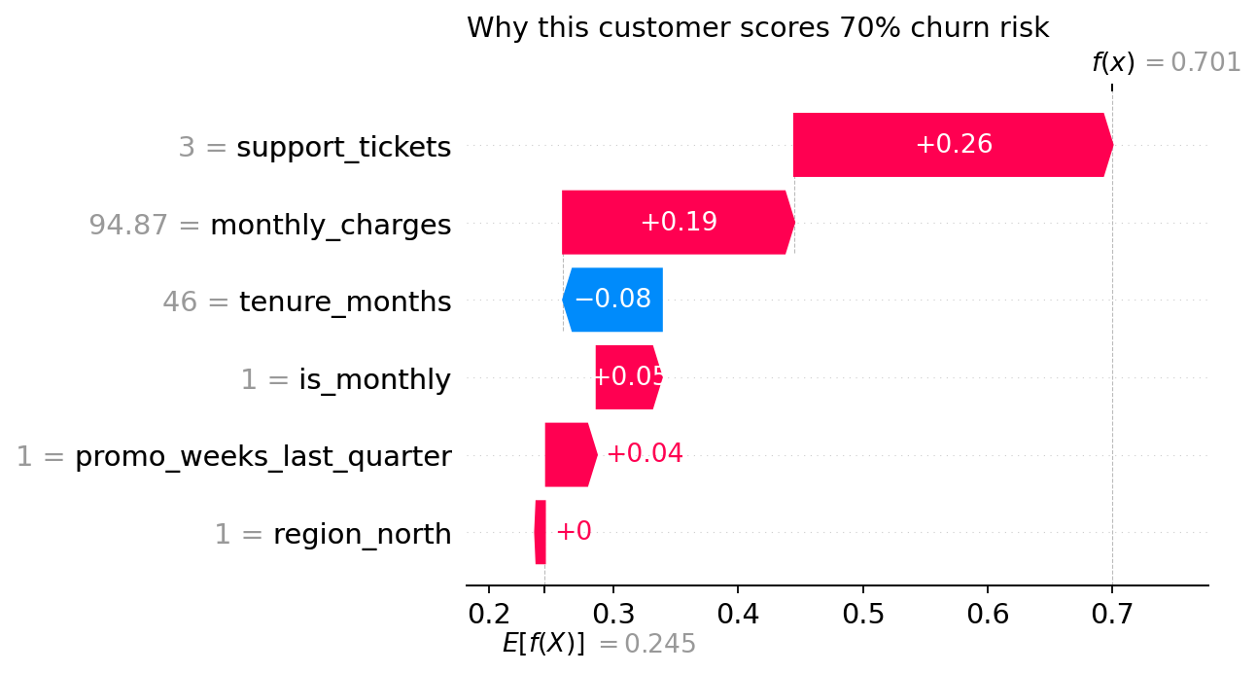
Master in Business Analytics and Data Science
What an explanation looks like: one customer, six features, one score
Transparent models
Simple enough to follow: a human could compute the prediction; each input and weight is understandable.
Post-hoc explanations
The model is complex; a method explains it afterwards: importance in words, visuals, examples, or one prediction at a time (LIME, SHAP).
Read it like a receipt: start from the average (24%), each feature adds or subtracts, arrive at 70%. A retention manager can read this without knowing what a random forest is.
MLOps · MBDS-PT2026F · Session 7 · Juan Ramírez
20
Notes:
Two routes to interpretability, from last year. Transparency: the model is simple enough to follow (a human could compute it; each input and parameter is understandable; the algorithm itself is understood). Post-hoc explanations: the model is complex, and a method explains its behaviour afterwards: feature importance in words, visualisations, representative examples, or local explanations around one prediction (LIME, SHAP). The chart is a SHAP waterfall for the customer in the demo: start from the average risk (24%), each feature pushes the score up (red) or down (blue), ending at 70%. Three support tickets and high charges pushed it up; long tenure pulled it down; region did nothing. A retention manager can read this without knowing what a random forest is.
Timing: minute 39–41.

Slide 21
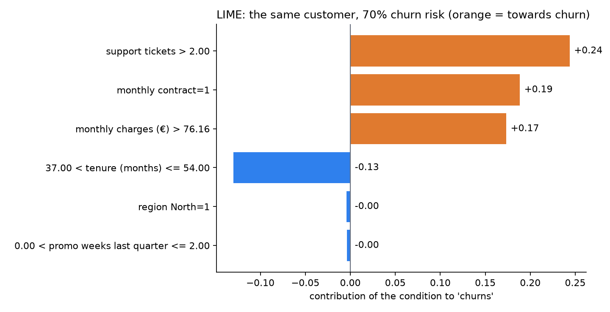
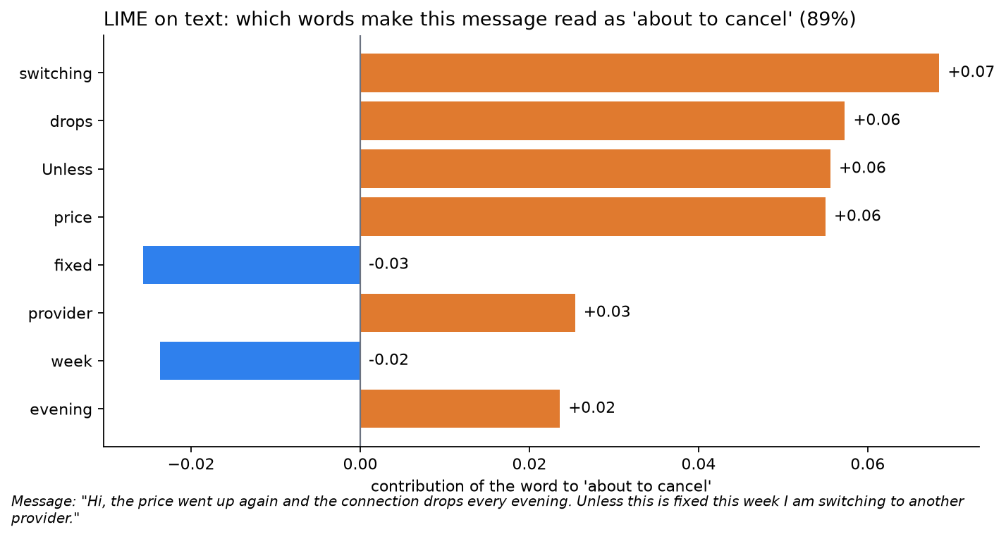
Master in Business Analytics and Data Science
A second opinion: LIME explains the same customer, and it can explain text
Same customer, different route
Text: which words drove the decision
LIME perturbs the input thousands of times and fits a simple model around her. Tickets, monthly contract, charges push up; tenure pulls down; region and promotions: nothing. SHAP said the same.
"switching", "drops", "unless", "price" push towards "about to cancel"; "fixed" and "week" pull back. A support manager reads it in five seconds. Session 10 starts here.
MLOps · MBDS-PT2026F · Session 7 · Juan Ramírez
21
Notes:
Two minutes, optionally with the browser: open lime_customer.html from S07/demo for the interactive version (script in MLOps_S07_Demo_Script.md, section 3, "Tab 4").
Left: LIME on the same customer as the SHAP waterfall. LIME works differently: it generates thousands of small variations of this customer, asks the model to score them, and fits a simple rule-like model around her; the bars are that simple model's weights. Read the story: more than two support tickets, a monthly contract and charges above €76 push towards churn; tenure between three and four and a half years pulls away; region and promotions: nothing. The same story as SHAP, by a different route. When two methods agree, trust the explanation more; when they disagree, that disagreement is itself information about how fragile the explanation is.
Right: what LIME does best, text. A support message classified as "about to cancel" with 89% confidence; LIME highlights the words that made the difference: "switching", "drops", "unless", "price", "provider"; "fixed" and "week" pull the other way. A support manager reads this in five seconds. Session 10: this is the seed of monitoring a language model, where "explain the output" becomes "which part of the input drove it".
Timing: minute 41–43.

Slide 22
Master in Business Analytics and Data Science
Do not trust an explanation blindly
1
An explanation is a model of the model
A simplified copy around one point. It can be wrong where the model is not locally simple.
2
It can be true and useless
"Your score is high because of feature 37." Interpretable features may not be the ones the model actually uses.
3
It is an operational signal
Store explanations with predictions; check them by segment; a shift in explanations is a monitoring signal (region at zero in June, decisive in October).
Explanations are evidence, not proof. Cheap enough to store with every prediction; valuable enough to audit.
MLOps · MBDS-PT2026F · Session 7 · Juan Ramírez
22
Notes:
Last year's caveats. A post-hoc explanation is itself a model of the model: a simplified copy around one point. It can be wrong: the model may not be locally linear; the interpretable features may not be the ones the model actually uses; too many important features make the explanation unreadable; it takes time to compute for each prediction. And an explanation can be true and useless: "your score is high because of feature 37". The operational rule: explanations are evidence, not proof; store them with the prediction, check them by segment, and treat a shift in explanations as a monitoring signal (the demo: region at zero).
Timing: minute 43–44.

Slide 23

Master in Business Analytics and Data Science
Bias: three places to catch it, two numbers to check
Data: who is in, who is missing
Training: what the objective rewards
Output: where the threshold falls
Pre-processing: rebalance; remove protected attributes and their proxies (postcode, first name)
In-processing: constraints during training that penalise unequal treatment
Post-processing: adjust thresholds or corrections on the output, per group, with a documented rationale
Equal error rates
Equal selection rates
Is the model wrong as often for men as for women? for the North as for the South? for new as for old customers?
Does it flag, approve or target groups at similar rates? If not, is the difference justified by the outcome, and documented?
The two can conflict. Choosing is a business and legal decision, made by the accountable owner with Risk & Compliance, not by the data scientist alone.
MLOps · MBDS-PT2026F · Session 7 · Juan Ramírez
23
Notes:
New slide, plain language. Bias enters with the data (who is in it, who is missing, which labels were recorded by whom), through the training (the objective rewards the majority), and at the output (a threshold that affects groups differently). It can be mitigated at each point: pre-processing (rebalance, remove or neutralise protected attributes and their proxies), in-processing (constraints during training), post-processing (different thresholds or corrections on the output). Two fairness numbers a non-technical person can demand: equal error rates across groups (is the model wrong as often for men as for women, for the North as for the South?), and equal selection rates (does it flag or approve groups at similar rates, and if not, is the difference justified by the outcome?). They can conflict; choosing between them is a business and legal decision, not a technical one. Forum 4 Q3 asks for one fairness risk and one audit method in credit scoring.
Timing: minute 44–46. Then the break.

Slide 24
Master in Business Analytics and Data Science
Break · 5 minutes
Back at minute 51. While you wait: which decision about you was made by a model this week, and could you get an explanation?
MLOps · MBDS-PT2026F · Session 7 · Juan Ramírez
24
Notes:
Five-minute break at minute 46. Check the rooms.

Slide 25
Master in Business Analytics and Data Science
Responsible AI, in the loop
Intentionality, accountability, and guardrails that are steps rather than documents
Data ingestion & versioning
Data validation
Data pre-processing
Model training
Model tuning
Model analysis
Model validation
Model deployment
Model feedback
The lifecycle we follow through the course · highlighted: where this section sits
MLOps · MBDS-PT2026F · Session 7 · Juan Ramírez
25
Notes:
Section divider. Minute 51. Seven minutes: what Responsible AI means operationally, the RACI revisited, a preview of the risk questionnaire that Video 2 develops. Then the activity brief.

Slide 26


Master in Business Analytics and Data Science
Responsible AI has two halves: intentionality and accountability
Intentionality
Accountability
Models designed and behaving in line with their purpose
Data from compliant, unbiased sources
Multiple checks on bias, by more than one person
Results explainable by humans who did not build the system
A central view: which teams use what data, how, in which models
Data reliable and collected within the rules
Traceability: when something goes wrong, you can find where (Session 3: lineage)
Someone signs (Session 1: the A in RACI)
Everything in this course so far is one of these two halves. Session 12 adds the regulation that makes them obligations.
Source: Treveil et al., Introducing MLOps (O'Reilly, 2020)
MLOps · MBDS-PT2026F · Session 7 · Juan Ramírez
26
Notes:
From Treveil. Intentionality: models are designed and behave in line with their purpose; data comes from compliant, unbiased sources; a collaborative approach with multiple checks on bias; results explainable by humans, ideally not only the ones who built the system. Accountability: a central view of which teams use what data, how, in which models; trust that data is reliable and collected within regulations; traceability: if something goes wrong, can you find where in the pipeline it happened (Session 3's lineage). Say: everything in this course so far is one of these two.
Timing: minute 51–53.

Slide 27
Master in Business Analytics and Data Science
Guardrails and audits are steps in the loop, not documents in a drawer
Where in the loop | The guardrail | Owner
Before training | Data-use check as a pipeline step: allowed? PII? protected attributes and proxies? Stops the run if not. | Data engineer (R), Risk & Compliance (C)
At validation | Fairness tests by segment as model tests, with thresholds; explanations sampled and reviewed. | ML engineer (R), Data scientist (C)
At approval | A named accountable owner signs; Risk & Compliance consulted for high-impact models. | Product owner (A)
In production | Fairness metrics and explanation drift in the monitoring plan, next to accuracy. | ML engineer (R)
Periodically | An audit re-runs the checks on stored predictions and explanations; findings become issues with owners. | Risk & Compliance (A)
Session 1's RACI, with one more column: who owns each guardrail. If nobody does, it is a document.
MLOps · MBDS-PT2026F · Session 7 · Juan Ramírez
27
Notes:
Map Responsible AI onto the loop from earlier. Before training: a data-use check (allowed? PII? protected attributes?) as a pipeline step that can stop the run. At validation: fairness tests by segment as model tests (Session 5's pyramid), with thresholds. At approval: a human gate with a named accountable owner, and Risk & Compliance consulted for high-impact models. In production: fairness and explanation drift monitored like accuracy, in the monitoring plan. Periodically: an audit that re-runs the checks on stored predictions and explanations. The RACI from Session 1 gets a new column of responsibilities: who owns each guardrail.
Timing: minute 53–55.

Slide 28
Master in Business Analytics and Data Science
Before Video 2: the questions a model-risk assessment asks
Compliance
Proportionality
Reliability
Fairness
Is this an algorithmic decision system? Does it follow privacy and data-protection rules?
Is personal data processed, and is all of it necessary?
Could it produce unreliable output, and what happens then?
Is there potential for discrimination in access or in outcomes?
Transparency
Contestability
Accountability
Wellbeing
Can the output be understood and explained to the affected person?
Can an affected person challenge or complain about the result?
Are the people in charge of development, deployment and monitoring clearly defined?
Could inaccurate outputs (including hallucinations or manipulation) cause loss or harm?
Video 2 (Session 12) turns this list into the EU AI Act risk tiers and the NIST AI Risk Management Framework. The activity's bonus question uses it.
MLOps · MBDS-PT2026F · Session 7 · Juan Ramírez
28
Notes:
A one-minute preview of last year's risk questionnaire, which Video 2 develops into the EU AI Act and NIST frameworks. Eight headings, each a question a non-technical owner can ask: compliance (is this an algorithmic decision system? does it follow privacy rules?), objective and proportionality (is personal data processed, and is it necessary?), reliability (could it produce unreliable output?), fairness (potential for discrimination?), transparency and explainability (can the output be understood?), contestability (can an affected person challenge the result?), accountability (are the people in charge of development, deployment and monitoring clearly defined?), human-centred values and wellbeing (could inaccurate outputs, hallucinations, manipulation cause harm?). The activity's bonus question uses this list.
Timing: minute 55–58. Then the activity brief.

Slide 29
Master in Business Analytics and Data Science
Activity · 15 minutes in breakout rooms: a monitoring plan for a churn model
Your task (15 min)
How to work
Read the case: TelcoNova churn model, monthly batch, 30-day label lag, two recent changes
Fill the monitoring plan: two data-drift metrics · one concept-drift signal · one performance metric by segment · one operational metric
For each: threshold (number + window) and action (alert whom, retrain, roll back, investigate)
Bonus: one fairness check, and one risk-questionnaire question that applies
Rooms of 4–5: your project team
Monitoring plan template on campus (or a whiteboard)
Use today's vocabulary: the three kinds of "worse", the plan's four columns, the loop, the two fairness numbers
Ask yourselves: what does a false alarm cost here? and a missed one?
Nominate a spokesperson: 2 minutes
Output per room: one slide or whiteboard. Three rooms present in the debrief; everyone posts theirs on the forum.
MLOps · MBDS-PT2026F · Session 7 · Juan Ramírez
29
Notes:
Brief before the rooms. Every room gets the same case: TelcoNova's churn model, with its cadence, its lag and two recent changes (a pricing change, a competitor in two regions). They fill the monitoring plan: two data-drift metrics, one concept-drift signal, one performance metric by segment, one operational metric, each with a threshold and an action, plus who receives the alert. Bonus: one fairness check and one row from the risk questionnaire that applies. Output: one slide or whiteboard; three rooms present.
Timing: brief 58–60; case 60–61; rooms 61–76; debrief 76–86.

Slide 30
Master in Business Analytics and Data Science
The case: TelcoNova churn model (facts only)
TelcoNova has 2 million residential customers. The churn model scores all of them on the first day of each month; the retention team calls the top 5% (about 100,000 customers) with an offer. A call costs about €4; a saved customer is worth about €300 a year.
Features: tenure, monthly charges, support tickets, promotions received, contract type, region. Trained in June on the previous twelve months. Evaluation accuracy 82%; the model card sets the retrain trigger at 75%.
Labels: whether a customer churned is known at the end of the following month (a 30-day lag). Retraining costs two days of a data scientist plus a review by the product owner.
Change 1 (September): a new pricing plan moved monthly charges up by €10–20 for about 40% of customers. The data team was not told.
Change 2 (September–October): a competitor launched fibre in two regions. Long-tenure customers there, who never churned, have started to leave.
The retention team reports that October's call list "felt wrong": many loyal customers were not on it, and the saved-customers count fell 15%.
Monitoring plan
2 data-drift metrics
1 concept-drift signal
1 performance metric, by segment
1 operational metric
Each: threshold (number + window) · action · who is alerted
Bonus: 1 fairness check · 1 risk question
MLOps · MBDS-PT2026F · Session 7 · Juan Ramírez
30
Notes:
Read the facts once, aloud. The two changes are designed to be one data drift (pricing) and one concept drift (competitor), so that the rooms must propose different signals for each. Full text on campus. Send them to rooms at minute 61.

Slide 31
Master in Business Analytics and Data Science
Debrief: what we heard, and what it tells us
Row | A strong answer
Data drift (2) | Share of drifted features, weekly: >30% two weeks running → alert ML engineer, check the extract with the data team. Monthly-charges distribution vs training: mean up >€8 → same, and ask the business what changed.
Concept-drift signal (1) | Predicted risk by region and tenure band, monthly: a segment's mean moves >5 points, or the call list's regional mix shifts sharply → investigate with the business before labels arrive. Business KPI: saved customers per campaign down >10% → escalate to the product owner.
Performance (1) | Accuracy on the month's labels, by region and tenure band: <75% overall or <70% in any segment >200 customers → retrain with new labels, consider region interactions; product owner approves the new version.
Operational (1) | Batch finished before 6 a.m. on day 1 (else page IT); share of customers with missing features >5% → hold the call list.
Bonus | Fairness: call-list selection rate by region and tenure band, with a documented justification if unequal. Risk question: contestability or fairness.
Monitoring is not a dashboard. It is a list of numbers, each with a line and a person behind it.
MLOps · MBDS-PT2026F · Session 7 · Juan Ramírez
31
Notes:
Three rooms present (76–82), then synthesis (82–86) with the table.
Expected: data drift, share of drifted features weekly (more than 30%, two weeks running → alert the ML engineer, check the extract with the data team, retrain on recent data if confirmed) and distribution of monthly charges vs training (mean up more than €8 → same); concept drift, an early signal before labels: distribution of predicted risk by region and tenure band (a segment's mean prediction moving more than 5 points, or the call list's composition changing sharply by region → investigate with the business: "what changed in the North?"), and the saved-customers count per campaign as the business KPI (down more than 10% → escalate to the product owner); performance, accuracy on the month's labels by region and tenure band (below 75% overall or below 70% in any segment over 200 customers → retrain with new labels, include region interactions, product owner approves); operational, the batch finishing before the retention team starts (not by 6 a.m. → page IT) and the share of customers with missing features. Fairness: selection rate of the call list by region and by tenure band, with a justification if unequal. Risk question: contestability (can a customer who was not called complain?) or fairness.
Correct: rooms that propose "retrain every month automatically" (costs two days each time, and would have trained on the September pricing data without anyone knowing why); rooms with thresholds without windows; rooms without a segment.
Close: "Monitoring is not a dashboard. It is a list of numbers, each with a line and a person behind it."
Timing: minute 76–86.

Slide 32
Master in Business Analytics and Data Science
Three things to remember
1
Three different things hide behind "worse".
Data drift: the inputs moved (visible without labels). Concept drift: the behaviour moved (needs labels, hides in segments). Performance decay: the symptom.
2
No threshold: a chart. No action: an alarm nobody answers.
The monitoring plan: metric, what it detects, number + window, action + person. Set thresholds from the cost of both errors.
3
Explanations are operational.
Customers, regulators and owners ask for them; they are evidence, not proof; store them with the prediction and watch them move.
MLOps · MBDS-PT2026F · Session 7 · Juan Ramírez
32
Notes:
Cheat-sheet material. Timing: minute 86–87.

Slide 33

Master in Business Analytics and Data Science
Your forum this week: Session 8 · 24–30 October, and Video 1
Q1
For a churn-prediction model, define a monitoring plan: list the metrics you would track for data drift, concept drift, and performance decay, and the alert thresholds that would trigger retraining.
Q2
Explain the difference between data drift and concept drift with a concrete example of each. How would your operational response differ between the two?
Q3
Pick an algorithmic decision system (e.g., credit scoring). Identify one fairness risk and one explainability requirement, and describe how you would audit for each.
Video 1 opens today: Monitoring Metrics in Depth (60 min, self-paced) · a 10-question knowledge check that counts towards continuous assessment. Watch it before answering Q1; the forum is about decisions, the video about definitions.
MLOps · MBDS-PT2026F · Session 7 · Juan Ramírez
33
Notes:
Verbatim from the syllabus. Q1 = the monitoring plan template and the activity; Q2 = the taxonomy slide; Q3 = the bias slide and the four-people slide. Video 1 opens today: the metrics in depth, 60 minutes, and a ten-question knowledge check that counts towards continuous assessment; point them to it for the metric definitions so the forum stays on decisions and thresholds. The poll is Theme A.
Timing: minute 87–89.

Slide 34

Master in Business Analytics and Data Science
Before Session 10 (Saturday 31 October): read the failure briefs, and watch Video 1
Read
Watch and answer
The six failure briefs on campus (one page each). Your team is allocated one; arrive having read it
Optional: Huyen, AI Engineering (O'Reilly, 2025), chapters 1 and 4
Video 1: Monitoring Metrics in Depth (60 min)
The knowledge check inside it, by Friday 30 October
Bring one metric you did not know to Session 10
Next: Session 10 · LLMOps & Enterprise Scenario Diagnostics
What changes when the model is a language model · prompts, RAG, guardrails, cost · the failure-case workshop · the course in one picture
MLOps · MBDS-PT2026F · Session 7 · Juan Ramírez
34
Notes:
Reading: the six failure briefs posted on campus, one page each; every team will be allocated one of them for the workshop and must arrive having read it. Huyen, AI Engineering (2025), chapters 1 and 4 (introduction; evaluation) for those who want the LLM background. Watch Video 1 and do its quiz by Friday. Preview: Session 10 is LLMOps, what changes when the model is a language model, plus the failure-case workshop and the course synthesis. Thank them; stop on time. Minute 89–90.

Slide 35
Master in Business Analytics and Data Science
Appendix · Drift statistics and explainers (not examinable)
Five slides for the curious: the two univariate tests, the domain classifier, how LIME and SHAP compute an explanation, and the Python lines behind the demo (Evidently; SHAP and LIME). Not covered live; not in the exam.
MLOps · MBDS-PT2026F · Session 7 · Juan Ramírez
35
Notes:
Appendix divider. Not covered live.

Slide 36

Master in Business Analytics and Data Science
Appendix · Two tests, one feature at a time
Kolmogorov–Smirnov (continuous)
Chi-squared (categorical)
Do two samples come from the same distribution?
Measures the largest gap between the two cumulative curves
Small p-value: the difference is unlikely to be chance
Reported alongside a distance: Wasserstein
Do the category frequencies match the training frequencies?
Observed vs expected counts per category
Same reading: small p-value, unlikely to be chance
Reported alongside a distance: Jensen–Shannon
p-values detect an effect; they do not measure its size. On big data they flag tiny changes. Set thresholds on the distance, not only on the p-value.
MLOps · MBDS-PT2026F · Session 7 · Juan Ramírez
36
Notes:
Not covered live. Kolmogorov–Smirnov for continuous features: a non-parametric test of whether two samples come from the same distribution; it measures the largest vertical distance between the two cumulative distribution curves; a small p-value says the difference is unlikely to be chance. Chi-squared for categorical features: compares the observed frequencies of each category in the new data with the frequencies expected from the training data. Advantage of p-values: they detect drift quickly. Drawback: they detect an effect but do not measure its size; on large datasets they flag tiny, harmless changes, which is why tools also report a distance (Wasserstein, Jensen–Shannon) and let you set a threshold on it.

Slide 37
Master in Business Analytics and Data Science
Appendix · The domain classifier
1
Label rows by origin
Training set = 0, production set = 1. Optionally add the model's prediction as a feature.
2
Train a classifier on that label
If it scores near 50%, the two look alike: no drift. If it scores high, the data has drifted; its accuracy is the drift score.
3
Read its feature importance
The features it used to tell them apart are the ones that moved, including combinations that single-feature tests miss.
MLOps · MBDS-PT2026F · Session 7 · Juan Ramírez
37
Notes:
Not covered live. Train a model whose target is the origin of each row: training set or production set (optionally including the model's prediction as a feature). If it cannot tell them apart (accuracy near 50%), no drift. If it can, the data has drifted, and its accuracy is a single drift score for the whole dataset, unlike the one-feature-at-a-time tests. Its feature importance ranks the features responsible for the drift, which tells you where to look. Cost: training a model for each check; benefit: it captures changes in combinations of features that univariate tests miss.

Slide 38
Master in Business Analytics and Data Science
Appendix · How LIME and SHAP compute an explanation
LIME
SHAP
Perturb the input many times; score the variations; fit a simple linear model around the point
Its weights are the explanation
Model-agnostic: works for text and images too
Cons: local fit may be poor; results vary with sampling
Each feature's contribution = its average marginal effect over all orderings (Shapley values)
Contributions add up exactly to prediction minus average: the waterfall
Exact and fast for trees; approximate otherwise
Plots: waterfall (one case), beeswarm and bar (many cases)
Ribeiro, Singh & Guestrin (2016); Lundberg & Lee (2017). Demo files: S07/demo/shap_waterfall.png, lime_customer.html, lime_text.html
MLOps · MBDS-PT2026F · Session 7 · Juan Ramírez
38
Notes:
Not covered live. LIME (Local Interpretable Model-agnostic Explanations): to explain one prediction, generate many small variations of that input, ask the model to score them, and fit a simple linear model to those scores around the point; the linear model's weights are the explanation; works for any model, including text and images; can surprise you about what the model really uses. Cons: the local linear model can be a poor fit; results vary with the sampling. SHAP (SHapley Additive exPlanations): from game theory; each feature's contribution is its average marginal effect over all possible orderings of the features; contributions add up exactly to the difference between the prediction and the average prediction, which is why the waterfall works; exact and fast for tree models (TreeExplainer), approximate for others. Plots: waterfall (one prediction), force, bar and beeswarm (many predictions).

Slide 39
Master in Business Analytics and Data Science
Appendix · The Evidently lines behind the drift report
The report you saw (s7_demo_setup.py)
The same, as tests a scheduler can act on (Video 1)
from evidently import Report, Dataset, DataDefinition
from evidently.presets import DataDriftPreset
ref["prediction"] = model.predict_proba(ref[F])[:, 1]
cur["prediction"] = model.predict_proba(cur[F])[:, 1]
d = DataDefinition(
numerical_columns=["tenure_months", "monthly_charges",
"support_tickets", "promo_weeks", "prediction"],
categorical_columns=["is_monthly", "region_north"])
ref_ds = Dataset.from_pandas(ref, data_definition=d)
cur_ds = Dataset.from_pandas(cur, data_definition=d)
report = Report([DataDriftPreset()])
snap = report.run(cur_ds, ref_ds) # current, reference
snap.save_html("drift_report.html")
from evidently.metrics import (DriftedColumnsCount,
ValueDrift, MissingValueCount, MeanValue)
from evidently.tests import lt, lte
report = Report([
DriftedColumnsCount(tests=[lte(2)]), # <= 2 of 7
MeanValue(column="monthly_charges",
tests=[lte(70)]), # <= 70 EUR
MissingValueCount(column="tenure_months",
tests=[lte(0.05)]), # <= 5%
ValueDrift(column="prediction",
tests=[lt(0.10)]), # < 0.10
])
snap = report.run(cur_ds, ref_ds)
for t in snap.dict()["tests"]:
print(t["status"], t["name"]) # PASS / FAIL
The model is never touched: monitoring code sits beside the model, not inside it. Left produces a page for a person; right produces PASS/FAIL for a scheduler (S09/demo/run_alert_checks.py).
MLOps · MBDS-PT2026F · Session 7 · Juan Ramírez
39
Notes:
Not covered live unless someone asks "how much code is that report?" (or open s7_demo_setup.py in an editor). Left: the seven lines that produced drift_report.html. Two DataFrames, reference and current, with the model's prediction added as a column so prediction drift is checked too; a DataDefinition that says which columns are numbers and which are categories; the two Datasets; a Report with the DataDriftPreset; run; save. Right: the same report as tests, which is what the Video 1 monitoring job does: instead of a preset you list metrics, each with a test (lte, lt), and the snapshot returns PASS or FAIL per test, so a scheduler can act on it. Point out that the model is not touched in either column; monitoring code sits beside the model, not inside it. Version used: evidently 0.7.x; the class names changed in 0.5 and again in 0.7, so older tutorials look different.

Slide 40
Master in Business Analytics and Data Science
Appendix · The SHAP and LIME lines behind the explanations
SHAP: the waterfall and the beeswarm
LIME: the same customer, and a support message
import shap
explainer = shap.TreeExplainer(model) # once
# one customer: North, tenure > 36, highest risk
north = cur[(cur.region_north == 1) &
(cur.tenure_months > 36)]
x = north.sort_values("prediction").tail(1)[F]
sv = explainer(x)[0, :, 1] # class 1 = "churns"
shap.plots.waterfall(sv, max_display=6)
# many customers: what drives risk in general
sample = cur[F].sample(600, random_state=3)
svs = explainer(sample)[:, :, 1]
shap.plots.beeswarm(svs, max_display=6)
from lime.lime_tabular import LimeTabularExplainer
from lime.lime_text import LimeTextExplainer
exp = LimeTabularExplainer(ref[F].values,
feature_names=F, class_names=["stays", "churns"],
categorical_features=[4, 5], random_state=7)
e = exp.explain_instance(x.values[0], model.predict_proba,
num_features=6, num_samples=5000)
e.save_to_file("lime_customer.html")
texp = LimeTextExplainer(class_names=["stays", "cancel"])
te = texp.explain_instance(msg, clf.predict_proba,
num_features=8)
te.save_to_file("lime_text.html")
Both need only a predict function, so they work with any model. SHAP: exact for trees, adds up to the prediction. LIME: any model, any input type (text here), fits a local approximation. Full scripts: S07/demo/s7_demo_setup.py, s7_lime_setup.py.
MLOps · MBDS-PT2026F · Session 7 · Juan Ramírez
40
Notes:
Not covered live unless someone asks "how did you make the waterfall?". Left, SHAP: one explainer object built from the trained model (TreeExplainer, exact and fast for tree models; shap.Explainer picks a method for anything else); call it on one row for one customer, or on a sample for the beeswarm; for a binary classifier the result has a third dimension, and index 1 is the "churns" class; then one plotting call each. Right, LIME: the tabular explainer needs the training data to learn what "normal variations" look like, the feature names for the labels, and which columns are categorical; explain_instance takes the row and the model's predict_proba function, generates 5,000 variations and fits the local model; save_to_file writes the interactive HTML. For text, three lines: the explainer with the class names, explain_instance with the message and the pipeline's predict_proba, and save. Both libraries only need a predict function: they work with any model, which is why they are the standard pair. Versions: shap 0.51, lime 0.2 (lime needs setuptools<70 to install; the pre-rendered files in S07/demo mean you do not have to).

