Slide 1

Master in Business Analytics and Data Science
MLOps: Machine Learning Operations
Video 1 · Session 9 · self-paced, 60 minutes
Monitoring Metrics in Depth: Classical ML and Prompt/LLM Deployments
Juan Manuel Ramírez García · jramirezg@faculty.ie.edu
Available 24–30 October 2026 · ends with a 10-question knowledge check that counts towards continuous assessment
Data ingestion & versioning
Data validation
Data pre-processing
Model training
Model tuning
Model analysis
Model validation
Model deployment
Model feedback
MLOps · MBDS-PT2026F · Video 1 (Session 9) · Monitoring Metrics in Depth · Juan Ramírez
1
Notes:
RECORDING SCRIPT · minute 0:00
Hello, and welcome to the first video lesson of the course. This is Session 9: a self-paced deep-dive into the metrics we use to watch a model once it is in production. In Session 7 we saw why models get worse and how to build a monitoring plan; today we open the toolbox and look at each metric properly: what it measures, which failure it would reveal, and, in the second half, two things the textbooks skip: how hard it is to get the truth you need to compute many of these metrics, and what an alert actually looks like when it is wired into production.
The video is about sixty minutes, in seven segments; the label in the top-right corner tells you where you are. Pause between segments. At the end there is a knowledge check of ten questions; it counts towards your continuous assessment, so keep a page of notes. Everything you need for the quiz is in these slides.
Very little mathematics. Where a formula matters for a decision you will make, I show it; otherwise I tell you what the number means.
[Timing: 0:00–1:00]

Slide 2




Master in Business Analytics and Data Science
Seven segments, two families of deployment, and how to use the video
# | Segment | What is in it | Minutes
1 | The drifts | input · prediction · concept | 3–13
2 | Performance | one confusion matrix; accuracy, precision, recall, AUC, calibration | 13–24
3 | Ground truth | which metrics need the truth; late, partial, absent labels | 24–31
4 | Operational | latency (p95), throughput, errors, cost, freshness | 31–34
5 | LLM deployments | judge, then measure the judge; hallucination, PII, tokens | 34–45
6 | Alerts in production | demo: rules → job → scheduler → message | 45–56
7 | Wrap-up | three things; the knowledge check | 56–60
Classical ML
TelcoNova churn · IberBank fraud. There is, eventually, a right answer.
Prompt / LLM
An HR assistant answering from policy documents. Usually no single right answer.
One line per metric in your notes: "this metric would catch …, and it needs … to be computed". The knowledge check asks for both halves.
MLOps · MBDS-PT2026F · Video 1 (Session 9) · Monitoring Metrics in Depth · Juan Ramírez
2
Notes:
RECORDING SCRIPT · minute 1:00
Here is the map. Segment one, the three drifts: input, prediction, concept. Segment two, the performance metrics: accuracy, precision and recall, AUC, calibration, all from one confusion matrix. Segment three is new this year: ground truth, which is to say, the awkward fact that most performance metrics need to know what really happened, and in production you often do not know, or you know late, or only for some cases. Segment four, three minutes on operational metrics. Segment five, language-model deployments, where there is usually no right answer at all. Segment six, alerts in production: a demo, with real files, of how a monitoring job evaluates rules, decides who to wake up, and sends the message. Segment seven, wrap-up and the quiz.
Running examples you know: TelcoNova churn and IberBank fraud; plus an internal HR assistant that answers from policy documents for the LLM segment. How to use it: for each metric, write one line: "this metric would catch…, and it needs… to be computed". That second half of the sentence is what segment three is about, and the quiz asks for both.
[Timing: 1:00–3:00]

Slide 3
Master in Business Analytics and Data Science
Segment 1 · The drifts · 3–13 min
Every drift metric compares two windows, and five choices decide whether the alert is useful
Reference window
June training data, or the first good weeks in production
Current window
last week · last month · the last 10,000 requests
a distance between the two
1 · Reference
2 · Window
3 · Threshold
4 · Weighting
5 · Segments
wrong reference, every metric wrong; a promotion week makes normal weeks look drifted
too short: noise; too long: late. Match it to how fast the business changes
on the distance, from the cost of a false alarm vs a missed one; not a p-value alone
share of drifted features, weighted by how much the model relies on each
region, tenure band, channel: drift hides where the overall picture looks calm
Evidently, the cloud monitors and IBM watsonx.governance compute the same distances. These five choices are yours, and they are where monitoring succeeds or fails.
MLOps · MBDS-PT2026F · Video 1 (Session 9) · Monitoring Metrics in Depth · Juan Ramírez
3
Notes:
RECORDING SCRIPT · minute 3:00
Segment one: the drifts. The model is a photograph of the world taken in June; the world keeps moving; drift is the distance between the picture and the world. Before any metric, two decisions people forget. The reference: what are we comparing against? The training data, or the first weeks in production when the model was known to be good. The current window: last week, last month, the last ten thousand requests. Too short and you see noise; too long and you see the change late. Every drift metric is a distance between these two windows; if the reference is wrong, every metric is wrong.
Then three more choices that decide whether the alert means anything. The threshold, set on the distance and from the cost of a false alarm versus a missed one, not on a p-value alone. The aggregation: the share of features that drifted, weighted by how much the model relies on each; drift in a feature the model ignores is noise. And segments: drift hides in a region or a customer type while the overall picture looks calm. Tools, Evidently, the cloud monitors, IBM watsonx.governance, all compute the same distances; these five choices are yours.
[Timing: 3:00–5:30]

Slide 4

Master in Business Analytics and Data Science
Segment 1 · The drifts · 3–13 min
Input drift: the features the model receives look different from the ones it learned from
monthly_charges · reference (June) vs current (October)
How it is measured
Numeric: a distance between curves (Wasserstein) or a test (Kolmogorov–Smirnov, p-value)
Categorical: a distance between frequencies (Jensen–Shannon) or chi-squared
reference: centred on €62
current: centred on €76
Catches · misses · needs
Catches: units changed, pricing changed, a new segment
Misses: same inputs, different behaviour
Needs: inputs only; no labels, no waiting
Read the distance, not only the verdict; on big data, tests flag harmless changes. One drifted feature is a question; half of them is an alarm.
MLOps · MBDS-PT2026F · Video 1 (Session 9) · Monitoring Metrics in Depth · Juan Ramírez
4
Notes:
RECORDING SCRIPT · minute 5:30
Input drift, also called feature or data drift. The question: are today's inputs like the training inputs? The picture: monthly charges, June on the left, October on the right, shifted up by a new pricing plan.
How it is measured, one line each. For a numeric feature, a distance between the two curves, the Wasserstein distance, roughly "how far would you have to move the mass of one curve to make it the other", or a test such as Kolmogorov–Smirnov that gives a p-value. For a categorical feature, a distance between the two sets of frequencies, Jensen–Shannon, or a chi-squared test. Tools report a score per feature and a verdict against a threshold.
Two cautions. Tests on large datasets flag tiny harmless changes, so read the distance, not only the verdict. And one drifted feature is a question; half of them is an alarm. What it catches: a supplier changing units, a pricing change, a new segment arriving. What it misses: behaviour changing with the same inputs. And notice what it needs: inputs only. No labels, no waiting. Keep that in mind for segment three.
[Timing: 5:30–8:00]

Slide 5


Master in Business Analytics and Data Science
Segment 1 · The drifts · 3–13 min
Prediction drift: the model's own outputs have moved, and that is the earliest warning you get
The question
Why it is the earliest warning
Are the model's outputs distributed like they were at reference time?
June: 12% of customers above 50% risk. October: 21%.
Needs: the logged predictions only; no labels, no waiting
A summary of all input drifts, as the model sees them
A hint of concept drift if the model reacts to something new
Measured like a numeric feature: a distance between two score distributions, or the share of each predicted class
Catches
Misses
Broken inputs in combination · a deployment that flags everyone or nobody · a segment quietly growing
A model confidently wrong in the same proportions as before. For that you need labels.
MLOps · MBDS-PT2026F · Video 1 (Session 9) · Monitoring Metrics in Depth · Juan Ramírez
5
Notes:
RECORDING SCRIPT · minute 8:00
Prediction drift is the drift metric people forget, and the most useful one when labels are late. The question: is the distribution of the model's outputs today like the distribution at reference time? In June the churn model gave 12% of customers a risk above 50%; this month, 21%. Nothing else is needed: the predictions are already in the log.
Why it matters: it summarises all the input drifts as the model sees them, plus a hint of concept drift if the model is reacting to something. Measured like any numeric feature, a distance between two score distributions, or the change in the share of each predicted class. What it catches: broken inputs in combination, a deployment that flags everyone or nobody, a segment quietly growing. What it misses: a model confidently wrong in the same proportions as before. For that you need labels, and that is the third drift, and segment three.
[Timing: 8:00–10:00]

Slide 6


Master in Business Analytics and Data Science
Segment 1 · The drifts · 3–13 min
Concept drift: the same inputs now lead to a different outcome
The question
How you know, and how you guess early
Do the same inputs still lead to the same outcome?
The North: tenure and region unchanged, behaviour changed. Accuracy in the segment 89% → 65%
Invisible in the inputs; needs labels, and labels are late
Labels: compare predictions with outcomes, overall and by segment, over time
Early hints: prediction drift, a shift in which features drive explanations, the business KPI ("the call list feels wrong")
Shapes of concept drift
Sudden
Gradual
Seasonal
Recurring
a rule changes overnight
habits shift over a year
every December; not drift if the model knows the season
comes and goes with the market
MLOps · MBDS-PT2026F · Video 1 (Session 9) · Monitoring Metrics in Depth · Juan Ramírez
6
Notes:
RECORDING SCRIPT · minute 10:00
Concept drift: the inputs look the same, the relationship between inputs and outcome has changed. In Session 7's demo a competitor launched fibre in the North and long-tenure customers who never churned started leaving. Tenure did not move, region did not move; the behaviour moved. The drift report saw nothing; accuracy in that segment fell from 89% to 65%.
How you know: only with labels. When the outcomes arrive you compare predictions with reality, overall and by segment, over time. Because labels are late, you triangulate with the two earlier drifts, with a shift in which features drive the explanations, and with the business KPI, which usually shows it first as "the call list feels wrong". Shapes worth knowing: sudden, a regulation overnight; gradual, habits over a year; seasonal, every December, which is not drift if the model knows the season; recurring. What it catches: everything the other two miss. What it costs: waiting for the truth.
[Timing: 10:00–12:00]

Slide 7
Master in Business Analytics and Data Science
Segment 1 · The drifts · 3–13 min
The three drifts side by side
 | Input drift | Prediction drift | Concept drift
What moved | The features the model receives | The model's own outputs | The relationship between inputs and outcome
Evidence needed | Inputs only | The logged predictions only | Labels (the outcomes), usually late
How it is measured | Distance or test per feature (Wasserstein, KS; Jensen–Shannon, chi-squared); share of drifted features | Distance between score distributions; change in predicted-class shares | Performance metrics over time, overall and by segment
When you can check | Daily, weekly | Daily, weekly | When labels arrive: monthly, or after 60 days
Typical catch | Units changed, pricing changed, a new segment | Broken combinations, a deployment flagging everyone, a growing segment | Behaviour changed: a competitor, a regulation, a crisis
The first two buy time while you wait for the third. A plan with only the third finds out months late; a plan with only the first two never confirms.
MLOps · MBDS-PT2026F · Video 1 (Session 9) · Monitoring Metrics in Depth · Juan Ramírez
7
Notes:
RECORDING SCRIPT · minute 12:00
The summary table for the quiz. Input drift: the features moved; evidence, the inputs alone; measured with distances and tests per feature; it catches broken or changed data. Prediction drift: the outputs moved; evidence, the model's own scores; the earliest warning; it catches combinations and deployment accidents. Concept drift: the relationship moved; evidence needs labels; measured as performance over time by segment; it catches changes in the world the inputs do not show.
The order matters operationally. Input and prediction drift you can check daily without waiting; concept drift you confirm when labels arrive, monthly, or later. The first two exist to buy time while you wait for the third. End of segment one.
[Timing: 12:00–13:30]

Slide 8

Master in Business Analytics and Data Science
Segment 2 · Performance · 13–24 min
One picture for all the performance metrics: the confusion matrix
Model said: churn
Model said: stay
1,000 customers, June
Really churned (200)
140
True positives
flagged, and they left
60
False negatives
missed: they left unflagged
Model flagged 250
200 actually churned
Every metric that follows is a ratio of the four boxes
Really stayed (800)
110
False positives
flagged, but they stayed
690
True negatives
not flagged, and they stayed
250 flagged
750 not flagged
The rows are the truth. Without knowing who really churned, none of the four boxes can be filled, and none of the next four metrics exists.
MLOps · MBDS-PT2026F · Video 1 (Session 9) · Monitoring Metrics in Depth · Juan Ramírez
8
Notes:
RECORDING SCRIPT · minute 13:30
Segment two: the performance metrics, the ones you compute when labels arrive. There are many; you need four, and one picture to understand all of them.
One thousand customers scored in June. The model flagged 250 as likely to churn. The month ended; 200 actually churned. Cross the two. Of the 250 flagged, 140 did churn: true positives. 110 did not: false positives, called for nothing. Of the 750 not flagged, 60 churned anyway: false negatives, the ones we missed. 690 stayed as predicted: true negatives. Every metric in this segment is a ratio of these four numbers. And notice: to fill in any of the four boxes, you must know who really churned. Hold that.
[Timing: 13:30–15:30]

Slide 9


Master in Business Analytics and Data Science
Segment 2 · Performance · 13–24 min
Accuracy: how often the model is right, and why that can lie
Accuracy = (true positives + true negatives) / all
Churn model: 83%
Fraud model that blocks nothing: 99.6%
(140 + 690) / 1,000 = 0.83
Churn is 20% of customers: accuracy is usable here
10,000 transactions, 40 fraud, zero blocked
(0 + 9,960) / 10,000 = 0.996, and zero fraud caught
Accuracy rewards the majority. When "99% accurate" is reported, ask first: how rare is the thing it predicts?
MLOps · MBDS-PT2026F · Video 1 (Session 9) · Monitoring Metrics in Depth · Juan Ramírez
9
Notes:
RECORDING SCRIPT · minute 15:30
Accuracy: the share of all decisions that were right, true positives plus true negatives over everything. 140 plus 690 over 1,000: 83%. For balanced problems it is fine.
Now the fraud model. Ten thousand transactions, forty are fraud. A "model" that blocks nothing is right on 9,960 of 10,000: accuracy 99.6%, zero fraud caught. Accuracy rewards the majority class; when the event is rare it is nearly meaningless. Churn at 20% is borderline; fraud at 0.4% is hopeless. When someone says "99% accurate", your first question is "how rare is the thing it predicts?".
[Timing: 15:30–17:00]

Slide 10

Master in Business Analytics and Data Science
Segment 2 · Performance · 13–24 min
Precision and recall trade against each other through one dial: the threshold
Precision: of what was flagged, how much was right?
Recall: of what really happened, how much was caught?
140 / (140 + 110) = 56%
Low precision = wasted calls, customers wrongly blocked
140 / (140 + 60) = 70%
Low recall = churners never called, fraud that went through
Threshold | Flagged | Precision | Recall | Who would choose it
0.3 | 400 | 42% | 85% | A big call budget that cannot afford to miss anyone
0.5 | 250 | 56% | 70% | The default; nobody chose it
0.7 | 120 | 75% | 45% | A small budget that wants every call to count
The threshold is a business setting, not a model property. Report precision and recall at the threshold you use, and re-check it when the model drifts. F1 compares models; it does not explain them.
MLOps · MBDS-PT2026F · Video 1 (Session 9) · Monitoring Metrics in Depth · Juan Ramírez
10
Notes:
RECORDING SCRIPT · minute 17:00
Two metrics that look at the positives only. Precision: of everything flagged, how much was right? 140 of 250, 56%. Recall: of everything that really happened, how much was caught? 140 of 200, 70%. Low precision is wasted calls and wrongly blocked customers; low recall is churners never called and fraud that went through. Which matters more is a business decision: for the retention campaign, precision is money, every call costs €4; for fraud, recall is money, but precision is reputation.
Where the trade-off comes from: the model does not say "churn", it says 0.73, and somebody decides that above 0.5 means churn. Move the threshold and the four boxes change. At 0.3 the model flags 400: recall 85%, precision 42%. At 0.7 it flags 120: precision 75%, recall 45%. The threshold is a business setting, not a model property. María chose 0.4 by looking at the test set; a retention manager should choose it from the budget. For monitoring: report precision and recall at the threshold you actually use, and re-check the threshold when the model drifts; the right line in June may be the wrong line in October with the model unchanged. F1 combines the two in one number: good for comparing models, useless for explaining to a manager, because it hides which one moved.
[Timing: 17:00–20:00]

Slide 11

Master in Business Analytics and Data Science
Segment 2 · Performance · 13–24 min
AUC asks "does it still rank?"; calibration asks "can I trust the number?"
AUC: pick a churner and a stayer at random
Calibration: when it says 80%, is it right 80% of the time?
AUC = probability the model scored the churner higher
0.5 coin toss · 0.8 good for churn · 1.0 perfect ranking
For: comparing versions, tracking separation. Not for: your threshold, the meaning of the scores
People act on the number: a €50 discount to everyone "above 80%" wastes half the budget if 80% means 50%
Curve bucket by bucket; one number: Brier score; by segment too
↑ observed
Drift often breaks calibration before it breaks ranking: the order is still right, every score is too high. Both metrics need the truth: who really churned.
● calibrated: on the diagonal
● overconfident: says 70%, right 50% of the time
predicted →
MLOps · MBDS-PT2026F · Video 1 (Session 9) · Monitoring Metrics in Depth · Juan Ramírez
11
Notes:
RECORDING SCRIPT · minute 20:00
Because precision and recall depend on the threshold, we want one number that does not: the AUC, the area under the ROC curve. The intuition without the curve: take one churner and one stayer at random; the AUC is the probability the model gave the churner the higher score. 0.5 is a coin toss, 1.0 perfect ranking, 0.8 good for churn; the fraud model in Session 3 had about 0.87. For: comparing versions regardless of the threshold, tracking separation over time. Not for: performance at your threshold, or whether "70%" means 70%.
That last question is calibration. Take all customers scored between 75% and 85%; if about 80% of them churned, the model is calibrated. If only 50% did, it is overconfident: rankings dressed as probabilities. Why it matters: people act on the number. A €50 discount to everyone "above 80%" wastes half the budget if 80% means 50%. Drift often breaks calibration before it breaks ranking: the order is still right, every score is too high. Measured with the calibration curve, bucket by bucket against the diagonal, and one number, the Brier score. By segment too. And, again, both need the truth to be computed.
[Timing: 20:00–22:30]

Slide 12
Master in Business Analytics and Data Science
Segment 2 · Performance · 13–24 min
Which metric for which decision
If the decision is… | Use | Watch out | Needs the truth?
Is the model right overall, on a balanced problem? | Accuracy | Meaningless when the event is rare (fraud at 0.4%) | Yes
Are we wasting effort on false alarms? | Precision | Depends on the threshold; report it at the one you use | Yes
Are we missing the cases that matter? | Recall | The two trade against each other through the threshold | Yes: and for every case, not only the flagged ones
Which model ranks better, regardless of the line? | AUC | Says nothing about the threshold or the meaning of the scores | Yes
Can we trust the number itself, to price an offer or set a limit? | Calibration (curve, Brier score) | Drift breaks it early; check by segment | Yes
Always by segment. Write the threshold next to the metric. Store every prediction with model version and date, or the truth cannot be joined back when it arrives.
MLOps · MBDS-PT2026F · Video 1 (Session 9) · Monitoring Metrics in Depth · Juan Ramírez
12
Notes:
RECORDING SCRIPT · minute 22:30
The table for the quiz and for your monitoring plan. "Is the model right overall on a balanced problem": accuracy. "Are we wasting effort on false alarms": precision. "Are we missing the cases that matter": recall. "Which of two models ranks better, regardless of the line": AUC. "Can we trust the number itself, to price a discount or set a limit": calibration. Always by segment, because the overall number hides the North.
Two habits to carry into the plan. Write the threshold next to the metric. And store every prediction with the model version and the date, because when the truth arrives, weeks later, you have to join it back to the prediction that was made; if you cannot, none of this column can be computed. Which brings us to the segment most courses skip. End of segment two.
[Timing: 22:30–24:00]

Slide 13

Master in Business Analytics and Data Science
Segment 3 · Ground truth · 24–31 min
Ground truth: half the metrics in this video cannot be computed until you know what really happened
Metric family | Truth needed? | When it arrives, in practice | For how many cases
Input drift, prediction drift | No | Immediately: inputs and predictions are already logged | All
Operational (latency, errors, cost) | No | Immediately | All
Performance, concept drift: accuracy, precision, recall, AUC, calibration | Yes: the outcome of every scored case | Churn: 30 days, from billing · Fraud: chargeback 30–90 days, only if the customer complains · Credit default: 12 months · Forecast: end of period | Churn: all · Fraud: partial · Credit: only the approved · Forecast: only what was in stock
Fairness: error rates by group | Yes, plus the group attribute | Same as performance, and the attribute is often not recorded | Partial
LLM quality, faithfulness | A judgement, not a fact | Only when someone (or a judge model) reviews | The reviewed sample
The early-warning metrics are early because they need no truth. The metrics that say whether the model is actually right all wait for the world to answer, and the world answers late, partially, or not at all.
MLOps · MBDS-PT2026F · Video 1 (Session 9) · Monitoring Metrics in Depth · Juan Ramírez
13
Notes:
RECORDING SCRIPT · minute 24:00
Segment three: ground truth. The phrase means "what really happened": the customer churned or did not, the transaction was fraud or was not, the forecast was right or wrong. In training, the truth was in the dataset; that is what made it a training set. In production, the truth arrives from the world, and the world is slow, partial and sometimes silent.
Look at the table. Input drift and prediction drift: no truth needed, that is why they are the early warnings. Operational metrics: none needed. Every performance metric, and therefore concept drift: truth needed, for every scored case, and it arrives late. Fairness metrics, error rates by group: truth needed. For the LLM assistant, the truth is a judgement, and it exists only for the sample somebody judged.
So the honest version of a monitoring plan has a column that says when the truth arrives and how much of it. Churn: 30 days after the month, for everyone, from billing; that is the easy case. Fraud: a chargeback arrives 30 to 90 days later, and only if the customer noticed and complained. Credit default: 12 months, and only for the people you approved. Demand forecast: at the end of the period, but only for the products you stocked; a stock-out hides the true demand. A support assistant: the user says nothing most of the time.
[Timing: 24:00–26:00]

Slide 14




Master in Business Analytics and Data Science
Segment 3 · Ground truth · 24–31 min
Four ways the truth goes missing, and what each does to your metrics
Late
Churn: 30 days. Credit default: 12 months. October's performance is drawn in December; the model may be wrong for two months while the chart says "no data yet".
Cost: time. Response: the early-warning drifts; show "pending" honestly.
Decoupled
Predictions logged by transaction id; chargebacks arrive by card and date. Nobody designed the join, so half the outcomes cannot be matched to their score.
Cost: a biased half. Response: design the join before go-live.
Partial: the decision hides it
IberBank blocks a payment: was it fraud? Never happens, never known. A rejected loan never defaults. 100 units stocked, 100 sold: demand was 150. Selective labels.
Cost: recall and false positives are invisible; the model looks better than it is. Response: random samples let through.
Absent
The HR assistant answers; the employee closes the window. No outcome will ever arrive; the only truth is a judgement someone makes later, for a sample.
Cost: no label. Response: feedback, judges, human review.
The third one is the trap: a model that blocks, rejects or limits is grading its own homework on the cases it chose to let through.
MLOps · MBDS-PT2026F · Video 1 (Session 9) · Monitoring Metrics in Depth · Juan Ramírez
14
Notes:
RECORDING SCRIPT · minute 26:00
Four ways the truth goes missing. First, late. The churn label is 30 days behind; the credit label a year. Your performance chart for October is drawn in December; the model may have been wrong for two months while the dashboard said "no data yet". The cost is time, and the response is segment one: the early warnings, and a dashboard that shows "pending" honestly instead of a flat line.
Second, decoupled. The prediction is logged in one system, the outcome in another, with different keys, and nobody designed the join. Fraud predictions are keyed by transaction; chargebacks by card and date. Half the outcomes cannot be matched to the score that was given. The metric is computed on the half that matched, which is not a random half.
Third, and this is the subtle one: partial, because the model's own decision hides the truth. IberBank blocks a transaction; you never learn whether it was fraud, because it never happened. The bank rejects a loan; you never learn whether the applicant would have paid. NorthRetail stocks 100 units and sells 100; true demand was maybe 150. This is the selective-labels problem: you only get the truth for the cases the model let through. Recall computed on that data is not recall: the false negatives you can see are only the ones that slipped past; the false positives are invisible, so the model looks better than it is, and it gets more confident about the very cases it never checks.
Fourth, absent. The HR assistant answers a question; the employee reads it and closes the window. There is no outcome to arrive; the only truth is a judgement someone makes afterwards, and it exists only for the sample they judge.
[Timing: 26:00–29:00]

Slide 15
Master in Business Analytics and Data Science
Segment 3 · Ground truth · 24–31 min
Five practices for living without the truth, or with less of it than you would like
1
Proxies now, truth later
1
Random samples let through
4
Prediction drift, the business KPI, complaints from blocked customers, thumbs down. Proxies trigger investigation, never retraining on their own.
A small random share of blocked, rejected or unstocked cases goes through, or is reviewed by hand: the only honest measure of what the model hides. A cost, and a fairness question.
2
Design the join before go-live
2
Deliberate labelling
Every prediction stored with id, timestamp, model version and an agreed key to the outcome system; the truth must find its prediction.
5
Pay for truth where it is not free: a weekly human review of 100 conversations, an audit of 50 rejected loans a month. A judge model scales it; then label a sample to check the judge.
3
Backfill and recompute
When labels land, recompute the month into its slot, by segment. Until then the chart says "pending", not a flat line.
None of the five is free. All of them are cheaper than learning in December that the model was wrong in October, or never learning at all.
MLOps · MBDS-PT2026F · Video 1 (Session 9) · Monitoring Metrics in Depth · Juan Ramírez
15
Notes:
RECORDING SCRIPT · minute 29:00
Five practices; none is free, all are cheaper than finding out in December. One: proxies. Something you can measure now that moves with the truth: prediction drift; the business KPI; for fraud, the share of blocked customers who call to complain, which is a fast proxy for false positives; for the assistant, thumbs down and rephrasing. Proxies trigger investigation, never retraining on their own.
Two: design the join before go-live. Every prediction stored with an id, a timestamp and the model version, and an agreed key to the outcome system. This is a Session 3 habit with a Session 9 reason: when the truth arrives, it must find its prediction.
Three: backfill and recompute. When labels land, recompute October's metrics into October's slot, by segment, and keep the "pending" label until then. A performance chart that shows a flat line for months with no labels is lying.
Four: random samples let through. To learn what the model hides, take a small random share of blocked transactions, rejected applications or unstocked products and let them through, or review them by hand. IberBank lets one in two hundred flagged payments through; that is how it learns its false-positive rate. Expensive, and the only honest measurement of recall you will get; the cost is a business decision, and it is a fairness question too: whom does the model never learn about?
Five: deliberate labelling. Pay for truth where it is not free: a weekly human review of a hundred assistant conversations; a manual audit of fifty rejected loans a month. The judge model, in segment five, scales this, and then you label a sample to check the judge. End of segment three.
[Timing: 29:00–31:00]

Slide 16




Master in Business Analytics and Data Science
Segment 4 · Operational · 31–34 min
Operational metrics: the machine's side, and why the average is the wrong number
Latency
Throughput
Error rate
Time from request to answer. Report percentiles (p95, p99), never only the average.
Predictions per second; decides how many copies (Session 5) you need.
Share of requests that fail: timeouts, crashes, inputs rejected; plus requests with missing or out-of-range features.
The bank queue: average wait 4 minutes, but one customer in twenty waits 25. The percentile shows them; the average hides them. "Under 150 ms" must mean p95 under 150 ms.
Batch on time?
Cost per 1,000 predictions
Freshness
The churn list must exist before the retention team starts at 06:00. A late batch is an outage.
Next to accuracy: 1% better at three times the cost is a business decision. A new version can double it silently.
Last snapshot, last retrain, share of features updated this week. NorthRetail: six months on empty features.
MLOps · MBDS-PT2026F · Video 1 (Session 9) · Monitoring Metrics in Depth · Juan Ramírez
16
Notes:
RECORDING SCRIPT · minute 31:00
Segment four, short: the metrics IT already collects for every service, and where models add something. Latency: how long one prediction takes. Throughput: predictions per second. Error rate: the share of requests that fail: timeouts, crashes, inputs rejected. None of them needs the truth; all of them are available in real time.
The trap is the average. A bank branch with one queue: the average wait is four minutes, but one customer in twenty waits twenty-five. The percentile shows them; the average hides them. p95 is the time within which 95% of requests are answered. The fraud model's "under 150 ms" must be p95 under 150 ms, or one card payment in twenty is slow. When you see a latency number, ask "which percentile?".
Model-specific additions: the share of requests with missing or out-of-range features, the Session 3 data checks applied live; for batch models, whether the run finished on time: the churn list must exist before the retention team starts at six; a late batch is an outage. Cost per thousand predictions, next to accuracy, because a model 1% better and three times more expensive is a business decision. And freshness: last data snapshot, last retrain; NorthRetail ran six months on features silently empty since February; "share of features updated this week" would have shown it. End of segment four.
[Timing: 31:00–34:00]

Slide 17



Master in Business Analytics and Data Science
Segment 5 · LLM deployments · 34–45 min
What is different when the deployed asset is a language model
No single right answer
The model is rarely yours
Quality is judged, by a person or by another model. Then we measure the judge. Segment three's "absent truth" is the normal case here.
You configure a prompt and retrieve documents. What drifts: the prompt, the documents, the questions asked.
Cost is per token
New kinds of failure
A verbose answer costs more than a short one; a pasted document costs more than a typed question.
Confident falsehoods (hallucination), offensive output, leaked personal data from a document.
Human feedback matters more here than anywhere: it is often the only label you will ever get.
Running example: an internal HR assistant answering employees' questions from policy documents (a RAG system; Session 10 explains how it is built).
MLOps · MBDS-PT2026F · Video 1 (Session 9) · Monitoring Metrics in Depth · Juan Ramírez
17
Notes:
RECORDING SCRIPT · minute 34:00
Segment five: monitoring a language-model application. The running example changes: an internal HR assistant that answers employees' questions from the company's policy documents, built as a RAG system, retrieval-augmented generation; Session 10 explains how it is built; today we only need to know that it retrieves passages and asks the model to answer from them.
Four differences that change everything. One: there is usually no single right answer, so quality cannot be measured against a label; it has to be judged, by a person or by another model, and then we measure the judge. This is segment three's "absent truth", as the normal case. Two: the model is rarely yours; you configure a prompt and retrieve documents; so what drifts is the prompt, the documents and the questions people ask. Three: cost is per token, in and out; a verbose answer costs more, a pasted document costs more. Four: new kinds of failure: confident falsehoods, offensive output, personal data leaked from a document.
So the families change: quality and faithfulness; hallucination, toxicity, PII; groundedness in the retrieved context; latency, tokens and cost; and human feedback, which matters more here than anywhere, because it is often the only label you will ever get.
[Timing: 34:00–36:30]

Slide 18
Master in Business Analytics and Data Science
Segment 5 · LLM deployments · 34–45 min
Quality and faithfulness: you judge, then you measure the judge
Method | How it works | Cost | Where it fits
Reference-based (ROUGE, BLEU, similarity) | Compare the answer with an approved reference answer: word overlap or semantic similarity | Cheap, fast | A golden set of questions with approved answers, run on every change to the prompt, the model or the documents
Judge-based (LLM-as-a-judge) | Another model scores the answer against a rubric (correct, complete, faithful; 1–5), given the question and the retrieved passages | Moderate | A sample of live traffic, daily. Check the judge against humans; judges prefer long answers
Human review | People from the business score conversations against the same rubric | Expensive | A small weekly sample; the gold standard; also calibrates the judge
Golden set on every change; judge daily; humans weekly. Deliberate labelling made routine: the truth here is a judgement, and it exists only for the sample you paid to judge.
MLOps · MBDS-PT2026F · Video 1 (Session 9) · Monitoring Metrics in Depth · Juan Ramírez
18
Notes:
RECORDING SCRIPT · minute 36:30
Quality: is the answer good? Faithfulness: is it true to the source it was supposed to use? Three ways to judge. Reference-based metrics compare the answer with an approved reference answer: ROUGE and BLEU count overlapping words, similarity scores are a little smarter; cheap, but they need a reference for every question, so they work on a golden set, a curated list of questions with approved answers, run on every change to the prompt, the model or the documents; not on live traffic. Judge-based: another language model reads the question, the retrieved passages and the answer, and scores it against a rubric, correct, complete, faithful, one to five; it scales to live traffic; and you must check the judge against humans on a sample, because judges have biases, for instance preferring longer answers. Human review: the gold standard, expensive, so you sample: a hundred conversations a week scored by the HR team, with the same rubric as the judge, so the two can be compared.
The pattern: golden set on every change; judge on a sample of live traffic daily; humans on a smaller sample weekly, which also calibrates the judge. That is segment three's practice five, deliberate labelling, made routine.
[Timing: 36:30–39:00]

Slide 19


Master in Business Analytics and Data Science
Segment 5 · LLM deployments · 34–45 min
The failures you count on every request: hallucination, toxicity, personal data, and losing the ground
Hallucination rate
Toxicity (HAP)
Personal data (PII)
Answers stating something unsupported or false
A judge checks each claim against the passages; humans confirm a sample
HR: an invented number of holiday days
Inputs and outputs flagged as hate, abuse or profanity
Both directions: users provoke, models sometimes comply
A classifier on every request
Names, identifiers, salaries in inputs or outputs
Policy documents contain real examples; never repeat them
Any PII in an output is an incident, not a trend
Question
Retrieve
Assemble prompt
Generate
Detectors run on every request; some thresholds are zero. After a policy update, groundedness tells you whether the assistant answers from the new policy or from memory.
Retrieval quality: was the right thing found? Golden set: hit rate. Live: share of questions where nothing relevant was found.
Groundedness: was the answer built from it? A judge checks claim by claim. Correct but ungrounded is still a failure.
MLOps · MBDS-PT2026F · Video 1 (Session 9) · Monitoring Metrics in Depth · Juan Ramírez
19
Notes:
RECORDING SCRIPT · minute 39:00
Four failure rates. Hallucination rate: the share of answers stating something not supported by the sources, or plainly false; a judge compares each claim with the retrieved passages, humans confirm a sample; for the HR assistant, an invented number of holiday days has a legal consequence; the Air Canada case in Session 10 cost a lawsuit. Toxicity, or HAP, hate, abuse and profanity: the share of inputs and outputs flagged by a classifier; both directions, because users provoke and models sometimes comply. PII: the share of inputs and outputs containing names, identifiers, salaries; the policy documents contain real examples and the assistant must not repeat them. Detectors are cheap enough to run on every request; the rates go on the dashboard with thresholds, and some thresholds are zero: any PII in an output is an incident, not a trend.
The fourth is specific to retrieval systems, and has two halves. Retrieval quality: did we find the right passages? On the golden set, hit rate; live, the share of questions where nothing relevant was found, which usually means the documents are missing something. Groundedness: was the answer built from what was retrieved? A judge checks claim by claim; correct but ungrounded is still a failure, because next time the memory will be wrong. When the policy changes and the documents are updated, groundedness tells you whether the assistant answers from the new policy or from memory.
[Timing: 39:00–41:30]

Slide 20

Master in Business Analytics and Data Science
Segment 5 · LLM deployments · 34–45 min
Tokens and cost, human feedback, and the three drifts of an LLM application
Tokens and cost
Feedback: the label you can get
Three drifts
Latency: time to first token and total time, p95 of both
Input tokens (question + passages + instructions) and output tokens; passages dominate
Cost = tokens × price; a budget line; watch for cost drift
Thumbs up / down: biased, still the best daily signal
Escalation and rephrasing: the answer did not help
Resolution rate: no ticket opened (the KPI)
Weekly human review, same rubric as the judge
Questions: new topics; embedding drift, low-retrieval share
Documents: policy updates; version the set, re-check groundedness
Answers: length, refusals, judge scores over time
Store every conversation with the prompt version, the document-set version and the model version, or no change in any of these numbers can be explained.
Vendor dashboards (for example IBM watsonx.governance) put quality per use case, input and output drift, and model health (requests, tokens, latency) on one screen. Different vendors, same families.
Next: what happens when a number crosses a line. Segment six is a demo, with files you can open.
MLOps · MBDS-PT2026F · Video 1 (Session 9) · Monitoring Metrics in Depth · Juan Ramírez
20
Notes:
RECORDING SCRIPT · minute 41:30
The operational side, with LLM specifics. Latency has two parts: time to first token, which drives the perception of speed, and total time, which grows with the answer; report p95 of both. Tokens: input, the question plus the retrieved passages plus the instructions, and output, the answer; the passages usually dominate, so a retrieval change can double the cost without anyone touching the model. Cost is tokens times price, per conversation, per user, per day, with a budget line. Cost drift is real: a prompt edit, longer documents, users pasting whole contracts.
Feedback: the label you can actually get. Thumbs up and down, low effort, biased, still the best daily signal. Escalation and rephrasing: "talk to a human", or the same question again: the answer did not help. Deflection or resolution rate: conversations that ended without a ticket, the business KPI. And the weekly structured review, same rubric as the judge. Noisy, partial, biased, indispensable. Store every conversation with the prompt version, the document-set version and the model version, or no change can be explained.
And drift, in three places. The questions move: new topics after a reorganisation, measured as topic or embedding drift and the share of low-retrieval questions. The documents move: a policy update, a deleted page; version the document set, check groundedness against the new one. The answers move: longer, more refusals, more hedging after a model or prompt update; track length, refusal rate and judge scores over time. Vendor dashboards, IBM watsonx.governance for one, put all of this on one screen; different vendors, same families. End of segment five.
[Timing: 41:30–45:00]

Slide 21

Master in Business Analytics and Data Science
Segment 6 · Alerts in production · 45–56 min
An alert is a rule: metric, threshold, window, severity, route, action. Here are eight, in a file
Part | Question it answers | drifted-features | missing-features
Metric | What number? | features whose distribution drifted vs June reference | share of customers with tenure_months missing
Threshold | Which line? | > 2 of 7 features | > 5%
Window | How often, for how long? | weekly, two consecutive weeks | every batch
Severity | Wake someone, or a channel? | trend | incident
Route | Who receives it? | #churn-model-alerts, ML engineer | page the on-call ML engineer
Action | What do they do? | check the extract with the data team; retrain if confirmed | hold the call list; check the upstream extract
alerts.yaml · 8 rules
- id: drifted-features
metric: features drifted vs reference
threshold: "> 2 of 7 features"
window: weekly, two consecutive weeks
severity: trend
route: "#churn-model-alerts"
action: check the extract with the
data team; retrain if confirmed
- id: accuracy-segment
metric: accuracy per region x tenure
threshold: "< 0.70, segment > 200"
window: monthly, when labels arrive
severity: trend
route: ML engineer + Product owner
action: retrain with new labels;
approve the new version
Eight rules: 3 data drift · 1 prediction drift · 2 performance ("monthly, when labels arrive") · 2 operational. Two are incidents; six are trends. A rule without a route and an action is a chart, not a control.
MLOps · MBDS-PT2026F · Video 1 (Session 9) · Monitoring Metrics in Depth · Juan Ramírez
21
Notes:
RECORDING SCRIPT · minute 45:00
Segment six: alerts in production. We have twenty metrics on the table; a monitoring plan is not twenty charts. It is a short list of rules, and a rule has six parts: the metric; the threshold, a number; the window, how long or how often; the severity, is this an incident that wakes someone at three in the morning, or a trend that goes to a channel; the route, who receives it; and the action, what they do. A rule without a route and an action is a chart, not a control.
On screen is the file that carries those rules for the TelcoNova churn model: alerts.yaml, eight rules; you have it in the Session 9 demo folder. Read one. drifted-features: the metric is the number of input features whose distribution drifted against the June reference; threshold, more than two of seven; window, weekly, two consecutive weeks; severity, trend; route, the Slack channel and the ML engineer; action, check the extract with the data team, retrain on recent data if confirmed. Now the rule below it: missing-features, more than 5% of customers with tenure missing; severity incident, page the on-call engineer, hold the call list. That is the NorthRetail bug from Session 1, turned into a rule.
Notice the two performance rules: their window says "monthly, when labels arrive". Segment three, written into the file. And notice that the accuracy rule exists twice: overall, and per region and tenure band, with a minimum segment size so a segment of twelve customers cannot page anyone.
[Timing: 45:00–47:30]

Slide 22
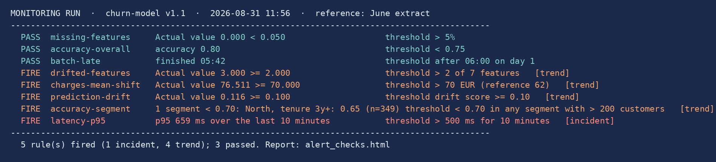

Master in Business Analytics and Data Science
Segment 6 · Alerts in production · 45–56 min
Demo 1 · The monitoring job runs the rules: three pass, five fire, one is an incident
What run_alert_checks.py does (100 lines)
Read the two accuracy lines together
Scores June reference and current data with churn_model.pkl; Evidently tests for drift and missing values
Joins the month's labels: accuracy overall and per segment; batch time; p95 latency
One PASS / FIRE line per rule in alerts.yaml; exit code 1 if any fired
accuracy-overall 0.80: PASS. The model "is fine".
accuracy-segment: FIRE. North, tenure 3y+: 0.65 on 349 customers.
Session 7's demo, turned into a rule. This is why the rule exists twice.
The exit code is the trick: 1 if any rule fired. A scheduler needs no understanding of the metrics to know that something is wrong.
MLOps · MBDS-PT2026F · Video 1 (Session 9) · Monitoring Metrics in Depth · Juan Ramírez
22
Notes:
RECORDING SCRIPT · minute 47:30
[Screen recording: terminal in the S09/demo folder. Type "python run_alert_checks.py" and let it run; it takes about ten seconds. Then read the output.]
This is the monitoring job: run_alert_checks.py, a hundred lines of Python you can read. It loads the June reference and this month's data, scores them with the churn model, runs the Evidently drift and missing-value checks as tests, joins the month's labels, which have arrived, computes accuracy overall and per segment, reads the batch time and the latency log, and evaluates every rule in alerts.yaml. Then it prints this.
Read it top down. Three passed: missing-features, zero; accuracy-overall, 0.80, above 0.75, so the overall number says the model is fine; batch finished at 05:42. Five fired. drifted-features: three of seven, above two. charges-mean-shift: mean 76.5 against a limit of 70; the pricing change. prediction-drift: 0.116, above 0.10; the model is reacting. And accuracy-segment: one segment below 0.70: North, tenure over three years, 0.65 on 349 customers. The overall rule passed and the segment rule fired: that is Session 7's demo turned into an alert, and it is why the rule exists twice. Last, latency-p95: 659 milliseconds over the last ten minutes, and this one is tagged incident.
Then the summary line: five fired, one incident, four trends, and the script exits with code 1. That exit code is the whole trick: it is how a scheduler knows something is wrong without understanding any of the metrics. Next slide: who runs it, and who gets told.
[Timing: 47:30–51:00]

Slide 23
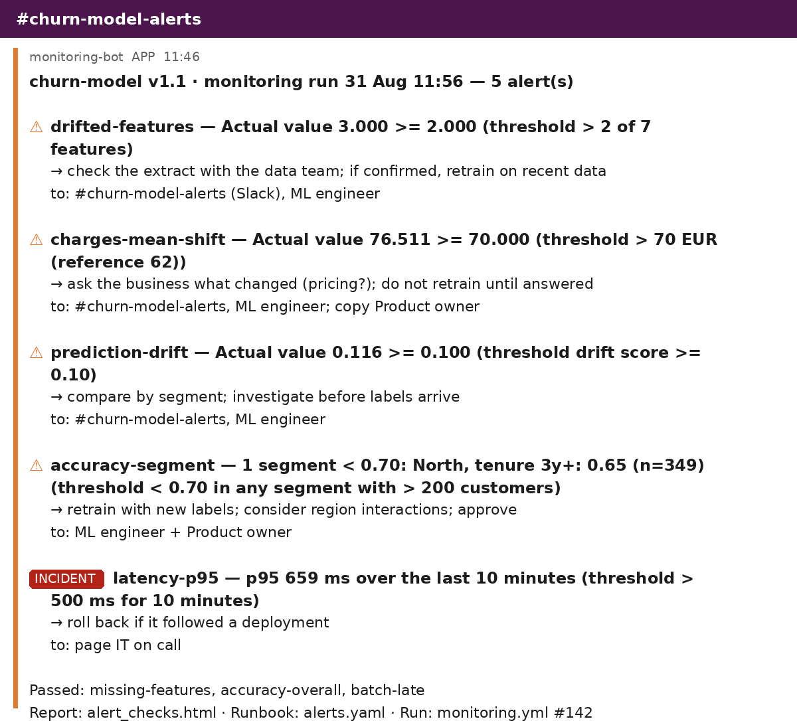
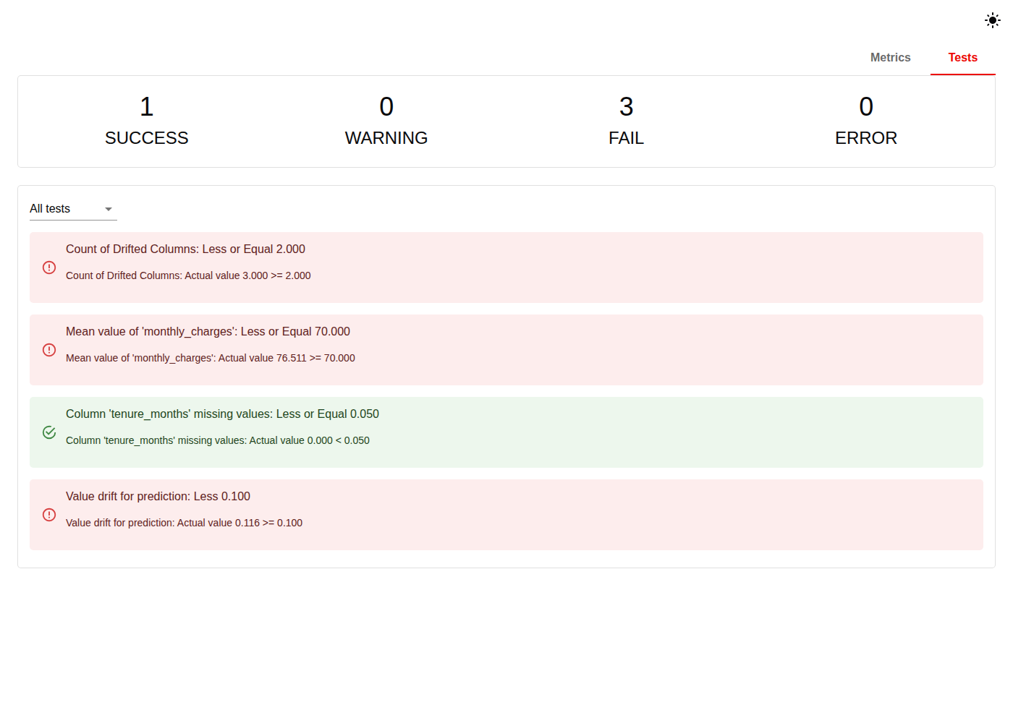
Master in Business Analytics and Data Science
Segment 6 · Alerts in production · 45–56 min
Demo 2 · Nobody runs it by hand: a scheduler runs it, and a message finds a person
monitoring.yml · GitHub Actions
on:
schedule:
- cron: "0 6 * * 1" # Mon 06:00 drift
- cron: "0 7 2 * *" # day 2: labels in
workflow_dispatch: # on demand
jobs:
check:
steps:
- run: python fetch_current.py
- run: python run_alert_checks.py
- name: Send the alert message
if: failure() # exit code 1
run: curl -X POST ... \
$SLACK_WEBHOOK_CHURN_ALERTS
- uses: upload-artifact
with: alert_checks.html
alert_checks.html · Tests tab: 1 success, 3 fail. Where the engineer clicks when the message arrives.
Two schedules
Weekly for the drifts, monthly for performance: the truth has its own calendar.
Scheduler → job → exit code → message → person → report. Everything needed to act; nothing that needs interpreting at three in the morning.
MLOps · MBDS-PT2026F · Video 1 (Session 9) · Monitoring Metrics in Depth · Juan Ramírez
23
Notes:
RECORDING SCRIPT · minute 51:00
[Screen recording: open monitoring.yml in the editor; then alert_message.md; then alert_checks.html in the browser, click "Tests".]
In production nobody types that command. A scheduler runs it: here, a GitHub Actions workflow, because you saw one in Session 5; cron, Airflow or a cloud scheduler do the same job. Read the schedule: every Monday at six, the weekly drift checks; the second of every month at seven, once the labels have arrived, the performance checks; and on demand, when someone wants to look now. Segment three again: the two schedules exist because the truth has its own calendar. Then the steps: fetch this month's data, run the rules, and, only if the job failed, that is, only if the exit code was 1, post the message to the channel. Last step: keep the HTML report as an artefact, so whoever answers the alert has the evidence.
The message is the second file: this is what the ML engineer sees on their phone. Five alerts. Each one: the rule name, the actual value against the threshold, the action, and who it went to. The incident is marked differently, because it pages IT rather than posting to a channel. And at the bottom, the three that passed, and links to the report, to the rules file, and to the run. Everything needed to act, nothing that needs interpreting at three in the morning.
The third file is the report: Evidently's Tests tab, one success and three failures, the same four data checks with their thresholds written on them. This is where the engineer clicks when the message arrives.
[Timing: 51:00–54:00]

Slide 24

Master in Business Analytics and Data Science
Segment 6 · Alerts in production · 45–56 min
One page for the owner, alerts for the responder, and the rule against alert fatigue
Batch finished
Missing features
Drifted features
Last snapshot: 1 Oct · Last retrain: 9 Jun · Model v1.1 · Labels received up to: September
05:42 ✓
0.0%
3 of 7
Accuracy on monthly labels · — all customers — North, tenure 3y+ - - threshold 0.75
Predicted risk: this month vs reference (needs no labels)
Oct
pending
May
Jun
Jul
Aug
Sep
labels due
2 Nov
KPI: saved customers 4,120 → 3,500 (−15%)
The owner's page shows "pending" where the truth has not arrived; it does not draw a flat line. Seven feature histograms live one click deeper, for the responder.
Alert fatigue rule: every alert answered within a defined time; any alert that fires weekly without action is reviewed or deleted. Five that always mean something beat fifty that sometimes do.
MLOps · MBDS-PT2026F · Video 1 (Session 9) · Monitoring Metrics in Depth · Juan Ramírez
24
Notes:
RECORDING SCRIPT · minute 54:00
The rules page a responder; the owner needs one page they look at every Monday and understand in a minute. For the churn model: at the top, health tiles: the batch finished on time, missing features, drifted features, and the dates: last snapshot, last retrain, model version. In the middle, performance by segment on the monthly labels, with the threshold drawn, and look at the right-hand end: October is marked pending, because October's labels have not arrived; the chart does not pretend. Below, the predicted-risk distribution against the reference, the early warning that does not wait, and the business KPI. Not on the page: seven feature histograms; those live one click deeper, for the engineer following an alert.
The HR assistant's page has the same shape: conversations, thumbs-up rate, escalation rate, cost against budget; judge scores over time with the weekly human sample as dots; hallucination, toxicity and PII rates with their thresholds, some of them zero; tokens and time to first token; and the three versions in the corner.
And the rule that keeps any of this alive. Every alert is answered by someone within a defined time, and every alert that fires more than once a week without action gets its threshold reviewed or gets deleted. Our demo fired five alerts in one run; if that happens every Monday, by November nobody reads the channel. Five alerts that always mean something beat fifty that sometimes do. End of segment six.
[Timing: 54:00–56:00]

Slide 25

Master in Business Analytics and Data Science
Segment 7 · Wrap-up · 56–60 min
Three things to remember, and the knowledge check
1
Three drifts; the evidence decides the timing.
Knowledge check
Input and prediction drift need no truth: they warn today. Concept drift and every performance metric wait for labels: late, partial, or never. "Pending" is honest; a blocking model hides its own false positives.
10 multiple-choice questions, about 12 minutes, on the campus after this video
Each: a symptom an owner would notice → which metric reveals it, and what it needs to be computed
6 classical ML, 4 LLM; one on a missing truth, one on routing an alert
Individual; no AI tools (syllabus policy); counts towards continuous assessment
2
Every metric is a ratio of four boxes.
Accuracy lies when the event is rare; precision and recall trade through the threshold; AUC ignores it; calibration asks if the number can be trusted. By segment: overall passed, the North fired.
3
A metric is a control only when it is a rule.
A file of rules, a job that exits 1, a scheduler on the truth's calendar, a message that finds a person. For an LLM: a judge in place of the label, and humans to check the judge.
Demo files: 2026-27/S09/demo (alerts.yaml, run_alert_checks.py, monitoring.yml, alert_checks.html). Next: Session 10, Saturday 31 October, LLMOps: we build the assistant we have just learned to monitor.
MLOps · MBDS-PT2026F · Video 1 (Session 9) · Monitoring Metrics in Depth · Juan Ramírez
25
Notes:
RECORDING SCRIPT · minute 56:00
Three things. One: three drifts, three kinds of evidence, and the evidence decides the timing. Input drift from the inputs, prediction drift from the model's own outputs, both available today; concept drift and every performance metric only from labels, and labels arrive late, partially, or never. The first two buy time while you wait for the third; a dashboard that says "pending" is telling the truth; a model that blocks or rejects is hiding its own false positives, and only a random sample let through can reveal them.
Two: every performance metric is a ratio of the four boxes, at a threshold somebody chose. Accuracy lies when the event is rare; precision and recall trade through the threshold; AUC ignores it; calibration asks whether the number can be trusted. All by segment: the overall accuracy passed while the North fired.
Three: a metric is only a control when it is a rule: threshold, window, severity, route, action. You saw eight of them in a file, a job that evaluates them and exits with code 1, a scheduler that runs it on the calendar the truth allows, and a message that finds a person. For a language model, the same, with a judge in place of the label, and then a human sample to check the judge.
The knowledge check is on the campus, right after this video: ten multiple-choice questions, about twelve minutes. Each describes a symptom an owner would notice and asks which metric would reveal it, and what it needs to be computed; six classical, four LLM; one is about a truth that is missing, one about routing an alert. Everything is in the slides. It counts towards continuous assessment, and it is individual, no AI tools, as agreed in the syllabus. Thank you for watching; see you on Saturday for Session 10, where we build the assistant we have just learned to monitor.
[Timing: 56:00–60:00]

