Slide 1


RichAnnotator: Annotating rich (XML-like) documents
#BLAHmuc 2016
Nikola Milosevic

Slide 2
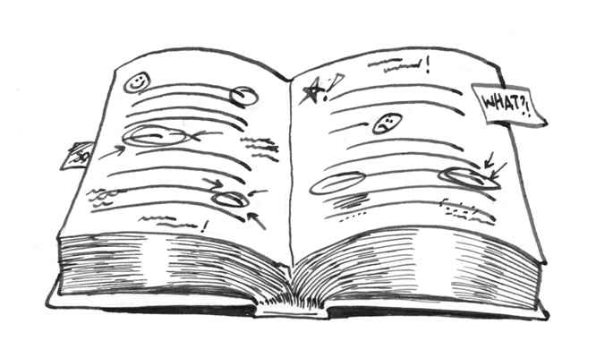
Annotating biomedical data
Text annotation is a process of adding notes or loss to a text
Can add links to semantic descriptors
Helps further document processing and querying
Can be manual, automatic, semi-automatic

Slide 3
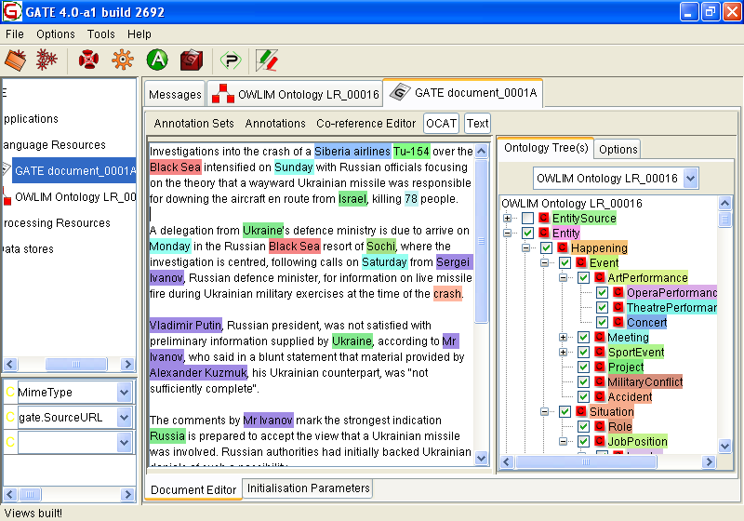
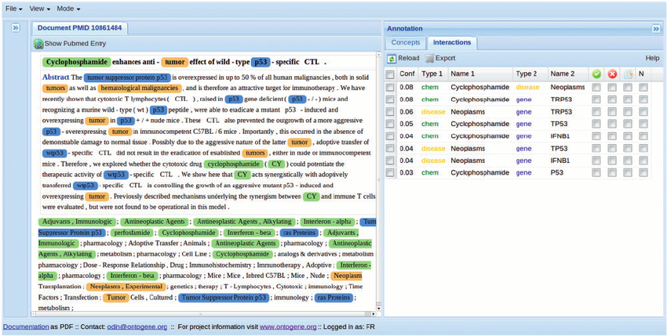
Annotation tool examples

Slide 4
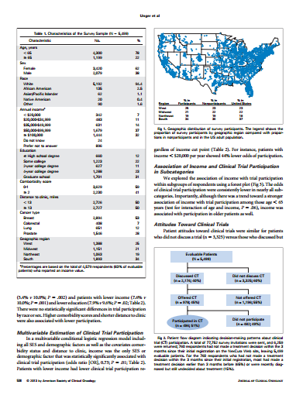
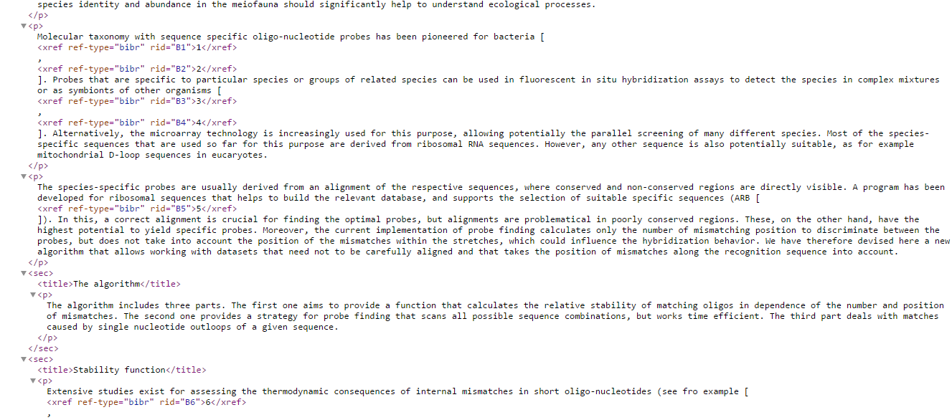
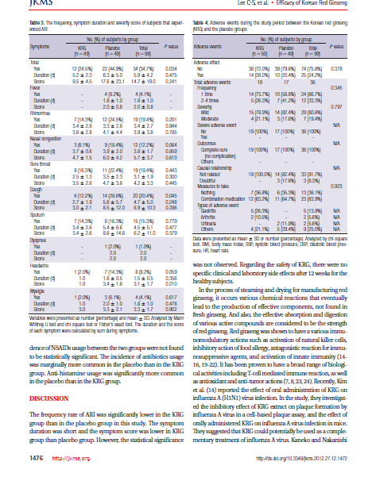
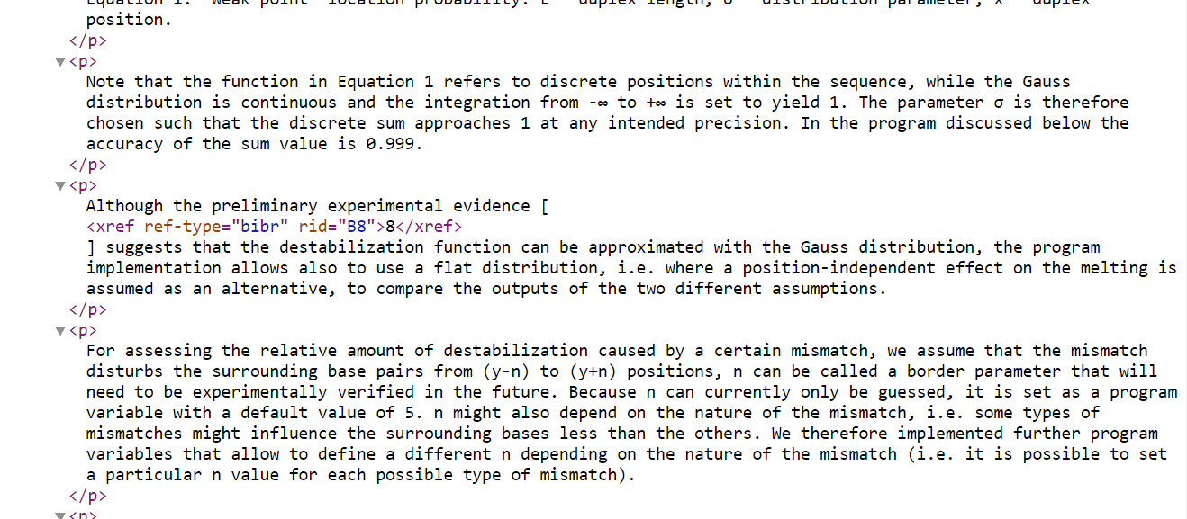
Rich documents

Slide 5
Motivation for RichAnnotator
Most annotation tools ignore rich document elements such as tables and figures
Important information stored in tables and figures
Loss of structure
Current tools do not reflect whole knowledge stored in paper

Slide 6



Annotation types
Model adopted from PubAnnotations
Denotation – describes a substring
Relation – describes relationship between two substrings
Modification - modifies the meaning of denotations and relations.

Slide 7
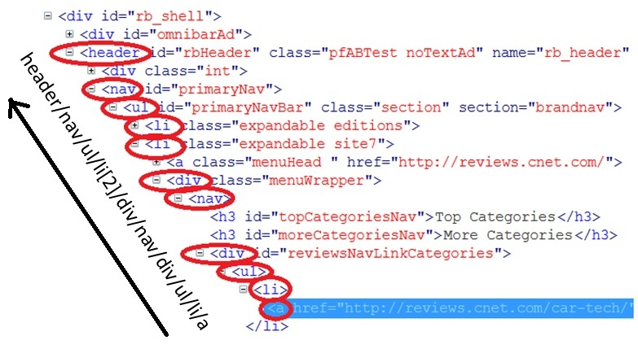
Annotating XML
How to locate substring in XML?
XPath
How XPath will be created?
Selection can be retrieved in JS. XML parser for JS will parse XML and build XPath
How will be data stored?
Locally in a database and
could be exported to JSON-LD
How it will be like?
Web interface

Slide 8
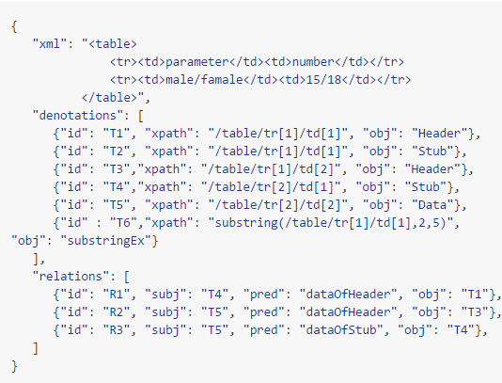
Example output (Proposed at BLAH2)

Slide 9

Preparation
Large project
Javascript XML parser built that:
Parses textual XML
Builds a tree of XML elements
For each node stores node name, data, position in original string
Mechanism to detect selected span in a field

Slide 10
Plan for BLAHmuc
Day 0: Arival and Symposium
Day 1: Generating XPath for selected areas in XML
Day 2: Annotation fields and storing annotations
Day 3: Export of annotations
Day 4: Integration with PMC
Post BLAHmuc: Fix issues and make GUI more user friendly. Visualizing XML and making annotations on visualized documents

Slide 11
Links
Proposal:
https://gist.github.com/nikolamilosevic86/c94382d4b52705e9ae75dab0eda6381e
Repository:
https://github.com/nikolamilosevic86/RichAnnotator
Personal web:
http://personalpages.manchester.ac.uk/staff/nikola.milosevic/
http://inspiratron.org/

Slide 12




nikola.milosevic@manchester.ac.uk

