Slide 1
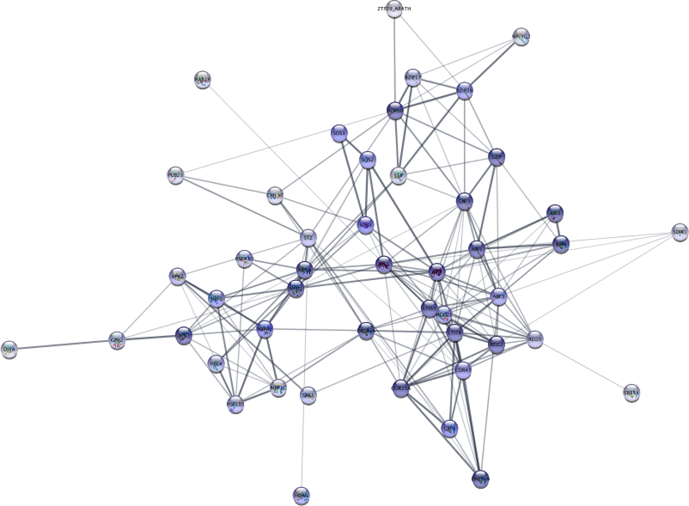


Text-mining-based retrieval of protein networks
Lars Juhl Jensen

Slide 2
topic of interest

Slide 3
PubMed query

Slide 4
set of abstracts

Slide 5
named entity recognition

Slide 6
foreground count

Slide 7
background count

Slide 8
score

Slide 9
set of proteins

Slide 10
STRING

Slide 11
Cytoscape App

Slide 12
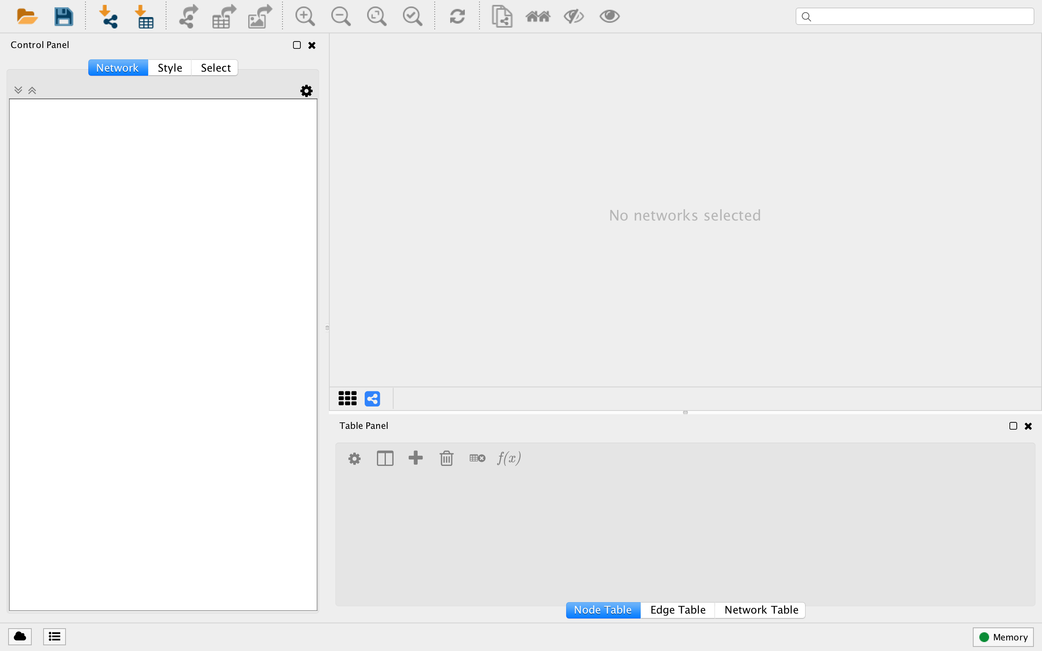

Slide 13
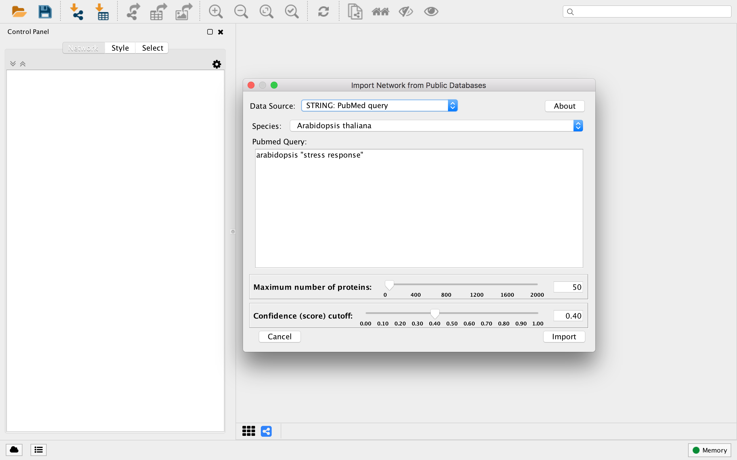

Slide 14
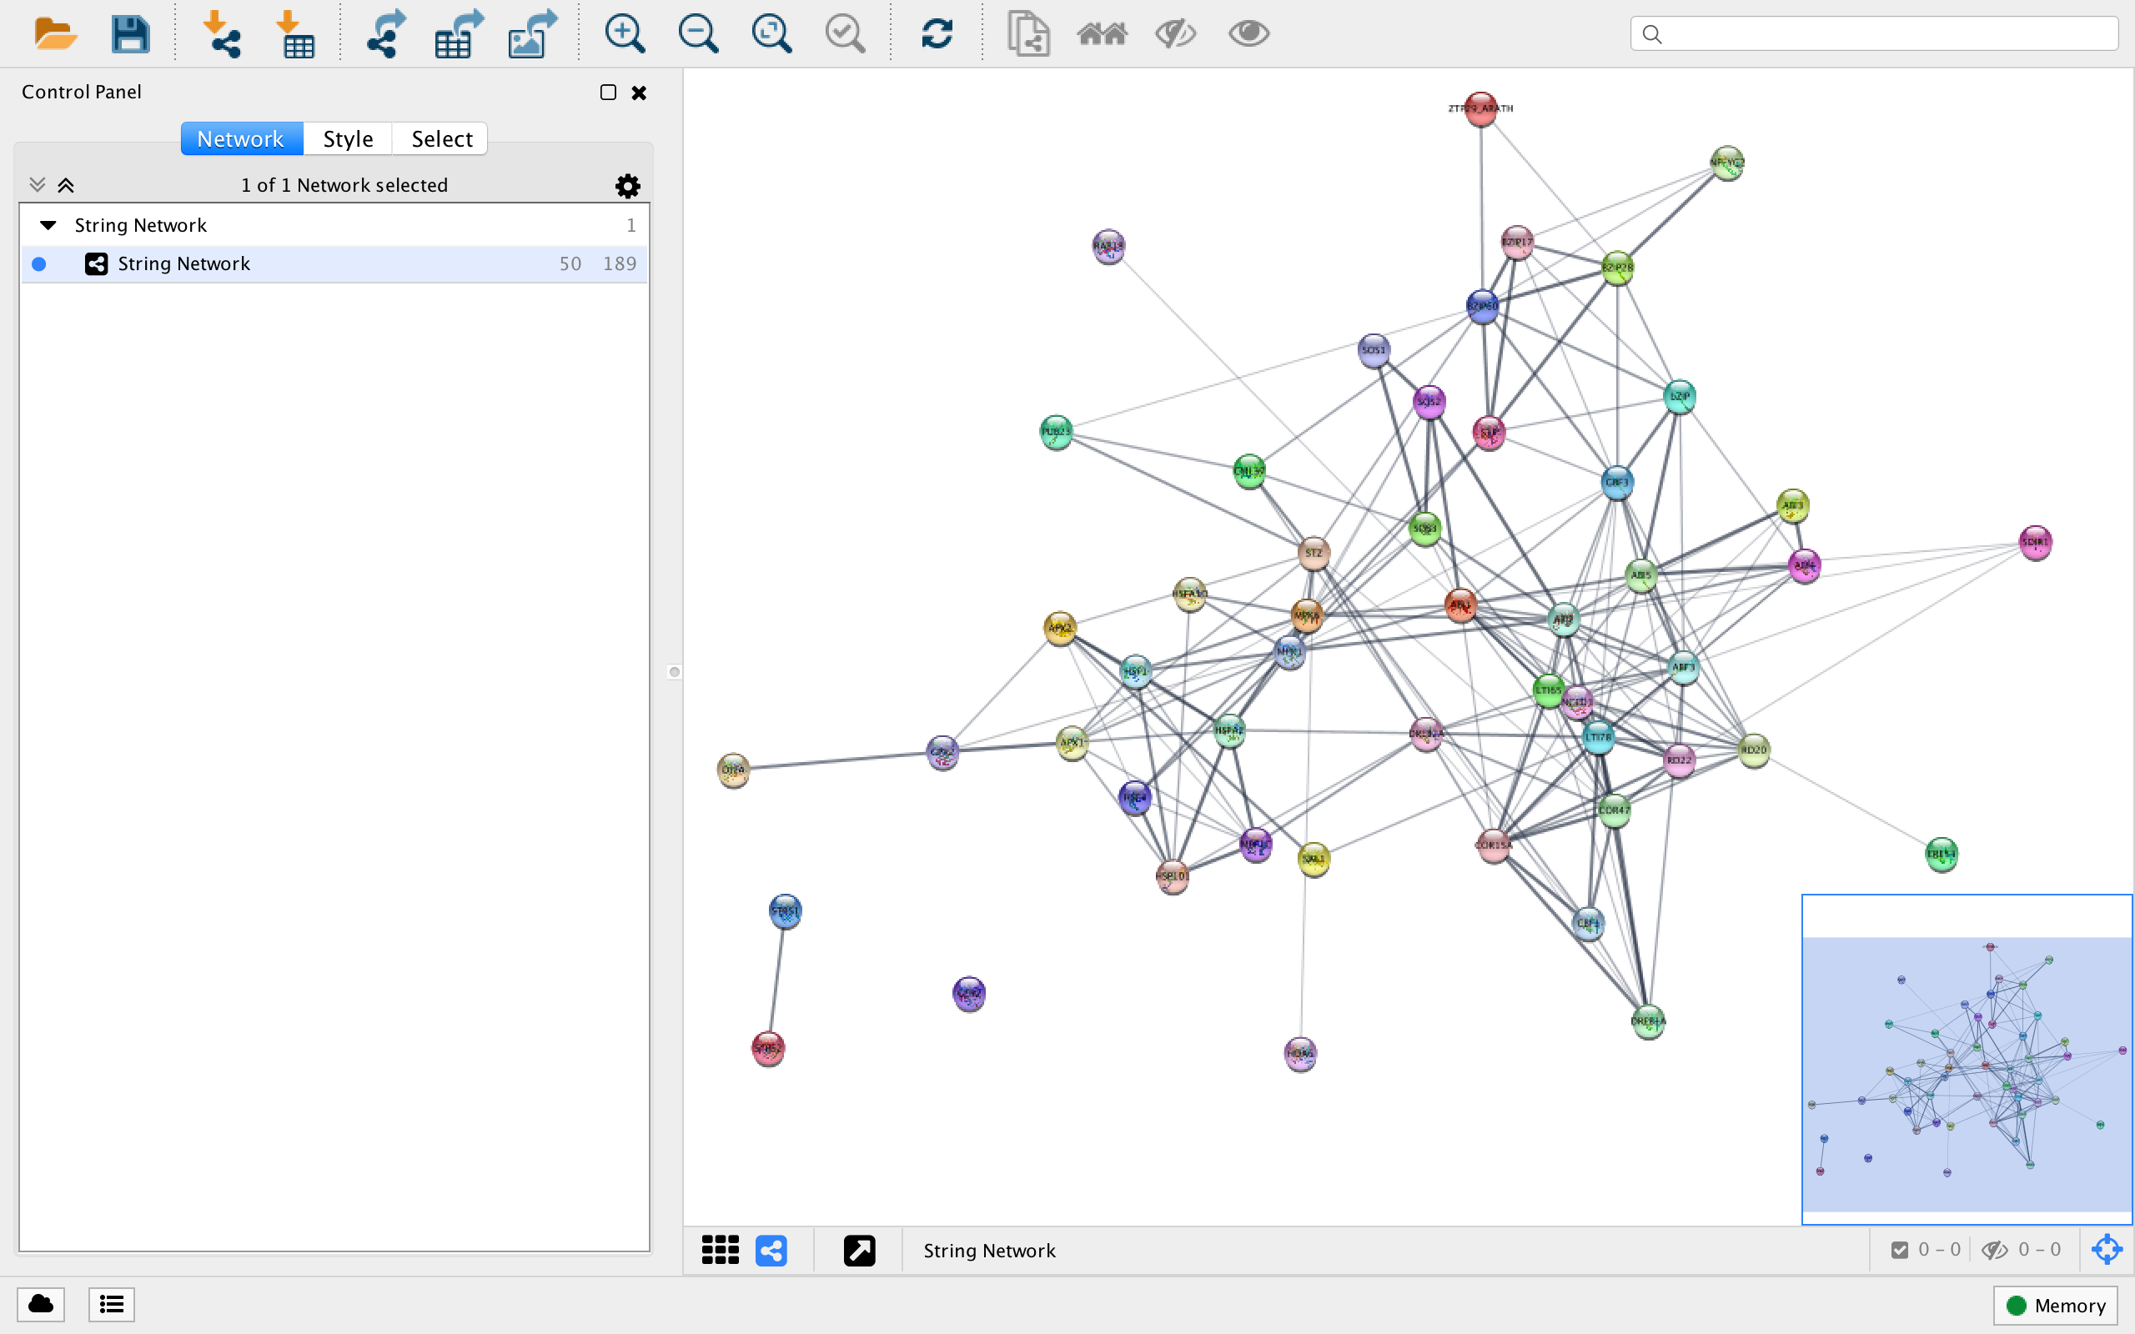

Slide 15
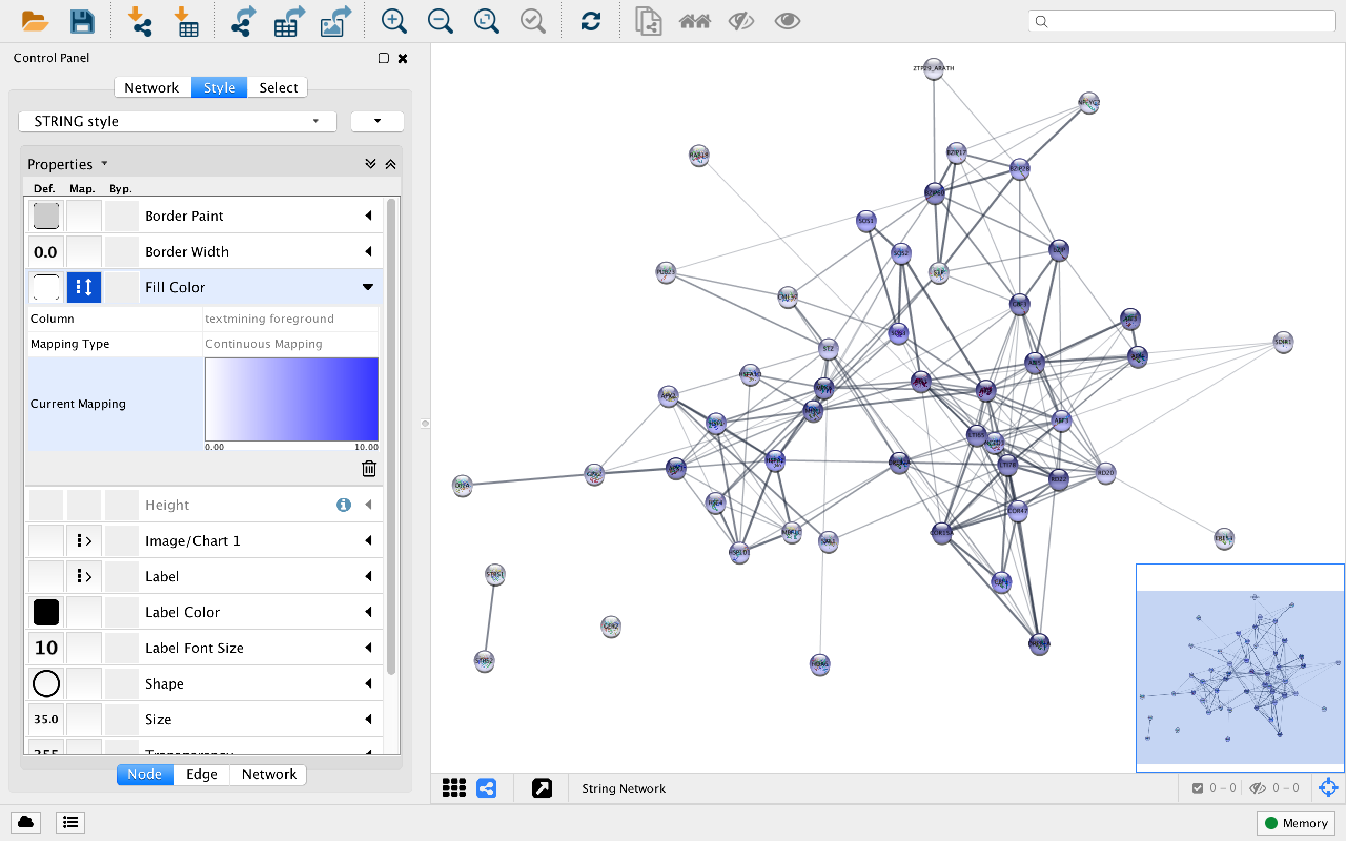

Slide 16
fast

Slide 17
flexible

Slide 18
lacks provenance

Slide 19
Open Annotation

Slide 20
JSON-LD

Slide 21
Acknowledgments
  John “Scooter” Morris
  Nadezhda Doncheva
  Sune Pletscher-Frankild
  Christian von Mering
  Peer Bork

