Slide 1
Free the data API
Juan Molera Pascual
October 2023
Ironhack

Slide 2
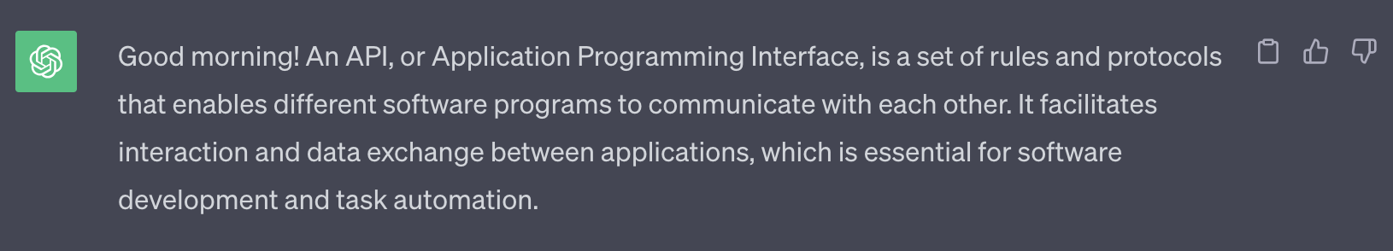
What is an API?

Slide 3



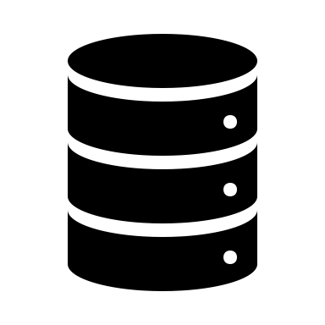







How it works?
database/collection
csv/json

Slide 4
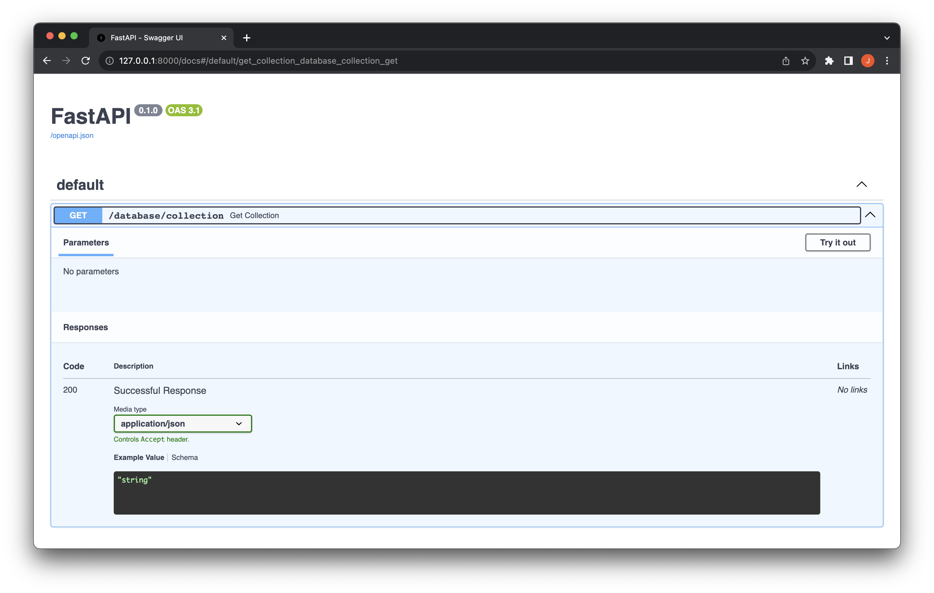
Endpoint

Slide 5
Next steps
Deployment of API, database and streamlit
Automatic updating of databases or collections
Add more products through web scraping

