Slide 1
Two-photon Imaging Using Tunable Spatial Correlations
Juan Sebastian Vargas

Slide 2
Outline
Imaging
Standard Imaging
Two-photon Imaging
Spatial Correlations
Spontaneous Parametric Down Conversion
Spatial Correlations
Tunable Spatial Correlations
Experiment
Experimental Setup
Results
Conclusions

Slide 3
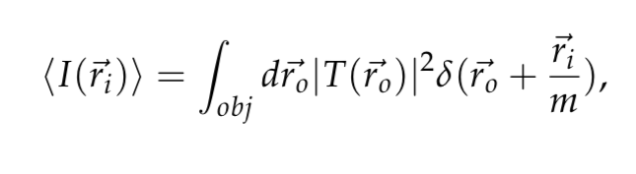
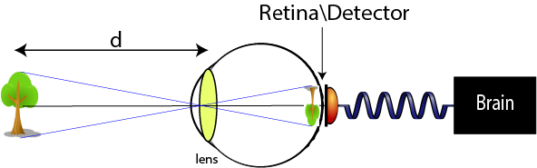
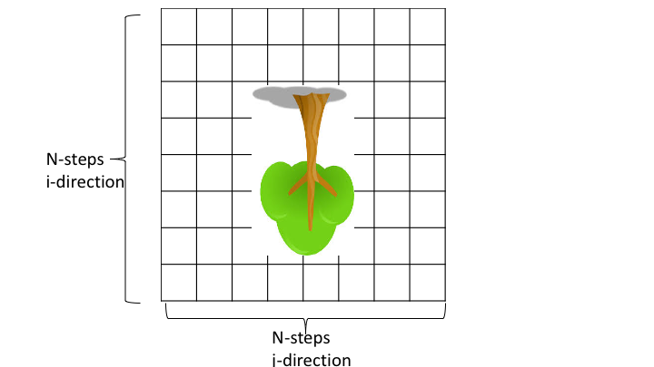
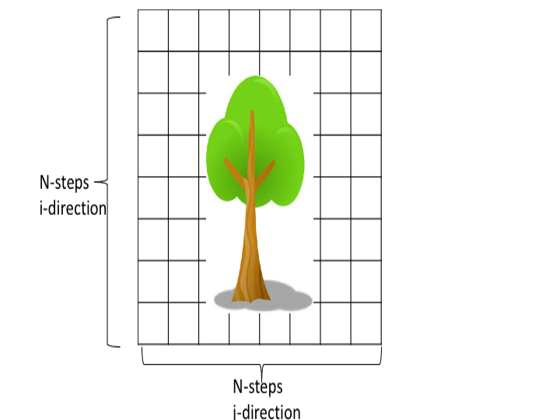
Standard Imaging
Notes:
AGREGAR ECUACION IDEAL IMAGING

Slide 4
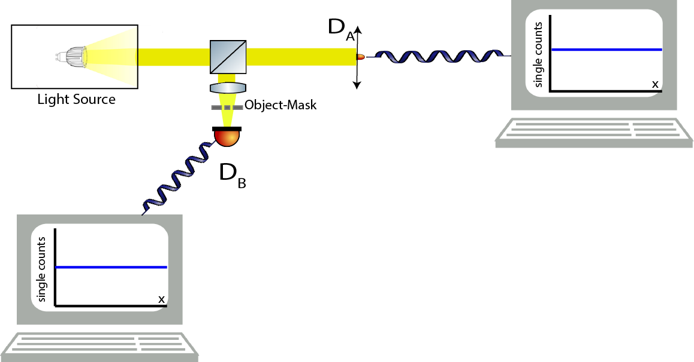
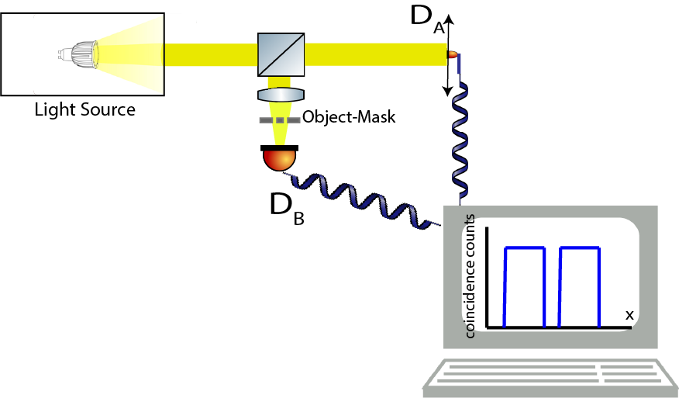
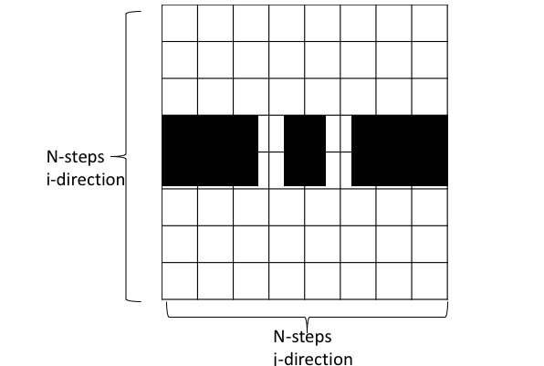
Two-Photon Imaging
Notes:
separar los computadores, bucket detecor

Slide 5
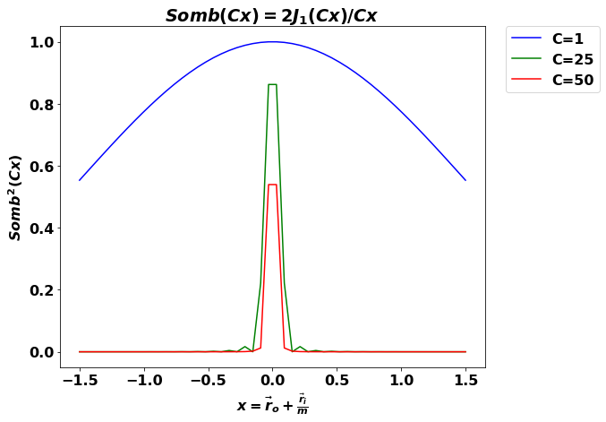
Standar vs. Two-photon Imaging

Slide 6
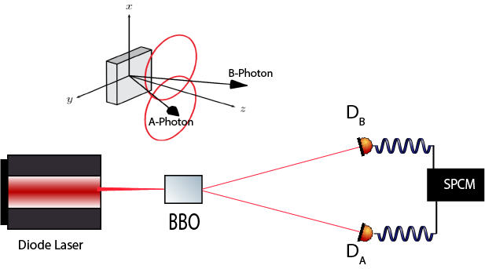
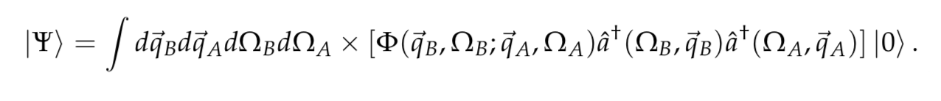
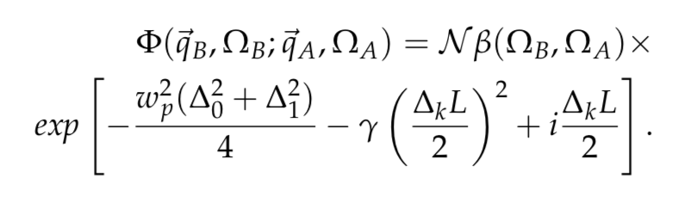

Spontaneous Parametric Down Conversion
Light State after Crystal:
Biphoton, Correlation:
Interferometer Filter
Notes:
No siglas
type of the cristal
Biphoton sin aproximaciones, gausin profile delta0 delta1, CW laser, inte temporal variables, FI

Slide 7
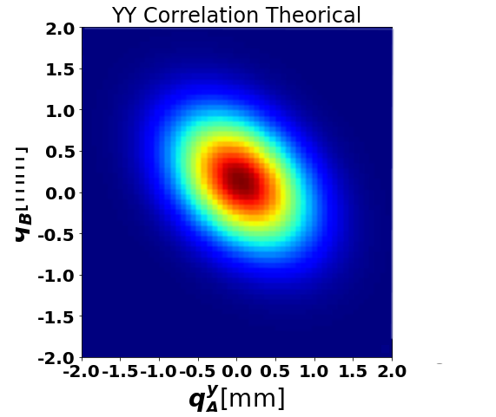
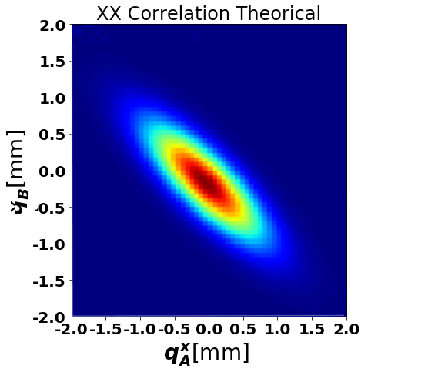
Spatial Correlations
Notes:
X is a 4 dimention vector (qx,qy,qx,qy) and A and b arise from the phase matching conditions of the crystal

Slide 8
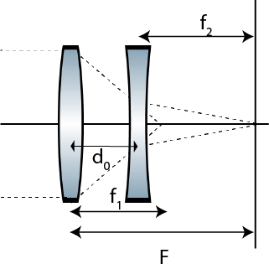
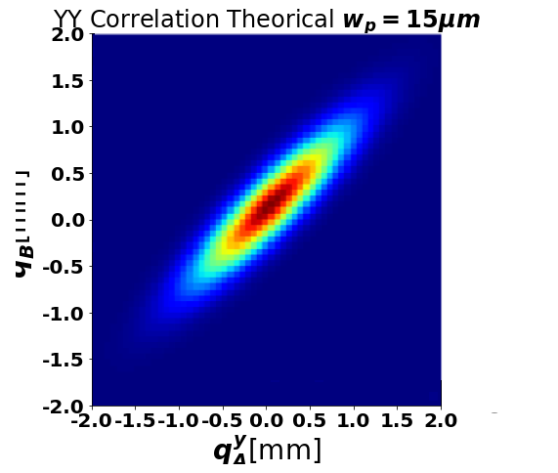
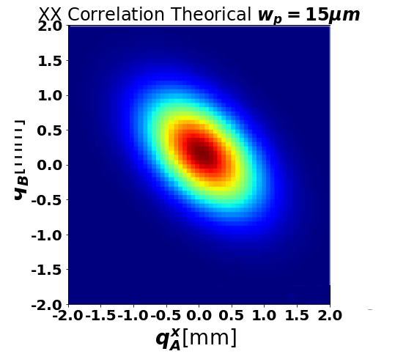
Tunable Spatial Correlations

Slide 9
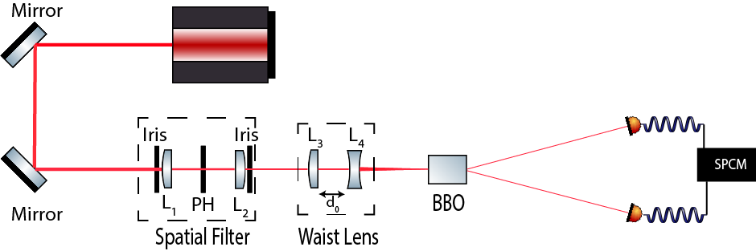
Light Source with Tunable Spatial Correlations

Slide 10
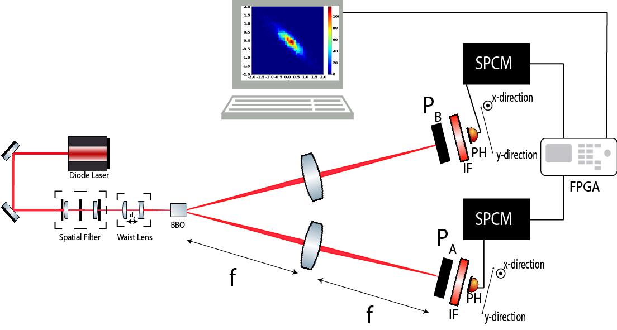
Spatial Correlations Measurement Setup

Slide 11
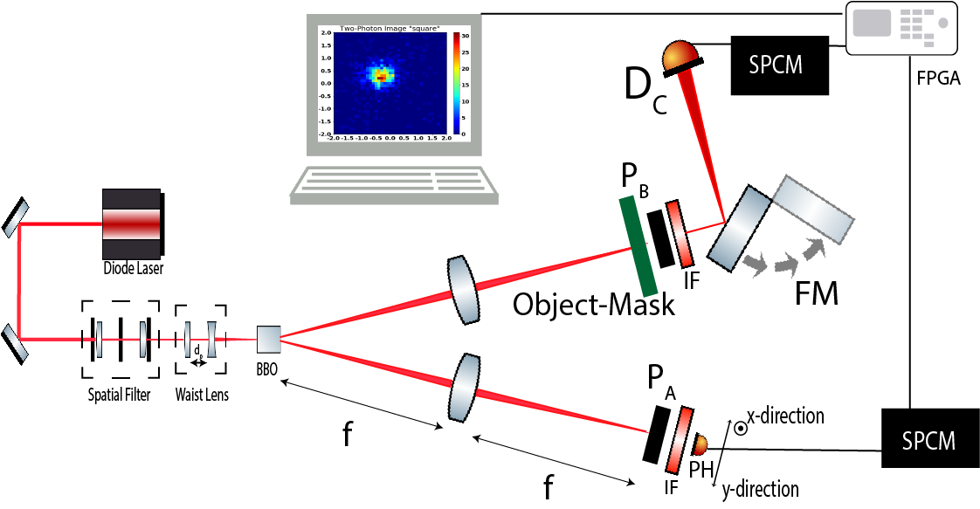
Two-Photon Imaging Setup

Slide 12
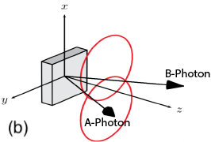
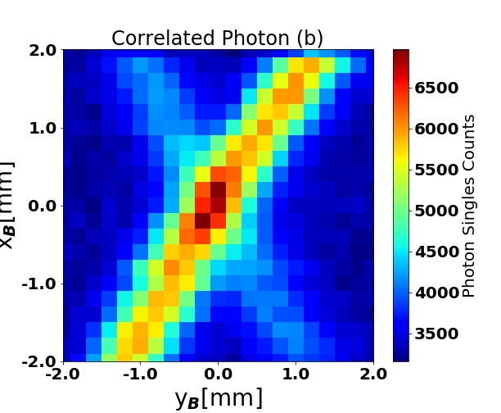
Finding The Correlated Photons
Notes:
anillos BBO

Slide 13
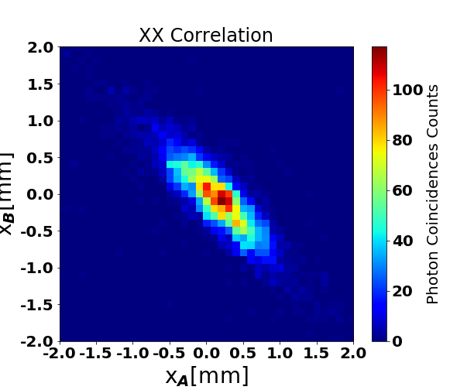
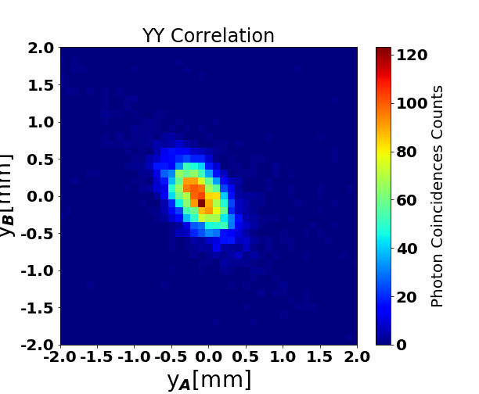
Experimental Correlations

Slide 14
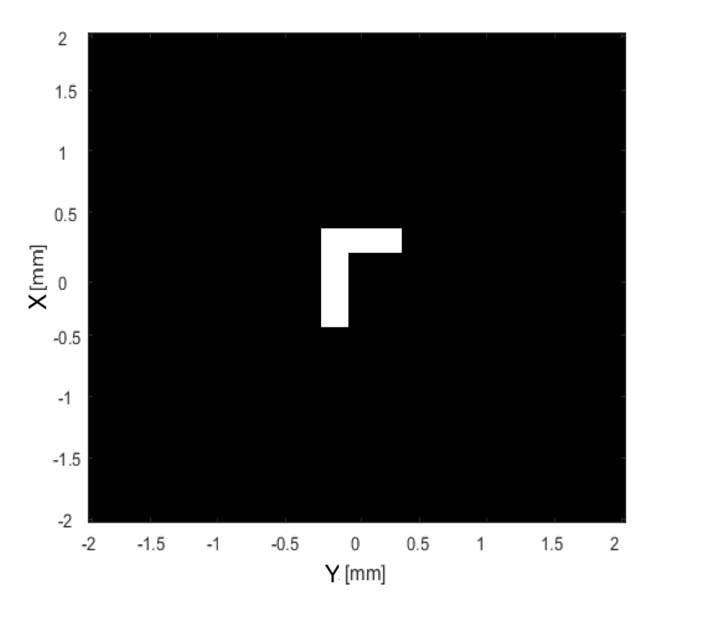
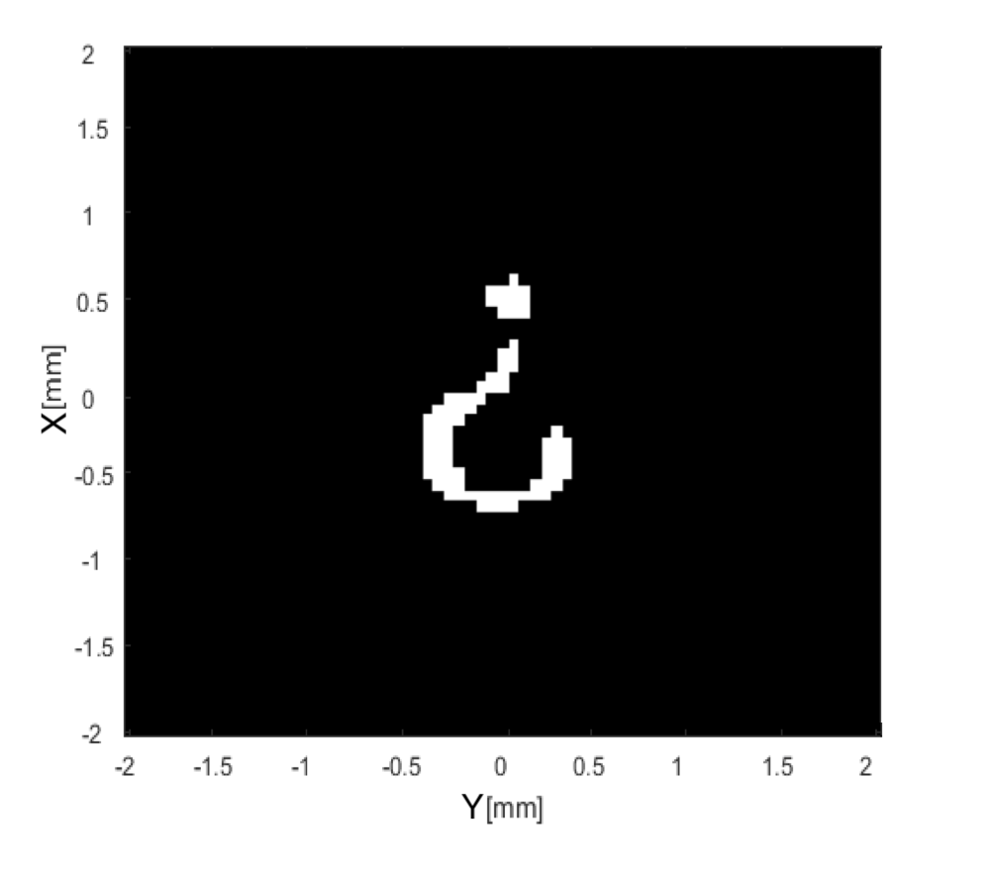
Masks Used

Slide 15
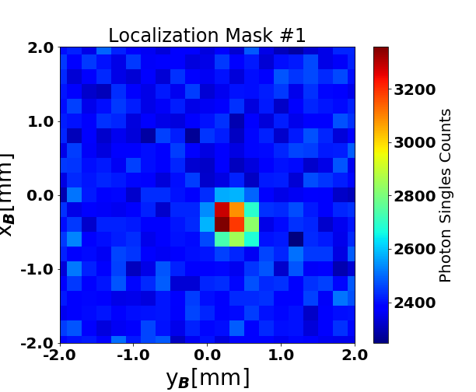
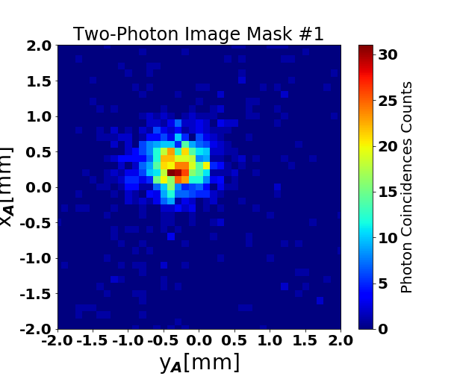
Two-photon Images

Slide 16
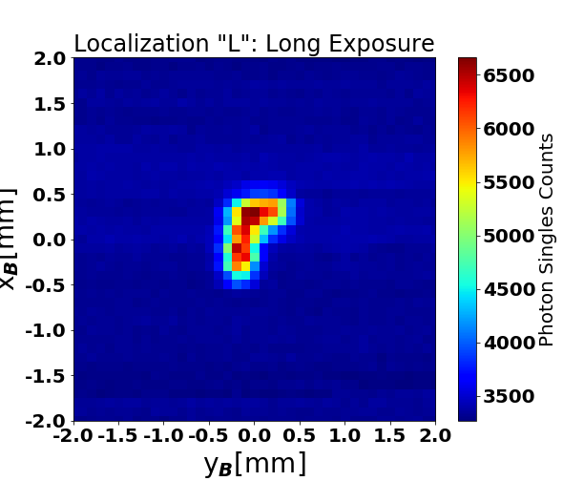
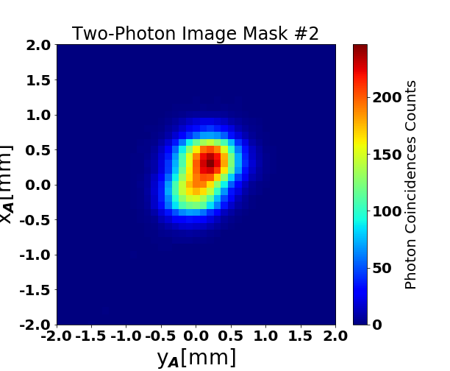
Two-photon Images

Slide 17
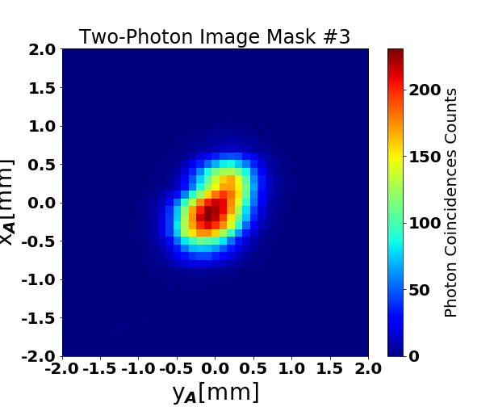
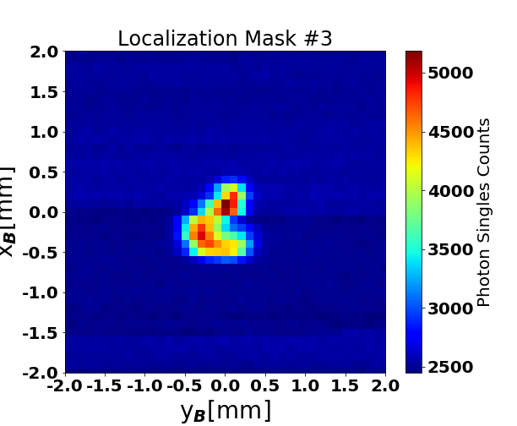
Two-photon Images

Slide 18
Conclusions:

Slide 19
BackUp

Slide 20
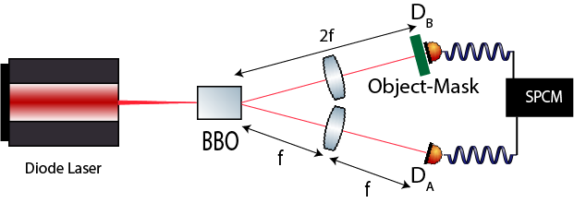
LenslessTwo-photon Imaging using entangled photon

Slide 21
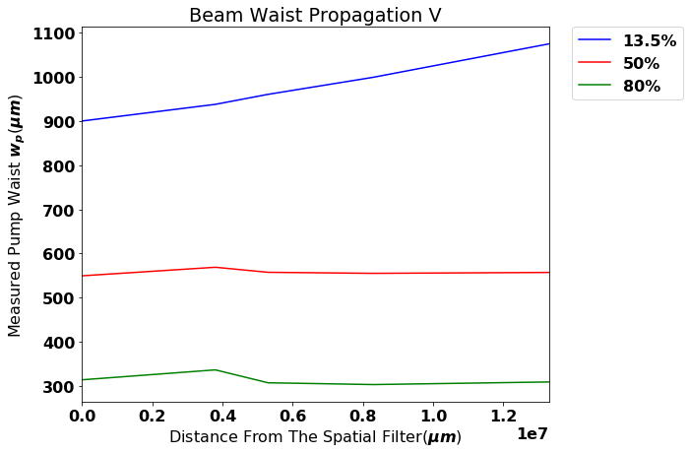
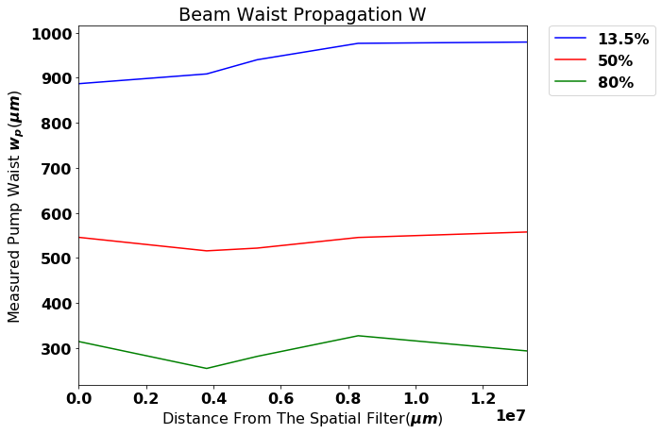
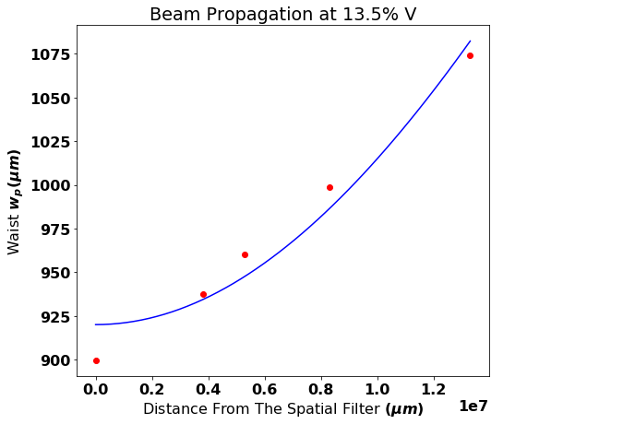
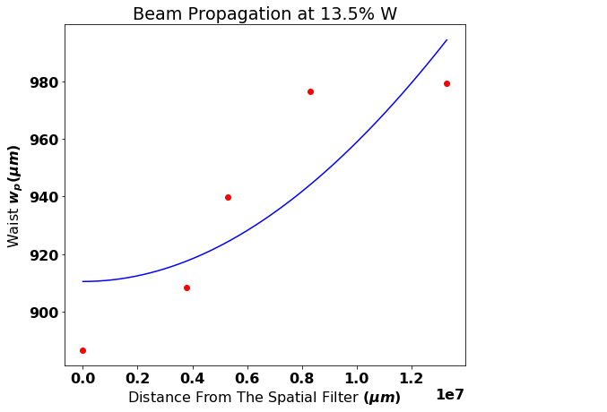
Notes:
Perfilador

