Slide 1
Two-photon Imaging Using Tunable Spatial Correlations
Juan Sebastian Vargas

Slide 2
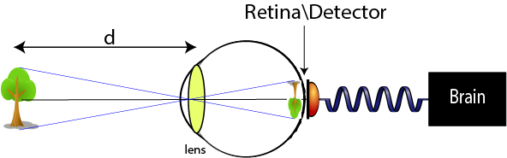
Standar Imaging

Slide 3
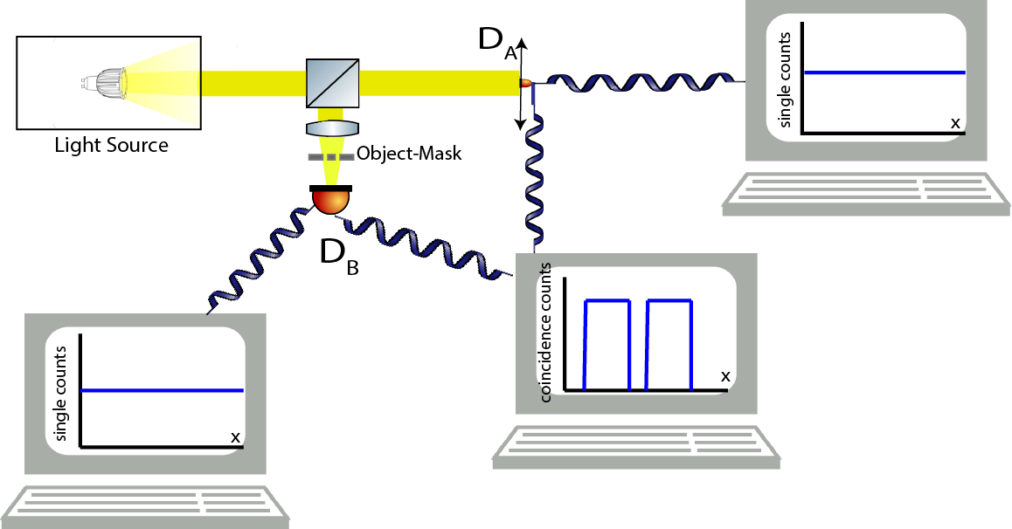
Two-Photon Imaging
Notes:
separar los computadores, bucket detecor

Slide 4
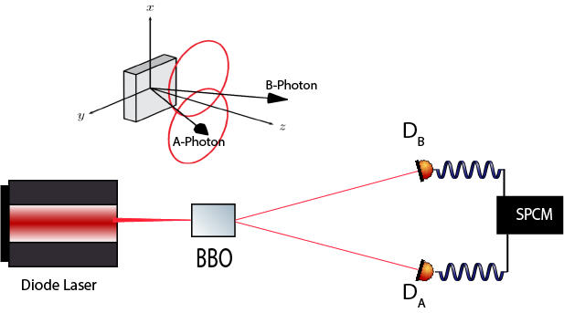
SPDC
Notes:
No siglas
type of the cristal
Biphoton sin aproximaciones, gausin profile delta0 delta1, CW laser, inte temporal variables, FI

Slide 5
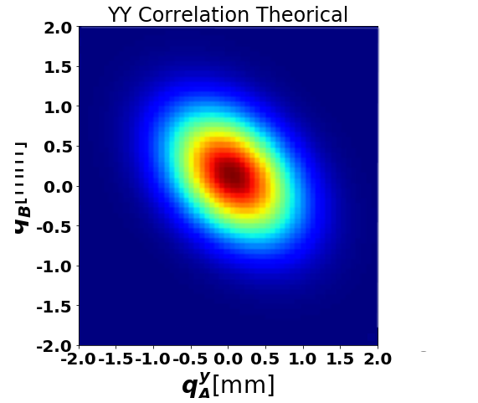
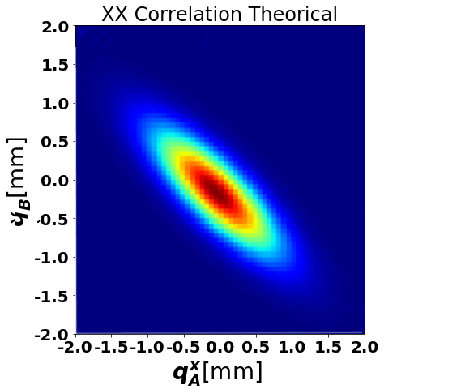
Spatial Correlations

Slide 6
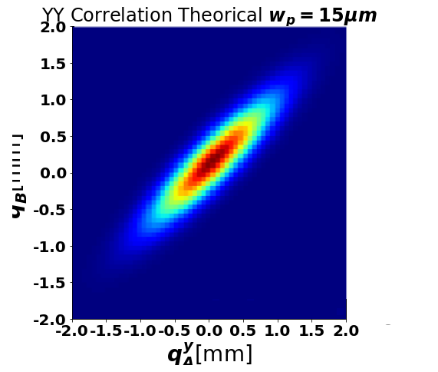
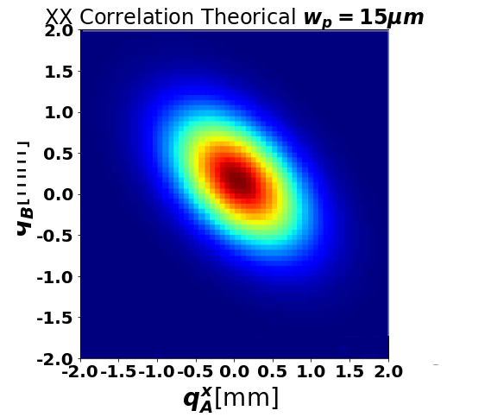
Tunable Spatial Correlations

Slide 7
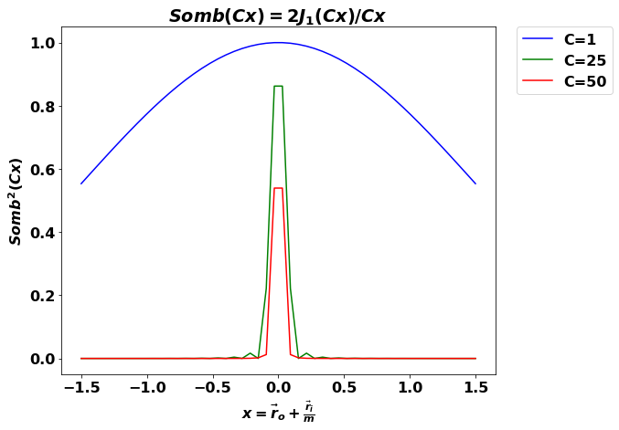
Standar vs. Two-photon Imaging

Slide 8
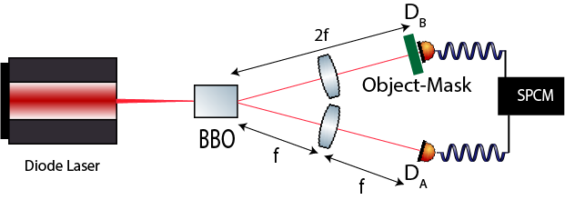
LenslessTwo-photon Imaging using entangled photon

Slide 9
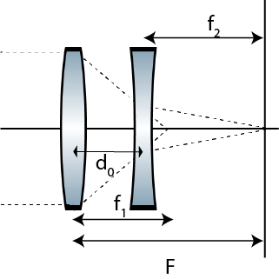
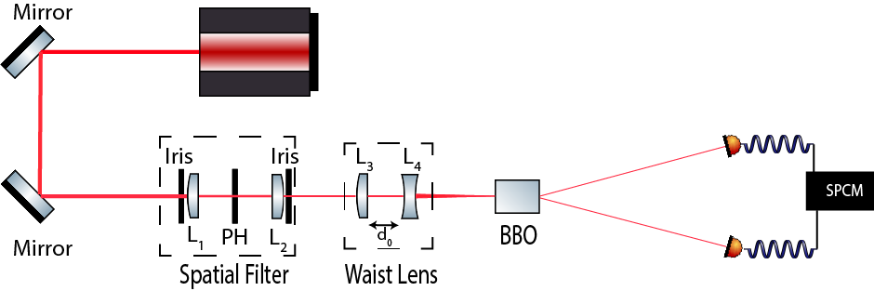
Light Source with Tunable Spatial Correlations

Slide 10
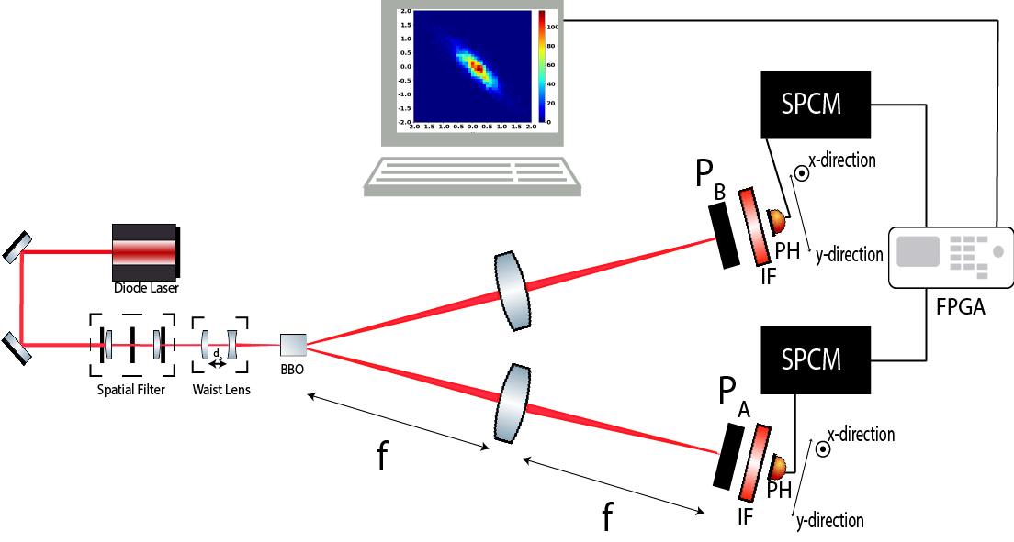
Spatial Correlations Measurement Setup

Slide 11
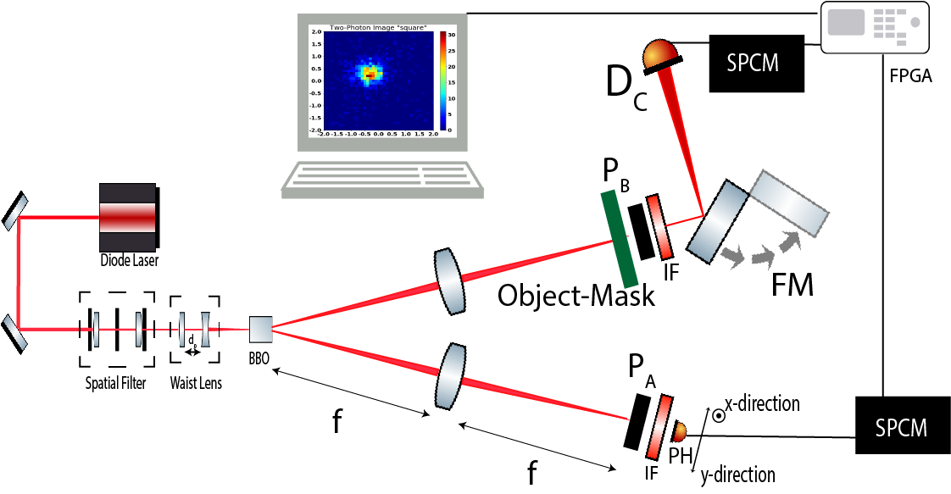
Two-Photon Imaging Setup

Slide 12
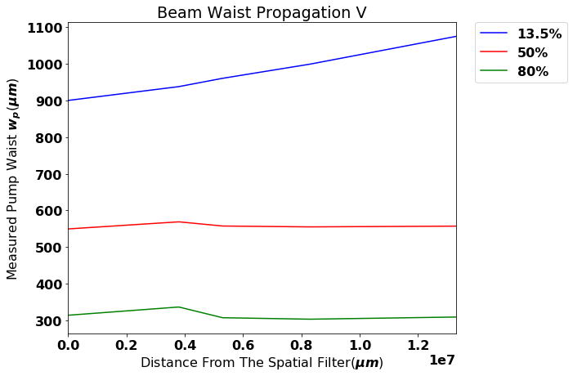
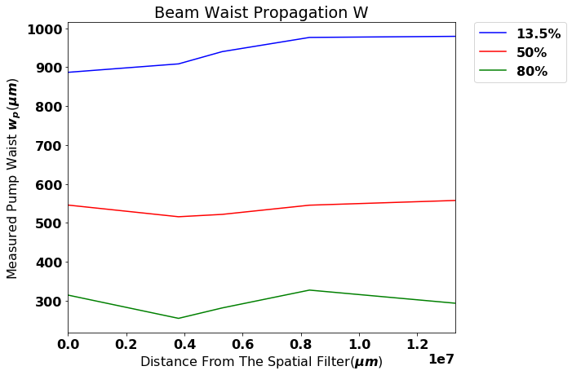
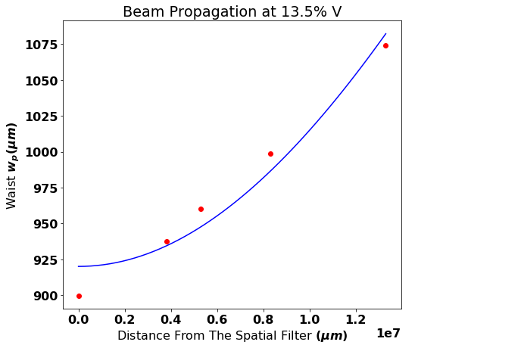
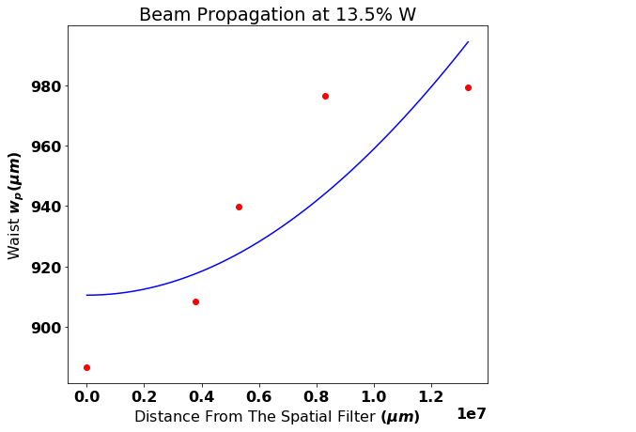
Notes:
Perfilador

Slide 13
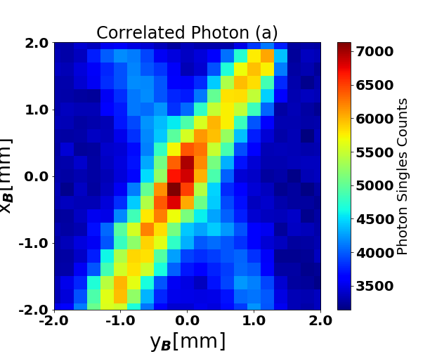
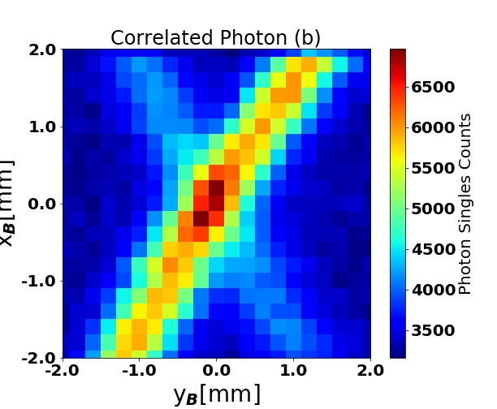
Finding The Correlated Photons
Notes:
anillos BBO

Slide 14
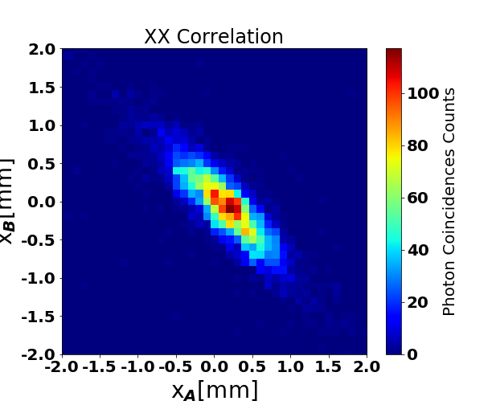
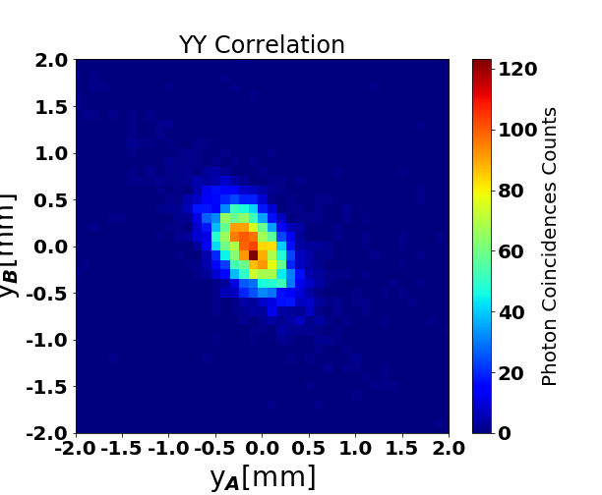
Experimental Correlations

Slide 15
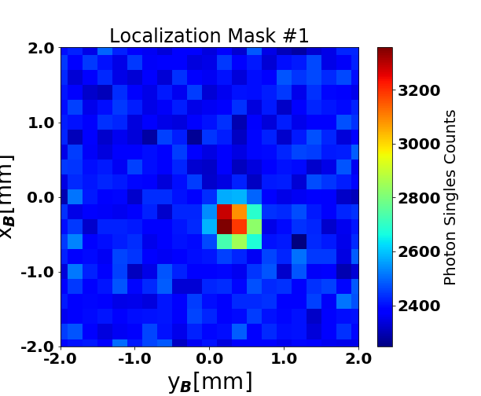
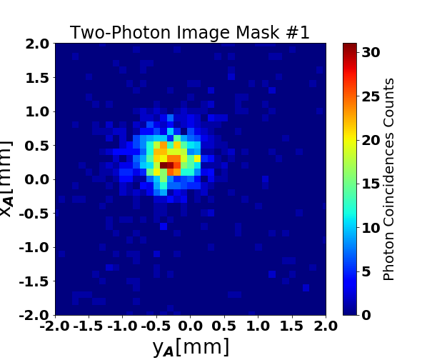
Two-photon Images

Slide 16
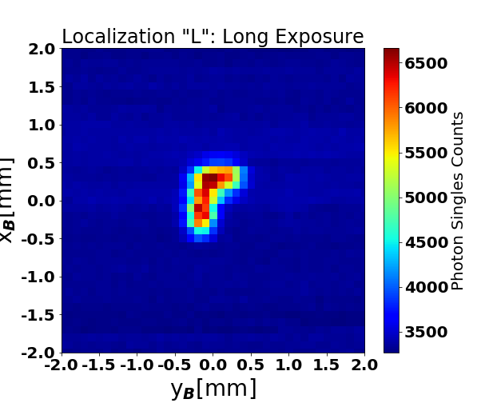
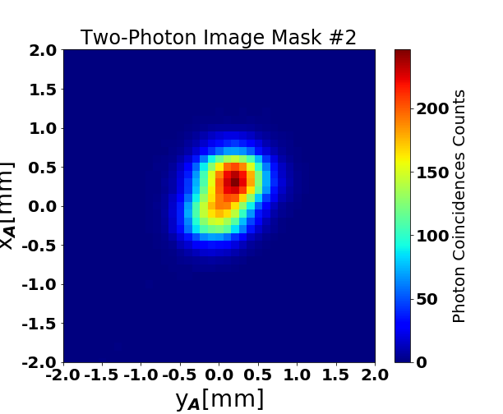
Two-photon Images

Slide 17
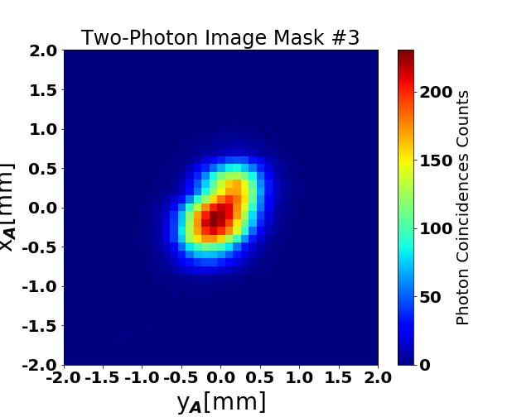
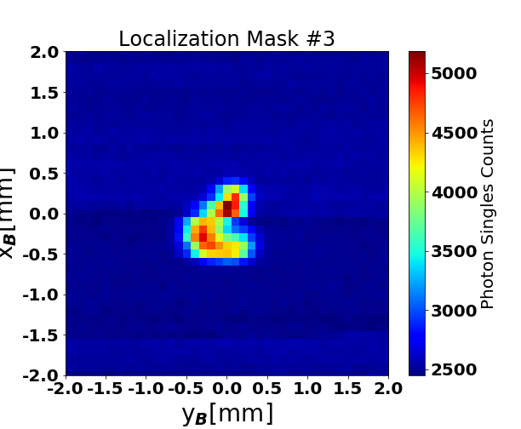
Two-photon Images

