Slide 1
Inventory Reorder Decision Assistant
Juan Pablo Osorio
EGN 321 final capstone
An inventory workbook with six fictional items
A local application with traceable recommendations
01
Notes:
Explain the original instructor-authorized inventory workbook. It asks what to reorder and how much. Inputs: stock, weekly use, lead time and safety stock. This is classroom data, not a real business deployment. About 45 seconds. Source: original/WORKBOOK_INTAKE_FORM.md.

Slide 2
What needed improvement
Row 7 added a fixed 5 and ignored safety-stock edits.
Negative stock still produced a purchasing quantity.
Row positions linked inputs to results.
The multiplier of 2 had no documented business rationale.
02
Notes:
Show Reorder Logic!C7 in the original workbook. Increasing Inventory!F7 from 5 to 20 leaves the old point at 15. Do not claim the original business exception was proven wrong: its intent was unknown. Our chosen classroom policy uses the input consistently. About 60 seconds. Source: original/INITIAL_RISK_AND_DEFECT_INVENTORY.md.

Slide 3
How the system grew
Modules 3 and 4: inventory audit and capstone proposal
Modules 5–7: separate temperature monitoring exercises
Final integration: inventory logic, Flask, SQLite and logs
Module 8: written operating guide and planned handoff
03
Notes:
Be candid: the sensor exercise did not measure inventory. Reused architecture patterns informed a new implementation of the original inventory proposal. Do not claim an uninterrupted inventory application through every module. About 45 seconds. Sources: original proposal and README.

Slide 4
Final application architecture
Browser input
Validation and reusable Decimal calculation
Atomic SQLite review storage
Recommendations, CSV and saved history
Structured events and supervised restart
04
Notes:
Explain logic.py calculate/review, app.py routes, reviews table and supervisor.py. Demand = weekly use times lead time; point = demand plus safety stock; if stock <= point, target twice point and subtract stock. Round up whole-item orders. Point to the explicit classroom policy. About 60 seconds.

Slide 5
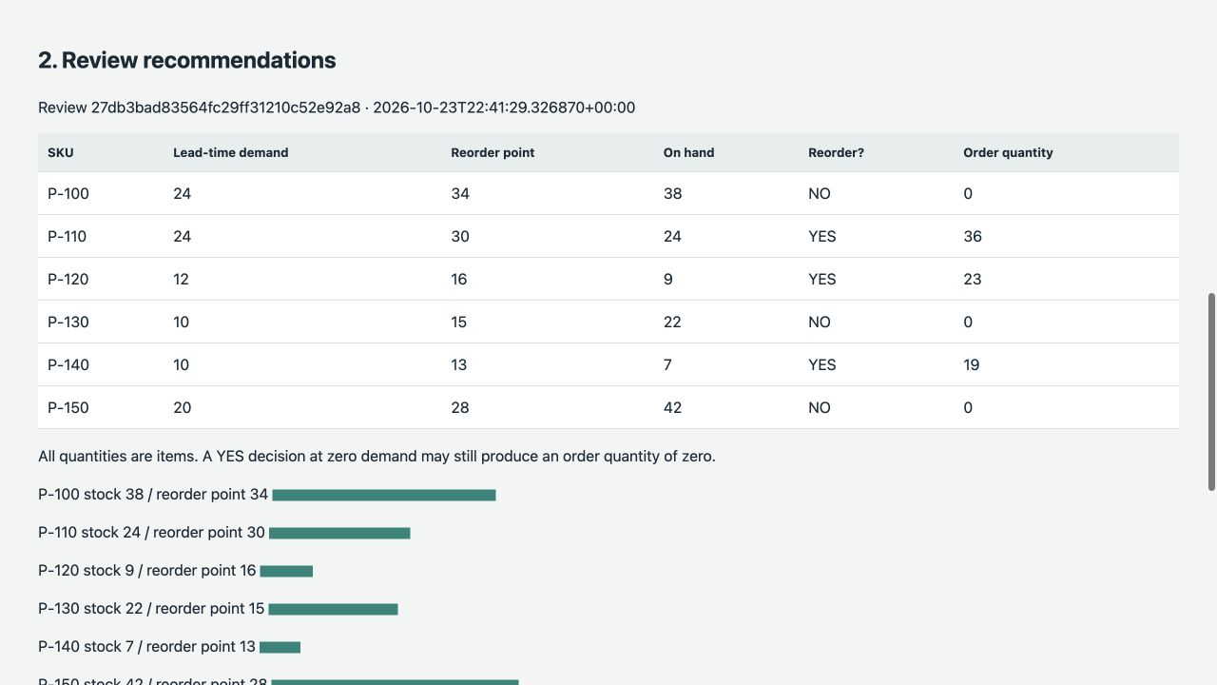
Live application demonstration
Load the sample and save.
P-110 order: 36 items.
Enter −1 stock to show refusal.
Inspect history and CSV.
05
Notes:
Use the live application rather than reading this slide. Demonstrate inputs, calculation columns, date, review ID, download and event. Invalid review must not save any partial rows. About 2 minutes. Source: evidence/live/02_workbook_review.json and 03_invalid_refusal.json.

Slide 6
Verification against the original
Six original workbook cases match.
P-130 safety stock 20: new point 30 and order 38.
The original fixed-5 formula still gives point 15 and no order.
Additional tests check boundaries, duplicates and SKU order.
06
Notes:
Show the supplied workbook and test suite. For P-110, independently compute 8 × 3 = 24, plus 6 = 30, then 60 − 24 = 36. State that baseline references are cached workbook outputs, not a fresh Excel recalculation during this build. The edge result is an intentional policy difference. About 75 seconds. Sources: workbook_expected.json, original/AUDIT_EVIDENCE.md, test_inventory.py.

Slide 7
Failure, recovery and handoff
Controlled storage outage refused new reviews.
Recovery preserved earlier history.
Supervisor replaced the terminated child in about 1.44 s.
Partner handoff is pending. No usability result is claimed.
07
Notes:
Demonstrate the marker outage and remove only the marker. Show FAILED and recovered HEALTHY, earlier review IDs, and a newly saved review. The second test actually kills the child through an opt-in supervisor control. It does not prove recovery from physical disk failure. Partner observations and two improvements after handoff will be added after the session. About 90 seconds. Sources: evidence/live/timeline.json, result.json.

Slide 8
Assumptions and remaining limits
Classroom policy uses each, items/week and weeks.
The order multiplier needs business approval.
Supplier constraints and live stock feeds are absent.
Technical evidence is available. Partner testing remains.
08
Notes:
Explain that validation cannot guarantee source truth. There is no authentication, production server, cost optimization or purchasing integration. AI helped implementation and documentation; verified work is recorded in AI_LOG.md. The live defense must be completed independently without AI. About 45 seconds.

