Slide 1


Narrated course site
A class turned into a bilingual lesson
Juan Pablo Arrobo · UTPL · VC-2026-021
Narration generated with an AI voice (ElevenLabs) and reviewed by the authors
1 / 10
Notes:
[1/10 · 15 s]
We present the narrated site for the course Decision-making and strategic communication in healthcare. It turns a slide-based class into a lesson that students can listen to in Spanish and in English.

Slide 2
The problem
Missing the Saturday class means losing the instructor’s voice.
Example: a nurse off a night shift wants to review active listening.
2 / 10
Notes:
[2/10 · 35 s]
Students in the Master’s in Health Management work in hospitals and health centers. Anyone who works in shifts can miss a live Saturday class. When that happens they are left with slides that have no voice and a syllabus in P D F. Think of a nurse coming off a night shift. She wants to review the class on active listening at her own pace. Today she has no version she can listen to, neither in Spanish nor in English.

Slide 3
The tool
Who
Instructors and master’s students
Takes in
Syllabus, slides and readings
Delivers
Bilingual site, narrated lesson and SCORM
3 / 10
Notes:
[3/10 · 30 s]
The tool builds on project guide twenty one of the course, the interactive syllabus site. Instructors and students of the course use it. It takes in the approved syllabus, the class slides and the course readings. It delivers a bilingual site with a schedule, an assessment plan and resources. The resources include a narrated lesson of fourteen slides with captions and quick checks. It also delivers two S C O R M packages for the Virtual Classroom.

Slide 4
How it works
1
Input
Slides and topic
2
AI
Script, voice, captions
3
Human review
Read, listen, decide
4
Output
Site and SCORM
4 / 10
Notes:
[4/10 · 40 s]
The workflow has four steps. The instructor provides the slides and chooses the topic of the lesson. Claude writes the script for each slide with narration rules and checks it with an automatic auditor. It then rebuilds the slides in both languages, generates the voice and the captions and assembles the packages. The instructor reads every text, listens to every clip and decides which examples stay. In this lesson he chose to replace photos of politicians with scenes from health management. A person always approves what gets published, and nothing reaches students without that review.

Slide 5
Evidence
30 / 30
scripts without errors
auditor
19 / 19
guide steps
ES, EN, phone
3
working quick checks
browser
Pending: test with students.
5 / 10
Notes:
[5/10 · 35 s]
We checked three things with programs rather than opinions. The script auditor reviewed thirty texts and found zero errors. The voice guide reviewer tested nineteen steps in Spanish, in English and at phone width. All nineteen steps circled the element the voice was naming. The lesson ran in the browser with synchronized captions and three quick checks. We have not yet tested it with students. That part is still a proposal and not a result, and we will treat it that way.

Slide 6
Limits and responsible use
Does not replace
the class or feedback
Data
no personal data
Next step
UTE Moodle and completion rate
6 / 10
Notes:
[6/10 · 25 s]
The tool does not replace the live class or the instructor’s feedback. The lesson voice is still provisional and we will replace it with ElevenLabs, using the same voice in both languages. The site collects no personal data. The next step is to upload the packages to the U T E Moodle and measure how many students complete the lesson.

Slide 7
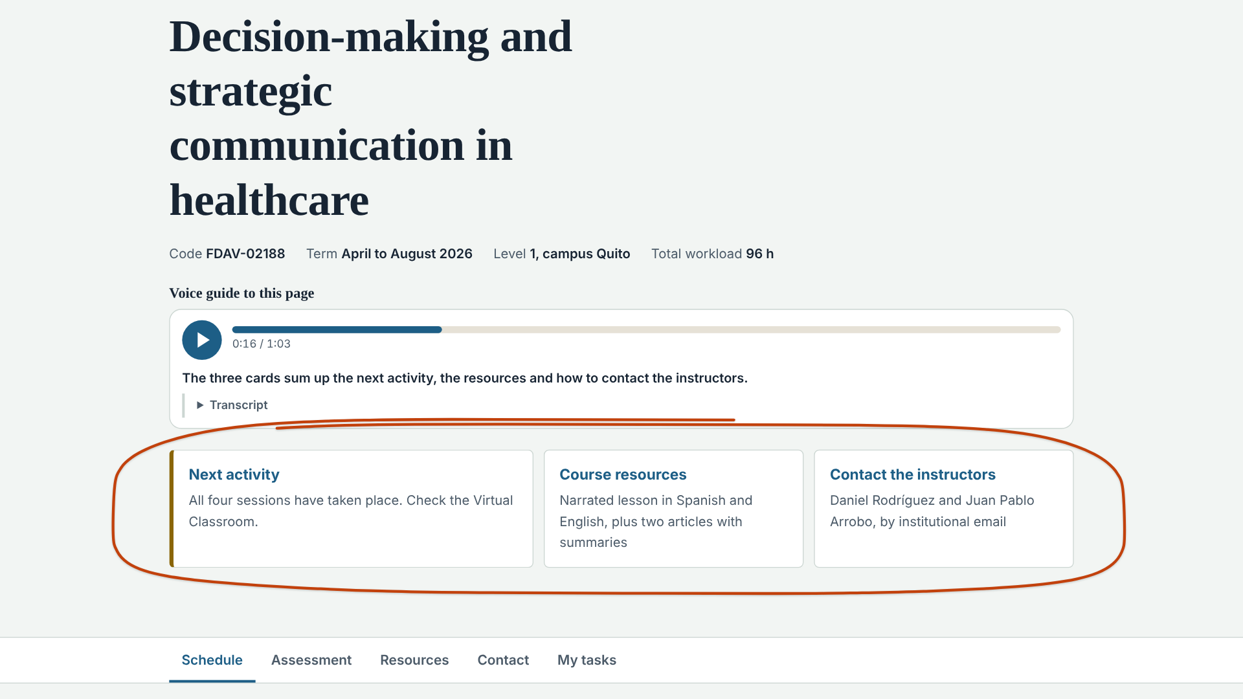
Demo · Input
Home: language, video and a voice guide that points at what it names.
7 / 10
Notes:
[7/10 · 30 s]
Let us look at the tool on screen. This is the home page of the site. Below the title and the course details sits the voice guide for the page. When you press it a voice walks through the site and circles whatever it names. In this capture it circles the three cards on the home page. That way a new person finds their way around without reading a manual.

Slide 8
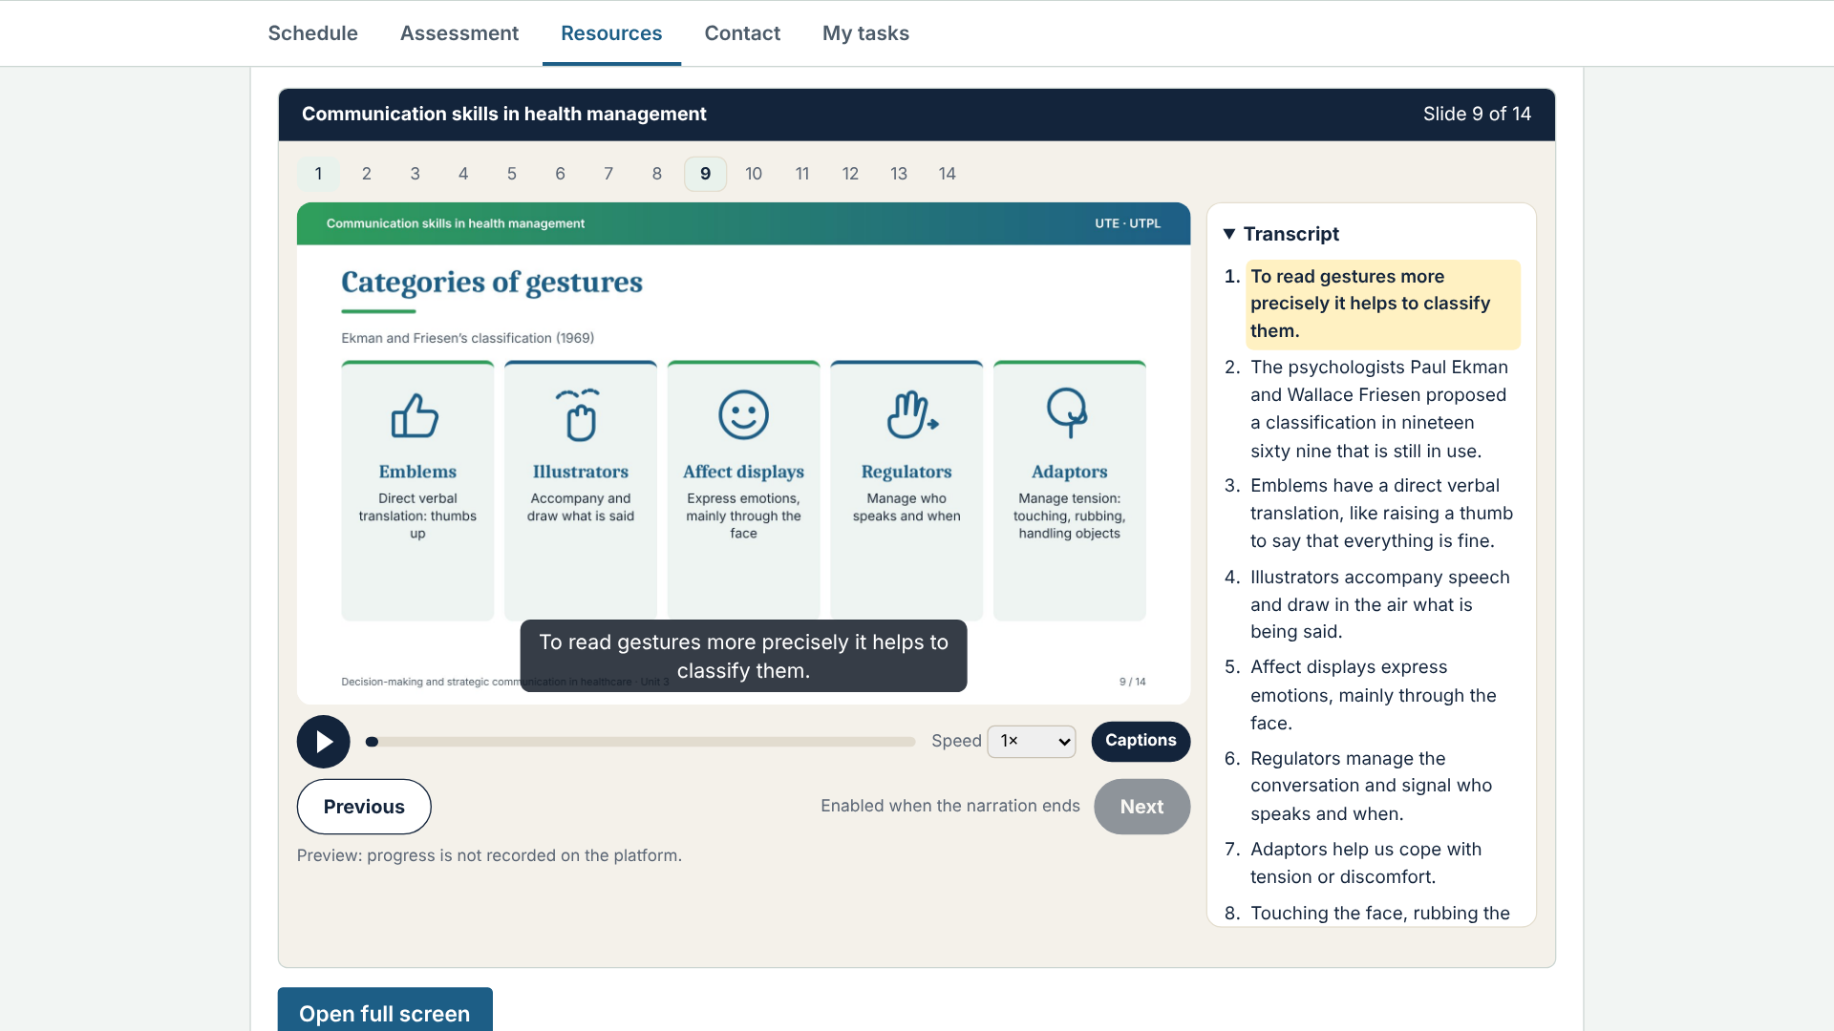
Demo · Result
Narrated lesson: slide, caption and synchronized transcript.
8 / 10
Notes:
[8/10 · 35 s]
This is the central result. In the Resources tab you find the narrated lesson on communication skills. On the left is the list of slides. In the center you see the slide with its caption. On the right the transcript highlights the sentence being spoken. The Next button is enabled when the narration ends. Anyone who cannot listen has an option to continue without the audio. Nobody gets stuck on a slide, and every sentence is also available as text.

Slide 9
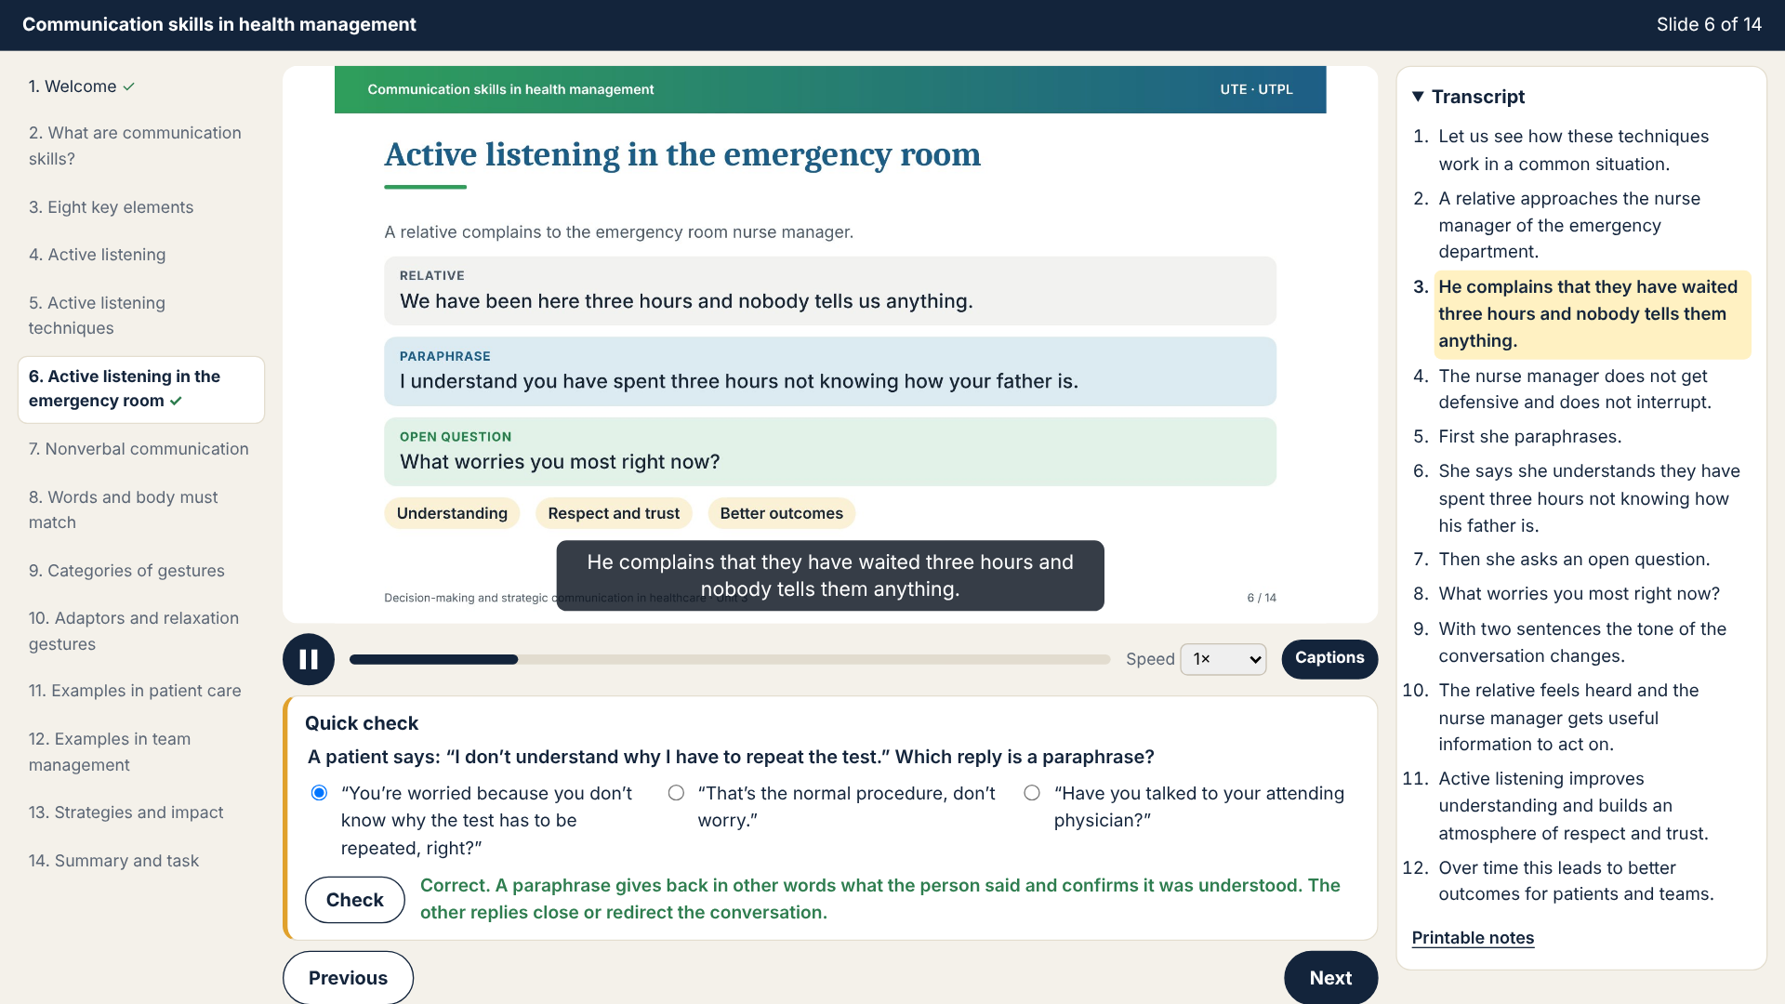
Demo · Review
English version with a formative check before SCORM.
9 / 10
Notes:
[9/10 · 30 s]
Here you see the English version of the lesson with a quick check. The question is formative and shows a short explanation once the student answers. Before publishing, the instructor reviews the captures that the automatic reviewer produces, step by step. Then the instructor uploads the S C O R M package to the Virtual Classroom of the course. The platform marks the lesson as completed when the student reaches the end.

Slide 10
A class you can hear
From voiceless slides to a bilingual lesson.
claude.ai/artifact/HtAaBUVm6Jyhrco22LPEc9
Juan Pablo Arrobo · UTPL
10 / 10
Notes:
[10/10 · 25 s]
With this tool a Saturday class becomes a lesson that students can hear in two languages. We prepared it in a single working session with Claude. The next step is to test it with the master’s cohort. We invite you to open the site and listen to the guide. Thank you very much for your attention.

