Slide 1
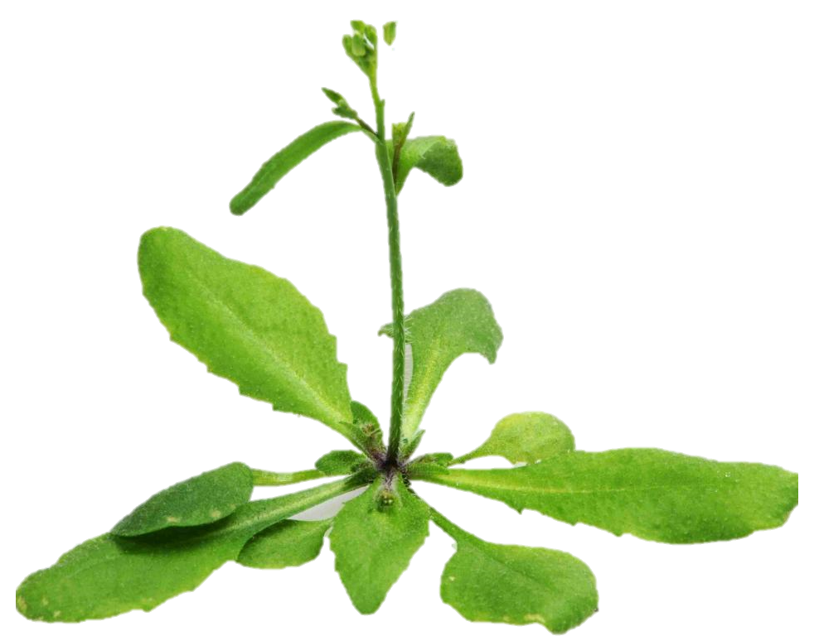
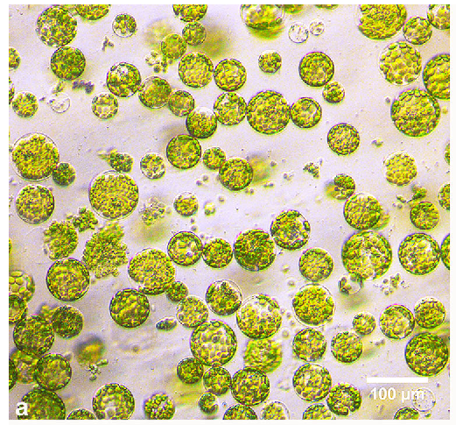
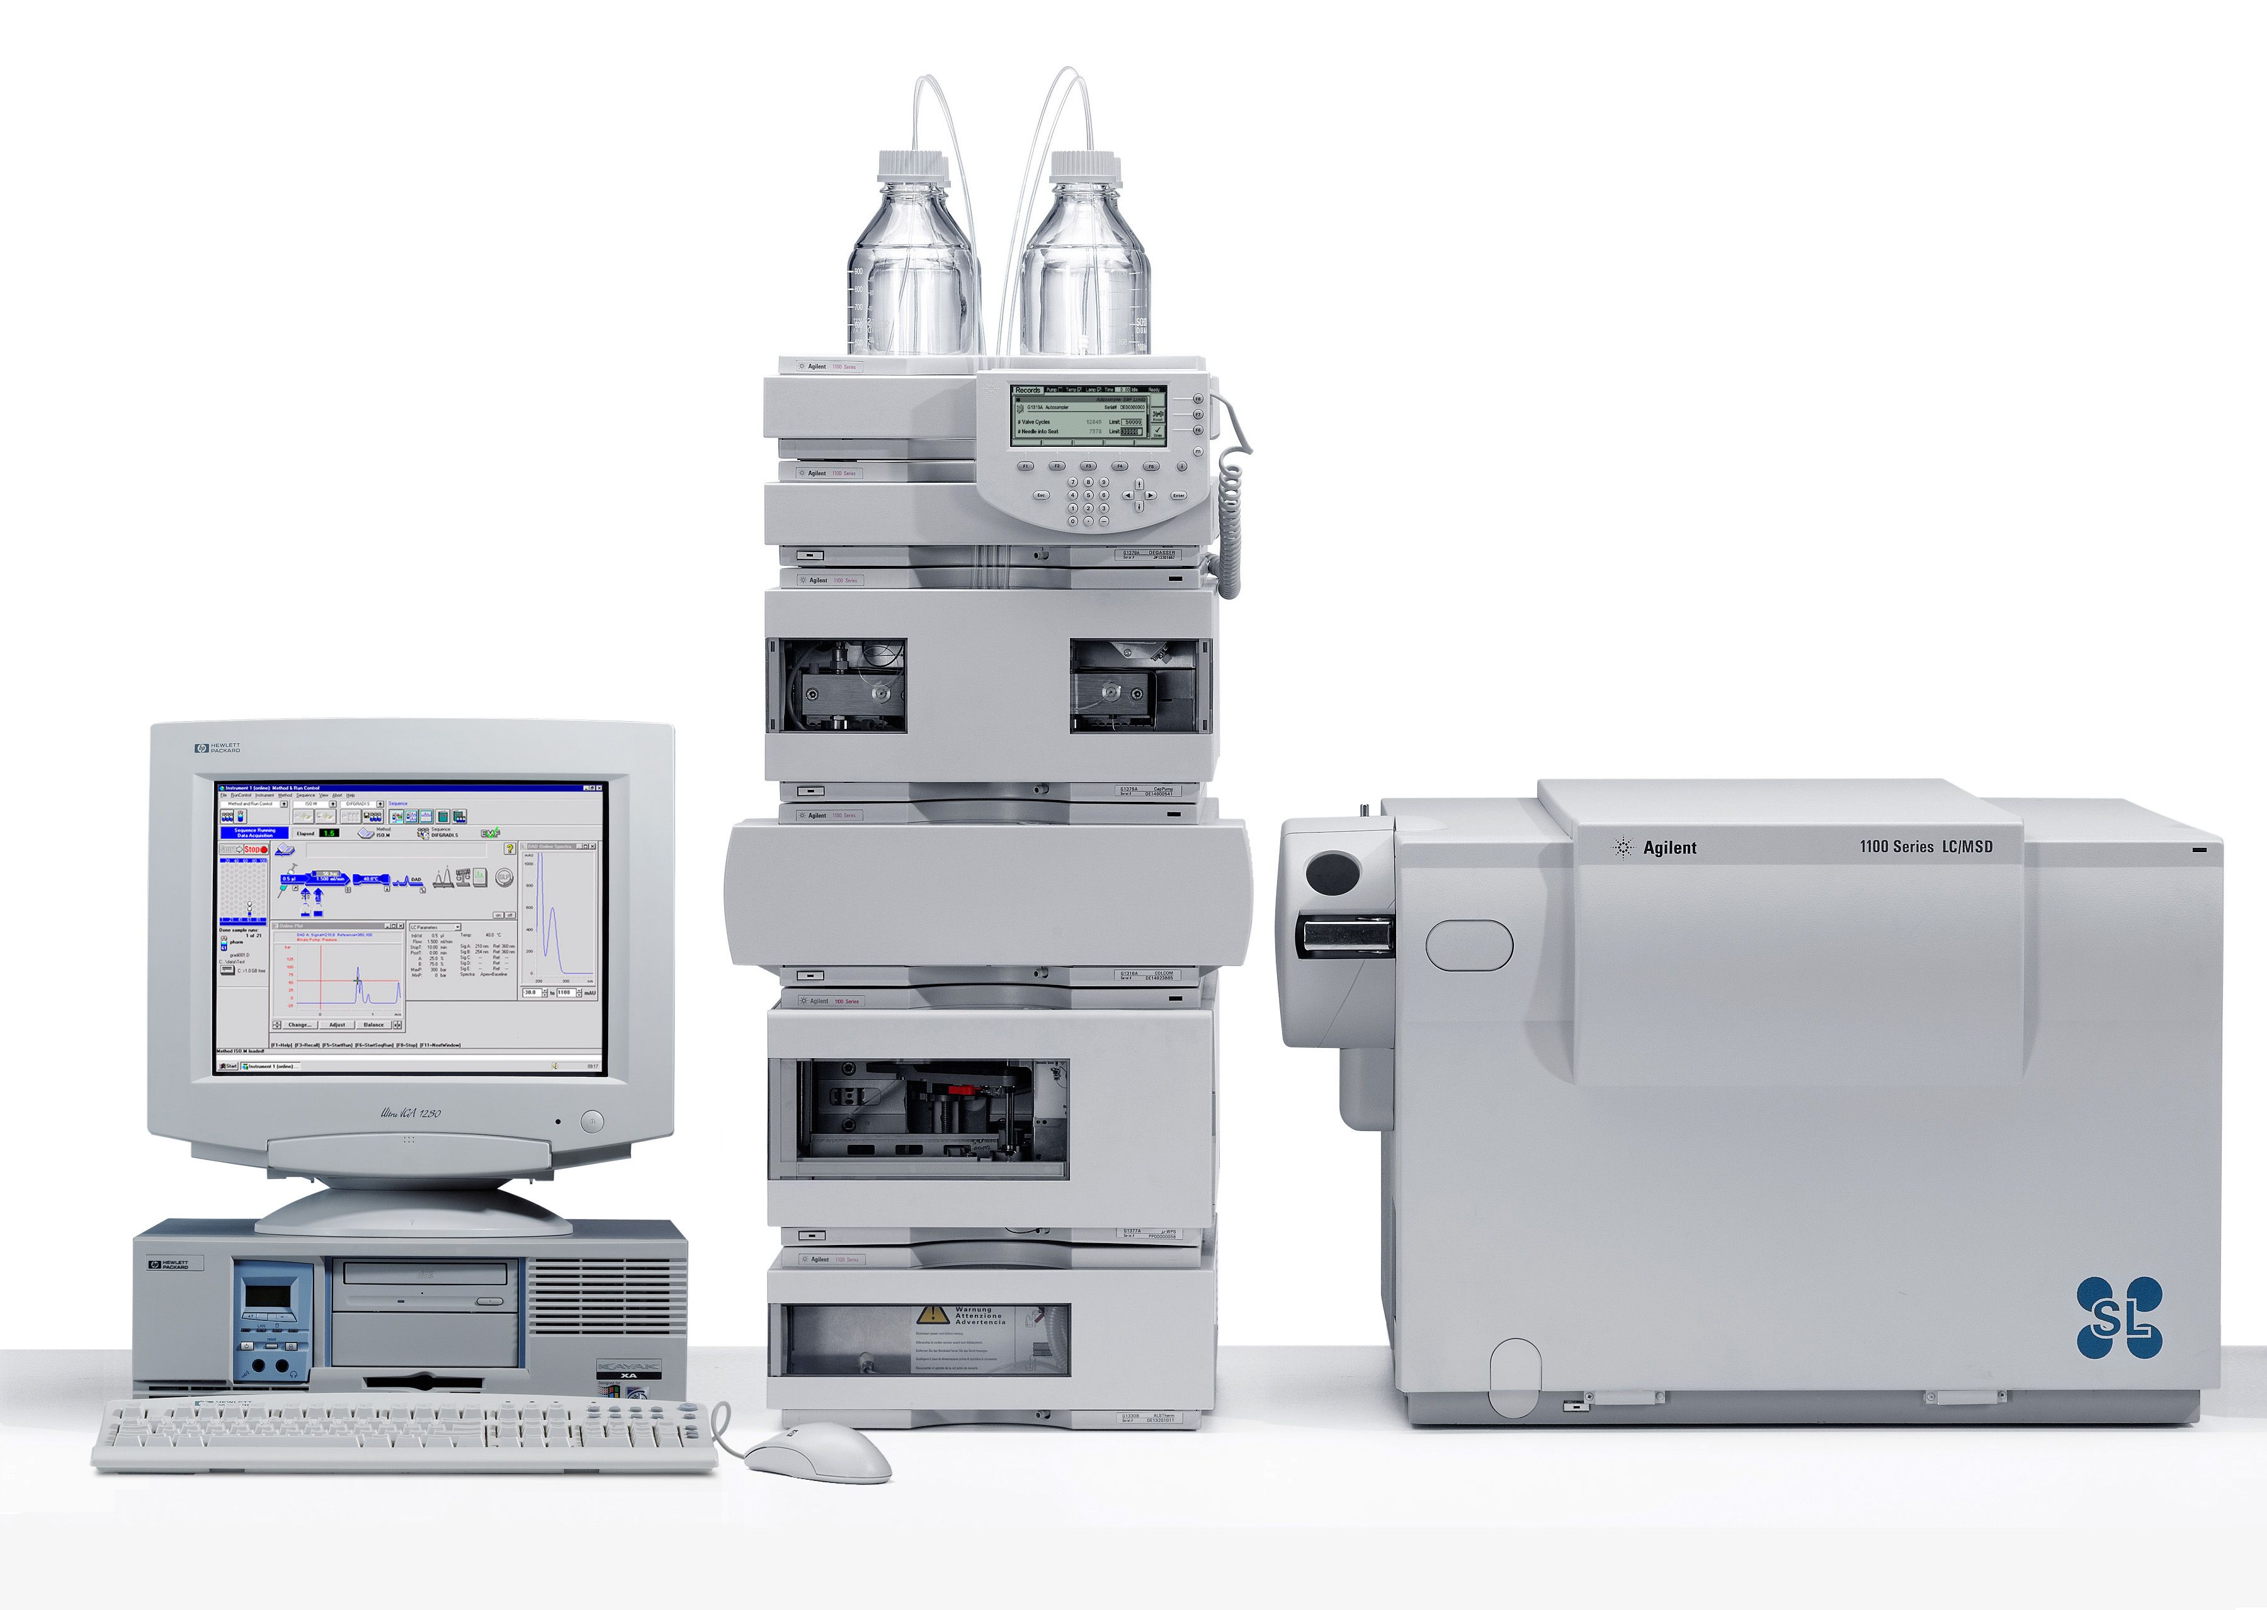
A. thaliana
Cell culture
Treatments
High salinity conditions for 0.5, 1, 2, 4, 12, 24, 48 and 72 h (n = 3).
Data
Metabolite (MET) | Time in hours (TIME) | Relative quantity (QT)
… | … | …
… | … | …
… | … | …
… | … | …
Metabolites quantification trough LC/MS and GC/MS

