Slide 1
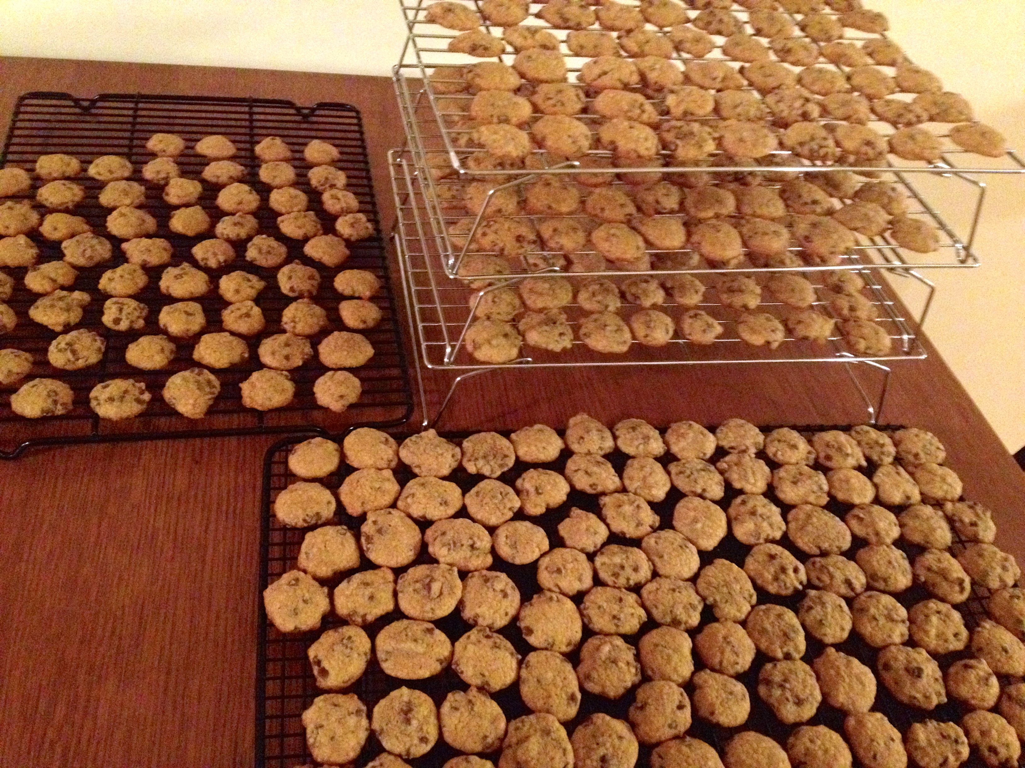
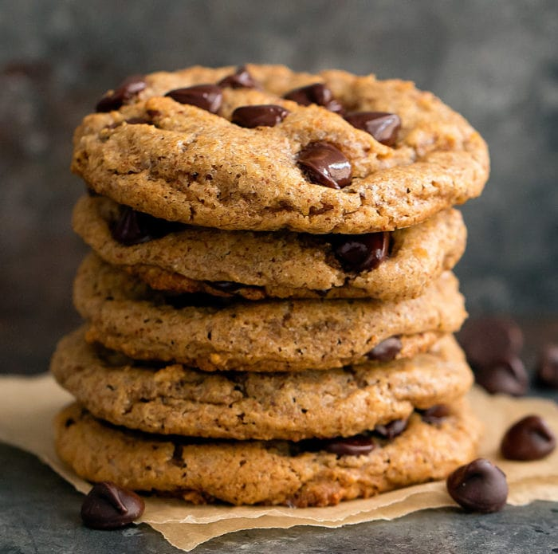
Population
Sample
Sampling
Inference
Size: N
Parameters: µ, σ², σ
Size: n
Statistics: x̄, s², s

