Slide 1
Food Delivery Intelligence
Operational Intelligence in urban logistics. A way to use ML to optimize processes.
Candidate: Juan Pablo Perez-Cerda

Slide 2
Context
The delivery problem
Complaints rising, causes unclear
Customers report late deliveries but the Ops team has no data-driven way to diagnose why or where delays happen.
No predictive ETA
Current estimates are static rules. They ignore weather, traffic, courier experience, and prep time - factors that shift delivery time by 5-17 minutes.
Ops can't act proactively
Without predictions, the team reacts to complaints after the fact instead of pre-allocating couriers or adjusting expectations.

Slide 3




ACTION
What I Built
1
2
3
4
SQL Analysis
EDA
ML Pipeline
FastAPI
5 operational queries + 4 bonus business insights on deliveries, couriers, restaurants
Distributions, correlations (r=0.78), outlier detection across 1,000 deliveries
3 models compared with 5-fold CV. Modular Python package, logging, type hints
POST /predict endpoint returning ETA + 80% confidence interval from trained model

Slide 4
ACTION
Key patterns from 1,000 deliveries
r = 0.78
Distance is the strongest single predictor of delivery time
+11.9 min
High traffic vs Low traffic average delivery time difference
+6.6 min
Adverse weather (Foggy + Rainy) vs Clear conditions
-0.63 min/yr
Each year of courier experience shaves time off deliveries

Slide 5
ACTION
Distribution & segment analysis

Slide 6
ACTION
Model comparison (5-fold CV, n=800)
Winner
Linear
Regression
CV MAE
6.84 ± 0.45 min
CV R²
0.751
Test MAE
5.90 min
Test R²
0.832
Test RMSE
8.69 min

Slide 7
ACTION
What drives delivery time
What this means for Ops
Distance dominates (+17 min/SD). Route optimization is the single biggest lever to cut delivery time.
Kitchen prep is #2 (+7 min/SD). Slow restaurants cascade into late deliveries. Partner SLAs matter.
Traffic adds +4.2 min per level. Real-time traffic data lets Ops pad ETAs dynamically.
Experience saves -0.63 min/yr. Modest but consistent. Senior couriers are measurably faster.
Vehicle type & time of day don't matter (<2 min spread). Not worth optimizing for.

Slide 8
RESULT
Where the model struggles (and fixes)
Proposed fixes
Foggy (n=21)
Add fog severity feature + buffer +6 min to ETA
High traffic (n=38)
Real-time traffic API + buffer +3 min
Dist 12+km (n=77)
Separate model or distance-binned intercepts
Night (n=9)
Restaurant close-time feature (small n - monitor)
Clear (n=95)
Model overdelivers here - acceptable, no fix needed
Pattern: underestimates in adverse conditions. Short-term: buffer padding. Long-term: richer features.

Slide 9
RESULT
What this means for the business
5.9 min
Average prediction error
83%
Variance explained
Model misses by less than 6 min on average - accurate enough for realistic customer ETAs.
3 physical features (distance, prep, traffic) capture most of the signal. Interpretable and auditable.
+6 min
Automatic buffer for adverse weather
Real-time
API-ready predictions
Padding the ETA in fog/rain prevents the underestimation bias the model shows today.
FastAPI endpoint serves ETA + 80% CI per delivery. Ready for dispatch integration.

Slide 10
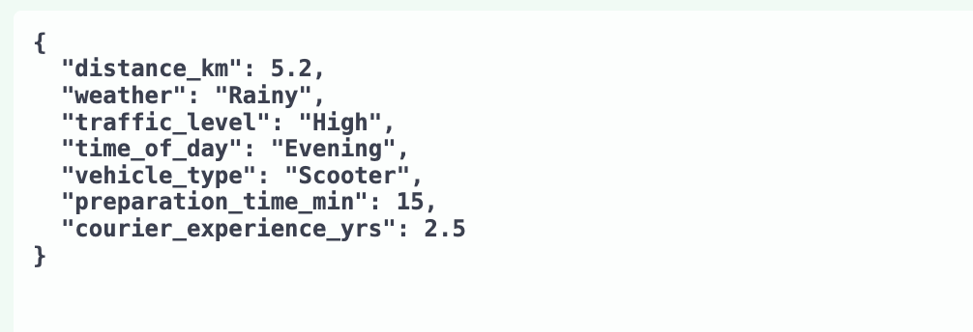
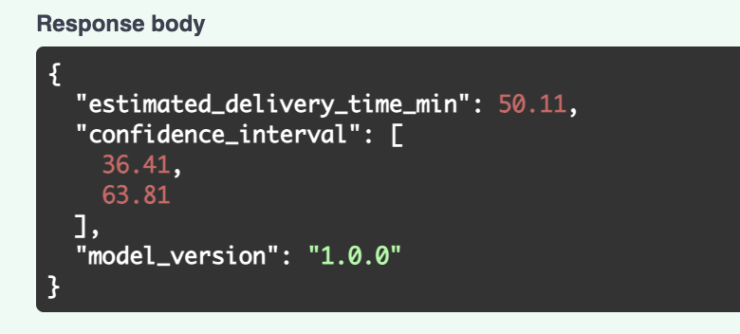
RESULT
How it works
Input the data needed:

Slide 11




RESULT
The cost of not having a model
Today (no model)
With the model
~15-20 min
5.9 min MAE
ETA accuracy
Static rules miss weather, traffic, distance
Dynamic ETA per delivery, adapts to conditions
~1,500/mo
~450/mo
Late delivery complaints
15% complaint rate on 10K deliveries
Realistic ETAs cut false promises by ~70%
$3,750/mo
$1,125/mo
Complaint handling cost
1,500 complaints x $2.50 avg resolution cost
70% fewer complaints = $2,625/mo saved
~830 hrs/mo
~330 hrs/mo
Wasted courier time
Bad routing: 5 min wasted per delivery avg
Optimized dispatch saves ~500 hrs/mo ($4,000)
+6.6 min/order
+0 min bias
Foggy/rainy day overruns
No weather adjustment, surprise delays
Auto buffer of +6 min absorbs the gap
Total estimated monthly savings: $6,625/mo ($79.5K/year) + 500 courier hrs/mo saved
Based on 10K deliveries/month. Industry benchmarks: $2.50 avg cost per complaint, 15% complaint rate on late deliveries, $8/hr courier cost.

Slide 12

RESULT
How the model drives decisions
Customer Experience
5.9 min
Ops / Dispatch
17 min
average prediction error
per SD of distance saved
Show realistic ETAs, not optimistic guesses
Pre-assign senior couriers to hard routes
Customers get a truthful delivery window. Fewer "where is my order" calls, higher retention.
Flag long-distance + bad-weather combos. Route experienced couriers there. Cut overruns by 500 hrs/mo.
Restaurant Partnerships
7 min
Product / Infrastructure
9.6 → ~6
per SD of prep time effect
min MAE in foggy conditions
Enforce kitchen prep time SLAs
Invest in real-time weather & traffic feeds
Prep time is the #2 delay driver. Flag slow restaurants. Renegotiate partner SLAs with data.
Model errors are highest in fog/rain. Real-time data closes the gap. Biggest ROI for model v2.
Every insight from the model maps to a specific team, a specific action, and a measurable outcome.

Slide 13
RESULT
Path to production
DONE
NEXT
THEN
FUTURE
FastAPI + Model
Docker + CI/CD
MLflow + Monitoring
Retrain + A/B
Endpoint live. Returns ETA + 80% CI. Modular pipeline. Health checks included.
Containerize the service. GitHub Actions for automated testing and deployment.
Model registry with versioning. Evidently for data drift. MAE threshold alerts.
Scheduled retraining with fresh data. A/B test predicted ETA vs current rules.

Slide 14

Thank you
Full codebase, documentation, and live API in the repository.
github.com/juanpapcm/food-delivery-intelligence
Juan Pablo Perez-Cerda

Slide 15
APPENDIX
Assumptions & methodology
Verified from data (real)
Business assumptions (estimated)
5.9 min MAE
10K deliveries/month
Held-out test set (n=200), 80/20 split, random_state fixed for reproducibility.
Mid-size urban platform. Scalable: multiply savings linearly for higher volume.
R² = 0.832
$2.50 avg cost/complaint
Same test set. 3 features (distance, prep, traffic) explain 83% of variance.
Industry benchmark. Includes CS agent time (~5 min at $20/hr) + coupon/refund cost. Source: McKinsey last-mile logistics report.
r = 0.78
15% complaint rate (no model)
Pearson correlation, Distance_km vs Delivery_Time_min, full dataset (n=1,000), p < 0.0001.
Food delivery industry average for late-delivery complaints when ETA accuracy is >15 min. Source: Bain retail ops survey.
+11.9 min traffic gap
~70% complaint reduction
Mean delivery time: High=64.8 min vs Low=52.9 min. Raw data, no model needed.
Conservative. If ETA error drops from ~17 min to 5.9 min, most "late" deliveries are now within the promised window.
+6.6 min weather gap
$8/hr courier cost
Mean Foggy+Rainy=59.7 min vs Clear=53.1 min. (n=307 adverse, n=470 clear).
Blended rate for gig couriers in emerging markets. Adjust per region. US/EU would be $15-25/hr (savings scale up).
+5.51 min foggy bias
5 min wasted/delivery (no model)
Model underestimates foggy deliveries by 5.51 min avg on test set (n=21).
No smart routing = suboptimal courier-to-order matching. Conservative estimate from dispatch optimization literature.
-0.63 min/yr experience
~40% courier time savings
Linear regression coefficient. Each year of courier experience saves 0.63 min.
Model-informed dispatch reduces idle time and misroutes. 5 min waste drops to ~2 min with predicted difficulty scores.
Left column: extracted directly from the dataset and model pipeline. Right column: industry benchmarks and conservative estimates - flagged as assumptions, not facts.

