Slide 1
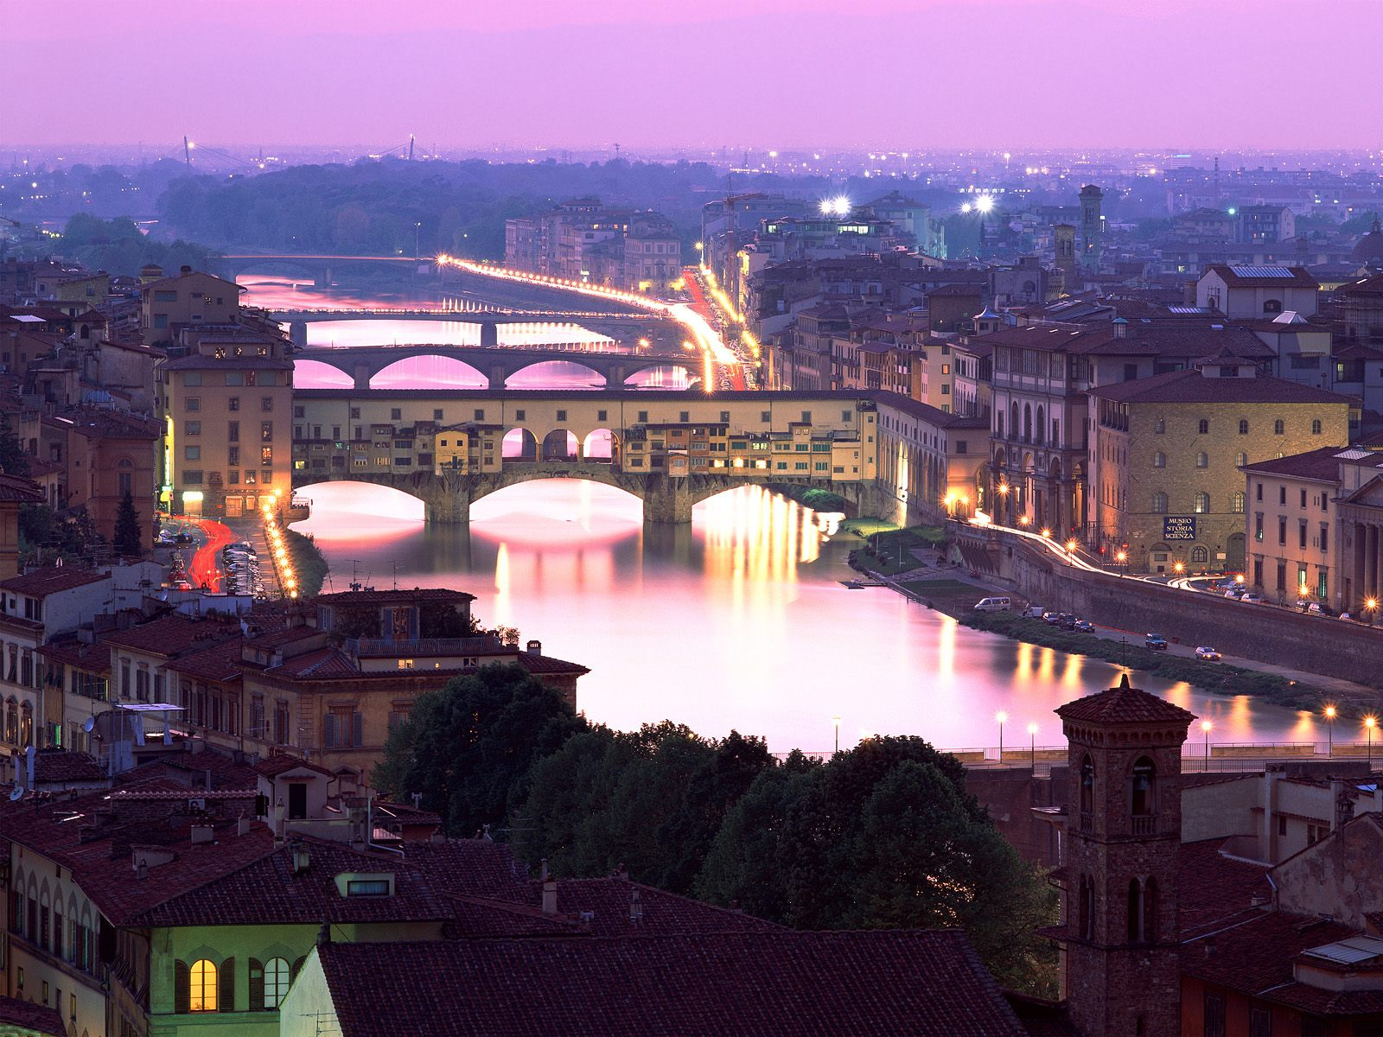
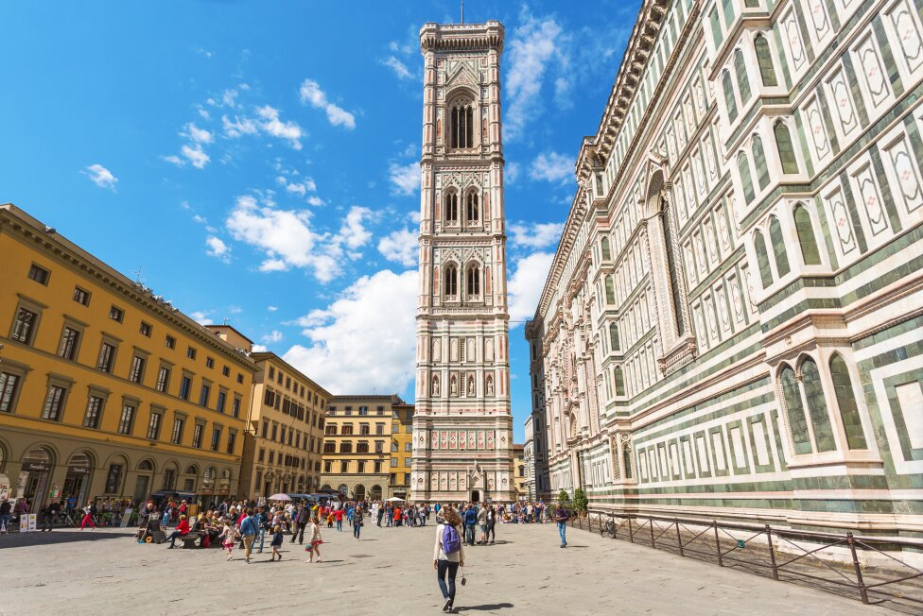
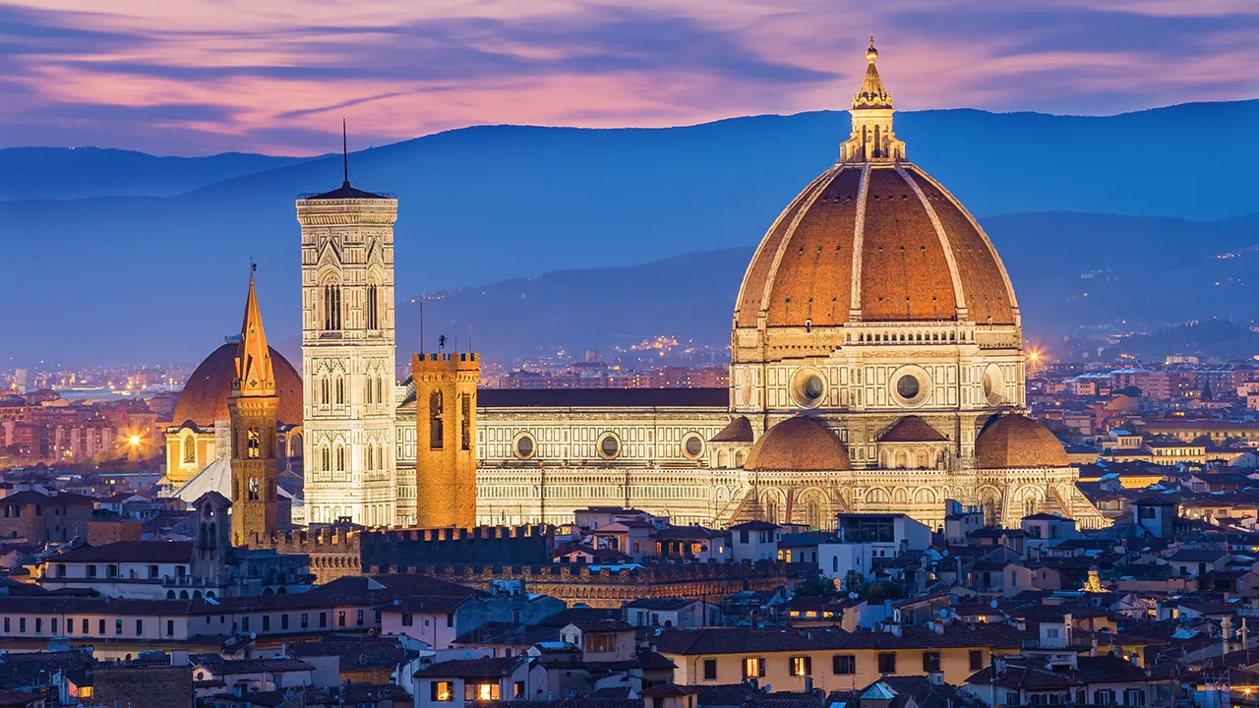
Florence,
Italy
Japan
Spain
Greenland
France
Florence 77℉ H:77 ℉ L:61 ℉
The Giotto's Campanile is a freestanding bell tower
located next to the Cathedral of Santa Maria del
Fiore in Florence, Italy.
The Cathedral of Santa Maria del Fiore, also known
as the Duomo di Firenze, is a magnificent cathedral
located in Florence, Italy

Slide 2

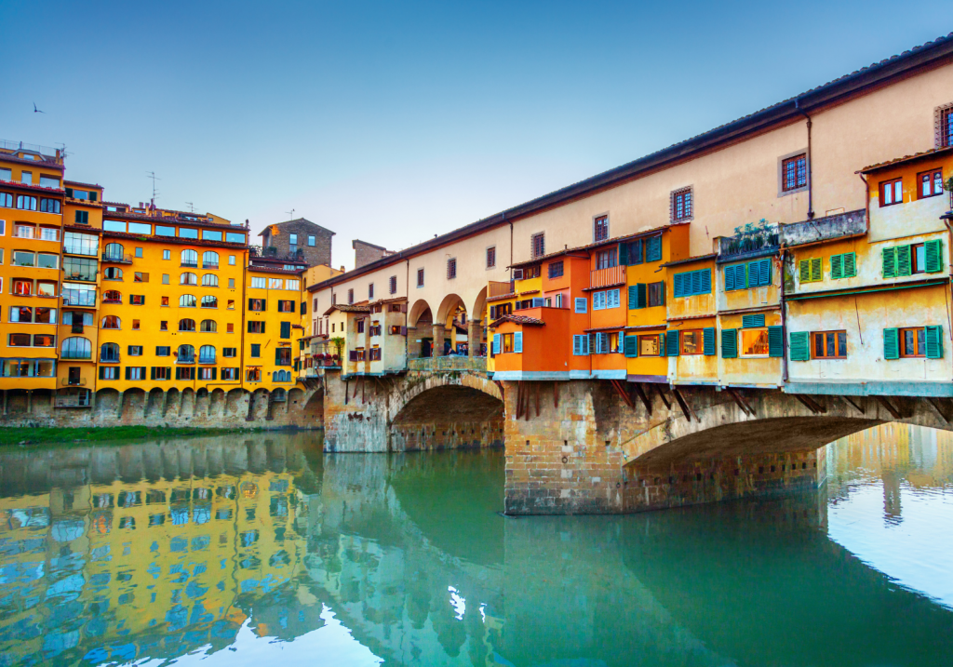
Florence, Italy
Florence Italy
Florence 77℉ H:77 ℉ L:61 ℉
Florence, Italy, is a fantastic vacation destination known for its rich cultural heritage, world-class art, and architectural marvels. The city's historic center is a UNESCO World Heritage site, and its museums, including the Uffizi Gallery and Accademia Gallery, house renowned artworks by masters such as Botticelli and Michelangelo. Florence's architectural gems, like the Florence Cathedral and Palazzo Vecchio, are awe-inspiring. The city's historical significance, charming atmosphere, delicious cuisine, and proximity to other Tuscan treasures make it a must-visit location for art enthusiasts, history buffs, and those seeking a memorable experience in Italy.
Walking across Ponte Vecchio offers breathtaking views of the Arno River, the bridge's arches, and the picturesque surroundings.
Visitors can climb the 414 steps to reach the top of Giotto's Bell Tower, where they are rewarded with breathtaking panoramic views of Florence.
For those who are physically fit and up for a challenge, there is an option to climb to the top of the dome.
Japan
Spain
Greenland
France
Japan Spain Greenland France

