Slide 1
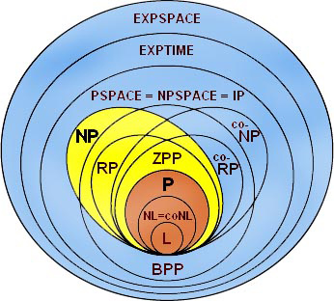

Slide 2


Slide 3

for(int i = 0; i < 10000000; i++)
s += “whatever”;

Slide 4

var builder = new StringBuilder(); for(int i = 0; i < 10000000; i++)
builder.Append(“whatever”);
s = builder.ToString();

Slide 5

var builder = new StringBuilder(); builder.Append(“whatever”);
builder.Append(“whatever”);
s = builder.ToString();

Slide 6

O

Slide 7
n | tempo
5 | 175
10 | 700
15 | 1575
20 | 2800
25 | 4375
30 | 6300
35 | 8575
50 | 17500

Slide 8

for(int i = 0; i < n; i++)
s += “whatever”;
O(n)?
i | len(s) | custo
0 | 0 | L
1 | L | 2*L
2 | 2*L | 3*L
…
n | n*L | (n+1)*L
Total:

Slide 9

for(int i = 0; i < n; i++)
s += “whatever”;
O(n²L)!

Slide 10


Slide 11


Slide 12



muitas linhas O(n log₂n)
4 linhas O(n³)
E. W. Dijkstra
R. W. Floyd

