Slide 1
Juan Lopes github.com twitter.com
/juanplopes

Slide 2
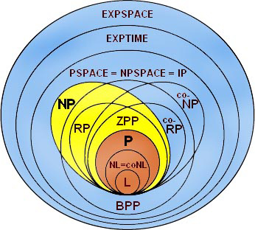

Slide 3


Slide 4

for(int i = 0; i < 30000; i++)
s += “whatever”;

Slide 5

var builder = new StringBuilder(); for(int i = 0; i < 30000; i++)
builder.Append(“whatever”);
s = builder.ToString();

Slide 6

var builder = new StringBuilder(); builder.Append(“whatever”);
builder.Append(“whatever”);
s = builder.ToString();

Slide 7

O

Slide 8
n | tempo
5 | 175
10 | 700
15 | 1575
20 | 2800
25 | 4375
30 | 6300
35 | 8575
50 | 17500

Slide 9
for(int i = 0; i < n; i++)
s += “whatever”;
O(n)?

Slide 10

for(int i = 0; i < n; i++)
s += “whatever”;
i | len(s) | custo
0 | 0 | L
1 | L | 2*L
2 | 2*L | 3*L
…
n | n*L | (n+1)*L
Total:

Slide 11

for(int i = 0; i < n; i++)
s += “whatever”;
O(n²L)!

Slide 12


Slide 13


Slide 14

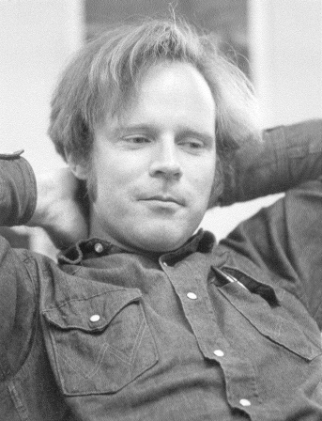

Menor caminho com multiplas origens em grafos
muitas linhas O(n² log₂n)
4 linhas O(n³)
E. W. Dijkstra
R. W. Floyd

Slide 15
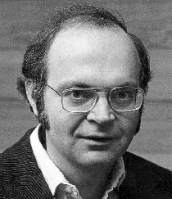
Dr. Donald E. Knuth
“Programmers waste enormous amounts of time thinking about, or worrying about, the speed of noncritical parts of their programs, and these attempts at efficiency actually have a strong negative impact when debugging and maintenance are considered. We should forget about small efficiencies, say about 97% of the time: premature optimization is the root of all evil. Yet we should not pass up our opportunities in that critical 3%.”

Slide 16
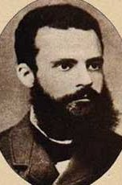
Vilfredo Pareto

Slide 17
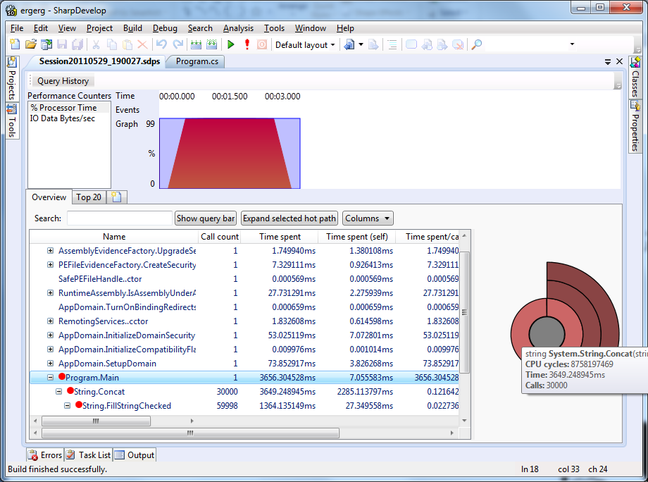

Slide 18
